Slide 1


Slide 2

Unit
3
TEENAGERS
LESSON 1: GETTING STARTED
It’s great to see you again!

Slide 3
LESSON 1: GETTING STARTED
WARM-UP
Name the pictures
Vocabulary
PRESENTATION
Task 1: Listen and read.
Task 2: Read the conversation again and write T or F.
Task 3: Write the words and phrases from the box under the correct pictures.
Task 4: Complete each of the sentences with a word or phrase.
PRACTICE
PRODUCTION
Task 5: Work in pairs. Ask and answer the questions. Report your friend’s answers to the class.
CONSOLIDATION
Wrap-up
Homework

Slide 4
Rule:
WARM-UP
I.N.I.T.I.A.L GAME
Work in 2 teams.
Look at 9 pictures.
Find the word for each picture, then take the first letter from each picture to form the mystery word.
Which team finds the mystery word first will become the winner.

Slide 5
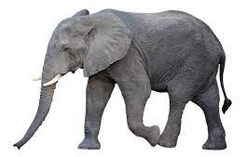

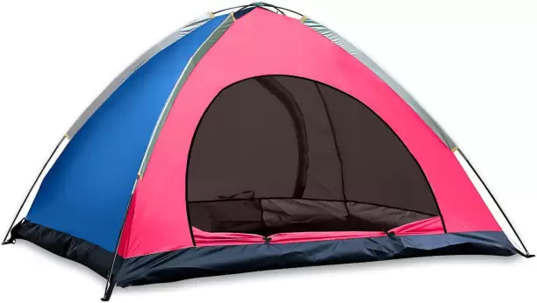




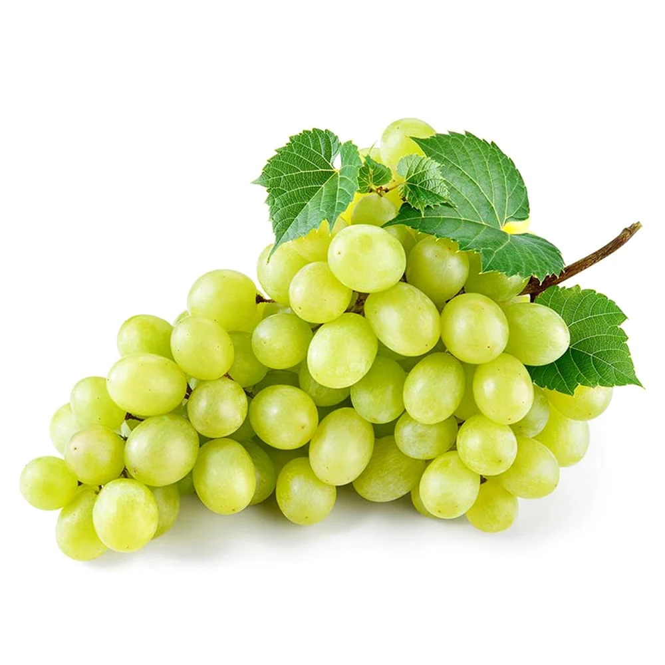
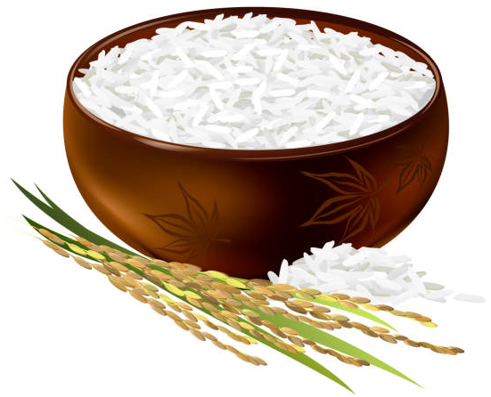
WARM-UP
I.N.I.T.I.A.L GAME
Tent
Eggs
Elephant
Nose
Apple
Grapes
Eagle
Rice
Sunflower

Slide 6


Slide 7


PRESENTATION
VOCABULARY
forum (n)
/ˈfɔːrəm/
diễn đàn

Slide 8

PRESENTATION
VOCABULARY
stress (n)
/ˌstres/
sự căng thẳng

Slide 9

PRESENTATION
VOCABULARY
stressful (adj)
/ˈstresfl/
căng thẳng, tạo áp lực

Slide 10

PRESENTATION
VOCABULARY
pressure (n)
/ˈpreʃə(r)/
áp lực

Slide 11
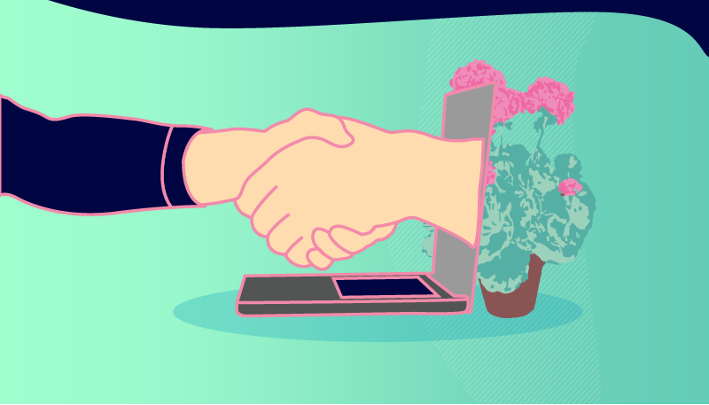
PRESENTATION
VOCABULARY
user-friendly (adj)
/ˈjuːzə-ˈfrendli/
thân thiện với
người dùng

Slide 12

PRESENTATION
VOCABULARY
midterm (adj)
/ˌmɪdˈtɜːm/
giữa kì

Slide 13
PRESENTATION
VOCABULARY
New words | Pronunciation | Meaning
1. forum (n) | /ˈfɔːrəm/ | diễn đàn
2. stress (n) | /stres/ | sự căng thẳng
3. stressful (adj) | /ˈstresfl/ | căng thẳng, tạo áp lực
4. pressure (n) | /ˈpreʃə(r)/ | áp lực
5. user-friendly (adj) | /ˌjuːzə ˈfrendli/ | thân thiện với người dùng, dễ dùng
6. midterm (adj) | /ˌmɪdˈtɜːm/ | giữa kì

Slide 14
PRACTICE
READ AND LISTEN
Look at the picture in the book
and answer the questions:
- Who are the people?
- What might they be talking about?

Slide 15
PRACTICE
1
Listen and read.
Teacher: It’s great to see you again, class. What’s going on?
Minh: We’ve decided to use Facebook for our class forum, and we joined some school club activities. We’re also preparing for the midterm tests. It’s really stressful.
Teacher: I’m sorry to hear that. I know exams may give you a lot of stress. But stay calm and work hard. What other pressure do you have?
Minh: Well, we also have pressure from our parents and friends.
Teacher: Do you? Let’s discuss these problems in your new Facebook group. By the way, why did you choose Facebook?
Ann: Because it’s user-friendly.
Teacher: Good! How about club activities? Do you find them enjoyable?
Ann: Yes. This year there are some new clubs like arts and crafts, and music. The club leaders will provide us with a variety of activities to suit different interests. And there will also be competitions as usual.
Teacher: Awesome! I hope you all can join the clubs you like.

Slide 16

PRACTICE
2
Read the conversation again and write T (true) or F (False).
Sentences | T | F
1. The students finished their midterm tests
2. Minh mentions the different types of pressure they are facing.
3. The teacher tells them to stay calm and work hard.
4. The class will discuss their problems offline.
5. The school has different clubs for its students.
They are preparing for the midterm test.
The class will discuss their problems in their new Facebook group.

Slide 17
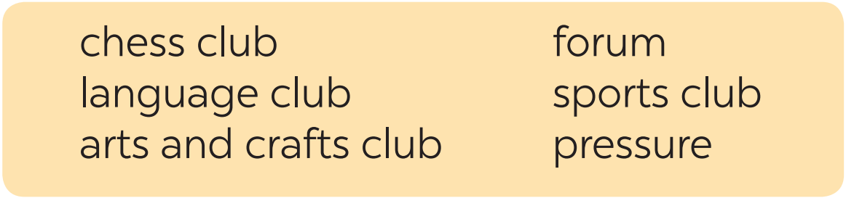

PRACTICE
3
Write a word or phrases from the box under the correct pictures.
language club
pressure
1. _______________
2. _______________

Slide 18

PRACTICE
3
Write a word or phrases from the box under the correct pictures.
arts and crafts club
forum
3. _______________
4. _______________

Slide 19
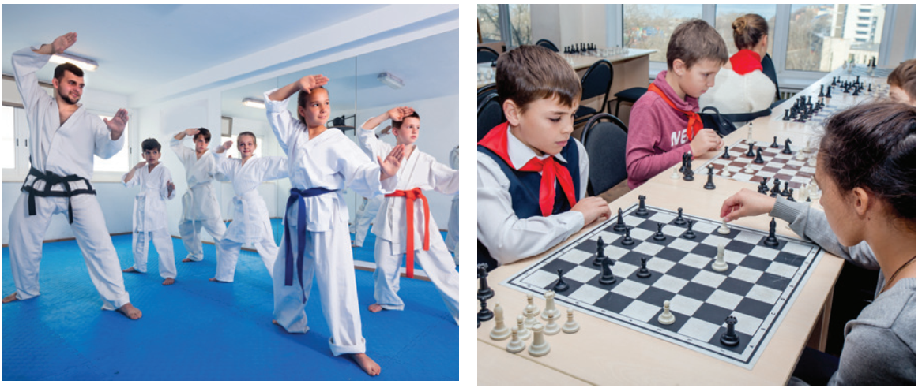
PRACTICE
3
Write a word or phrases from the box under the correct pictures.
sports club
chess club
3. _______________
4. _______________

Slide 20
PRACTICE
4
Complete each of the sentences with a word or phrase in 3. There is one extra word or phrase.
arts and crafts club
1. Minh is a member of our ________________. The greeting cards he makes are really creative.
2. Students can discuss their problems in their class ______.
3. We share the essays and stories that we write in English in our _____________.
4. She is not feeling very well this weekend because of all the _______
from her school work.
5. The coach of our _____________ tells us to drink plenty of water during our practice sessions.
forum
language club
pressure
sports club

Slide 21
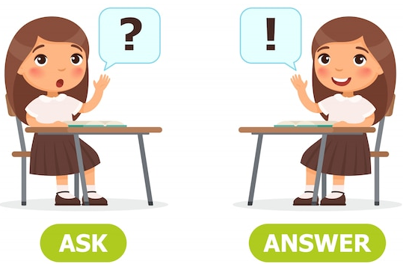
PRODUCTION
5
Work in pairs. Ask and answer the questions below. Report your friend’s answers to your class.
What types of social media do you use?
What kinds of pressure do you have?
What clubs do you participate in?
Why do you choose to participate in that club?

Slide 22

PRODUCTION
5
Work in pairs. Ask and answer the questions below. Report your friend’s answers to your class.
REPORTING
My friend, …, often use Facebook/ Instagram/ Zalo… to get information or keep in contact with her/his relationships.
…

Slide 23

CONSOLIDATION
1
Wrap-up
What have we learnt in this lesson?
identify the topic of the unit
use lexical items related to hobbies
identify the language features that are covered in the unit

Slide 24

CONSOLIDATION
2
Homework
Name a list of school clubs and pressures.
Do exercises in the workbook.
Start preparing for the Project of the unit.

Slide 25

Website: hoclieu.vn
Fanpage: facebook.com/www.tienganhglobalsuccess.vn/

