Slide 2








WARM - UP
2
elbow
1
3
ears
nose
4
eye
8
Parts of the body
arm
fingers
7
5
6
mouth
knee

Slide 3
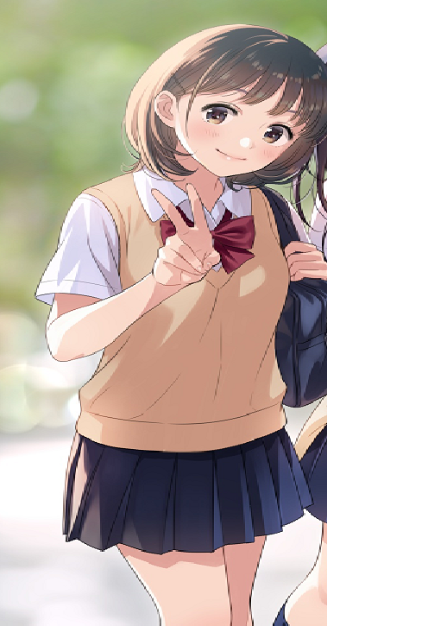
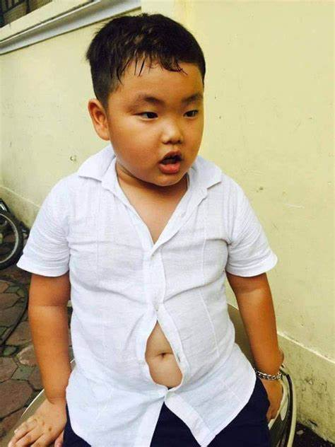
Describe body shape and personality about Nam and Lan using adjectives: short, fat, tall, thin
Nam is short and fat but he is clever
Lan is tall and thin. She is active.
Nam
Lan

Slide 4
PERIOD 17: UNIT 3 : MY FRIENDS
LESSON 2
A CLOSER LOOK 1

Slide 5









Vocabulary
Pronunciation
Personality adjectives
/b/ and /p/
Listen and circle the words you hear. Then repeat.
Match the adjectives to the pictures.
Use the adjectives in the box to complete the sentences.
Pay attention to the highlighted words / phrases.
Listen. Then practise the chant. Notice the rhyme.
Friendship ﬂower.

Slide 6
I. Vocabulary
Personality adjectives (Tính từ mô tả tính cách)

Slide 7
* Vocabulary
- hard-working /ˌhɑːd ˈwɜːkɪŋ/ (adj): chăm chỉ
- confident /ˈkɒnfɪdənt/ (adj.): tự tin, tin tưởng
- funny /ˈfʌni/ (adj): hài hước, khôi hài
- caring /ˈkeərɪŋ/ (adj):quan tâm
- active /ˈæktɪv/ (adj): hăng hái, năng động

Slide 8
* Vocabulary
- hard-working /ˌhɑːd ˈwɜːkɪŋ/ (adj):
- confident /ˈkɒnfɪdənt/ (adj.):
- funny /ˈfʌni/ (adj):
- caring /ˈkeərɪŋ/ (adj):
- active /ˈæktɪv/ (adj):

Slide 9
* Vocabulary
- hard-working /ˌhɑːd ˈwɜːkɪŋ/ (adj): chăm chỉ
- confident /ˈkɒnfɪdənt/ (adj.): tự tin, tin tưởng
- funny /ˈfʌni/ (adj): hài hước, khôi hài
- caring /ˈkeərɪŋ/ (adj):quan tâm
- active /ˈæktɪv/ (adj): hăng hái, năng động

Slide 10


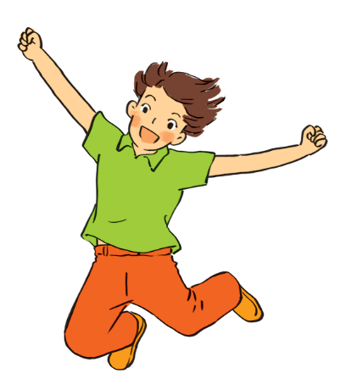
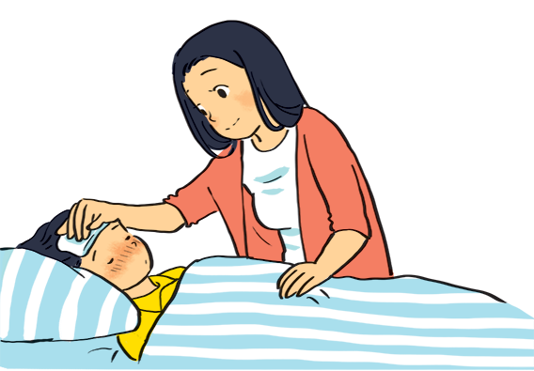
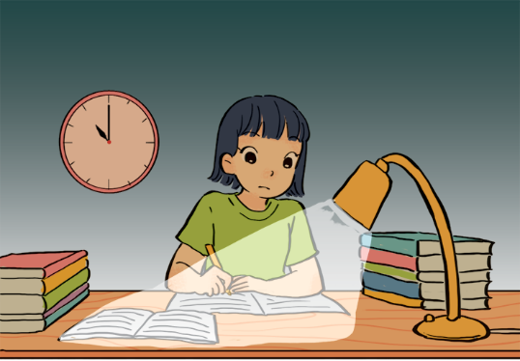
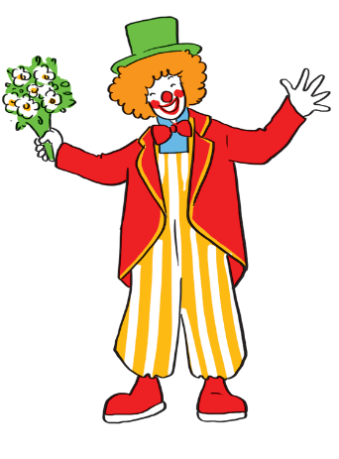
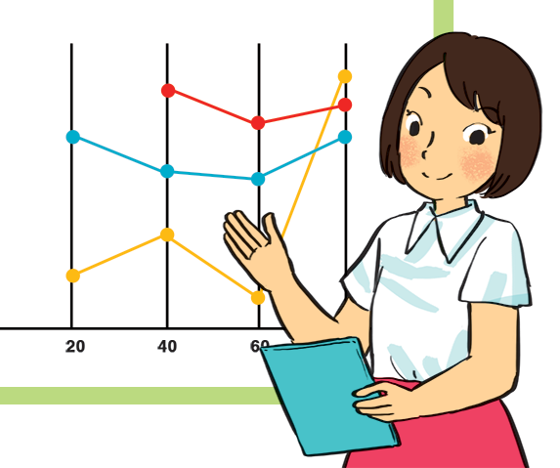
Match the adjectives to the pictures.
a
a
1. hard - working
b
b
2. confident
4. caring
3. funny
4. caring
4. caring
5. active
5. active
5. active
c
d
e
1. hard - working
3. funny
2. confident

Slide 11
* Cách miêu tả ngoại hình, tính cách
He is fat
She is friendly
S + am/is/are + adj
They/kind
They are kind
Nam / funny
Nam is funny

Slide 12
* Vocabulary
- careful /ˈkeəfl/(adj): cẩn thận
- shy /ʃaɪ/ (adj): bẽn lẽn, hay xấu hổ, nhút nhát.
- creative /kriˈeitiv/ (adj) : sáng tạo
- clever /ˈklevə/ (adj.): lanh lợi, thông minh
- kind /kaɪnd/ (adj.): tử tế, ân cần.

Slide 13

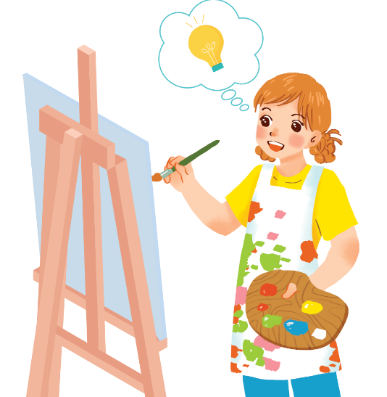
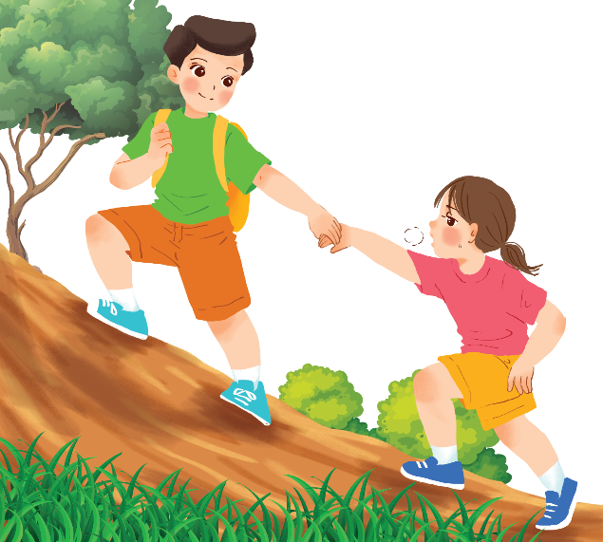
Use the adjectives in the box to complete the sentences.
Pay attention to the highlighted words / phrases.
careful
clever
shy
kind
creative
friendly
1.
Mina is very . She likes drawing pictures. She always has lots of new ideas.
creative
Nam is .
He likes helping his friends.
2.
kind

Slide 14
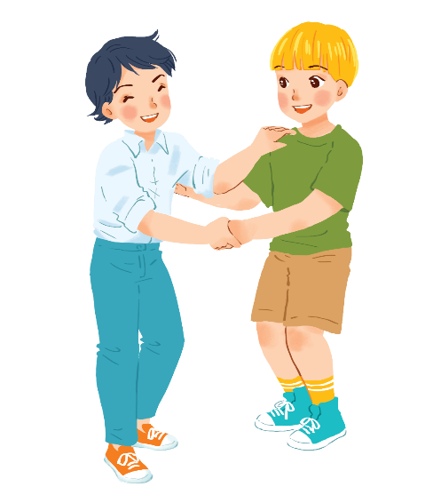
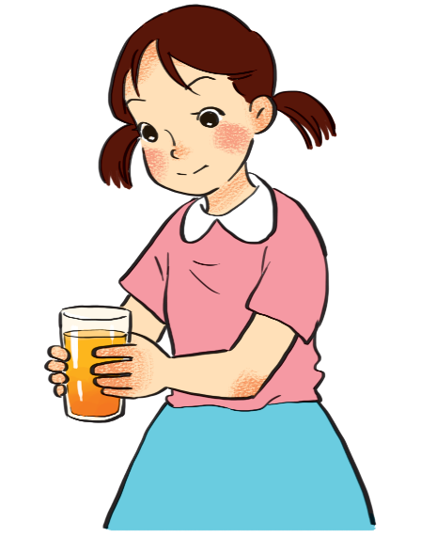
Use the adjectives in the box to complete the sentences.
Pay attention to the highlighted words / phrases.
careful
clever
shy
kind
creative
friendly
friendly.
3.
Minh Duc is
He likes meeting new people.
4.
Kim is very
She pays attention to what she’s doing.
careful.

Slide 15
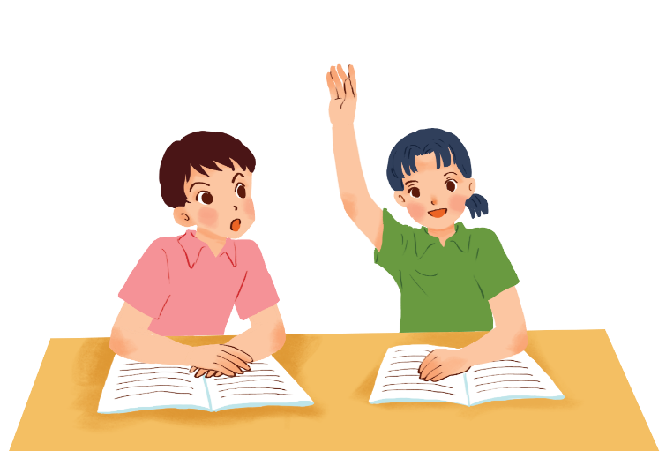
Use the adjectives in the box to complete the sentences.
Pay attention to the highlighted words / phrases.
careful
clever
shy
kind
creative
friendly
clever.
5.
Mai is
She things
learns
quickly and easily.

Slide 16


Friendship ﬂower.
Work in groups. Write two personality adjectives for each group member.
Minh: kind funny
Nam: helpful friendly

Slide 17
II. Pronunciation
/b/ and /p/

Slide 18
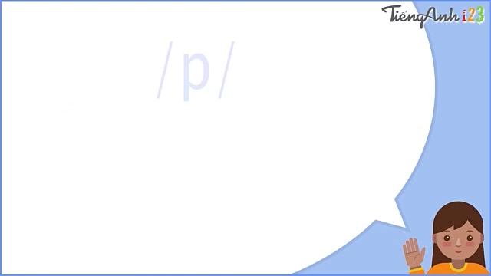

Slide 19
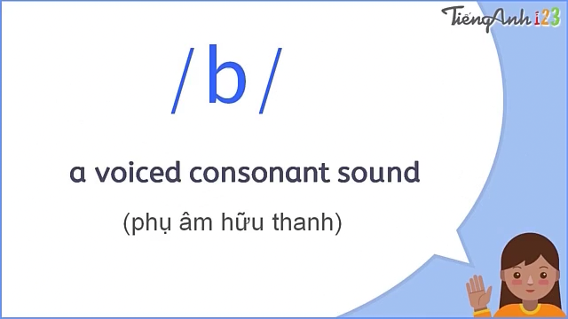

Slide 20


Listen and circle the words you hear. Then repeat.
 | /b/ | /p/
1. | big | pig
2. | bear | pear
3. | buy | pie
4. | robe | rope

Slide 21



Listen. Then practise the chant. Notice the rhyme.
We’re having a picnic
We’re having a picnic
Fun! Fun! Fun!
We’re bringing some biscuits
We’re bringing some biscuits
Yum! Yum! Yum!
We’re playing together
We’re playing together
Hurrah! Hurrah! Hurrah!

Slide 22
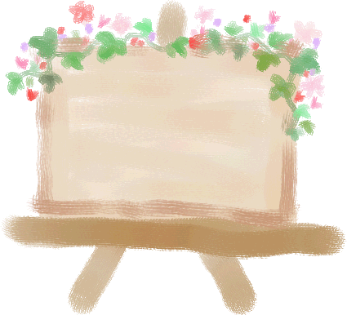


Homework
Learn vocabulary
Do the exercise again.
♦ Prepare “Unit 3 A CLOSER LOOK 2”

Slide 23
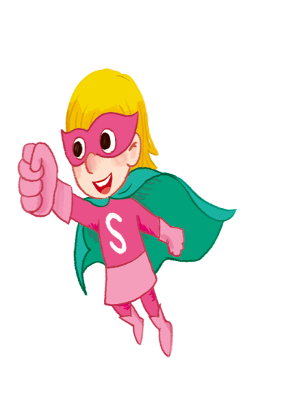

Thanks you
Goodbye
See you again!!!

