Slide 1
Monday, November 18th, 2024
UNIT 3: SCHOOL
LESSON 2: C, D

Slide 2
Objectives
By the end of this lesson, students will be able to pronounce the sound /ɪ/ and ask what subjects people like.
Phonics: /ɪ/
Structure: Do you like (math)?
- Yes, I do./No, I don’t.

Slide 3

WARM UP

Slide 4

LET’S CHANT!

Slide 5
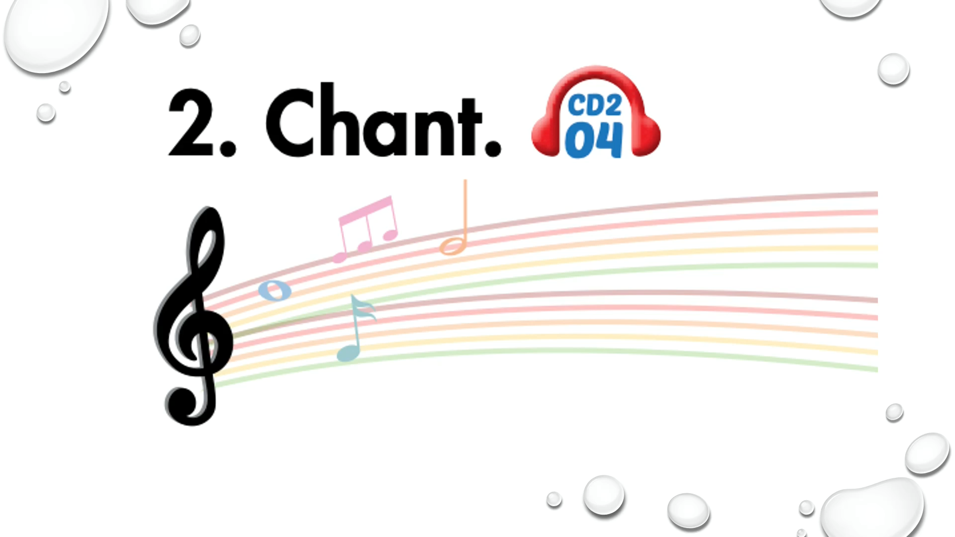

Slide 6
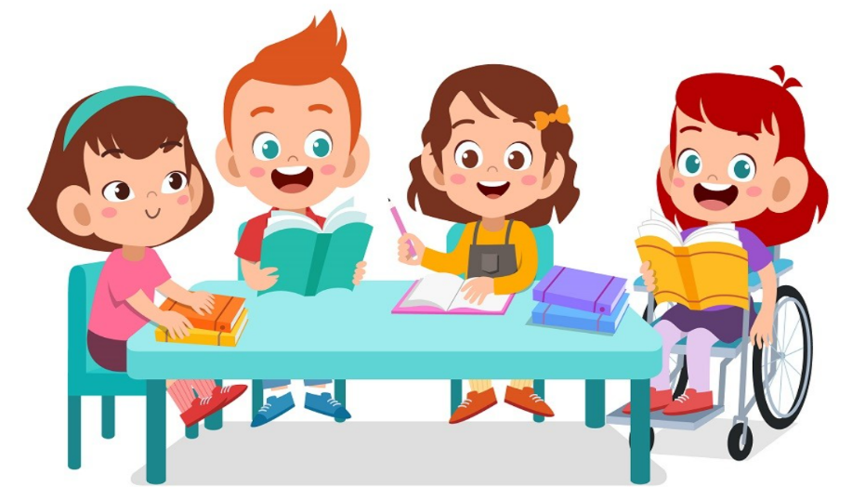
It’s time to learn …

Slide 7

Presentation

Slide 8
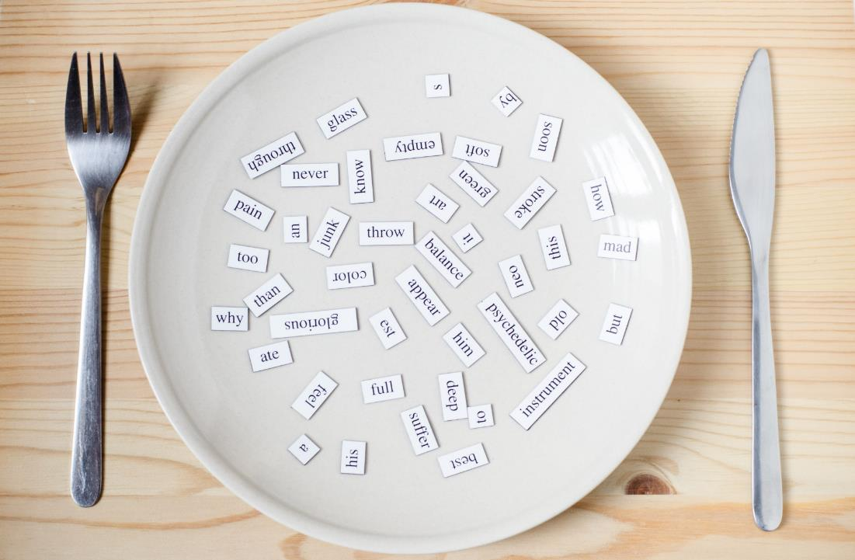
Phonics
/ɪ/

Slide 9
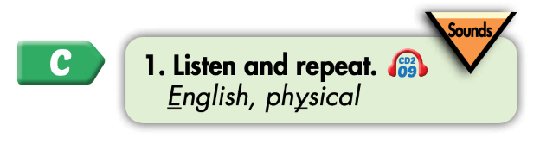

Click on the icon to hear the sound
Click on each word to hear the sound
English
physical
/ɪ/
/ɪ/

Slide 10

Practice

Slide 11
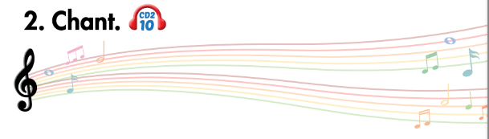
Listen and point
Listen and clap
Listen and chant

Slide 12
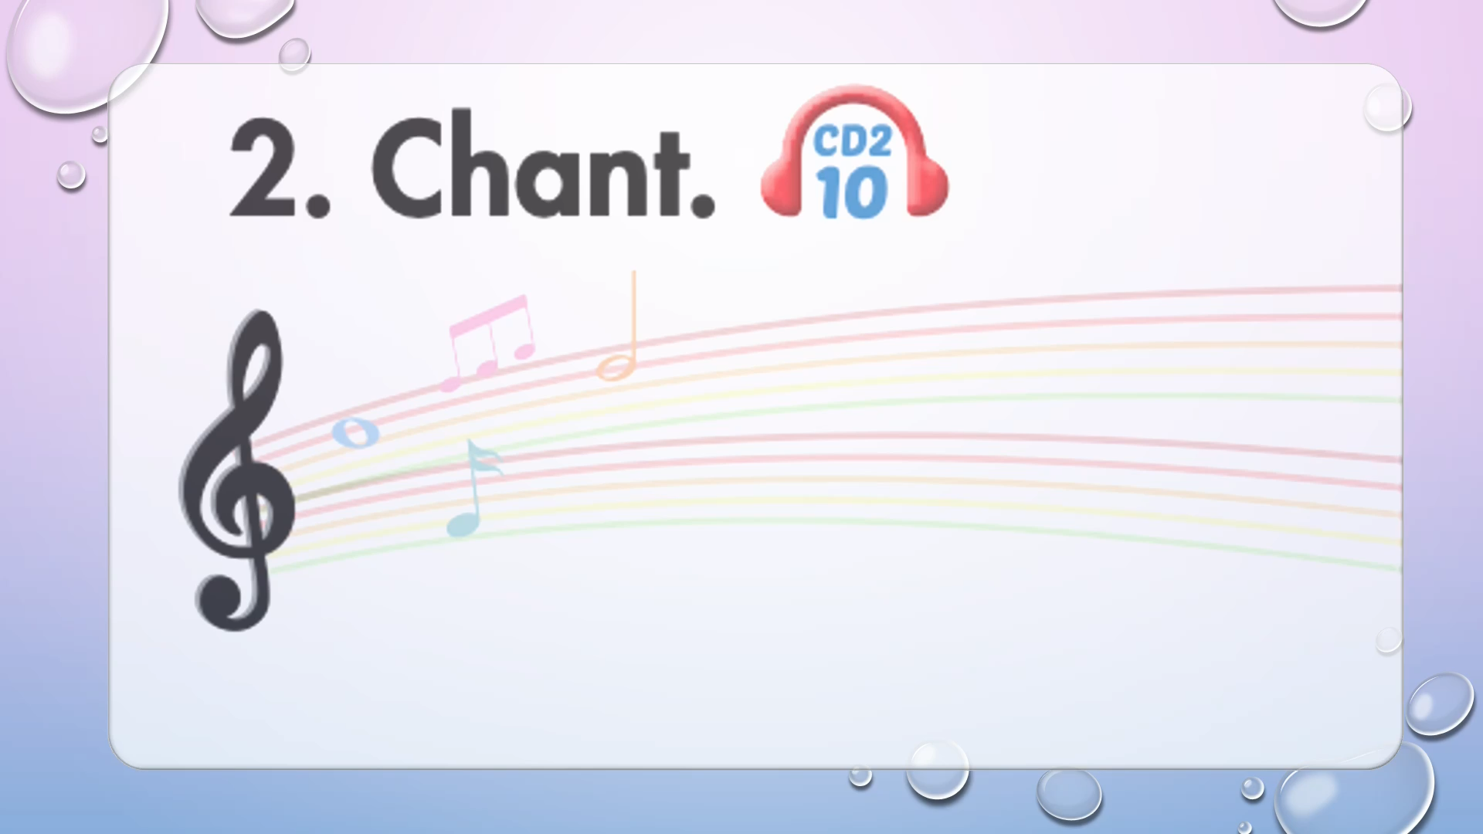

Slide 13

Listening

Slide 14
Pre-Listening
Look at the pictures and answer these questions.

Slide 15
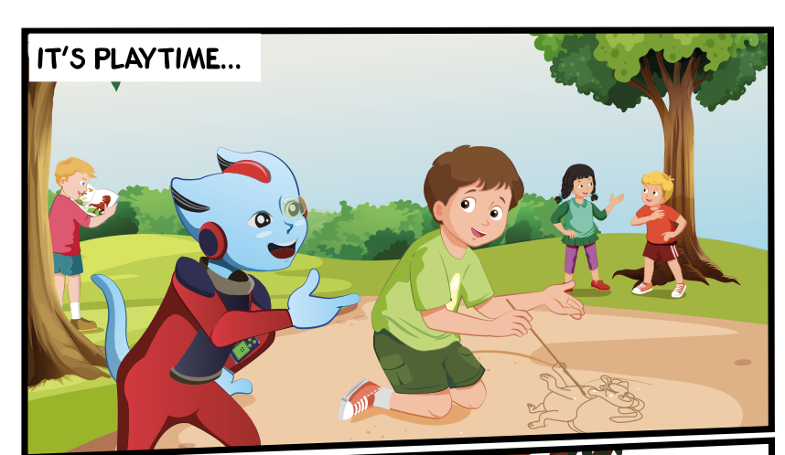
Who can you see?
What are they doing?
Where are they?

Slide 16

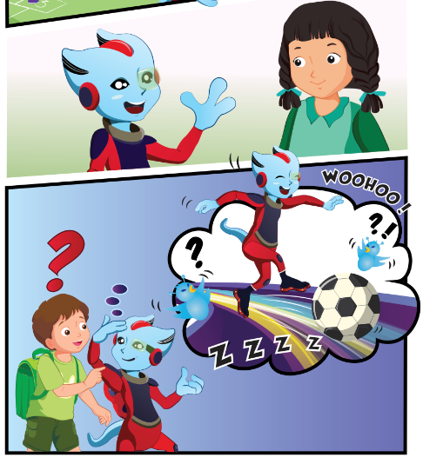

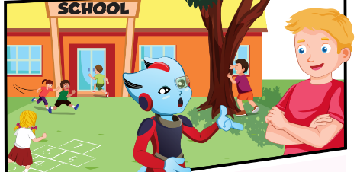
While-Listening
Click on the icon to hear the sound
3.
1.
4.
2.

Slide 17

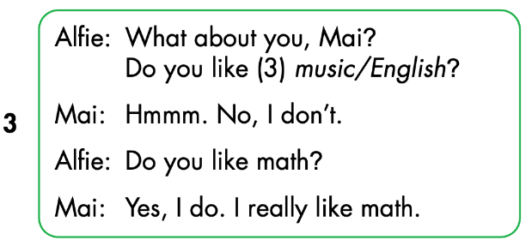
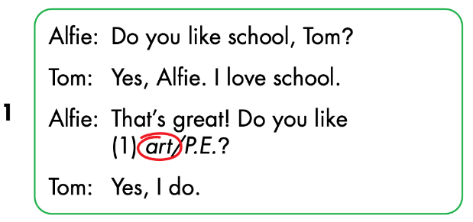
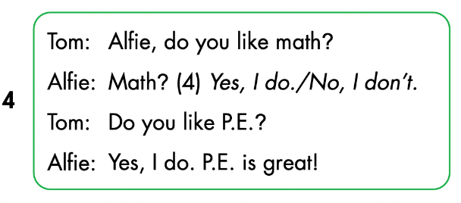
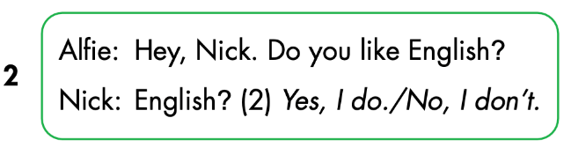
Click on the icon to hear the sound

Slide 18
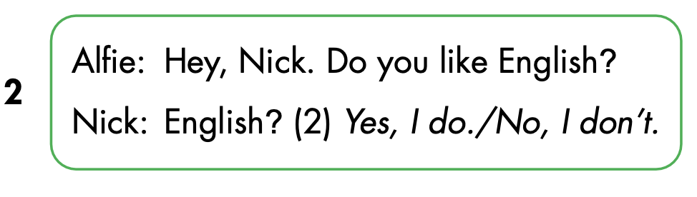
Let’s check!

Slide 19
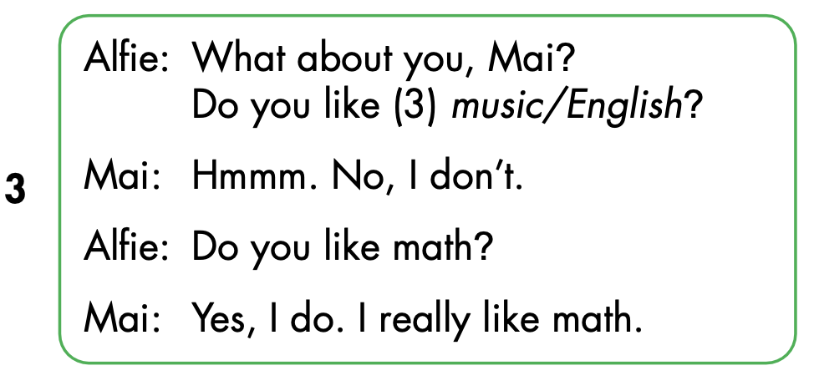

Slide 20
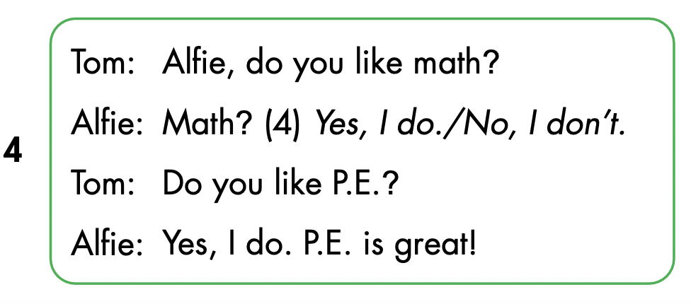

Slide 21

Speaking

Slide 22



Slide 23
Let’s play!

Slide 24


School subjects

Slide 25
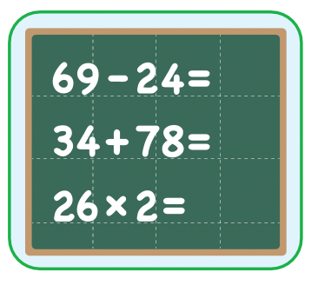


Do you like math ?
GREAT
Yes, I do.
math
No, I don’t.

Slide 26
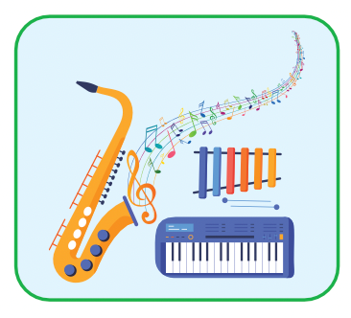


Do you like music?
GREAT
music
Yes, I do.
No, I don’t.

Slide 27
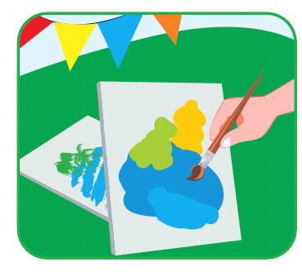
Do you like music ?
GREAT
math
Yes, I do.
No, I don’t.

Slide 28
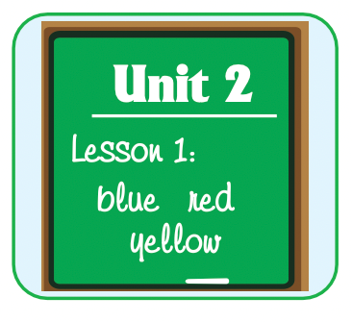


Yes, I do.
Do you like music?
GREAT
Do you like English?
Do you like art?

Slide 29
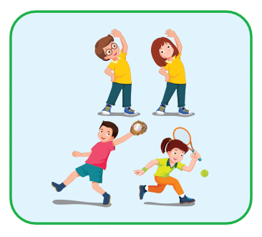

No, I don’t.
Do you like music?
GREAT
Do you like art?
Do you like P.E.?

Slide 30

CONSOLIDATION

Slide 31
Interview game
Draw this table
Choose 3 school subjects to write
Names | Math | English | Art
Tam
✓
✓
✘
Move around to ask: Do you like…? And write in the table
Work in pairs and tell about your friends
Notes:
134722862

Slide 32
Lesson 3
Homework
Review the vocabularies, structure
Do the exercises
Do the exercises
Prepare the next lesson

Slide 33

Lesson 3
Stay positive and have a nice day!

