Slide 1
Tuesday, November 12th, 2024
UNIT 3: SCHOOL
LESSON 1: E, F

Slide 2
Objectives
By the end of this lesson, students will be able to ask and answer who owns different school supplies.
Vocabulary: eraser, ruler, pencil, notebook, pencil case
Structure: Is this your eraser?
- Yes, it is./No, it isn't.
Are these your notebooks?
- Yes, they are./No, they aren't.

Slide 3
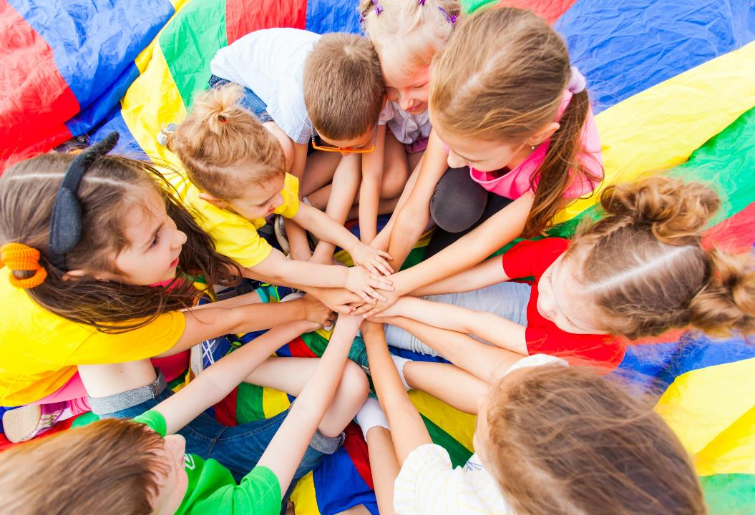
WARM UP

Slide 4
SPACE RACE
Choose One:
Rocket Ship or Alien Ship?

Slide 5
How to Play:
SPACE RACE
-Make 2 teams: one team is the ’Rocket’ and one team is the ‘Alien Ship’
- The teams take turns to choose a number and then answer the question.
- After answering the question correctly, click on the Rocket / Alien Ship and it will move.
-The first team to arrive at Mars is the winner.

Slide 6
SPACE RACE
GO!
3
2
1
ROCKET SHIP WINS!
ALIEN SHIP
WINS!

Slide 7
SPACE RACE
1
2
3
4
5
6
7
8
9
10
11
12
13
14
15

Slide 8
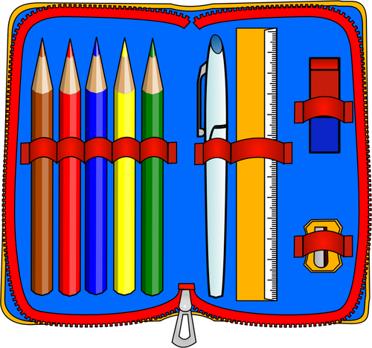
What’s this?
It’s a pencil case.

Slide 9
What’s this?
It’s a book.

Slide 10
What’s this?
It’s an eraser.

Slide 11
What’s this?
It’s a pencil.

Slide 12
Is this a pencil?
Yes, it is.

Slide 13
What are these?
They are pens.

Slide 14
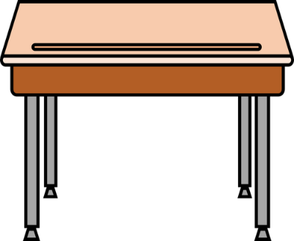
Is this a notebook?
No, it isn’t.

Slide 15
Are these rulers?
No, they aren’t.

Slide 16
What are these?
They are erasers.

Slide 17
Are these erasers?
Yes, they are.

Slide 18
What’s this?
It’s a notebook.

Slide 19
What’s this?
It’s a notebook.

Slide 20
What’s this?
It’s a pencil case.

Slide 21
What are these?
They are pencil cases.

Slide 22
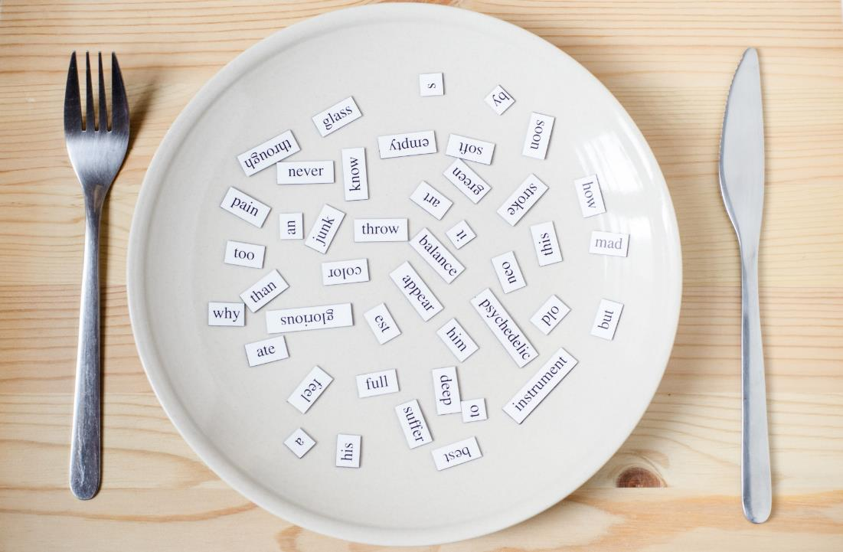
Structures
Is this your eraser?
Yes, it is./No, it isn’t.
Are these your notebooks?
Yes, they are./No, they aren't.

Slide 23
Presentation

Slide 24
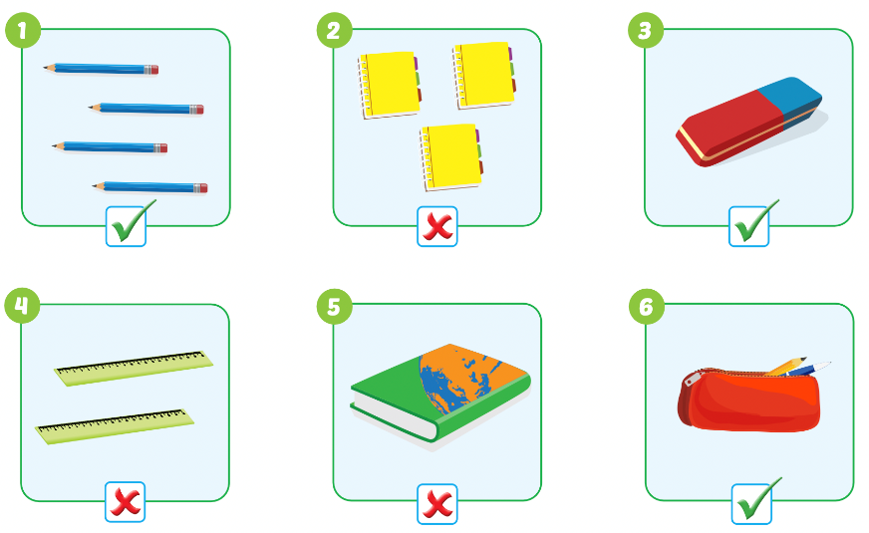

Slide 25
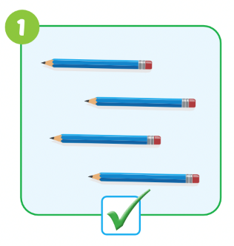
Teacher models first!

Slide 26
Practice

Slide 27
Divide the class into two teams.
Have Team A ask the question and Team B answer it.
Swap roles and repeat.

Slide 28
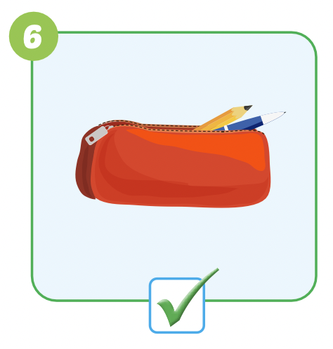
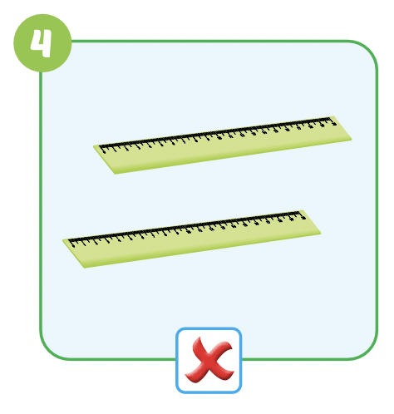
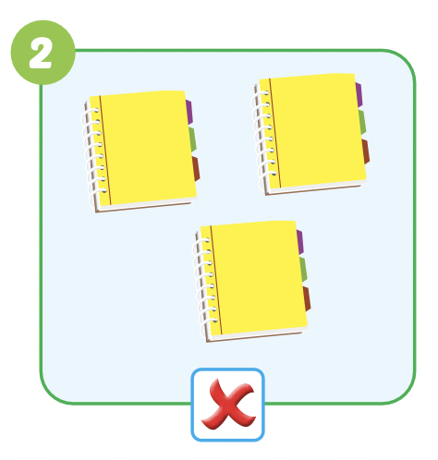
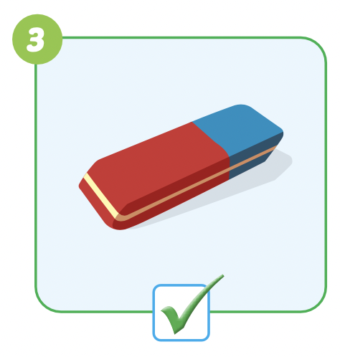
Are these your………………..?

Slide 29
Speaking

Slide 30
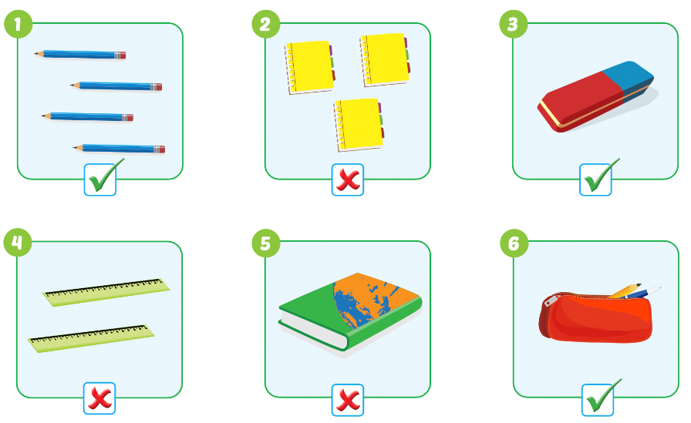
Pairwork

Slide 31
DEMONSTRATION
Have some pairs demonstrate the activity in front of the class

Slide 32
Production

Slide 33
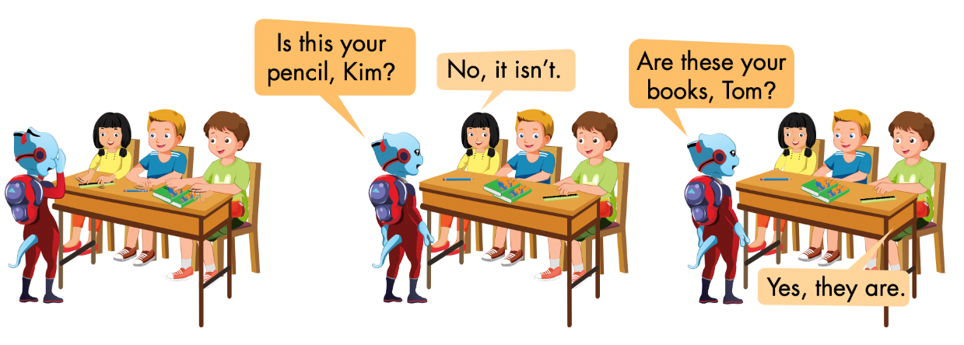
Notes:
Divide the class into groups of four.
Have Student A cover their eyes.
Have the other students put one of their own items on the
desk in a random order.
Have Student A open their eyes and try to guess.
Have other students respond.
Have students swap roles and repeat.

Slide 34
CONSOLIDATION

Slide 35
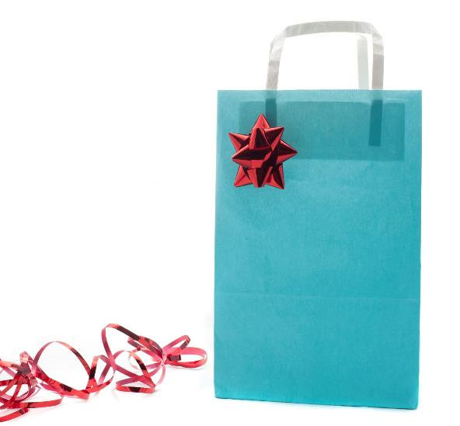
Guessing game
Work in groups of 4
Choose your favorite school thing and put it in a bag
Take turns to take out 1 school thing
Make a guess by asking:
Is this your…?
Are these your…?
Notes:
134722862

Slide 36
Lesson 3
Homework
Review the vocabularies, structure
Do the exercises
Do the exercises
Prepare the next lesson

Slide 37
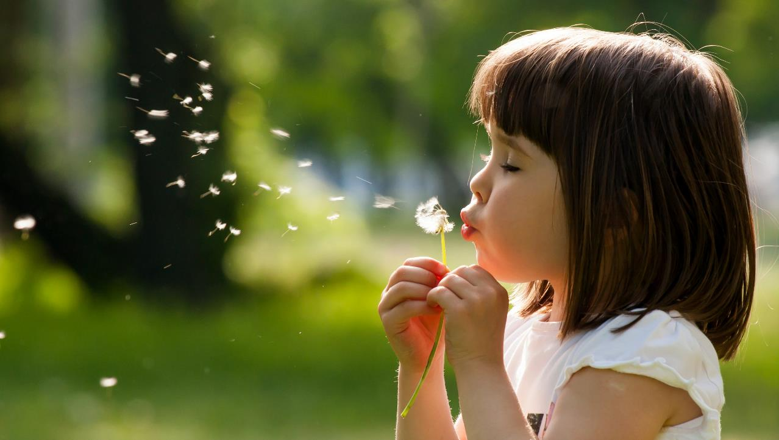
Enjoy your day!

