Slide 1
Tuesday, November 12th, 2024
UNIT 3: SCHOOL
LESSON 1: C, D

Slide 2
Objectives
By the end of this lesson, students will be able to pronounce the sounds /eɪ/, /ɪə/ and ask and answer who owns different school supplies.
Phonics: /eɪ/ and /ɪə/
Structure: Is this your (eraser)?
- Yes, it is./No, it isn't.
Are these your (notebooks)?
- Yes, they are./No, they aren't.

Slide 3

WARM UP

Slide 4

LET’S CHANT!

Slide 5
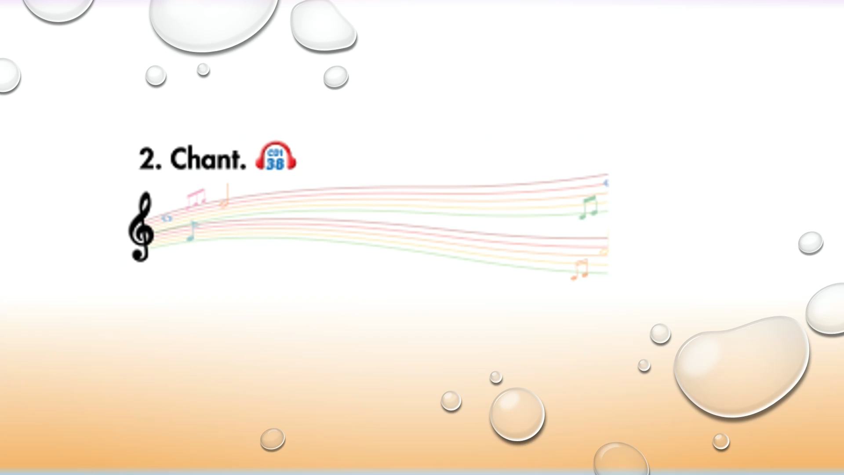

Slide 6
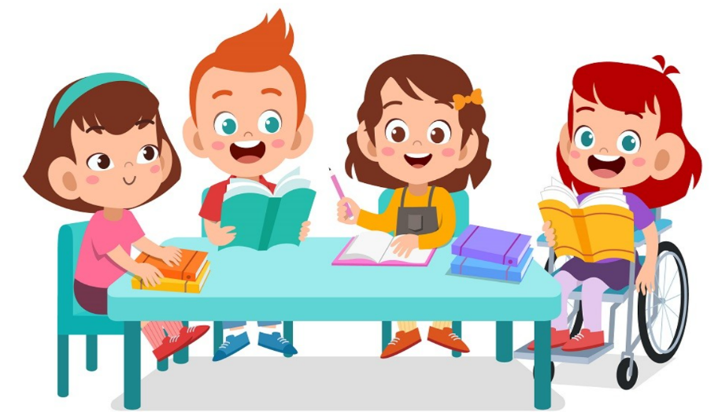
It’s time to learn …

Slide 7

Presentation

Slide 8
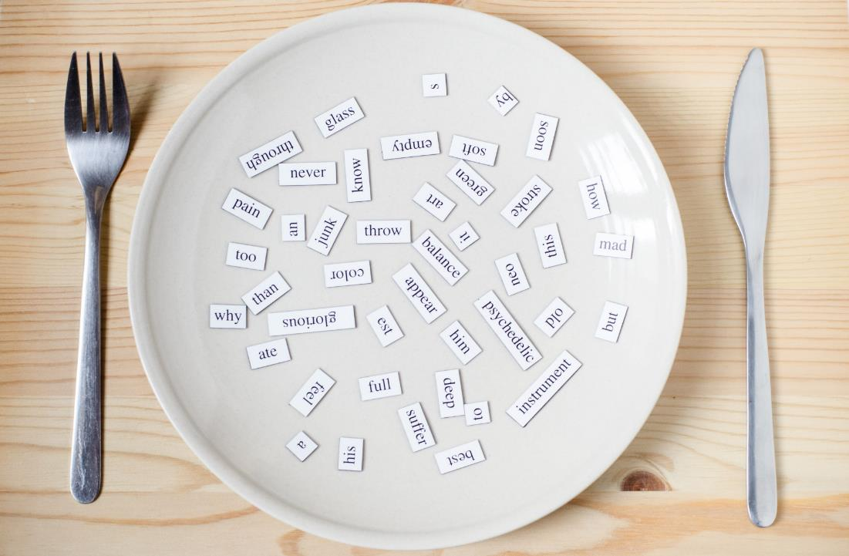
Phonics
/eɪ/ and /ɪə/

Slide 9


Click on the icon to hear the sound
Click on each word to hear the sound
eraser
here
/eɪ/
/ɪə/

Slide 10
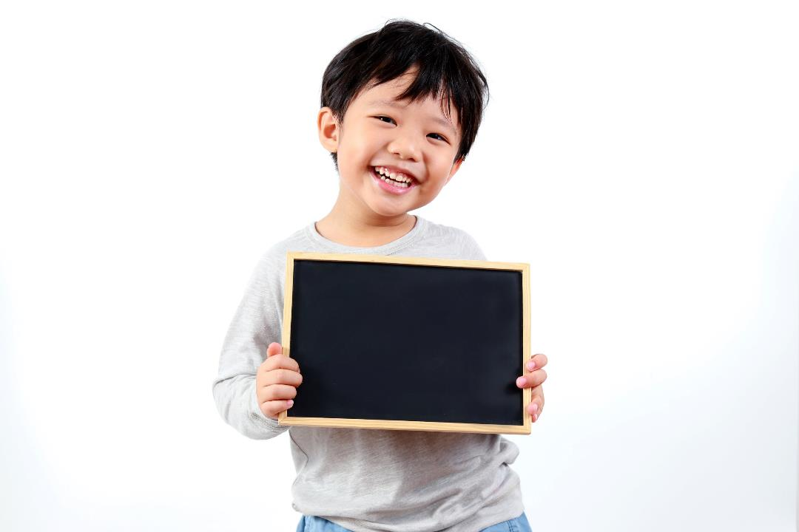
Practice

Slide 11
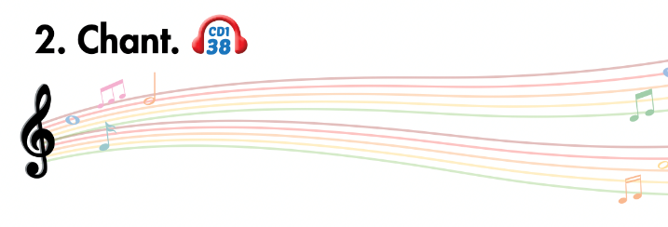
Listen and point
Listen and clap
Listen and chant

Slide 12


Slide 13
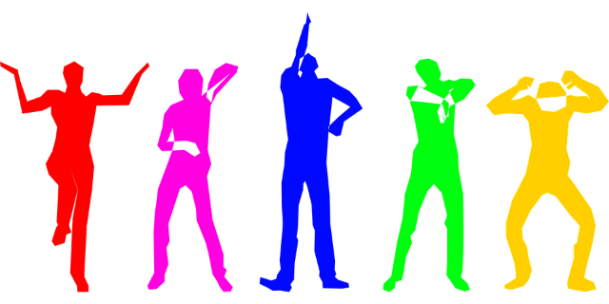
Let’s play!
Let’s Dance Game

Slide 14
How To Play
Students must take turns reading the words in order.
Each time a student can choose to say the words in 1 square, 2 squares or a maximum of 3 squares.
The student who says the last word must dance!

Slide 15

pen
pencil
eraser
ruler
pencil case
book
bag
note-book
friends
mother
books
bags
DANCE!!
father
pencils
brother
rulers
pens
sister
uncle
note-books
pencil cases
school
here
friend
aunt
eraser
ruler
pencils
cousin
erasers

Slide 16
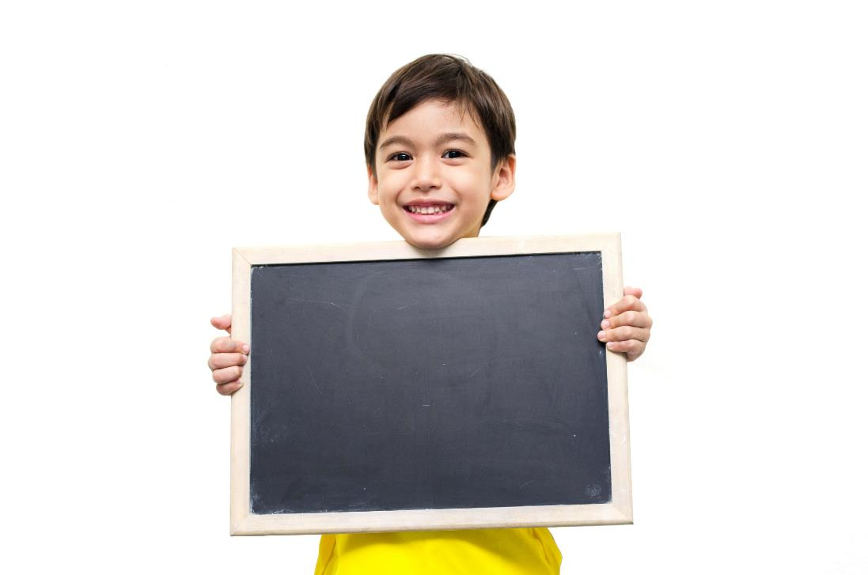
Listening

Slide 17
Pre-Listening
Look at the pictures and answer these questions.

Slide 18
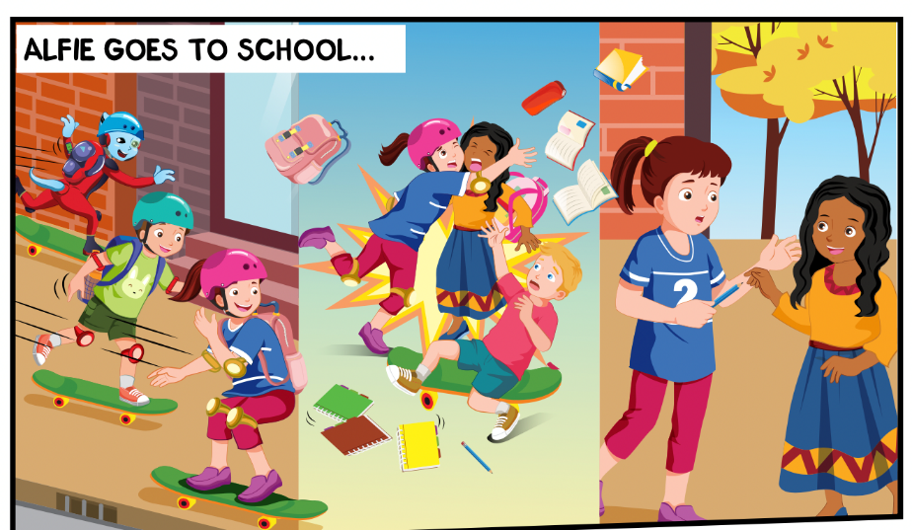
What things can you see?
Where are they?
Who can you see?

Slide 19
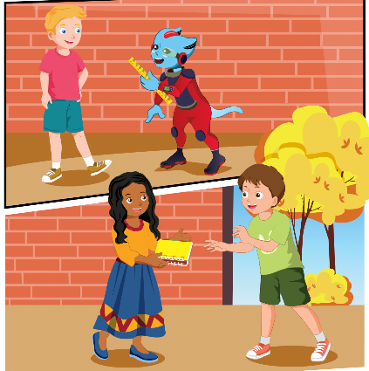

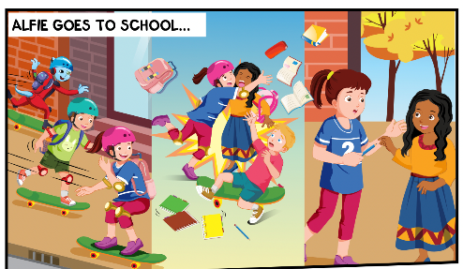
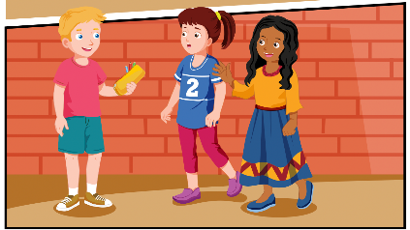
While-Listening
2.
Click on the icon to hear the sound
3.
1.
4.

Slide 20

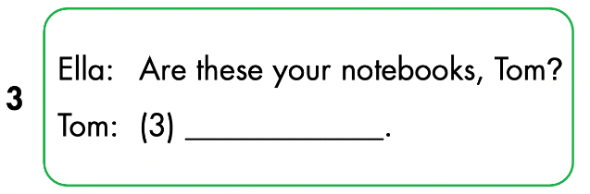
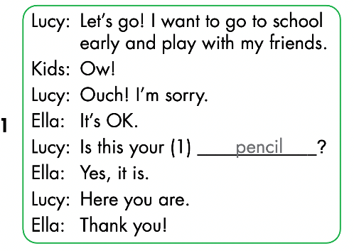
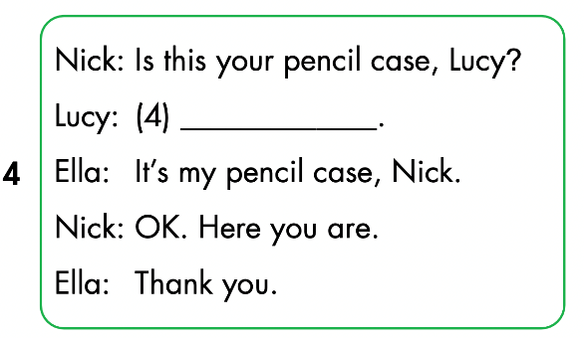
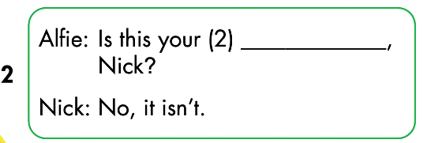
Click on the icon to hear the sound

Slide 21
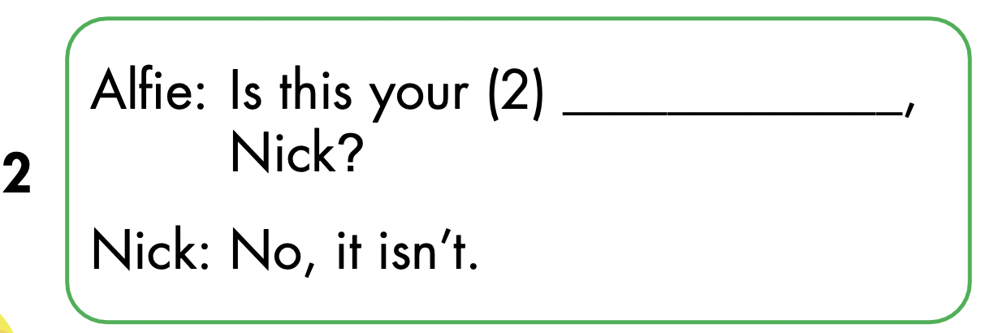
Let’s check!
ruler

Slide 22
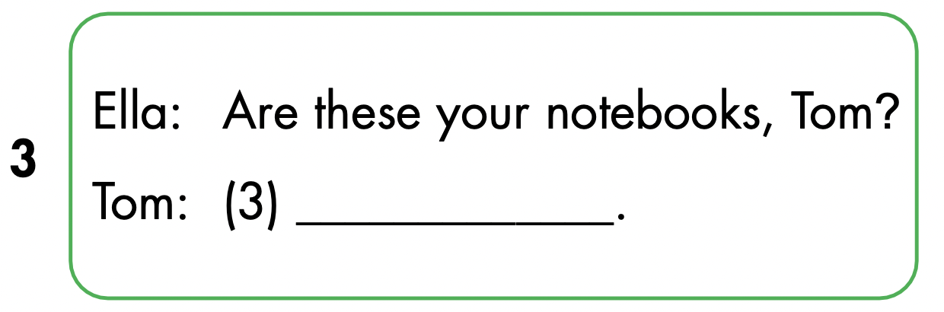
Yes, they are

Slide 23

No, it isn’t

Slide 24

Speaking

Slide 25

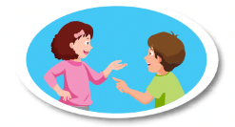
Yes, they are
No, it isn’t
ruler

Slide 26

CONSOLIDATION

Slide 27

Let’s draw!
Work in pairs
Draw your favorite school thing
Tell your friend about your picture
Notes:
134722862

Slide 28
Lesson 3
Today’s lesson
Phonics
/eɪ/ and /ɪə/
Structures/ Sentence patterns
Is this your (eraser)?
- Yes, it is./No, it isn't.
Are these your (notebooks)?
- Yes, they are./No, they aren't.

Slide 29
Lesson 3
Homework
Review by hearts vocabularies, structures
Do the exercises
Prepare the next lesson

Slide 30
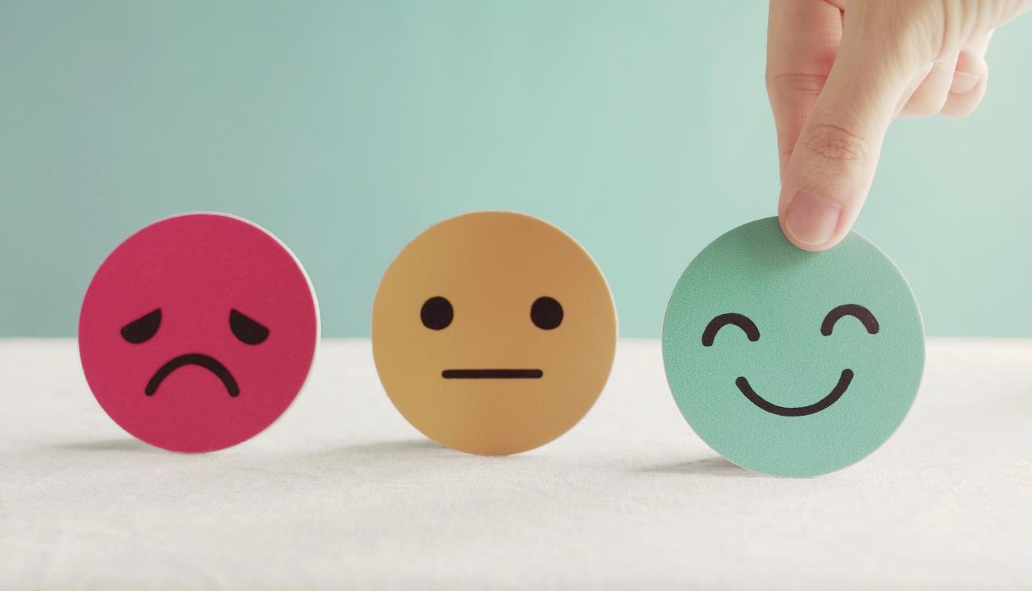
Lesson 3
Stay positive and have a nice day!

