Slide 1


Slide 2

Unit
2
1
Unit
FAMILY LIFE
HUMANS AND THE ENVIRONMENT
LESSON 1
GETTING STARTED
Go Green Club

Slide 3

Unit
1
1
FAMILY LIFE
Family Life
Unit
OBJECTIVES
Gain an overview about the topic Humans and the Environment
Memorize vocabulary to talk about activities to adopt a green lifestyle.

Slide 4
LESSON 1
GETTING STARTED
Unit
WARM-UP
Clip watching
PRESENTATION
Vocabulary
Task 1: Listen and read.
Task 2: Read and answer the questions.
Task 3: Match the verbs or phrasal verbs in A with suitable ones in B.
Task 4: Complete the sentences.
PRACTICE
PRODUCTION
Task 5: Interview
CONSOLIDATION
Wrap-up
Home work

Slide 5
LESSON 1
GETTING STARTED
Unit
WARM-UP
Clip watching

Slide 6
WARM-UP
Clip watching
Watch the clip and answer the following questions:
What has the man done?
What is the consequence of his activities?

Slide 7

WARM-UP
Clip watching
Notes:
Video link: https://www.youtube.com/watch?v=WfGMYdalClU

Slide 8
WARM-UP
Clip watching
1. He has:
+ killed animals for food, for clothing and even for fun;
+ destroyed forests to make room for factories, buildings or urban areas.
+ released a lot of oil, waste into the sea and on the land
2. He has made the earth a huge landfill, an unlivable place and in the end he has been killed by aliens.

Slide 9
LESSON 1
GETTING STARTED
Unit
GETTING STARTED
WARM-UP
Clip watching
PRESENTATION
Vocabulary

Slide 10

PRESENTATION
adopt
(v)
/əˈdɒpt/
start to use a particular method

Slide 11

PRESENTATION
awareness (of)
(n)
/əˈweənəs/
interest in and concern about a particular situation or area of interest

Slide 12
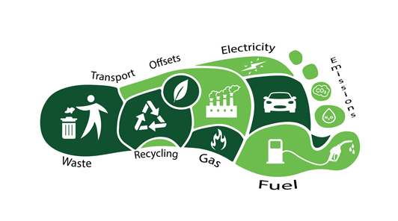
PRESENTATION
carbon footprint
(n)
/ˌkɑːbən ˈfʊtprɪnt/
a measure of the amount of carbon dioxide that is produced by the activities of a person or company

Slide 13
PRESENTATION
New words | Pronunciation | Meaning
adopt | /əˈdɒpt/ | start to use a particular method
awareness | /əˈweənəs/ | interest in and concern about a particular situation or area of interest
carbon footprint | /ˌkɑːbən ˈfʊtprɪnt/ | a measure of the amount of carbon dioxide that is produced by the activities of a person or company

Slide 14
LESSON 1
GETTING STARTED
Unit
WARM-UP
Clip watching
PRESENTATION
Vocabulary
Task 1: Listen and read.
Task 2: Read and answer the questions.
Task 3: Match the verbs or phrasal verbs in A with suitable ones in B.
Task 4: Complete the sentences.
PRACTICE

Slide 15
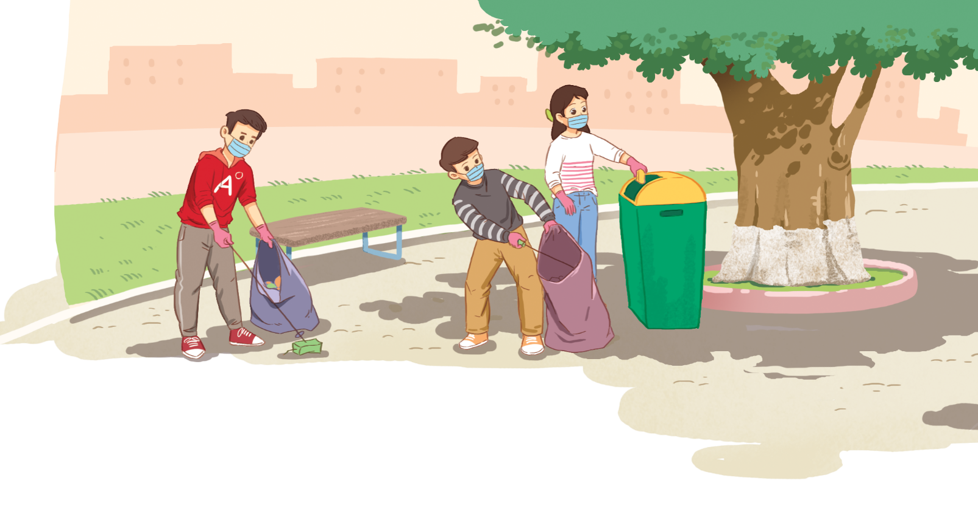
PRACTICE
1
Listen and read.
Go Green Club
1. What are the students doing?
2. Is cleaning up the school/ the
street/ public places a way to adopt
a green lifestyle?
3. What are you going to listen to?

Slide 16
PRACTICE
1
Listen and read.
Go Green Club
Mike: What are you going to do this weekend, Nam?
Nam: I’m going to attend the first meeting of my school’s Go Green Club.
Mike: Really? Can you tell me about the club, please?
Nam: Well, it was set up by the Youth Union in my school. Its aim is to improve our environment and encourage people to adopt a greener lifestyle.
Mike: Sounds interesting. What’s the first thing you are going to do?
Nam: We’re going to clean up the school right after the ceremony.

Slide 17
PRACTICE
PRACTICE
1
Listen and read.
Go Green Club
Mike: Do you have any other planned events?
Nam: Not yet, but I think we’ll organise more activities to raise local people’s awareness of environmental issues.
Mike: I’m keen to reduce my carbon footprint, but I don’t know what to do. Can I join the club?
Nam: Sure. The club welcomes all students in the area. I hope we’ll be able to do a lot to protect our environment.
Mike: Great. Can you please give me the time and place of the club meeting?
Nam: OK. I’ll text you. See you then.

Slide 18
PRACTICE
PRACTICE
2
Read the conversation again and answer the following questions.
1. Who set up the Go Green Club?
2. What does the club want to achieve?
3. What does Nam think the club will do in the future?
4. What is the first activity of the club?
5. What is Mike keen to do?
6. What do they decide at the end of the conversation?

Slide 19
PRACTICE
PRACTICE
2
Read the conversation again and answer the following questions.
GAME: LUCKY NUMBER
1
2
3
4
5
6
7
8

Slide 20

PRACTICE
PRACTICE
2
Read the conversation again and answer the following questions.
GAME: LUCKY NUMBER
1. Who set up the Go Green Club?
The Youth Union in Nam’s school set it up.
10

Slide 21

PRACTICE
PRACTICE
2
Read the conversation again and answer the following questions.
GAME: LUCKY NUMBER
2. What does the club want to achieve?
To improve the environment and encourage people to adopt a green life style.
15

Slide 22
PRACTICE
PRACTICE
2
Read the conversation again and answer the following questions.
GAME: LUCKY NUMBER
3. What does Nam think the club will do in the future?
He thinks the club will organize more activities to raise people’s awareness of environmental issues.
15

Slide 23
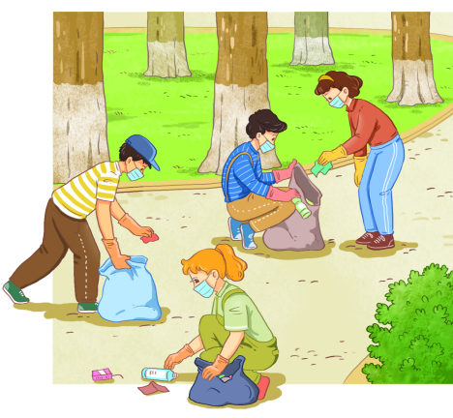
PRACTICE
PRACTICE
2
Read the conversation again and answer the following questions.
GAME: LUCKY NUMBER
4. What is the first activity of the club?
It is cleaning up the school right after the ceremony.
5

Slide 24
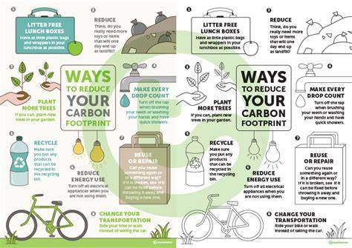
PRACTICE
PRACTICE
2
Read the conversation again and answer the following questions.
GAME: LUCKY NUMBER
5. What is Mike keen to do?
He is keen to reduce his carbon footprint.
5

Slide 25

PRACTICE
PRACTICE
2
Read the conversation again and answer the following questions.
GAME: LUCKY NUMBER
6. What do they decide at the end of the conversation?
Nam will tell/text Mike the time and the place of the club meeting.
15

Slide 26

PRACTICE
PRACTICE
2
Read the conversation again and answer the following questions.
GAME: LUCKY NUMBER
50

Slide 27
PRACTICE
3
Match the verbs or phrasal verbs in A with suitable nouns or noun phrases in B.
A | B
1. raise | a. a club
2. reduce | b. a greener lifestyle
3. clean up | c. awareness
4. adopt | d. your carbon footprint
5. set up | e. the school
thành lập câu lạc bộ
áp dụng lối sống xanh hơn
nâng cao nhận thức
giảm lượng khí thải các bon
dọn vệ sinh trường học

Slide 28
PRACTICE
4
Complete the following sentences based on the conversation in 1.
The club __________ by the Youth Union in Nam’s school.
The club members __________ clean up the school right after the ceremony.
Nam thinks they ________ organise more activities to raise local people’s awareness of environmental issues.
was set up
are going to
will

Slide 29
LESSON 1
GETTING STARTED
Unit
WARM-UP
Clip watching
PRESENTATION
Vocabulary
Task 1: Listen and read.
Task 2: Read and answer the questions.
Task 3: Match the verbs or phrasal verbs in A with suitable ones in B.
Task 4: Complete the sentences.
PRACTICE
PRODUCTION
Task 5: Interview

Slide 30
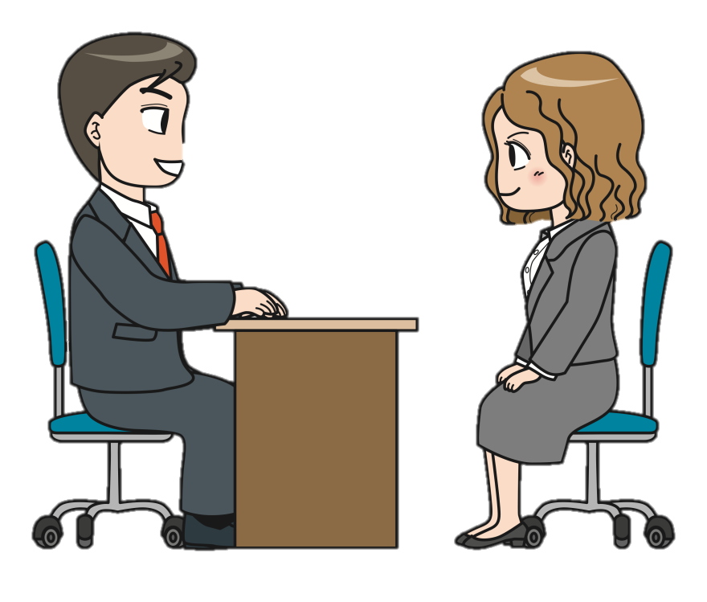
PRODUCTION
5
Interview.
To become a member of our school Go Green Club, you must participate in an interview with the club chairman. Think about activities which you can do at school and in your community to help protect the environment.
Ask the candidate about the reason why he/she wants to become a club member, his/her experiences in the past to protect the environment and the intention in the future.
Think of reasons why you want to become a club member, activities you did and are going to do to protect the environment.

Slide 31
LESSON 1
GETTING STARTED
Unit
WARM-UP
Clip watching
PRESENTATION
Vocabulary
Task 1: Listen and read.
Task 2: Read and answer the questions.
Task 3: Match the verbs or phrasal verbs in A with suitable ones in B.
Task 4: Complete the sentences.
PRACTICE
PRODUCTION
Task 5: Interview
CONSOLIDATION
Wrap-up
Home work

Slide 32
CONSOLIDATION
1
Wrap-up
Gain an overview about the topic Humans and the Environment.
Memorize vocabulary to talk about activities to adopt a green lifestyle.

Slide 33
CONSOLIDATION
2
Homework
+ Do exercises in the workbook
+ Prepare for the project

Slide 34
CONSOLIDATION
2
Homework
Project preparation
- Make a plan for a Go Green Weekend;
- Suggest activities for the event, provide the reasons and expected results of the activities;
- Include information as stated in the table on page 27 in the Student’s Book.
- Present your plans in the last lesson of the unit.
(You can search for ideas on the Internet, in the newspaper, etc. for references and you should use photos/pictures to illustrate your ideas.)

Slide 35

Website: hoclieu.vn
Fanpage: facebook.com/www.tienganhglobalsuccess.vn

