Slide 1


Slide 2

Unit
3
1
Unit
FAMILY LIFE
MUSIC
LESSON 3
READING

Slide 3

Unit
1
1
FAMILY LIFE
Family Life
Unit
OBJECTIVES
Read for specific information in a text about a famous TV music show;
Guess the meaning of words/phrases in context;
Talk about reasons why they want or don’t want to participate in a music competition.

Slide 4
LESSON 3
READING
Unit
GETTING STARTED
WARM-UP
Crossword
PRE-READING
* Vocabulary
Task 1: Look at the pictures and discuss the following questions.
Task 2: Match the highlighted words and phrases in the text to the meaning below.
Task 3: Choose the best answers.
WHILE-READING
POST-READING
Task 4: Discuss whether you want to participate in Vietnam Idol. Give your reasons.
Wrap-up
Home work
CONSOLIDATION

Slide 5
LESSON 3
READING
Unit
GETTING STARTED
WARM-UP
GUESSING

Slide 6
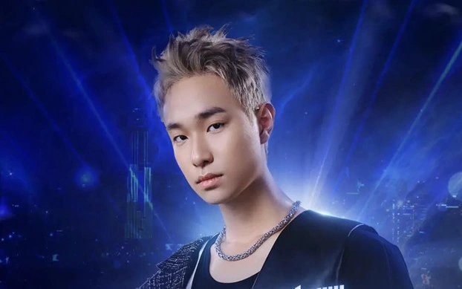
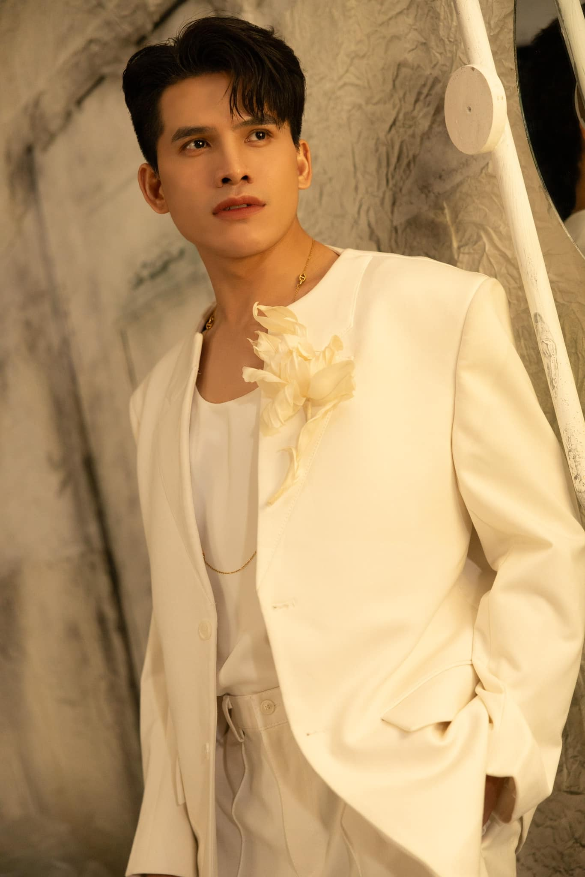
HÀ AN HUY
QUỐC THIÊN

Slide 7
LESSON 3
READING
Unit
GETTING STARTED
WARM-UP
Crossword
PRE-READING
* Vocabulary
Task 1: Look at the pictures and discuss the following questions.

Slide 8
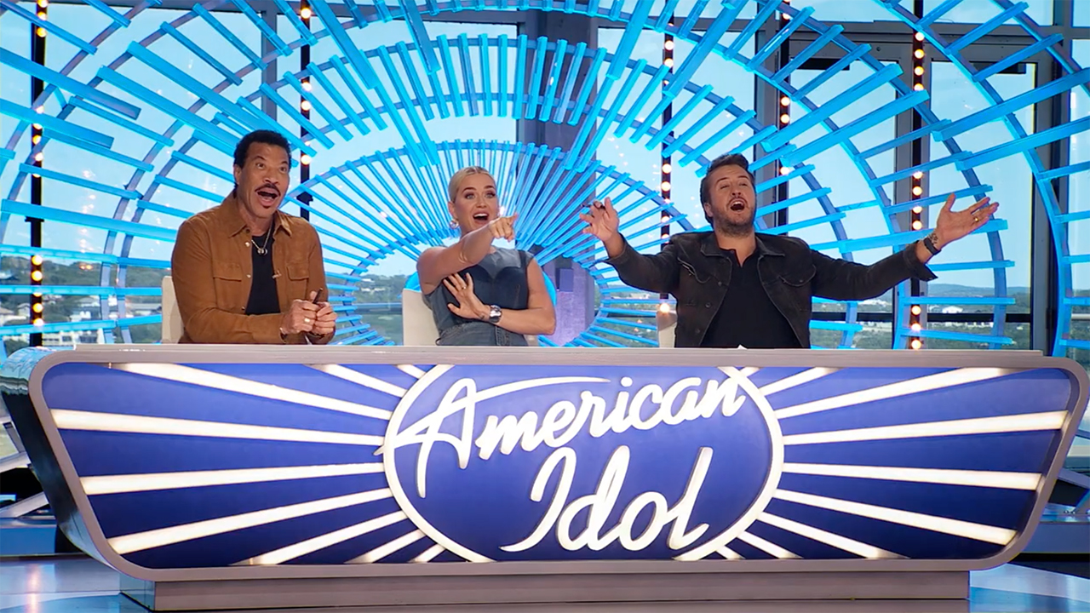

PRE-READING
1
Work in pairs. Look at the pictures and discuss the following questions.
What are these shows? What do you know about them?

Slide 9

VOCABULARY
series (n)
/ ˈsiəri/
Loạt, nhiều

Slide 10

VOCABULARY
identify with (n)
feel that they are similar to
and can understand them
Đồng cảm

Slide 11


VOCABULARY
semi-final (n)
/ˌsemi ˈfaɪnl/
one of the two games or parts of a sports competition that are held to decide who will compete in the last part
bán kết

Slide 12
VOCABULARY
play a role in (idiom)
/pleɪ ə rəʊl ɪn /
be involved in or have an effect on
đóng vai trò
Ex: Deciding to travel instead of going straight to college after high school played a major role in my life.

Slide 13
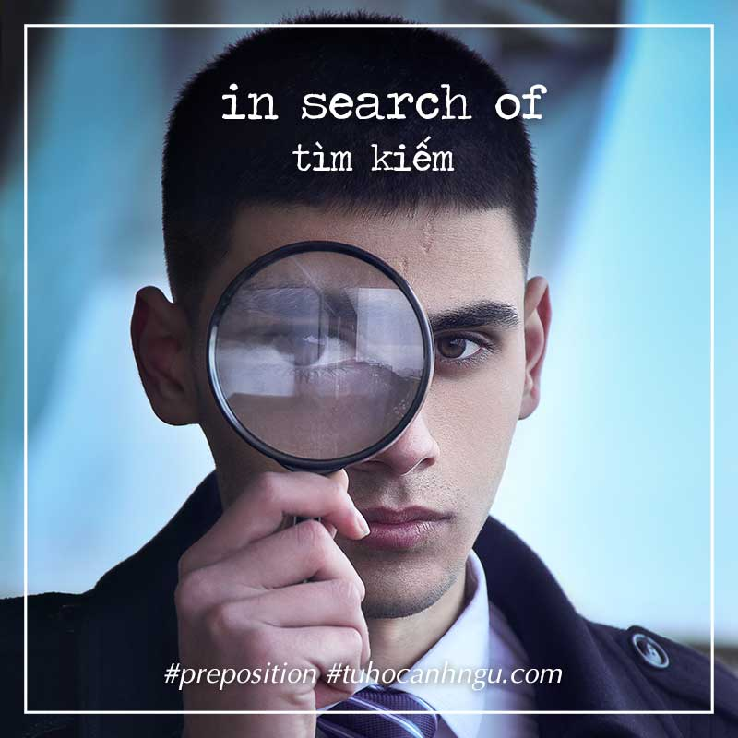
VOCABULARY
in search of
Tìm kiếm

Slide 14

VOCABULARY
eliminated (v)
be knocked out or thrown away
Loại bỏ

Slide 15
LESSON 3
READING
Unit
GETTING STARTED
WARM-UP
Crossword
PRE-READING
* Vocabulary
Task 1: Look at the pictures and discuss the following questions.
Task 2: Match the highlighted words and phrases in the text to the meaning below.
Task 3: Choose the best answers.
WHILE-READING

Slide 16
WHILE-READING
2
Read a text about a famous music show. Match the highlighted words and phrases in the text to the meanings.
1. series
2. identify with
3. in search of
4. eliminated
a. feel that they are similar to and can understand them
b. a set of TV or radio programmes on the same subject
c. removed from the competition
d. looking for

Slide 17
WHILE-READING
3
Read the text again and choose the best answers.
1. What is American Idol?
A game show on TV
A TV singing contest
A live dancing competition
2. Which if the following statements is correct?
A. From the semi-final, singers who can go to the next stage are decided by the audience vote.
B. The judges choose as many singers as they can.
C. People around the world can vote for the songs they like.
3. Who wins American Idol?
A. The singer with the highest number of the votes on the final night.
B. The singer with the highest number of votes and highest scores from the judges.
C. The singer with the highest scores from the judges.
4. Which of the following statements about the judges is NOT mentioned?
A. They give comments after each live performance.
B. They have different views about the singers’ performances.
C. They are not in favour of choosing ordinary people.
5. What can be inferred about the competition in Viet Nam?
A. The audience decides who makes it to the final stage.
B. All the singers will be famous.
C. It can help develop participants’ singing careers.
6. When was American Idol shown for the first time on television?
A. twenty-four years ago B. in 2002 C. in 2007
7. Who can vote for their preferred singers in American Idol?
A. People who are over thirteen
B. People who live in the US, Puerto Rico or the Virgin Islands
C. People living in the US, Puerto Rico or the Virgin Islands and over thirteen

Slide 18
WHILE-READING
3
Read the text again and choose the best answers.
1. What is American Idol?
A. A game show on TV
B. A TV singing contest
B. A TV singing contest
C. A live dancing competition

Slide 19
WHILE-READING
3
Read the text again and choose the best answers.
2. Which of the following statements is correct?
A. From the semi-final, singers who can go to the next stage are decided by the audience vote.
A. From the semi-final, singers who can go to the next stage are decided by the audience vote.
B. The judges choose as many singers as they can.
C. People around the world can vote for the songs they like.

Slide 20
WHILE-READING
3
Read the text again and choose the best answers.
3. Who wins American Idol?
A. The singer with the highest number of the votes on the final night.
A. The singer with the highest number of the votes on the final night.
B. The singer with the highest number of votes and highest scores from the judges.
C. The singer with the highest scores from the judges.

Slide 21
WHILE-READING
3
Read the text again and choose the best answers.
4. Which of the following statements about the judges is NOT mentioned?
A. They give comments after each live performance.
B. They have different views about the singers’ performances.
C. They are not in favour of choosing ordinary people.
C. They are not in favour of choosing ordinary people.

Slide 22
WHILE-READING
3
Read the text again and choose the best answers.
5. What can be inferred about the competition in Viet Nam?
A. The audience decides who makes it to the final stage.
B. All the singers will be famous.
C. It can help develop participants’ singing careers.
C. It can help develop participants’ singing careers.

Slide 23
WHILE-READING
3
Read the text again and choose the best answers.
6. When was American Idol shown for the first time on television?
A. Twenty-four years ago
B. In 2002
B. In 2002
C. In 2007

Slide 24
WHILE-READING
3
Read the text again and choose the best answers.
7. Who can vote for their preferred singers in American Idol?
A. People who are over thirteen
B. People who live in the US, Puerto Rico or the Virgin Islands
C. People living in the US, Puerto Rico or the Virgin Islands and over thirteen
C. People living in the US, Puerto Rico or the Virgin Islands and over thirteen

Slide 25
LESSON 3
READING
Unit
GETTING STARTED
WARM-UP
Crossword
PRE-READING
* Vocabulary
Task 1: Look at the pictures and discuss the following questions.
Task 2: Match the highlighted words and phrases in the text to the meaning below.
Task 3: Choose the best answers.
WHILE-READING
POST-READING
Task 4: Discuss whether you want to participate in Vietnam Idol. Give your reasons.

Slide 26

POST-READING
PRACTICE
4
Work in pairs. Discuss whether you want to participate in Vietnam Idol. Give your reasons.

Slide 27
LESSON 3
READING
Unit
GETTING STARTED
WARM-UP
Crossword
PRE-READING
* Vocabulary
Task 1: Look at the pictures and discuss the following questions.
Task 2: Match the highlighted words and phrases in the text to the meaning below.
Task 3: Choose the best answers.
WHILE-READING
POST-READING
Task 4: Discuss whether you want to participate in Vietnam Idol. Give your reasons.
Wrap-up
Home work
CONSOLIDATION

Slide 28
CONSOLIDATION
1
Wrap-up
A text about a famous music show: American Idol

Slide 29
CONSOLIDATION
2
Homework
Search for more music shows on the Internet, take note the regulations and the prizes and post them on the Facebook/ Zalo group of your class.
Prepare for the Speaking lesson

Slide 30

Website: hoclieu.vn
Fanpage: facebook.com/www.tienganhglobalsuccess.vn

