Slide 1


Slide 2
A leaflet about ways to reduce black carbon emissions
Unit
5
GLOBAL WARMING
Unit
FAMILY LIFE
LESSON 6
WRITING
Student Book – page 58

Slide 3
LESSON 6
WRITING
Left or Right?
WARM-UP
Task 1: Match the ways to reduce black carbon emissions with the reasons
Task 2: Label the parts of the leaflet with the words in the box.
PRE-WRITING
WHILE-WRITING
Task 3: Complete the leaflet in Task 2.
POST-WRITING
Peer review
CONSOLIDATION
Wrap-up
Homework

Slide 4

WARM-UP
Left or Right?

Slide 5
WARM-UP
What are the names of the items below?
Raise your left/ right hand to choose ONE answer for each item..

Slide 6

WARM-UP
BANNERS
POSTERS

Slide 7
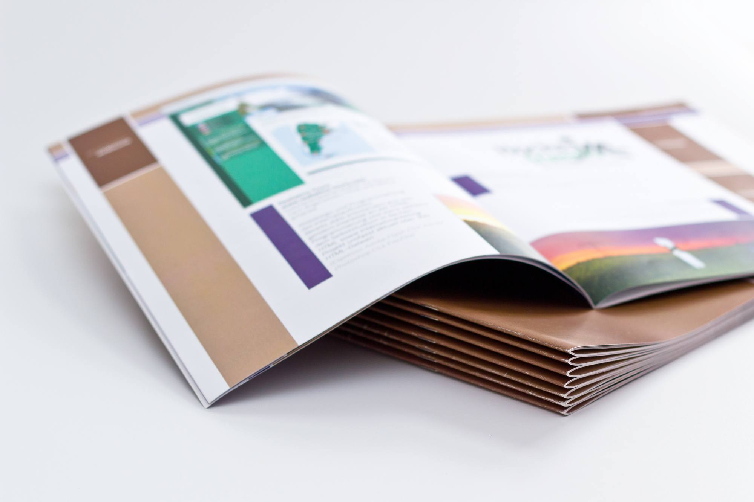
WARM-UP
POSTERS
BOOKLETS

Slide 8

WARM-UP
BOOKLET
POSTER

Slide 9
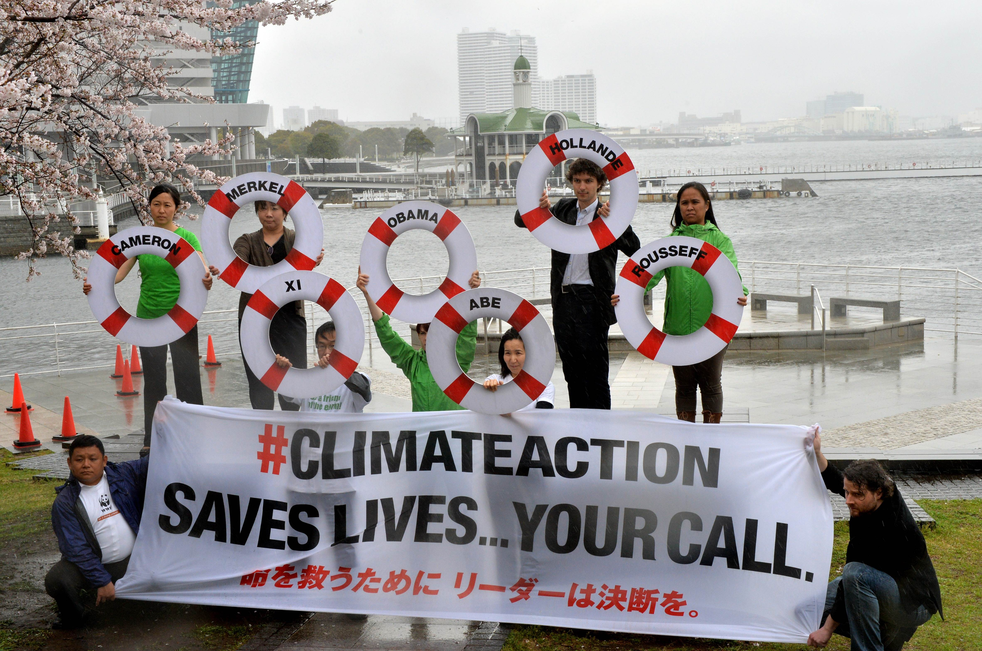
WARM-UP
BANNER
LEAFLET

Slide 10

WARM-UP
LEAFLET
POSTER

Slide 11
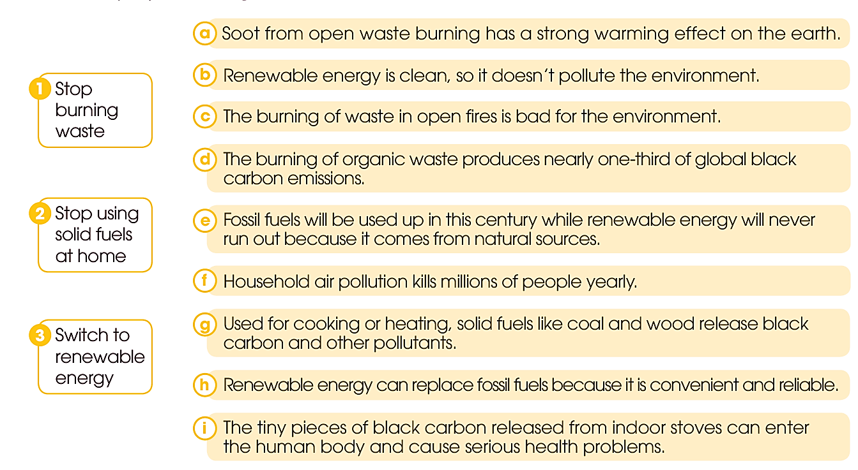
PRE-WRITING
1
Match the ways to reduce black carbon emissions with the reasons.

Slide 12
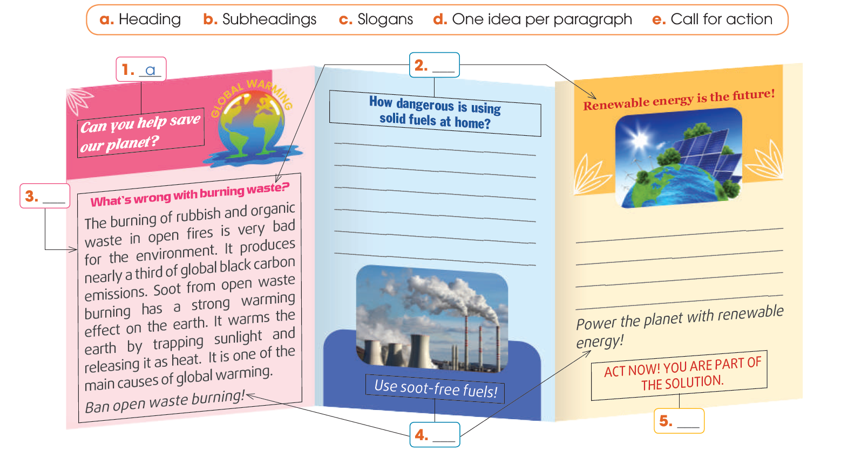
PRE-WRITING
2
Label the parts of the leaflet.
b
d
e
c

Slide 13
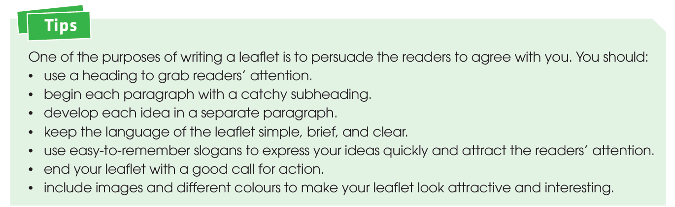


PRE-WRITING
S S

Slide 14

WHILE-WRITING
3
You are organising your school's Green Fair. Write about 120–150 words to complete the leaflet in 2. Use the suggested ideas in 1, and the tips above to help you.

Slide 15



SAMPLE ANSWER
How dangerous is using solid fuels at home?
Many people still use solid fuels like coal and wood for heating and cooking. However, when burnt at home, they produce black carbon and other pollutants. The tiny pieces of black carbon released from indoor stoves can enter the human body and cause serious health problems. Household air pollution kills millions of people every year.
Use soot-free fuels!
Renewable energy is the future!
Renewable energy is clean and free of black carbon and greenhouse gases, so it does not pollute the environment. Renewable energy can replace fossil fuels because it is convenient and reliable. Fossil fuels will be used up in this century while renewable energy will never run out because it comes from the Earth’s natural sources.
Power the planet with renewable energy!

Slide 16

POST-WRITING
Exchange your writing with your friend for peer review.
Writing rubric
Organization: …/10
Legibility: …/10
Ideas: …/10
Word choice: …/10
Grammar usage and mechanics: …/10
TOTAL: …/50

Slide 17
CONSOLIDATION
1
Wrap-up
What have you learnt today?
How to write a leaflet about ways to reduce carbon emissions
Apply structures to practice

Slide 18
CONSOLIDATION
2
Homework
Do exercises in the workbook.
Prepare for Lesson 7 - Unit 5.

Slide 19
Thank you so much !!
Website: hoclieu.vn
Fanpage: facebook.com/tienganhglobalsuccess.vn/

