Slide 1


Slide 2
Unit
1
A long and healthy life
Unit
FAMILY LIFE
LESSON 2
LANGUAGE

Slide 3
LESSON 2
LANGUAGE
WARM-UP
Watch a video
Task 1: Listen and repeat.
Task 2: Read the sentences out loud. Listen and check.
PRONUNCIATION
Task 1: Match each word with its meaning
Task 2: Complete the sentences using the correct forms of the words
VOCABULARY
Task 1: Put the verbs in brackets in either the past simple or the present perfect.
Task 2. Talk about your healthy activities
GRAMMAR
Wrap-up
Homework
CONSOLIDATION

Slide 4
WARM-UP
WATCH A VIDEO
Work in 4 groups.
Watch the video and list out good habits to stay healthy mentioned in the video.
Stick the paper on the boards.
The group with the most correct answers is the winner.

Slide 5

WARM-UP
WATCH A VIDEO
Notes:
Video link: https://www.youtube.com/watch?v=UxnEuj1c0sw

Slide 6
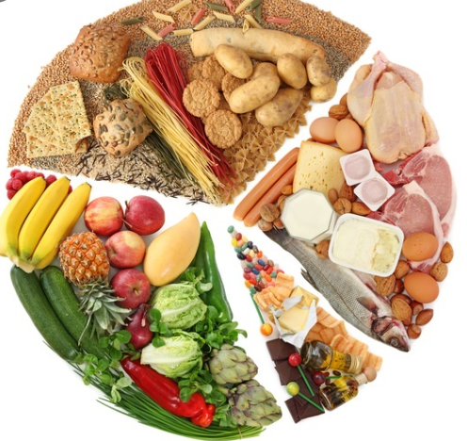


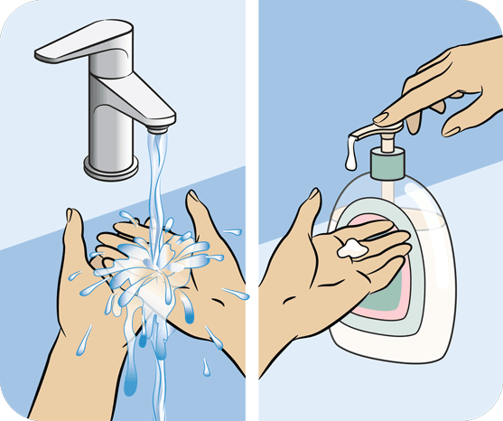
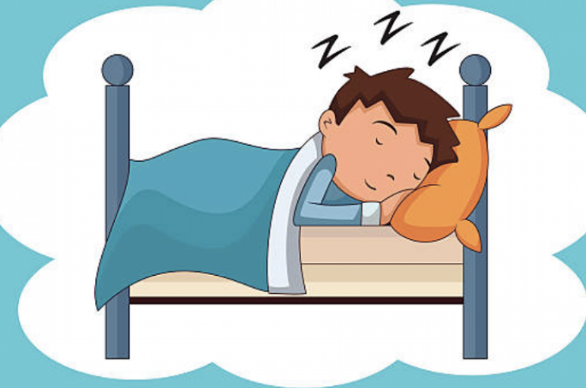
WARM-UP
What do humans need to stay healthy?
- Eat a good balance of all kinds of food
- Drink lots of water
- Do lots of exercises
- Keep clean and wash off germs
- Have enough sleep

Slide 7

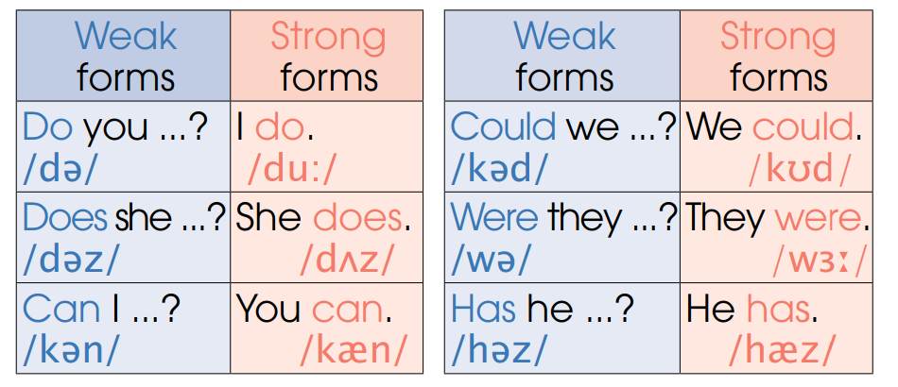
PRONUNCIATION
1
Listen and repeat. Pay attention to the strong and weak forms of auxiliary verbs. Then practice saying them.

Slide 8
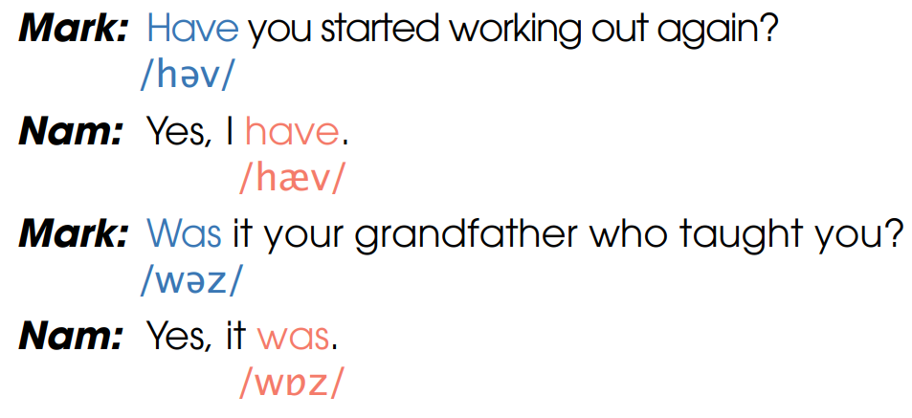
PRONUNCIATION
1
Listen and repeat. Pay attention to the strong and weak forms of auxiliary verbs. Then practice saying them.

Slide 9








PRONUNCIATION
2
Read the sentences out loud. Pay attention to the strong and weak forms of auxiliary verbs. Listen and check.
1. Does she exercise? – Yes, she does.
2. Were you eating healthily? – Yes, I was.
3. Do you eat vegetables? – Yes, I do.
4. Can he get up early? – Yes, he can.

Slide 10
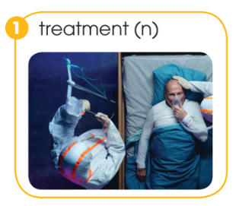
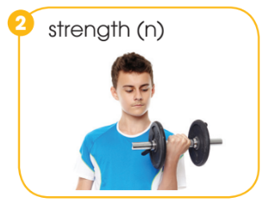
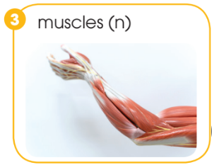
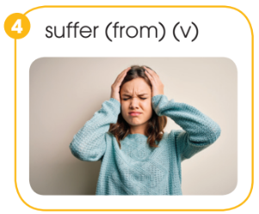
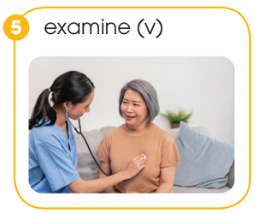
VOCABULARY
1
Match each word (1-5) with its meaning (a-e)
a. pieces of flesh in our body that allow the movement of our arms, legs, etc.
b. something that helps to cure an illness or injury
c. the quality of being physically strong
d. to have a health problem
e. to look at someone’s body carefully to find out if there is a health problem

Slide 11
VOCABULARY
2
Complete the sentences using the correct forms of the words in Task 1
1. The doctor _________ her carefully, but could not find anything wrong.
2. He is receiving _________ for his health problem.
3. Regular exercise can help you improve your muscle _________.
4. To build your _________, you can try lifting weights.
5. Nam can’t sleep well. He is _____________ stress.
examined
treatment
strength
muscles
suffering from

Slide 12
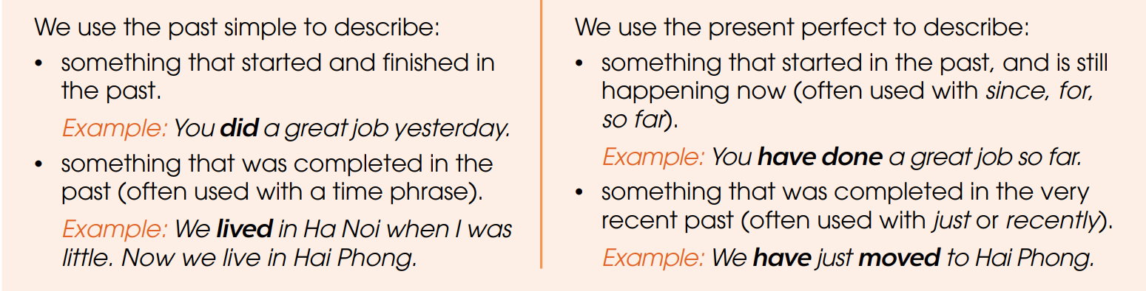
GRAMMAR

Slide 13
The present perfect simple
a. Formation:
S + has/ have + P. P
We have lived here for 20 years.
Her father has been a teacher since 1985.
Their children have watched TV for an hour.

Slide 14
c. Time expressions: make the sentences using …….
Since: ____________________________
For: ___________________________.
Just: ___________________________.
Already: ___________________________
Yet: ___________________________

Slide 15
how long: ___________________________
Ever: ___________________________
Never: ___________________________
Lately/recently: ___________________________

Slide 16
The past simple
a. Formation: S+ V-ed/ II
We add -ed to most regular verbs: wait-waited; climb-climbed
If a verb ends in -e, add -d
use-used; smile-smiled

Slide 17
Time expressions: make sentences using ……
Yesterday
Then
Ago
last month/ night/ week/ year,
In 2022
etc

Slide 18
GRAMMAR
1
Put the verbs in brackets in either the past simple or the present perfect.
1. He (see) _________ the doctor yesterday.
2. She (suffer) _________ from a serious headache, but after treatment, she felt better.
3. Our living conditions (improve) __________________ over the last few decades. now people live much better.
4. The doctor (just, examine) _________________ her. Fortunately, the treatment is working.
saw
suffered
have been improved
has just examined

Slide 19

GRAMMAR
2
Work in pairs. Talk about your healthy activities, using the past simple or the present perfect.

Slide 20
CONSOLIDATION
1
Wrap-up
What have you learnt today?
Some lexical items about health and fitness
Strong and weak forms of auxiliary verbs
Present perfect and past simple tense

Slide 21
CONSOLIDATION
2
Homework
Do exercises in the workbook.
Prepare for Lesson 3 - Unit 1.

Slide 22

Website: hoclieu.vn
Fanpage: facebook.com/www.tienganhglobalsuccess.vn

Slide 23
Supply the correct verb form: Simple past or Present perfect.
1. I (see) _____________ her last year.
2. Tom (never /be) _____________in Hanoi.
3. I (read) _____________the novel written by Jack London several times before.
4. What (you /do) _____________ yesterday?
5. (You /watch) _____________ TV last night?

Slide 24
6. She (be) _____________ born in 1980.
7. He (write) _________ a book since he (be) …….8 years old.
8. Mr Green. (teach) _____________ English in this school since he (graduate) _____________ from the university in 1986.
9. How long you (learn) ________ English?
10. I (meet) …………………my friend last night

Slide 25
Supply the correct verb form: Simple past or Present perfect.
1. I (see) _____________ her last year.
2. Tom (never /be) _____________in Hanoi.
3. I (read) _____________the novel written by Jack London several times before.
4. What (you /do) _____________ yesterday?
5. (You /watch) _____________ TV last night?
6. She (be) _____________ born in 1980.
7. He (write) _________ a book since he (be) ………………8 years old.
8. Mr Green. (teach) _____________ English in this school since he (graduate) _____________ from the university in 1986.
9. How long you (learn) _____________ English?
10. I (meet) …………………my friend last night

