Slide 2
Unit
6
Preserving our heritage
Unit
FAMILY LIFE
LESSON 3
READING
Teenagers’ ideas for preserving heritage

Slide 3
LESSON 3
READING
WARM-UP

Slide 4
WARM-UP
BRAINSTORMING
- Work in 4 groups.
- Discuss: What can we do to protect our heritage?
- 3 minutes to discuss and write.
- Stick your paper on the board.
- The group with the most appropriate ideas will be the winner.

Slide 5
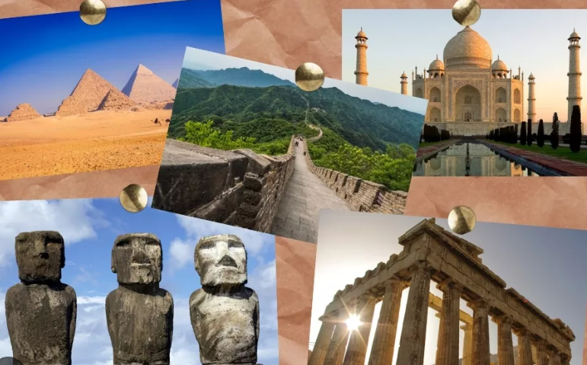
PRE-READING
1
Work in pairs. Ask and answer the questions.
Why do people visit heritage sites?
What can we do at heritage sites?

Slide 6
PRE-READING
appreciate (v)
/əˈpriːʃieɪt/
to recognise the good qualities of somebody/something

Slide 7
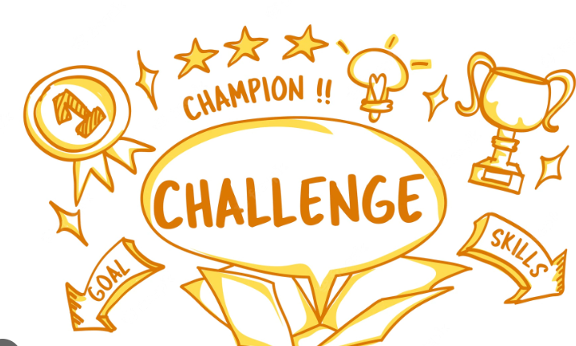
PRE-READING
challenge (n)
/ˈtʃælɪndʒ/
a new or difficult task that tests somebody’s ability and skill

Slide 8
PRE-READING
trending (adj)
/ˈtrendɪŋ/
being discussed a lot on social media

Slide 9
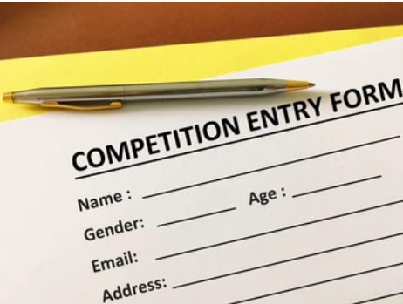
PRE-READING
entry (n)
/ˈentri/
something that you do, write or make to take part in a competition, for example answering a set of questions

Slide 10
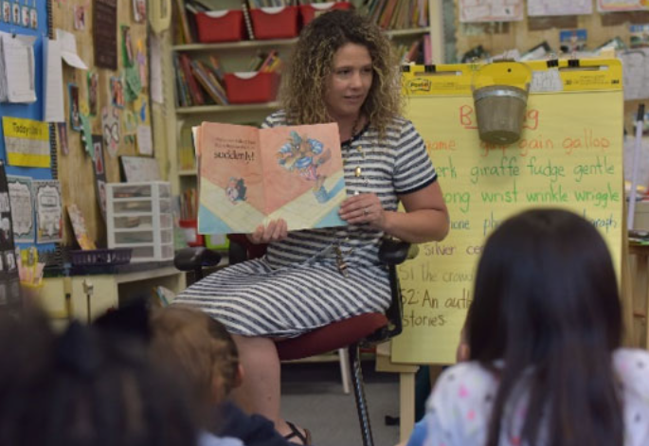
PRE-READING
keen (adj)
/kiːn/
[usually before noun] strong or deep
E.g. She took a keen interest in her daughter’s education.

Slide 11
Form | Pronunciation | Meaning | Vietnamese equivalent
1. appreciate (v) | /əˈpriːʃieɪt/ | to recognise the good qualities of somebody/something | trân trọng
2. challenge (n) | /ˈtʃælɪndʒ/ | a new or difficult task that tests somebody’s ability and skill | thử thách
3. trending (adj) | /ˈtrendɪŋ/ | being discussed a lot on social media | theo xu hướng
4. entry (n) | /ˈentri/ | something that you do, write or make to take part in a competition, for example answering a set of questions | bài dự thi
5. keen (adj) | /kiːn/ | [usually before noun] strong or deep | mạnh mẽ, sâu sắc

Slide 12
WHILE-READING
2
Read the article and circle the correct meanings of the highlighted words and phrases.
1. appreciate A. to recognise the good qualities of something B. to realise that something is dangerous C. to discuss a new idea
2. trending A. being discussed a lot on social media B. being forgotten by the public C. creating and sharing information

Slide 13
WHILE-READING
2
Read the article and circle the correct meanings of the highlighted words and phrases.
3. give voice to A. to take action about something B. to listen to someone’s advice C. to express opinions about something
4. proposed A. asked someone for information B. suggested something as a plan or course of action C. invited guests for an event

Slide 14
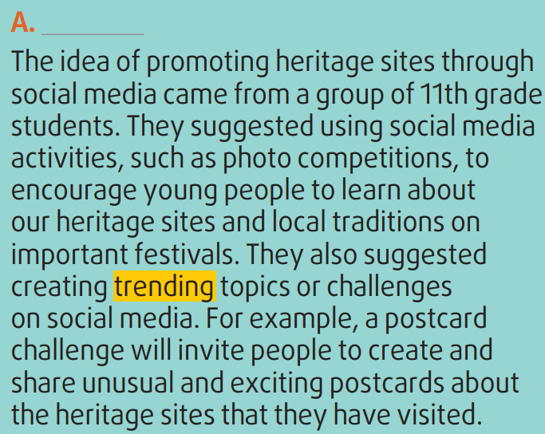
WHILE-READING

Slide 15
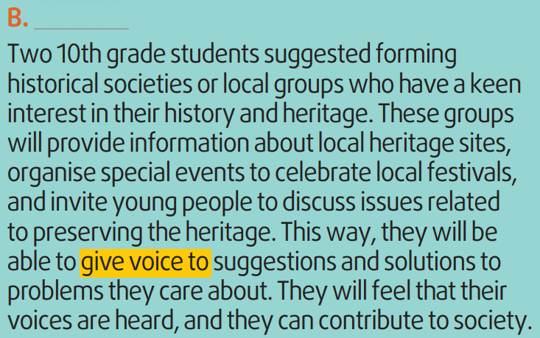
WHILE-READING

Slide 16
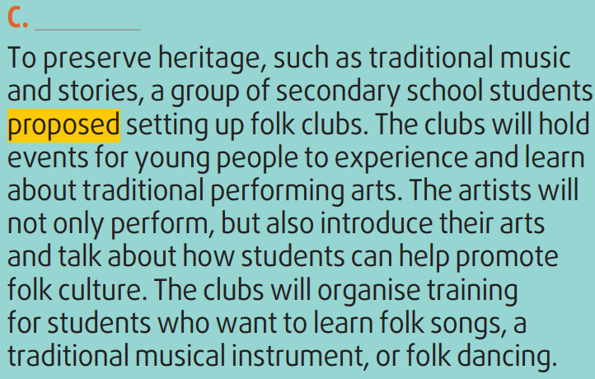
WHILE-READING

Slide 17
WHILE-READING
3
Read the article again. Match the section (A-C) with the heading (1-4) below. There is ONE extra heading.
3. Making use of social media to promote heritage

Slide 18
WHILE-READING
3
Read the article again. Match the section (A-C) with the heading (1-4) below. There is ONE extra heading.
4. Opportunities to learn about heritage and be involved in problem-solving

Slide 19
WHILE-READING
3
Read the article again. Match the section (A-C) with the heading (1-4) below. There is ONE extra heading.
2. Promoting and developing the folk arts

Slide 20
WHILE-READING
4
Read the article again and decide which paragraph includes the following information.
 | Paragraph
Creating popular topics on the Internet such as sharing postcards | A
Raising awareness of preserving our heritage through discussions
Organising photo competitions on social media
Setting up local historical societies to organise festivals and other events
Inviting artists to perform and teach folk singing, dancing, and music
B
A
B
C

Slide 21
POST-READING
5
Discussion

Slide 22
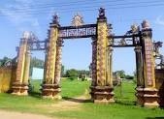
emperor Wall

Slide 23
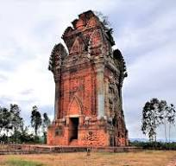
Canh Tien Tower

Slide 24
Phu Loc Tower

Slide 25
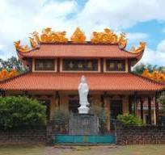
NN
Nhan Son pagoda

Slide 26
Kahoot!

Slide 27
CONSOLIDATION
2
Homework
Do exercises in the workbook.
Prepare for Lesson 4 - Unit 6.

