Slide 2
UNIT 4: ASEAN AND VIETNAM
LESSON 3: READING
ASEAN news
ASEAN news
ASEAN news

Slide 3
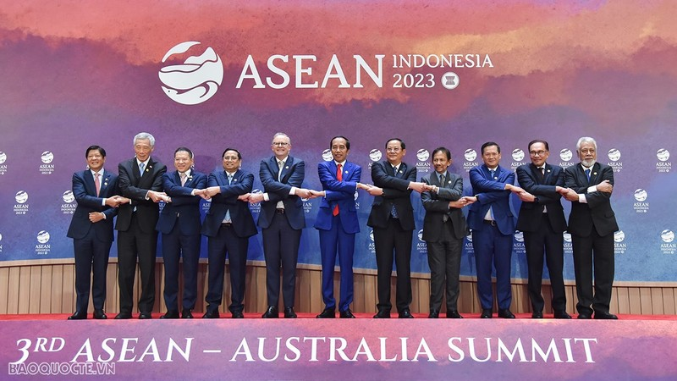
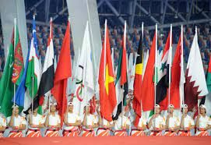
Activity 1: Answer the questions below.

Slide 4
regularly (adv)
/ˈreɡ.jə.lə.li/
Eg: We do exercise regularly to make our health better.

Slide 5
variety (n)
/vəˈraɪ.ə.ti/
There is a large variety of colors here.

Slide 6
journey (n)
/ˈdʒɜː.ni/
a set of experiences that someone has over a period of time
Example: Thank you for being part of my journey.

Slide 7
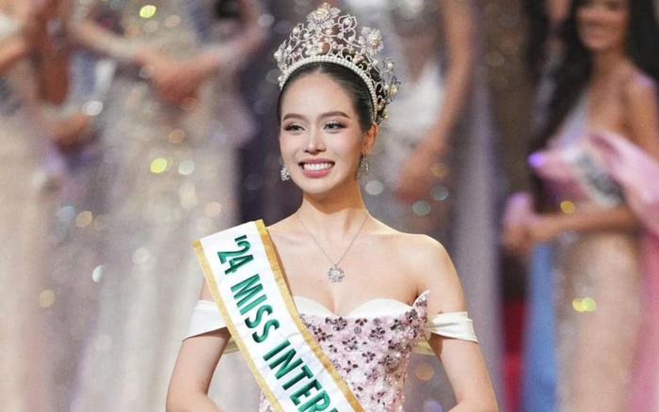
represent (v)
/ˌrep.rɪˈzent/
Thanh Thuy represented Vietman to Miss International 2024.

Slide 8
VOCABULARY
regularly (adv)
/ˈreɡ.jə.lə.li/
variety (n)
/vəˈraɪ.ə.ti/
journey (n)
/ˈdʒɜː.ni/
represent (v)
/ˌrep.rɪˈzent/

Slide 9
Activity 2: Read the news items and choose the most suitable
headline for each one.

Slide 10
Activity 2: Read the news items and choose the most suitable
headline for each one.
1.______________________
A. Don't miss this opportunity to represent your country!
B. Travelling to ASEAN countries
C. Equality in sport for ASEAN women
D. Korean and ASEAN students
E. Volunteers needed to take part in cultural exchanges

Slide 11
Activity 2: Read the news items and choose the most suitable
headline for each one.
2.______________________
A. Don't miss this opportunity to represent your country!
B. Travelling to ASEAN countries
C. Equality in sport for ASEAN women
E. Volunteers needed to take part in cultural exchanges

Slide 12
Activity 2: Read the news items and choose the most suitable
headline for each one.
3. _________________________
B. Travelling to ASEAN countries
C. Equality in sport for ASEAN women
D. Korean and ASEAN students
E. Volunteers needed to take part
in cultural exchanges

Slide 13
Activity 3: Read the news items again and match the highlighted
words with their meanings.

Slide 14
Activity 4: Read the news items again and answer each question below with no more than FOUR words and/or a number.

Slide 15
Activity 4: Read the news items again and answer each question below with no more than FOUR words and/or a number.
1. How many students visited the AKC last week?
→ 121 (students)

Slide 16
Activity 4: Read the news items again and answer each question below with no more than FOUR words and/or a number.
2. How long will SSEAYP participants stay together on board the ship?
→ 50 days

Slide 17
Activity 4: Read the news items again and answer each question below with no more than FOUR words and/or a number.
3. What will participants in SSEAYP discuss besides youth issues?
→ current social issues

Slide 18
Activity 4: Read the news items again and answer each question below with no more than FOUR words and/or a number.
4. When did the ASEAN talk show on women in sport happen?
→ (in) December

Slide 19
Activity 4: Read the news items again and answer each question below with no more than FOUR words and/or a number.
5. Where was the talk show shown live?
→ (on) the ASEAN webpage

Slide 20
Wrap-up
What have you learnt today?
Read for main ideas and specific information in news items about ASEAN countries.
New vocabulary words

Slide 21
Homework
Do exercises in the workbook.
Prepare for Lesson 4 - Unit 4.

