Slide 1
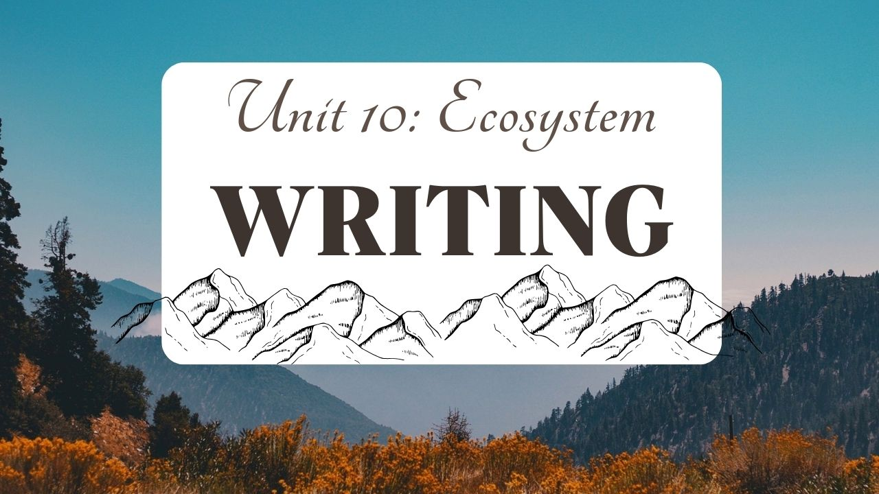

Slide 2
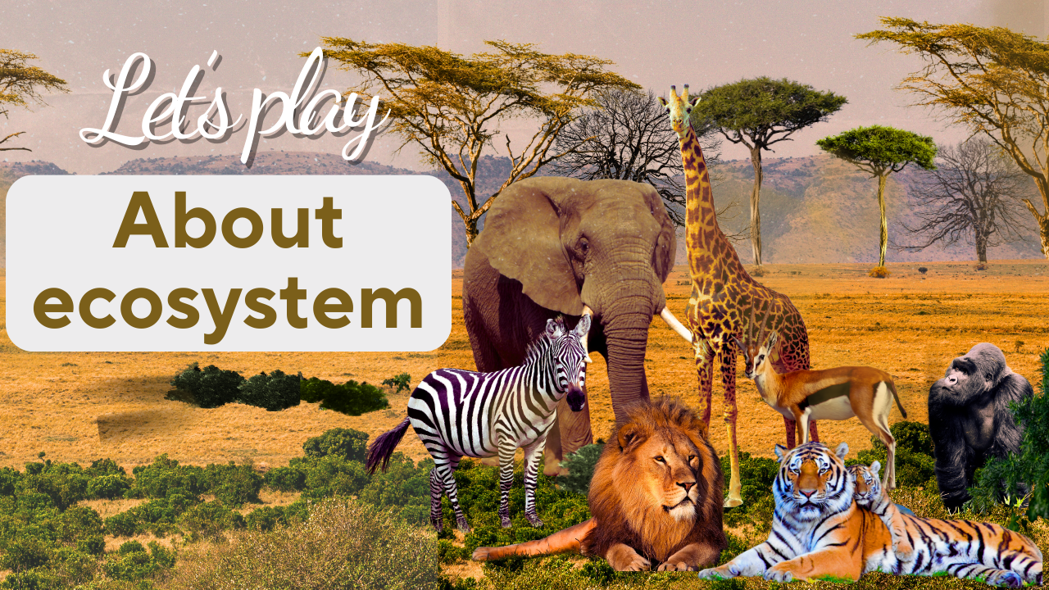

Slide 3
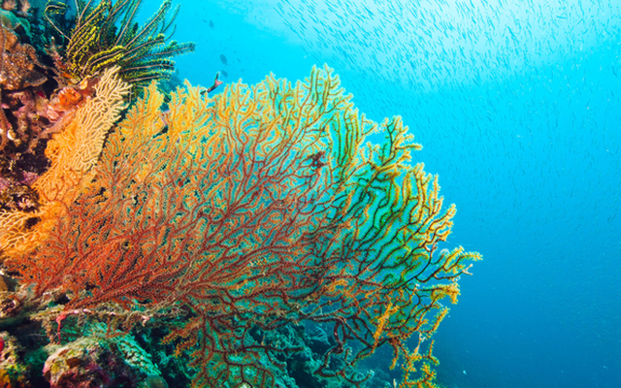
1. A line of hard rock formed by coral found in warm sea water? (9 letters)
CORAL REEF

Slide 4
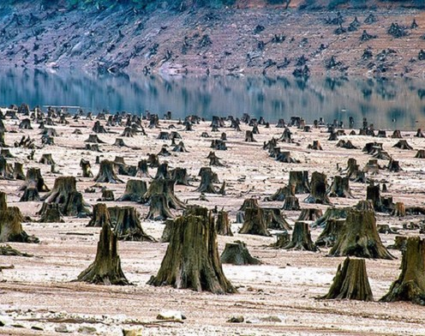
2.To use all of something
(6 letters)
RUN OUT

Slide 5
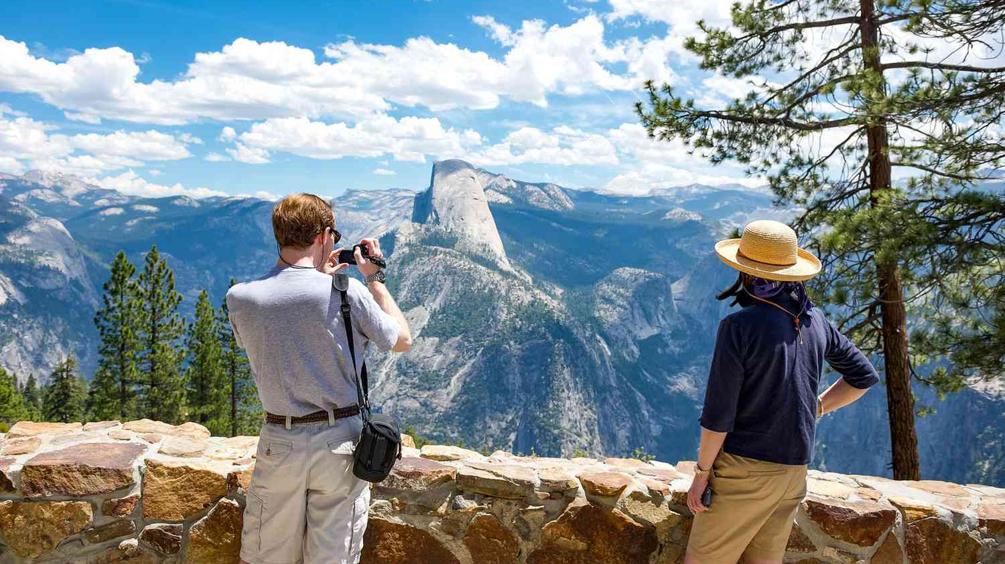
3. U Minh Thuong is unique ______ park (6 letters)
NATIONAL

Slide 6
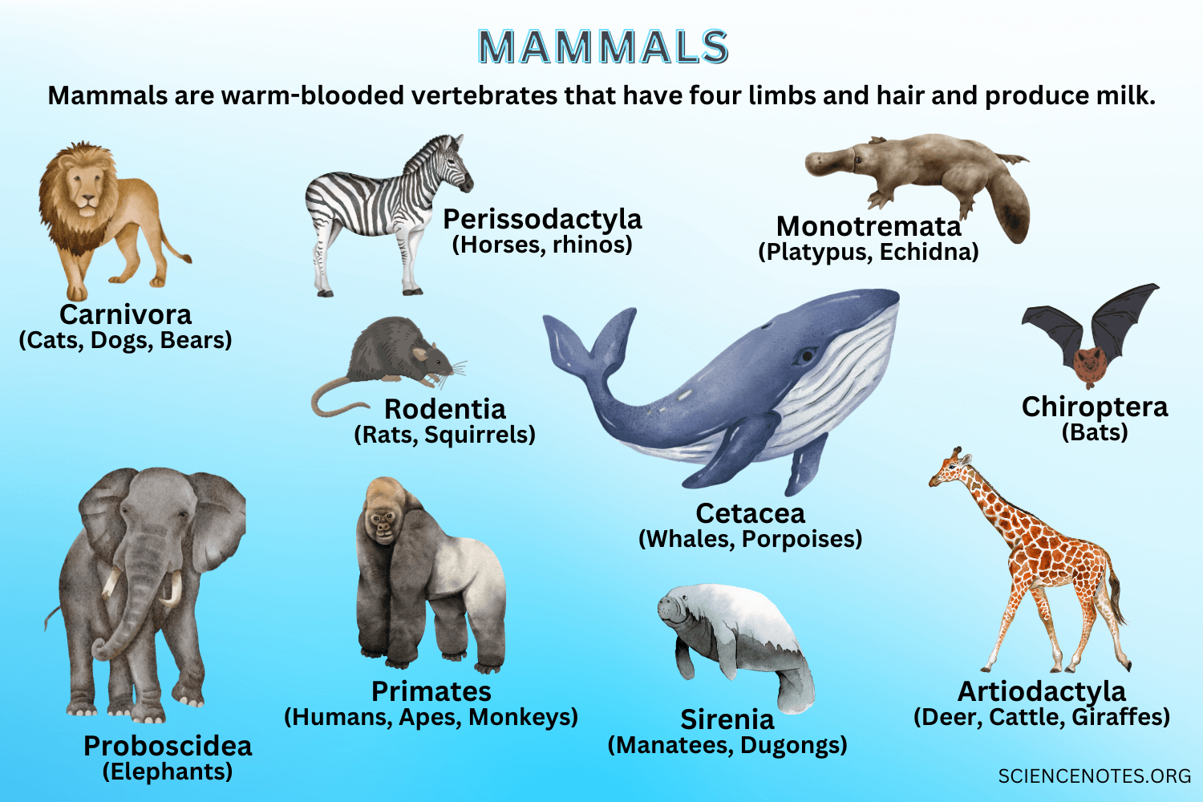
4. Any animal of which the female feeds her young on milk from her own body. They give birth to live young, not eggs? (6 letters)
MAMMAL

Slide 7
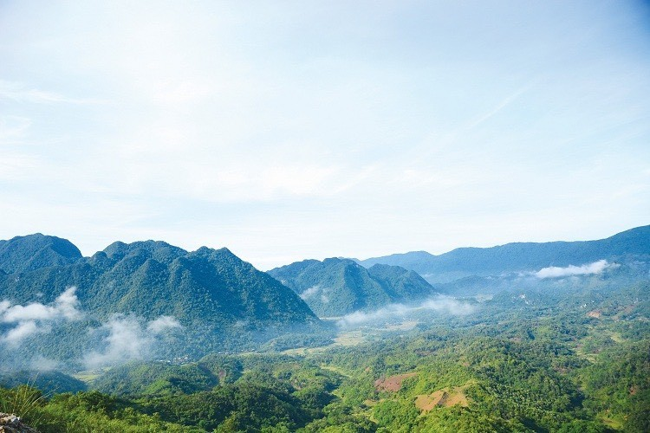
5. People should stop damaging the environment, _______they?
a) SHOULD
b) AREN’T
c) SHOULD’T

Slide 8
5. People should stop damaging the environment, _______they?
b) shouldn’t

Slide 9
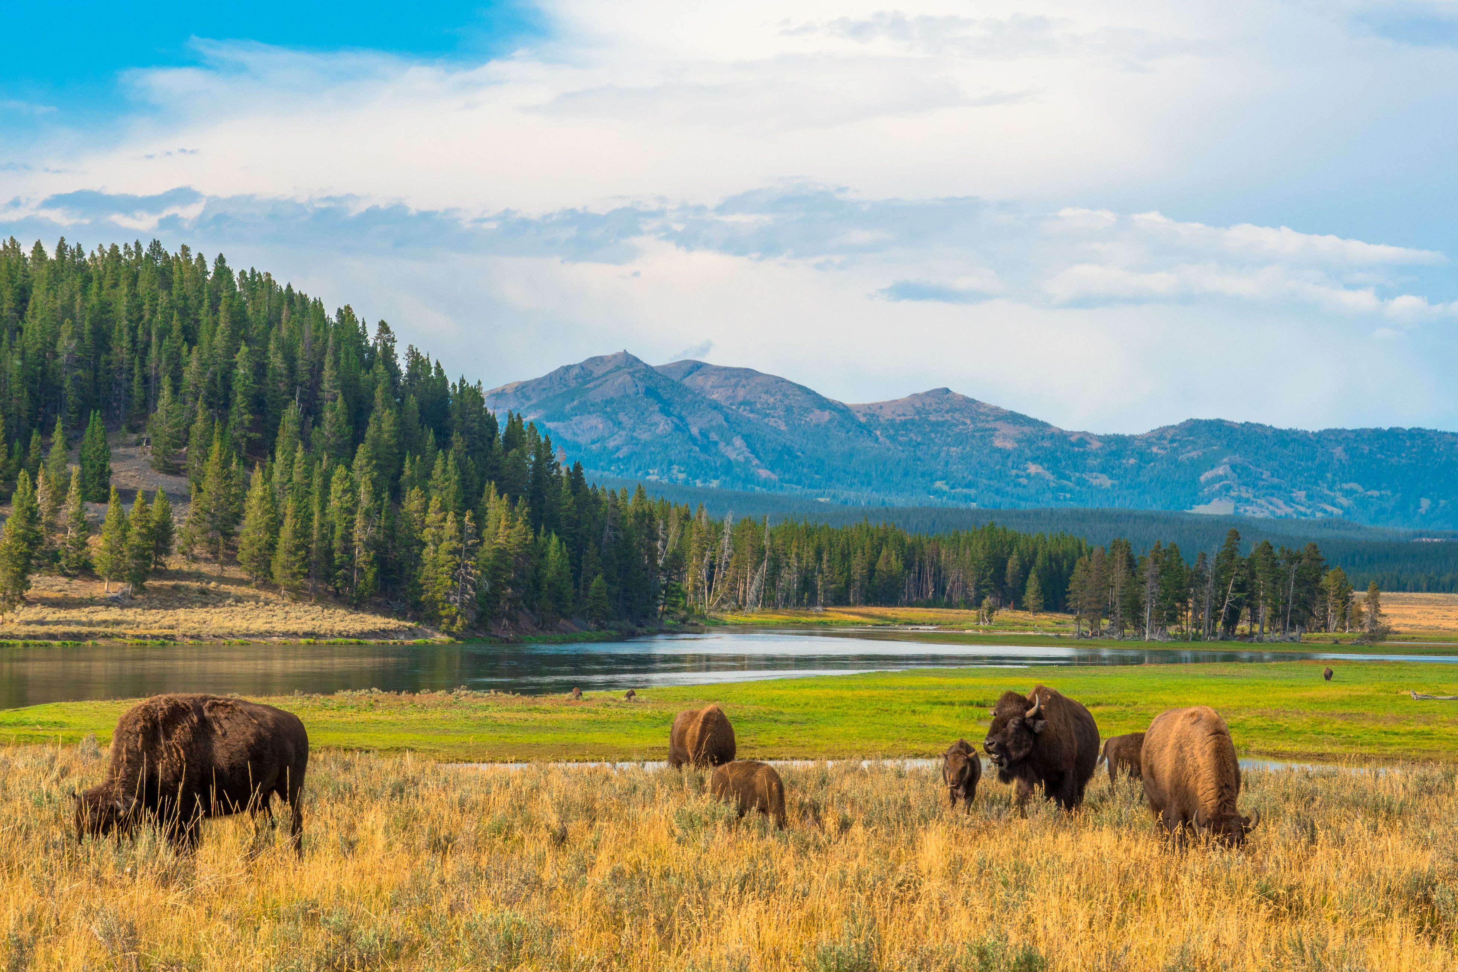
6. ____ is existing naturally in a place
NATIVE

Slide 10
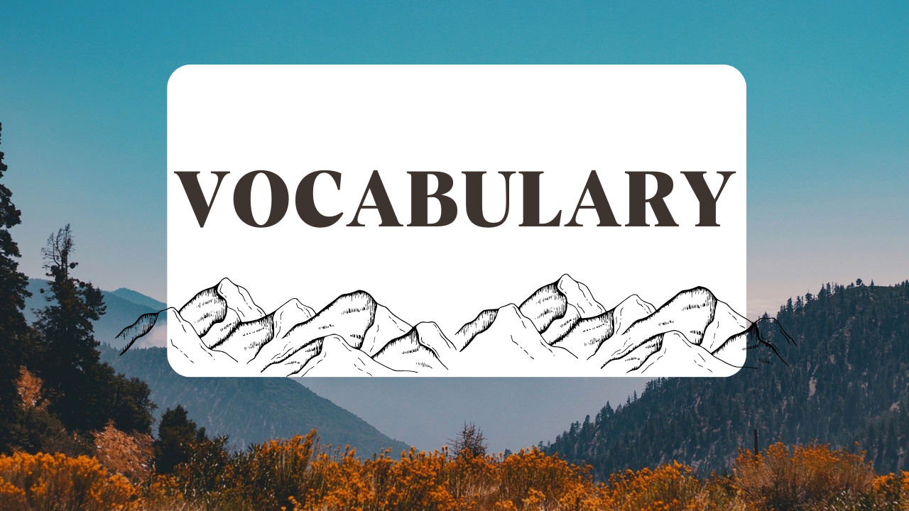

Slide 11


invest (v)
/ˌɪnˈvɛst/
To commit (Money or capital) in order to gain a financial return.

Slide 12
unemployment (n)
/ən.ɪmˈplɔɪ.mənt /
The number of people who do not have a job that provides money

Slide 13
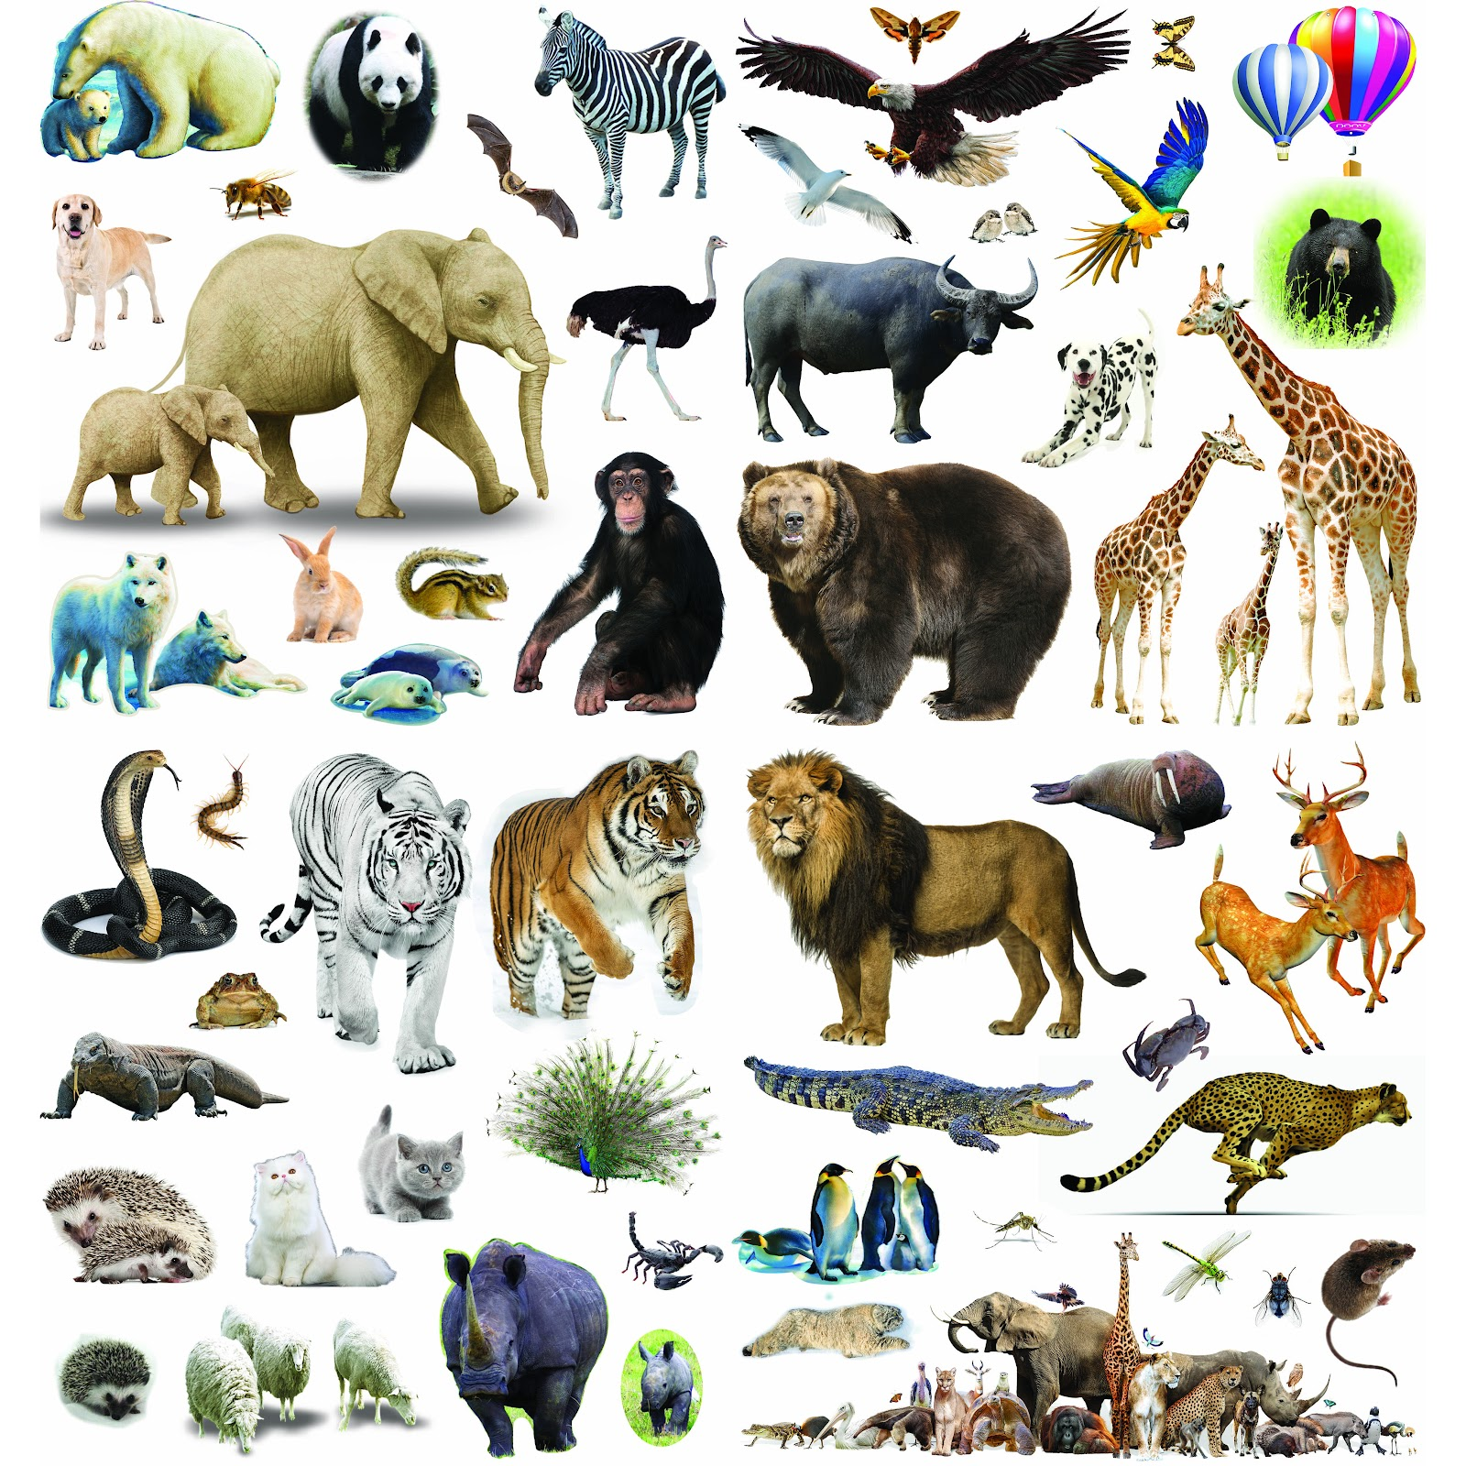
species (n)
/ˈspiʃiz/
A set of animals or plants in which the members have similar characteristics to each other and can breed with each other.

Slide 14
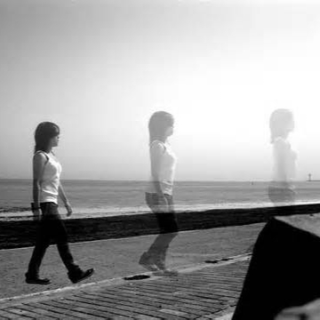
disappear (v)
/ˌdɪsəˈpiɹ/
If people or things disappear, they go somewhere where they cannot be seen or found.

Slide 15

Vocabulary:
-invest (n) /ˌɪnˈvɛst/
-unemployment (n) /ən.ɪmˈplɔɪ.mənt /
-species (n) /ˈspiʃiz/
-disappear (v) /ˌdɪsəˈpiɹ/

Slide 16
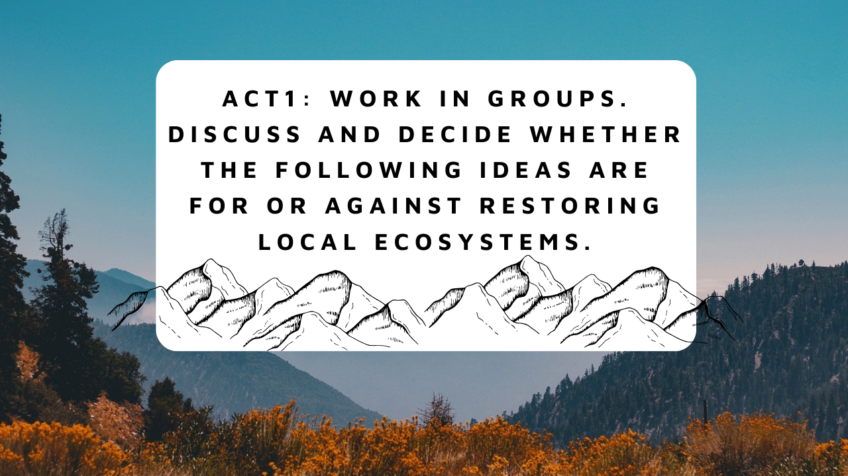

Slide 17
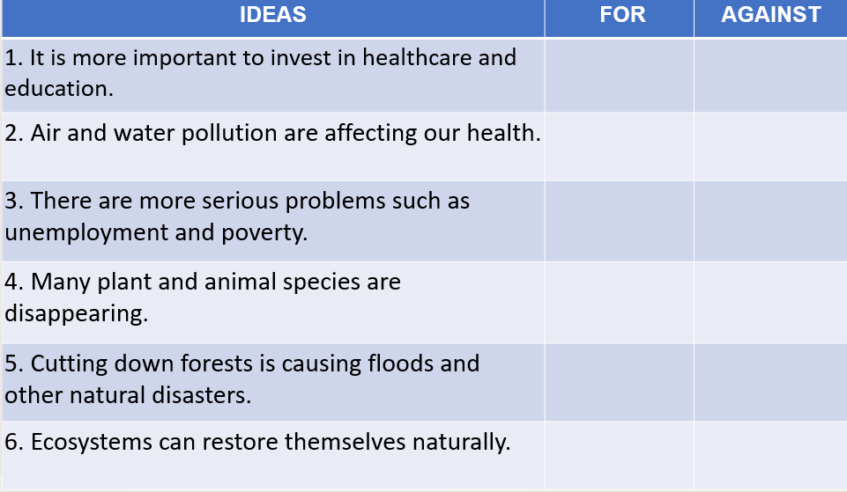
✔
✔
✔
✔
✔
✔

Slide 18


Slide 19
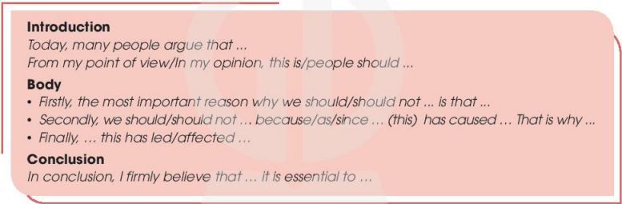

Slide 20
SAMPLE
Today, many people argue that we should spend more money on restoring local ecosystems. From my point of view, people should prioritize restoring local ecosystems as it is crucial for the survival of our planet.
Firstly, the most important reason why we should restore local ecosystems is that they provide numerous benefits to both humans and animals. Ecosystems provide clean air, water, and food which are necessary for our survival. Without healthy ecosystems, we will face numerous problems such as air and water pollution, food scarcity, and natural disasters.
econdly, we should invest in restoring local ecosystems because human activities such as deforestation and pollution have caused serious harm to our planet. These activities have led to the loss of biodiversity, soil erosion, and climate change. By restoring local ecosystems, we can help reverse some of these negative effects and preserve our planet for future generations.
Finally, neglecting the restoration of local ecosystems has led to the extinction of many species and the loss of habitats for others. It has also affected the lives and livelihoods of people who depend on natural resources for their survival.
In conclusion, I firmly believe that we should invest more money in restoring local ecosystems. It is essential for the survival of our planet, and it will provide numerous benefits to both humans and animals. By doing so, we can create a sustainable future for ourselves and the generations to come.

