Slide 1
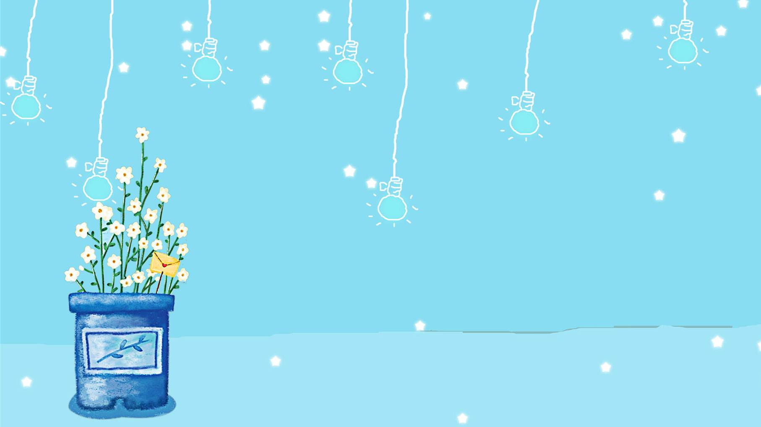
WELCOME TO
OUR CLASS!

Slide 2
Look at the picture and answer some questions.
1. How does the activity help the environment?
2. What things do you do that help the environment?

Slide 3
Unit 4: Global warming
Lesson 2.1: Vocab. & Reading
Pages: 40 & 41

Slide 4
A. Vocabulary

Slide 5
prohibit(v) = ban (v)
Government should prohibit people from cutting down trees.

Slide 6
tax (n)
Government should increase the tax on gas.

Slide 7
sustainable (adj)
Wind and solar power are sustainable kinds of energy.

Slide 8
switch (v) = change(v)
We should switch from fossil fuels to sustainable kinds of energy.

Slide 9
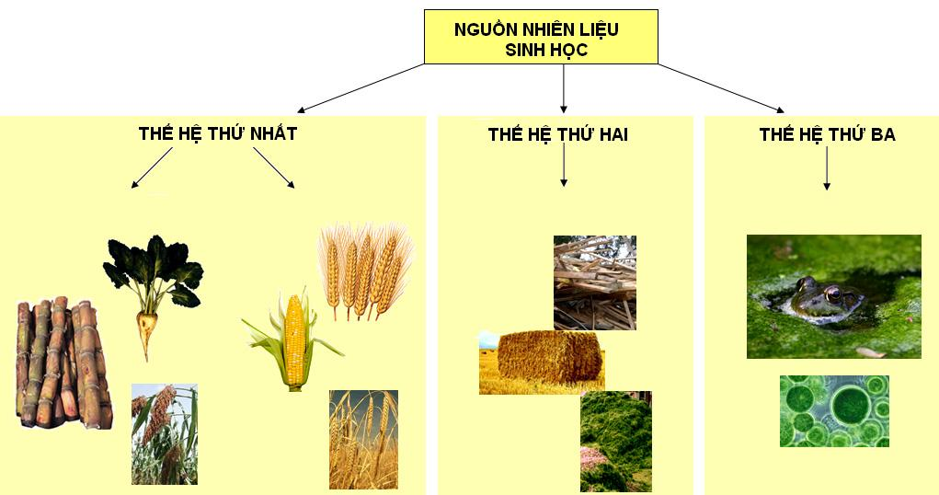
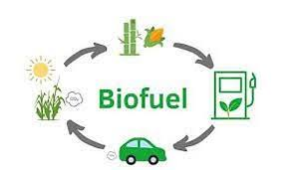
biofuel (n)

Slide 10
consume (v) = use(v)
We should consume biofuels instead of fossil fuels.

Slide 11
Listen and repeat. Click each word to hear the sound.
Practice saying these words with a partner.
biofuel (n) /ˈbaɪəʊfjuːəl/ nhiên liệu sinh học
consume(v) /kənˈsuːm/ tiêu thụ
prohibit (v) /prəˈhɪbɪt/ (prəʊˈhɪbɪt) cấm
sustainable (adj) /səˈsteɪnəbl/ bền vững
switch (v) /swɪtʃ/ chuyển, thay đổi
tax (n) /tæks/ thuế
Notes:
GV click vào từng cụm nghe âm thanh

Slide 12
a. Match the underlined words with the definitions
1. Governments should prohibit farmers from destroying forests to step deforestation. | a. Use something, usually in large amounts
2. We can switch from oil to solar power. | b. Energy made from living things
3. Governments should increase the tax on gas to make it more expensive. | c. Part of the money that we earn or spend, which goes to the government
4. Biofuels are much cleaner than fossil fuels. | d. Stop something by using a rule or law
5. If we continue to consume fossil fuels, global warming will get worse. | e. Change to something different
6. Wind and solar energy are more sustainable than fossil fuels. | f. Using natural products and energy that doesn’t damage the environment

Slide 13
b. Talk about things that can be done to help the environment where you live.
-plant trees
-stop using plastic bags
-consume biofuels instead of fossil fuels.
-switch from fossil fuels to sustainable kinds of energy.

Slide 14
B. Reading

Slide 15
a. Read the magazine article and circle the main idea.
1. the effects of global warming
2. ways to stop global warming

Slide 16
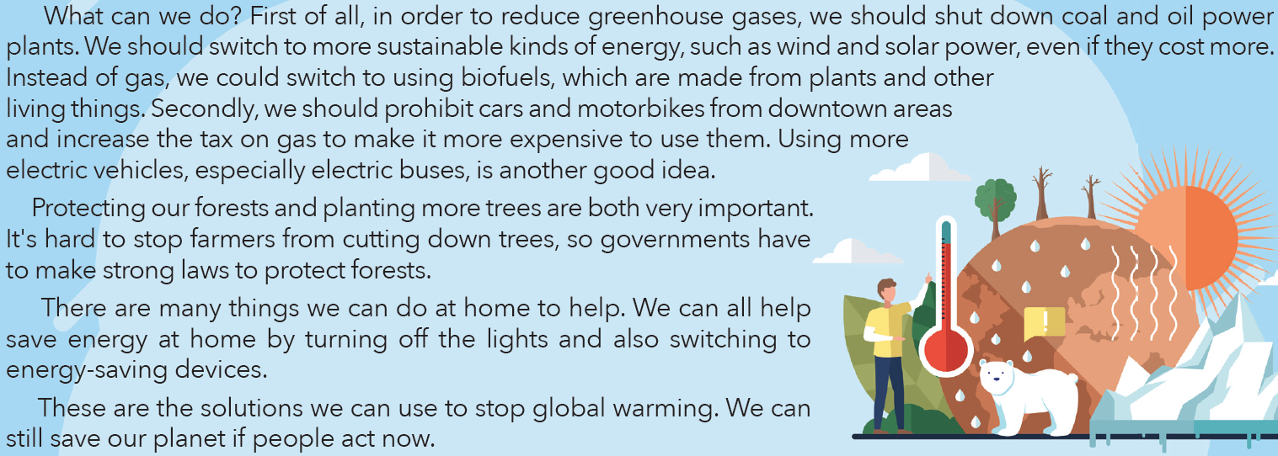
a. Read the magazine article and circle the main idea.
1. the effects of global warming 2. ways to stop global warming

Slide 17
b. Now, read and answer the questions.
According to the article,………
1.What creates sulfur dioxide?
2. The word “ consume” in paragraph 1 is closest in meaning to……………….
a. eat b. use c. destroy
3.What could we replace gas with?
4. What should we stop using in the busy parts of towns?
5. How can people save energy at home?

Slide 18
Game: Secret in the ball
Question

Slide 19
Rule:
Choose a ball which has your question in it.
Have 5s to give your group’s answer.
Get 10 points for one correct answer.
Get 10 or 20 points without answering any questions if you choose lucky ball.

Slide 20
Game: “Secret in the ball”
1
2
3
4
5
6
7
8
9
Choose a ball

Slide 21
Question 1
1.What creates sulfur dioxide?
→Burning fossil fuels
2
1
4
3
0
5
Time up
Time
Open
Shoot

Slide 22
Question 2
2. The word “ consume” in paragraph 1 is closest in meaning to……………….
a. eat b. use c. destroy
2
1
4
3
0
5
Time up
Time
b. use
Open
Shoot

Slide 23
Question 3
What could we replace gas with?
2
1
4
3
0
5
Time up
biofuels
Time
Open
Shoot

Slide 24
Question 4
What should we stop using in the busy parts of towns?
2
1
4
3
0
5
Time up
cars and motorbikes
Time
Open
Shoot

Slide 25
Question 5
A lucky ball
10 points
Open
Shoot

Slide 26
Question 6
How can people save energy at home?
By turning off the lights and switching to energy-saving devices.
2
1
4
3
0
5
Time up
Time
Open
Shoot

Slide 27
Question 7
2
1
4
3
0
5
Time up
Time
A lucky ball
20 points
Open
Shoot

Slide 28
Question 8
A lucky ball
20 points
Open
Shoot

Slide 29
Question 9
2
1
4
3
0
5
Time up
Time
A lucky ball
20 points
Open
Shoot

Slide 30
b. Now, read and answer the questions.
1. Burning fossil fuels
2. b. use
3. Biofuels
4. Cars and motorbikes
5. By turning off the lights and switching to energy-saving devices.

Slide 31
c. Do you remember to switch off the lights? How else do you save electricity?
E.g:
- I always/ often remember to switch off the lights before leaving the house or when not in use.
- I think that to save electricity, we should
+turn off the lights, electronic devices when I don’t use them.
+ switch to energy-saving LED lights
+ understand and improve your home’s energy use.
+ …………………………..

Slide 32
Homework
Learn by hearts vocabularies and make sentences using them.
Do the exercises on page 22 WB.
Prepare the next lesson (pages 41 & 42 SB)
Play the consolidation games on www.eduhome.com.vn

