Slide 1
Unit 4: Global warming
Lesson 2.1: Vocab. & Reading
Pages: 40 & 41

Slide 2
WARM UP

Slide 4
Pre-Reading Vocabulary

Slide 5
Listen and repeat. Click each word to hear the sound.
Practice saying these words with a partner.
biofuel (n) /ˈbaɪəʊfjuːəl/
nhiên liệu sinh học
consume(v) /kənˈsuːm/
tiêu thụ
prohibit (v) /prəˈhɪbɪt/ (prəʊˈhɪbɪt)
cấm
sustainable (adj) /səˈsteɪnəbl/
bền vững
switch (v) /swɪtʃ/
chuyển, thay đổi
tax (n) /tæks/
thuế
Notes:
GV click vào từng cụm nghe âm thanh

Slide 6
1. Governments should prohibit farmers from destroying forests to step deforestation. | a. Use something, usually in large amounts
2. We can switch from oil to solar power. | b. Energy made from living things
3. Governments should increase the tax on gas to make it more expensive. | c. Part of the money that we earn or spend, which goes to the government
4. Biofuels are much cleaner than fossil fuels. | d. Stop something by using a rule or law
5. If we continue consume fossil fuels, global warming will get worse. | e. Change to something different
6. Wind and solar energy are more sustainable than fossil fuels. | f. Using natural products and energy that doesn’t damage the environment

Slide 7
b. In pairs: talk about things that can be done to help the environment where you live.
-plant trees
-stop using plastic bags

Slide 8
Reading

Slide 9
Read & underline the key words.
Pre-reading

Slide 10
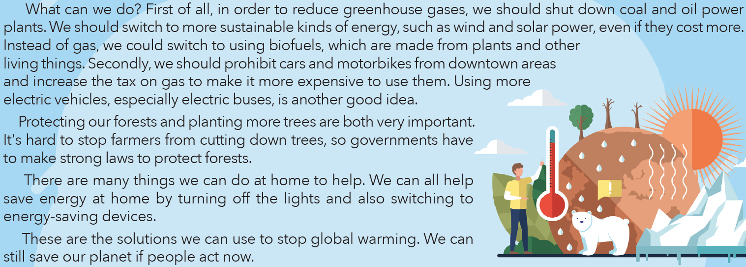

Slide 11
While-reading
Read & answer the questions
➔Burning fossil fuels (line 3-P1)
➔Biofuels ( line 3- P2)
➔cars and motorbikes (line 4-P2)
➔by turning off the lights and switching to energy-saving devices (line 2-P4)

Slide 12
Post-reading
c. In pairs: do you remember to switch off the lights? How else do you save electricity?
Example: Yes, I do. I always/ often remember to switch off the lights when I go out.
I think that to save electricity, I turn off the lights, electronic devices when I don’t use them.

Slide 13
CONSOLIDATION

Slide 14
WRAP-UP

Slide 15
Playing game
Vocabularies
biofuel, consume, law, natural, prohibit, remove, sustainable, switch, tax

Slide 16
Playing game

Slide 17
Today’s lesson
Vocabularies
biofuel, consume, law, natural, prohibit, remove, sustainable, switch, tax

Slide 18
Today’s lesson
Reading:
- Understanding instructions.
Skimming and scanning for general and specific information.
Speaking:
- Talking about ways to stop global warming.

Slide 19
Homework
Learn by hearts vocabularies and make sentences using them.
Do the exercises on page 22 WB.
Prepare the next lesson (pages 41 & 42 SB)
Play the consolidation games on www.eduhome.com.vn

Slide 20
Lesson 3
Stay positive and have a nice day!

