Slide 1
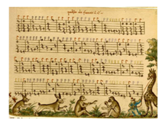
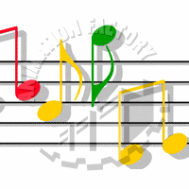

Slide 2
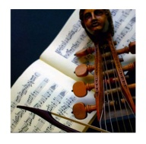
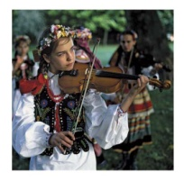
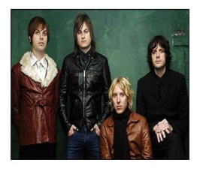
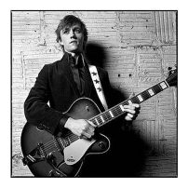
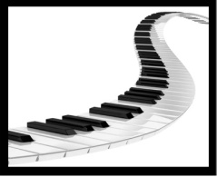
A
Listen
to
the
music
and
Match
A form of entertainment
B
C
D
E

Slide 3
UNIT 2: ENTERTAINMENT & LEISURE
Lesson 1.1 – Vocabulary & Reading
Page 12

Slide 4
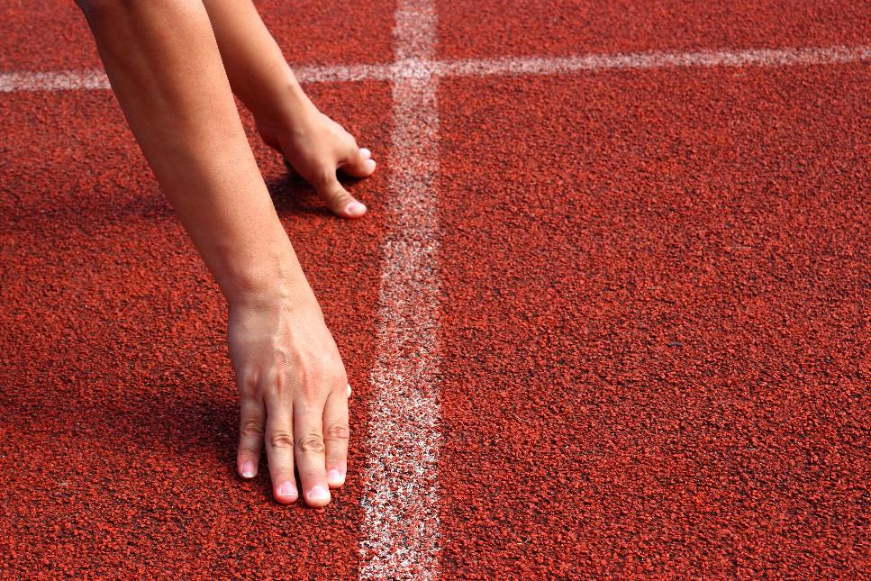

Slide 5
Work in pairs.
What do you do on the weekends? Do you have a lot of free time?

Slide 7
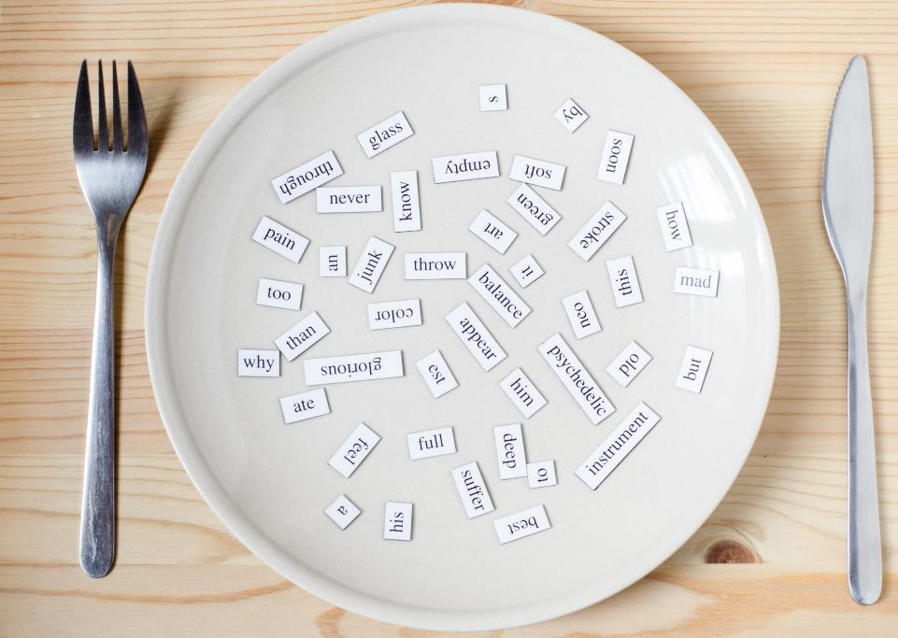
New words
do karate
go for a bike ride
go canoeing
do crossword puzzles
play role-playing games
go running do aerobics
hang out with friends

Slide 8

1. do karate 3. go for a bike ride 5. go canoeing 7. do crossword puzzles
2. play role-playing games 4. go running 6. do aerobics 8. hang out with friends
8
1
2
6
4
3
7
5

Slide 9
Listen and repeat.
do karate (v phr) / duː kəˈrɑːti / tập võ karate

play role-playing games (v phr)/ pleɪ ˈroʊl pleɪɪŋ ɡeɪmz / chơi trò chơi nhập vai

go for a bike ride (v phr) / goʊ fɔːr ə baɪk raid / chạy xe đạp

go running (v phr) / goʊ ˈrʌnɪŋ/ chạy bộ

go canoeing (v phr) / goʊ kəˈnuːɪŋ / chèo xuồng

do aerobics (v phr) / duː eˈroʊbɪks / tập thể dục nhịp điệu

do crossword puzzles (v phr) / duː ˈkrɔːswɜːrd ˈpʌzlz / chơi ô chữ

hang out with friends (v phr) / hæŋ aʊt wɪð frendz / đi chơi với bạn


Slide 12
Pre- reading
What is the title of the passage?
→ Over to you
What are the highlighted words in the passage?
→ leisure, clue
Listen and repeat
leisure (n) / ˈliːʒər / thời gian rảnh
clue (n) / kluː / manh mối

Slide 13
While- reading
✓
_____________________________

Slide 14
While- reading
b. Now, read and answer the questions.
1. What sport does Huy do on a team?
2. What activities does Huy say are boring?
3. What activities does Như do twice a week?
4. What activity does Như do with her dad?

Slide 15
1. What sport does Huy do on a team? ____________________
2. What activities does Huy say are boring? ________________
karate
running and playing board games
I really like doing sports. My favorite sport is karate. I love doing karate. I'm a member of a club, and I'm on the high school team, too. At home, I enjoy doing crossword puzzles. My mom does a crossword every day, and we sometimes do it together. I like solving the clues before she can. I really like playing soccer with my friends, but I don't like just running. Running by yourself is just so boring! The other members of my family love playing board games, but I think that's boring, too. I think playing video games is much more fun.

Slide 16
3. What activities does Như do twice a week? __________________
4. What activity does Như do with her dad? ___________________
playing role-playing games and going to an aerobics class
going for a bike ride
I enjoy doing aerobics. I go to an aerobics class on Mondays and Thursdays. A few of my friends go to the class, too. I also like playing role-playing games with my friends once or twice a week. Role-playing games are so cool! My dad loves going for a bike ride. Sometimes I go with him. He likes going fishing, too. I really don't like going fishing because there's nothing to do but sit there.

Slide 17
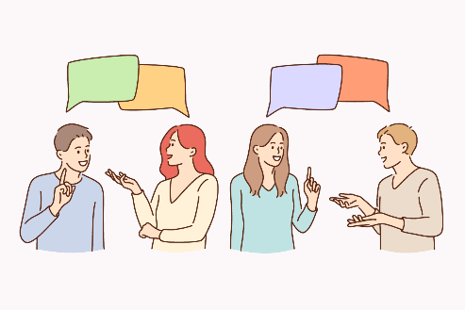
Post- reading
c. In pairs:
Do you prefer playing games and doing puzzles at home, or going outside to play sports? Why?

Slide 18
Consolidation

Slide 19
Today’s lesson
Wrap-up
Vocabulary: about leisure activities.
Reading: for a gist and specific information.
Speaking: about leisure activities.

Slide 20
Finish the Reading exercise on pages 8 & 9, WB.
Do the exercises in Tiếng Anh 10 i-Learn Smart World Notebook on page 8.
Prepare the next lesson on page 13, SB.
Play the consolidation games in Tiếng Anh 10 i-Learn Smart World DHA App on www.eduhome.com.vn

Slide 21
Have a nice day!

Slide 25
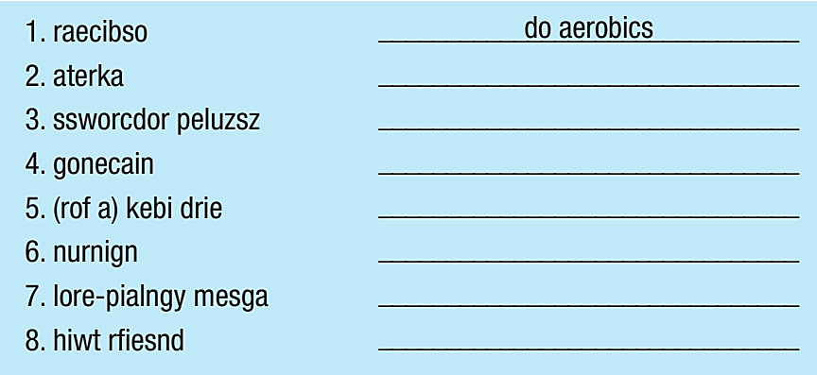
Extra Practice, WB page 8.
do karate
do crossword puzzles
go canoeing
go for a bike ride
go running
play role-playing games
hang out with friends

Slide 26
Extra Practice, WB page 8.
aerobics
1. My brother started doing ____________ last week. He likes the music and the fast movements. 2. I used to hang out _____________ every weekend when we lived near a park. We had picnics and chatted for hours. 3. Katie started doing ____________ when she was eight. Doing martial arts helps her become stronger and more confident. 4. The first thing my dad does when he gets the newspaper is solving the ____________. 5. _____________________ can be difficult for new players. You have to use your imagination, and it isn't easy to come up with a good story right away. 6. My mom and I sometimes go ____________ on the weekends at a lake. The water is beautiful. 7. My soccer coach wants me to go ____________ every day. He says it will make my legs and heart stronger. 8. I like to go ______________ on the weekends. My dad bought me a new bike, so I can ride it to school, too.
with friends
karate
crossword puzzles
Role-playing games
canoeing
running
for a bike ride

