Slide 1

UNIT 1: FAMILY LIFE
Lesson 2.2 – Grammar
Page 8

Slide 2



Lesson .
LESSSON OUTLINE
Consolidation

Slide 3

By the end of this lesson,
students will be able to:
use because and so to give a reason or a result .
talk about a person’s personality.
write about a family member or a friend.

Slide 4



Slide 5
a. Match the words with their definitions.
(Click on  to see the answers)
kind unreliable easygoing untidy
helpful selfish lazy intelligent
Which word means “__”?
“Selfish” means “__”.
helpful
☞
________________ “happy to do things for other people”
________________ “not wanting to do work or be active” ________________ “thinking about themselves more than other people”
________________ “not doing what they say they will do”
________________ “good at learning and understanding things”
________________ “not keeping their things clean and tidy”
________________ “relaxed and happy, not worried or angry”
________________ “friendly and generous”
lazy
☞
selfish
☞
unreliable
☞
intelligent
☞
untidy
☞
easygoing
☞
kind
☞

Slide 6



Slide 7

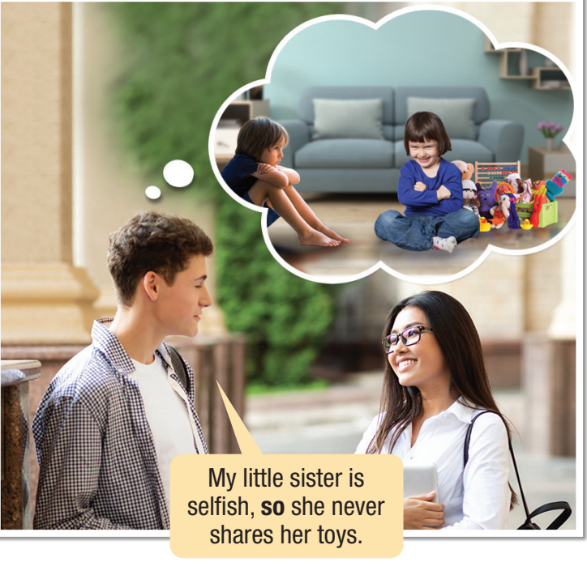

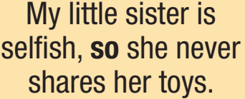



Slide 8

because + a reason
so + a result
Look and read the sentences:
Meaning and Use
We use because to give a reason .
She always helps other people because she is kind.
We use so to talk about a result .
She is kind, so she always helps other people.
I missed the bus because I woke up late.
My brother knows many things because he reads a lot.
I woke up late, so I missed the bus.
My brother reads a lot, so he knows many things.
I missed the bus because I woke up late.
My brother knows many things because he reads a lot.
I woke up late, so I missed the bus.
My brother reads a lot, so he knows many things.
Note:
If so connects two clauses, we put a comma (,) before it.

Slide 9



Slide 10

b. Write sentences using the prompts.
1. My brother/intelligent/so/I/always/ask/him/help/my/homework.
_______________________________________________________
2. My cousin/bedroom/untidy/because/he/never/put away/clothes.
_______________________________________________________
3. My sister/lazy/so/she/not do/her/chores.
_______________________________________________________
4. My aunt/help/feed/poor/people/because/she/kind.
_______________________________________________________
5. My uncle/easygoing/so/I/like/spend time/him.
_______________________________________________________
My brother is intelligent, so I always ask him to help with my homework.
My cousin’s bedroom is untidy because he never puts away his clothes.
My sister is lazy, so she doesn’t do her chores.
My aunt helps feed poor people because she is kind.
My uncle is easygoing, so I like spending time with him.

Slide 11

c. Fill in the blanks with , so or because.
1. I was really tired last night ____________ I went to bed early.
2. My mother helps poor children around the world ____________ she is kind.
3. My dad is easygoing ____________ I like to be around him.
4. My sister doesn’t help with the household chores ____________ she is lazy.
5. My brother doesn’t like sharing things ____________ he is selfish.
, so
because
, so
because
because

Slide 12
WB, page 5
c. Fill in the blanks with , so or because.
because
1. I think she's very intelligent __________________ she likes to learn new things and she understands them very quickly.
2. A lot of people like talking to my mom __________________ she is very easygoing. She's funny, too!
3. My brother is lazy and untidy __________________ his room is always a mess.
4. My friend is unreliable. He's always late and he never calls __________________ I don't make plans to meet him anymore.
5. When he's upset, he listens to music __________________ he can feel better.
6. He doesn't do his homework __________________ he is lazy.
because
, so
, so
, so
because

Slide 13
WB, page 15
b. Finish the sentences using your own ideas.
I often do chores at home to help out my
mom and dad.
1. I am helpful, so ______________________________________ _____________________________________________________
2. I think he is selfish and unreliable because _____________________________________________________
3. I think it's good to have a hobby, so ______________________ _____________________________________________________
4. My friend passes all his tests because ____________________ _____________________________________________________
5. My sister spends too much time watching TV, so____________ _____________________________________________________
6. All my family likes hiking, so ____________________________ _____________________________________________________

Slide 14

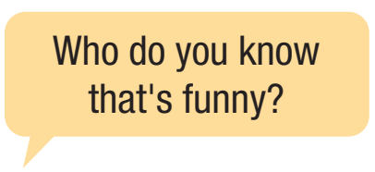
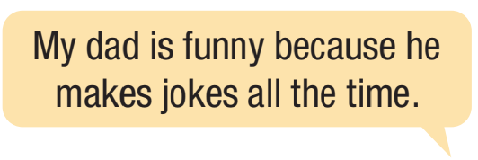
d. In pairs: Tell your partner about a person you know.
Describe his/her personality, and say why you think so.

Slide 15

Consolidation

Slide 16


Extra Practice, WB page 5.
Choose two people from your family or friends and write about them. Use the new words in this lesson and your own ideas. Write 100 to 120 words.

Slide 17
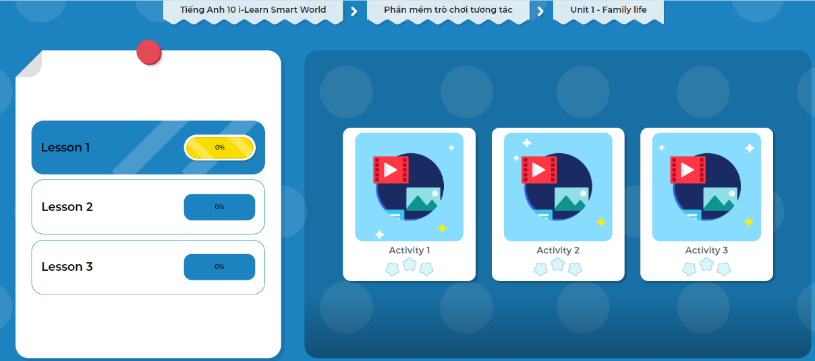
Click the picture below to play the games.

Slide 18
Today’s lesson
Wrap-up
Grammar: using because to give a reason, and so to give a result.
Speaking: talking about a person you know.
Writing: writing about a family member or a friend.

Slide 19

Complete the grammar notes in Tiếng Anh 10 i-Learn Smart World Notebook on page 5.
Do the exercises in WB, page 5.
Prepare the next lesson on page 9, SB.
Play the consolidation games in Tiếng Anh 10 i-Learn Smart World DHA App on www.eduhome.com.vn

Slide 20

Have a nice day!

