Slide 1

UNIT 4: INTERNATIONAL ORGANIZATIONS AND CHARITIES
Lesson 2.2 – Grammar
Page 34

Slide 2


Lesson 2.2
LESSON OUTLINE
Consolidation

Slide 3

By the end of this lesson,
students will be able to …
practice and use The Present Perfect Tense correctly.

Slide 4



Slide 5
Quiz “What does … stand for?”
WHO
World Health Organization
UN
United Nations
ASEAN
Association Of South East Asian Nations
UNESCO
United Nations Education Scientific & Cultural Organization

Slide 6

PRESENTATION
The Present Perfect Tense

Slide 7
Lead in:
They study English.
They started studying English in 2019.
They have studied English since 2019.
They have studied English for 3 years.
He is a famous writer.
He has written 5 best-selling novels so far.
THE PRESENT PERFECT TENSE

Slide 8
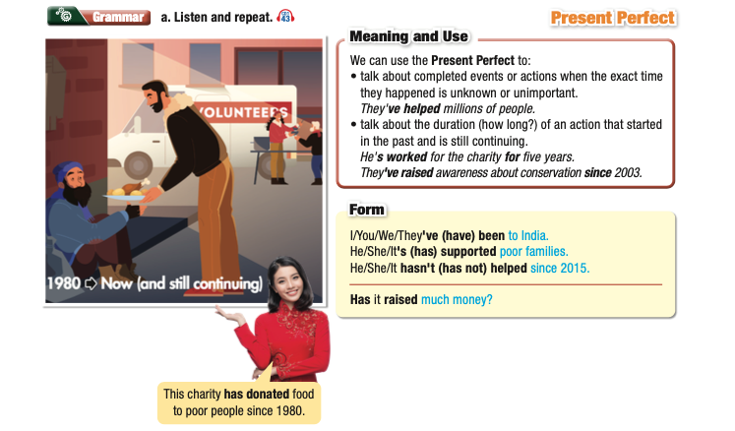


Slide 9
THE PRESENT PERFECT TENSE
(+) | S + have/has + PP
(-) | S + haven’t/ hasn’t + PP
(?) | (Wh) + have/has + S + PP ?
Note:
PP = Past Participle ( V3 or V-ed)
I/ You/ We/ They/ Plural N + have
He/ She/ It/ Singular N + has

Slide 10
THE PRESENT PERFECT TENSE
1. The present perfect tense is used to talk about completed events or actions when the exact time they happened is unknown or unimportant.
Ex: They've helped millions of people.
I (read) ______________ that books many times.
She (already have) ______________ breakfast this morning.
Common words or phrases:
already, yet, several times, many times, ever, never, just
have read
has already had

Slide 11
THE PRESENT PERFECT TENSE
2. The present perfect tense is used to talk about the duration (how long?) of an action that started in the past and is still continuing.
Ex: He's worked for the charity for five years.
They've raised awareness about conservation since 2003.
I (know) ______________ my best friend for a long time.
He (check) ______________ his email since nine o’clock.
Common words or phrases:
since + a point in time (since 2010, since July, since I was born, etc.)
for + duration (for 2 years, for a minute, for a long time, etc.)
have known
has checked

Slide 12

PRACTICE

Slide 13
b. Circle the correct words:
1. How long have/has it supported people to find better jobs?
2. It has/have raised awareness about animal rights in 20 countries.
3. It has donated food to poor families for/since 1992.
4. How long has it been/being interested in conservation?
5. It's organize/organized a lot of events recently.
6. The aim of the charity for/since the last three years has been to raise awareness about environmental problems.

Slide 14
c. Write sentences using the prompts and the Present Perfect.
1. How long/it/support/poor children?
___________________________________________________________
2. It/help/raise awareness/2010.
___________________________________________________________
3. What/else/it/do?
___________________________________________________________
4. Company/donate/a lot of money/support/conservation.
___________________________________________________________
5. It/provide/food/homeless people/70 years.
___________________________________________________________
How long has it supported poor children?
It has helped to raise awareness since 2010.
What else has it done?
The company has donated a lot of money to support conservation.
It has provided food to homeless people for 70 years.

Slide 15

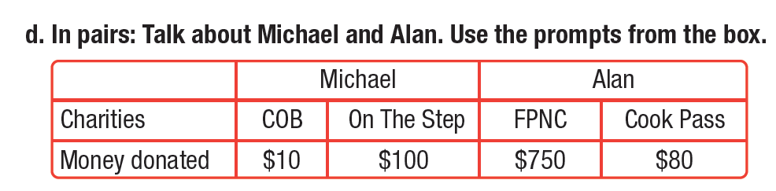
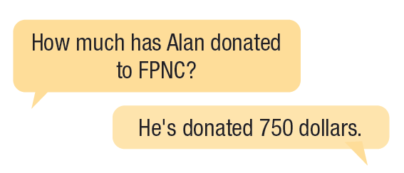
Work in pairs.

Slide 16
Extra Practice
WB, page 23
a. Fill in the blanks using the Present Perfect.
have discovered
1. Their scientists _________________ (discover) new things about how the brain works.
2. The charity _________________ (raise) lots of money for sick children.
3. We _________________ (organize) many similar events to raise people's awareness of the dangers of plastic pollution.
4. They _________________ (support) women in setting up businesses since 1995.
5. It ______________(give) job training to disabled people for 55 years.
6. The company _________________ (donate) money to these charities since 2002.
has raised
have organized
have supported
has given
has donated
Notes:
Taken from TA 10 i-Learn Smart World WB, page 2

Slide 17
Extra Practice
WB, page 23
b. Underline the mistakes in the sentences, then write the correct sentences on the lines.
1. It has helped people in developing countries since 50 years.
_______________________________________________________
2. It has helped people get jobs for 2001.
_______________________________________________________
3. Their volunteers has helped run the homeless shelter since 1989.
_______________________________________________________
4. Their scientists have discover many important medicines.
_______________________________________________________
5. It have hired scientists from all over the world to work at its research center.
_______________________________________________________
It has helped people in developing countries for 50 years.
It has helped people get jobs since 2001.
Their volunteers have helped run the homeless shelter since 1989.
Their scientists have discovered many important medicines.
It has hired scientists from all over the world to work at its research center.

Slide 18
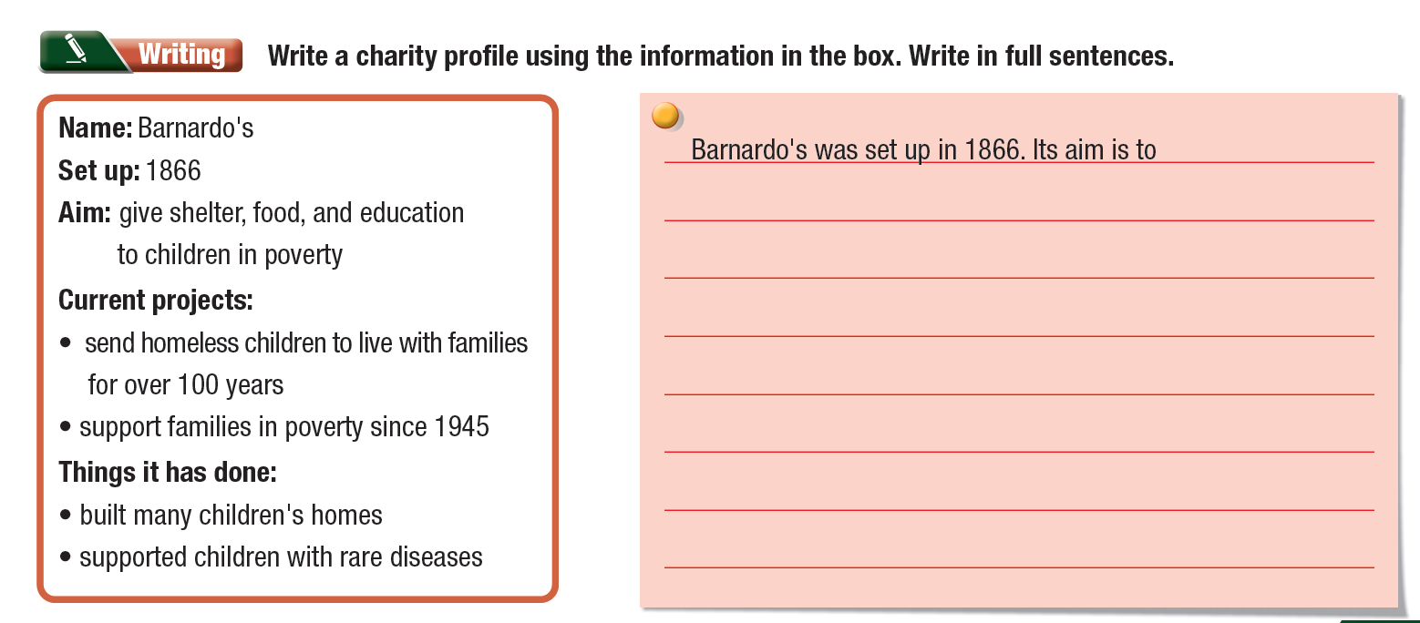
Extra Practice
WB, page 23
Notes:
Taken from TA 10 i-Learn Smart World WB, page 2

Slide 19

Consolidation

Slide 20

Work in pairs.
Write a list of what you often do every day.
What have you done today? What haven’t you done?
Make sentences using the Present Perfect tense.
have breakfast
do morning exercises
water the plants
play video games
read an English article
learn five new words
…
I have had breakfast today.
I haven’t watered the plants yet.
…
→

Slide 21
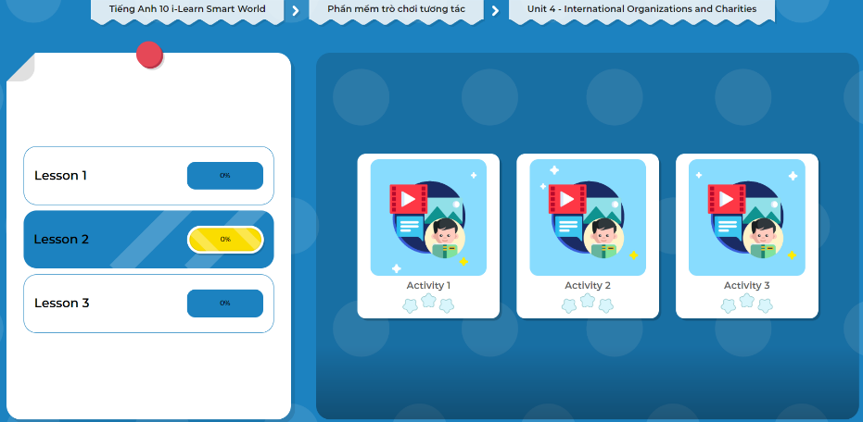
LET’S PLAY!
Click here to play the games.

Slide 22

WRAP-UP

Slide 23
Today’s lesson
Grammar The Present Perfect Tense

Slide 24

Practice making sentences using The Present Perfect Tense
Do the exercises in WB on page 23 (Writing ).
Complete the grammar notes in Tiếng Anh 10 i-Learn Smart World Notebook (page 23)
Prepare the next lesson - Pronunciation & Speaking on page 35 in SB.

