Slide 1
Unit 4: Graduation and Choosing a Career
Lesson 3.1: Listening & Reading
Pages: 47 & 48

Slide 2
Lesson Outline
Warm-up
Listening
Reading
Consolidation
Wrap-up

Slide 3
By the end of this lesson, students will be able to…
- practice listening and reading for gist and specific information.
- express your qualifications and experience.

Slide 4
WARM - UP

Slide 5
Game:
WHO IS THE FASTEST person?

Slide 6
1. A person who has an important job at a bank
A. editor
B. instructor
C. banker

Slide 7
2. My sister is an ____. She’s helping someone write their first novel.
A. beautican
B. editor
C. influencer

Slide 8
3. A large building with various connected rooms or a group of buildings
A. flat
B. complex
C. villa

Slide 9
4. Style of cooking
A. Magnificent
B. elegant
C. Cuisine

Slide 10
5. The general appearance of the natural environment, especially when it is beautiful
A. Scenery
B. Emerging
C. Breathtaking

Slide 11
6. A plan to show how much money a person or organization will earn and how much they will need or be able to spend
A. Cuisine
B. Magnificent
C. budget

Slide 12
7. We really need to ___ some creative some solutions for our project
A. Get along with
B. Come up with
C. Deal with

Slide 13
8. I think ____ help students figure out their future.
A. Interior designers
B. counselors
C. entrepreneurs

Slide 14
1. LISTENING

Slide 15
Mr. Smith: Good morning, class. Today we’re going to discuss how to write a résumé. It’s the first thing that potential employers see, so it’s really important that it’s well-written.

Slide 16
Listen the second time. Check again and fill in the blank.
Listen the first time. Take note (2-3 words) when the keywords come up.
Underline keywords before and after the blank
Underline blank
Underline keywords in the sentences

Slide 17
You should use ________________ for your professional profile.
2. Your profile should relate to ____________________.
3. People without working experience should highlight their __________.
4. Another thing they can focus on is ______________ and school club activities.
5. You should make sure that your résumé doesn't have ____________.
positive language
the job you’re applying
education
volunteer work
any mistakes
One thing you can do is highlight your education.
You’ll want to use positive language because after all, you’re trying to sell yourself as a good employee.
Finally, you should go over your résumé many times and make sure that it doesn’t have any mistakes because that’ll leave a really bad impression
And make sure that your profile relates to the job you’re applying for.
Another thing you can focus on is your volunteer work and school club activities.

Slide 18
Script:
Mr. Smith: Good morning, class. Today we’re going to discuss how to write a résumé. It’s the first thing that potential employers see, so it’s really important that it’s well-written. The first thing that you’ll often see on a résumé, after the name and contact information, is a professional profile. This summarizes who you are and what you can offer a company. You’ll want to use positive language because after all, you’re trying to sell yourself as a good employee. However, don’t make up things that aren’t true. And make sure that your profile relates to the job you’re applying for. If this résumé is for your first job, you might feel unsure what to write about, but don’t worry. One thing you can do is highlight your education.

Slide 19
Script:
This includes your grades if they’re good, awards you’ve received, and classes that can be helpful for the job such as IT or foreign languages. Another thing you can focus on is your volunteer work and school club activities. Again, highlight related responsibilities and skills that can be helpful for the job. For example, if the job requires organizational skills, you can include “organized meetings and scheduled appointments”. Or if it requires customer service skills, you can include “greeted participants and assisted them with their needs during volunteer events”. Finally, you should go over your résumé many times and make sure that it doesn’t have any mistakes because that’ll leave a really bad impression. Now, do you have any questions?

Slide 20
c. In pairs: Have you ever written a résumé before? What would you include on your résumé if you applied for a job?
Suggested answers :
1. Objective
2. Background
3. Skills
4. Experience
5. References

Slide 21
2. READING

Slide 22
Pre - reading
Read the statements and underline the key words.
a. Read the parts of a résumé below. Which sentence best summarizes the person who wrote it?
They are creative and have good time management skills and
experience working part-time in an office.
2. They are well-organized and have good communication skills and experience working part-time.

Slide 23
Vocab in context
Can you guess the meaning of the words in bold in the reading text?
Read the text again and find their meanings.

Slide 24
Vocab in context
b. Match the bold words in the text with their definitions.
role
purchase
mentality
contribute
interpersonal
1. __________: the act of buying
2. _______: the position that somebody has or is expected to have in an organization or society
3. ___________: improve, or add to something
4. ___________: the way of thinking of a person or group
5. _____________: connected with relationships between people
purchase
role
contribute
mentality
interpersonal

Slide 25
While - reading
c. Now, read and answer the questions.
What type of job is the writer looking for? ________________
customer services
Motivated and responsible high school student with great interpersonal skills, looking for a full-time job in a customer service role in a sales company

Slide 26
While - reading
c. Now, read and answer the questions.
2. Which of the following can be inferred from "sometimes managed the store alone"?
They like to work alone.
B. They are responsible.
C. They don't work well in a team.
Sometimes managed the store alone while making sure all customers were happy

Slide 27
While - reading
c. Now, read and answer the questions.
3. What did the writer develop from taking care of money at their place of work? _____________________
a responsible mentality
Developed a responsible mentality from helping run a business and managing payments

Slide 28
While - reading
c. Now, read and answer the questions.
4. The word finding in the Experience section is closest in meaning to ______.
discover something by chance
B. discover by searching carefully
C. get back something that was lost
Assisted in organizing fundraising events by promoting them and finding volunteers

Slide 29
While - reading
c. Now, read and answer the questions.
5. What skills did the writer learn from running the basketball club? ___________________
interpersonal skills
Developed interpersonal skills by building a strong relationship with club members

Slide 30
While - reading
Listen and read the text to find the answer.
PROFILE:
Motivated and responsible high school student with great interpersonal skills, looking for a full-time job in a customer service role in a sales company.
EDUCATION: Nguyễn Ánh School, Hanoi, Vietnam 2019 – present
• Achieved high grades in all subjects last year and was top of class in math and English
• Received excellent school reports from teachers about writing assignments and always submitted them on time
EXPERIENCE:
Store Worker – My Store, Hanoi 2021 – present
Responsibilities and Achievements:

Slide 31
While - reading
Listen and read the text to find the answer.
• Learned about the importance of having good customer service skills in a business by handling customers' requests
• Handled payments, operated cash registers, and made sure all purchases were recorded
• Sometimes managed the store alone while making sure all customers were happy
• Talked to customers and co-workers daily to maintain a positive and friendly working environment
• Developed a responsible mentality from helping run a business and managing payments
Nguyễn Ánh Basketball Club 2020 – 2022
Responsibilities and Achievements:

Slide 32
While - reading
Listen and read the text to find the answer.
• Played on the school basketball team for four years with a promotion to captain in 2021
• Organized the school basketball club and contributed to helping other students learn and play basketball after school
• Organized practice sessions for players and encouraged new players to participate
• Communicated with school managers to arrange practice sessions and basketball equipment
• Increased the number of students in the club by 15% by designing posters and putting them up in school
• Developed interpersonal skills by building a strong relationship with club members

Slide 33
While - reading
Listen and read the text to find the answer.
Happy Home Shelter 2019 – 2022
Responsibilities and Achievements:
• Assisted in organizing fundraising events by promoting them and finding volunteers
• Collected and organized weekly donations and kept an accurate budget
• Learned event planning skills including organizational and problem-solving skills
• Successfully organized over 10 fundraising events which raised over $1,000 for the shelter

Slide 34
Post - reading
e. In pairs: What part-time jobs or school projects have you done before? What did you learn from them?
Suggested answers:
1. Research papers or presentations
2. Group projects
3. Interships

Slide 35
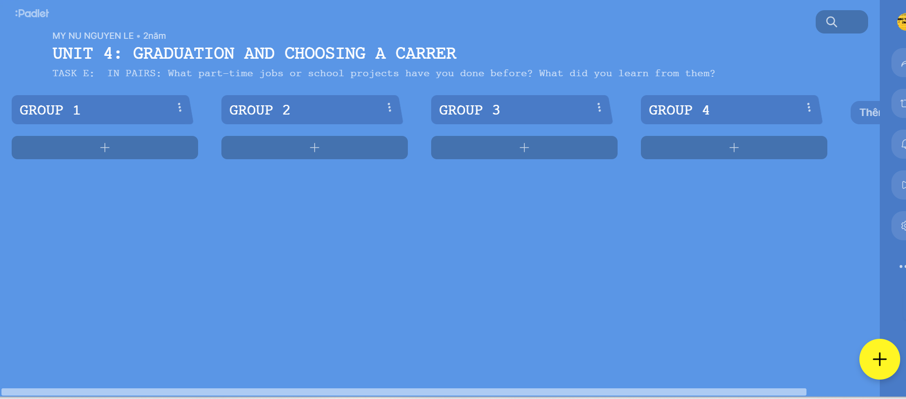
https://padlet.com/mynundc/unit-4-graduation-and-choosing-a-carrer-ndzpyrw288qiy6jw

Slide 36
CONSOLIDATION

Slide 37
WRAP-UP

Slide 38
Today’s lesson
Listening & Reading
- practice listening and reading for gist and specific information.
Speaking:
- express your qualifications and experience.

Slide 39
1. PERSONAL DETAILS & CONTACT INFORMATION
2. PROFILE
4. EDUCATION BACKGROUND/
EXPERIENCE
3. EDUCATION

Slide 40
Homework
- Practice listening and reading for gist and specific information
- Do Listening & Reading exercises in the workbook on page 24.
- Prepare the next lesson: Lesson 3.2 – Speaking & Writing, pages 48 & 49
- Play the consolidation games on www.eduhome.com.vn

