Slide 1



Welcome to our class
ENGLISH 12

Slide 2

Unit 4:
GRADUATION AND CHOOSING A CAREER
Lesson 1.2: GRAMMAR (Page 40&41

Slide 3
Lesson Outline
Warm-up
Presentation
Practice
Production
Wrap-up

Slide 4

By the end of this lesson, students will be able to…
- practice and use phrasal verbs correctly

Slide 5
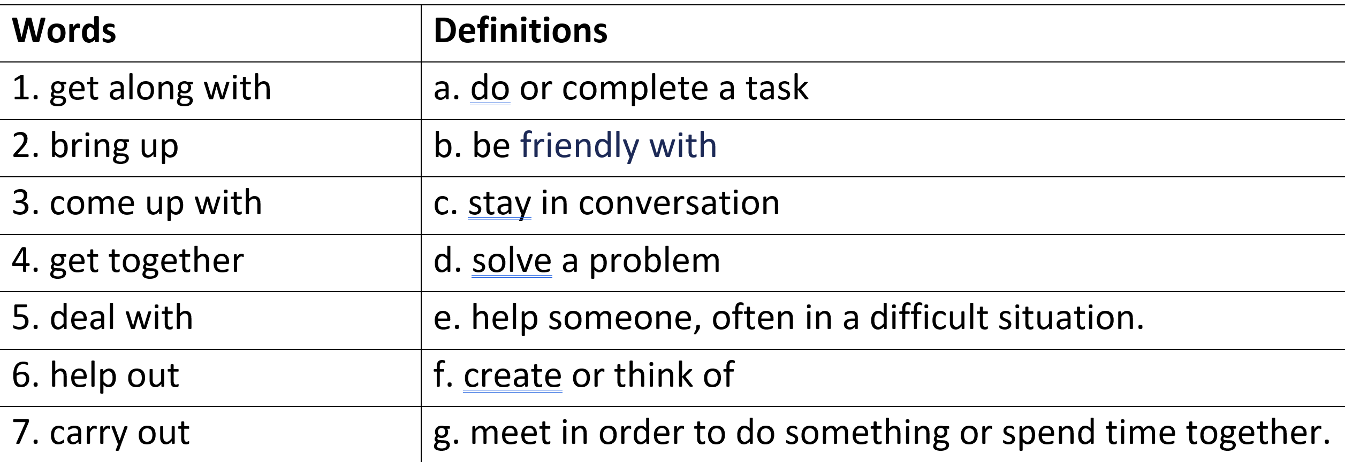

Match the words with the definitions
Answer keys:
1. b; 2. c; 3. f; 4. g; 5. d; 6. e; 7. a

Slide 6

PRESENTATION

Slide 7
Look at this example.
You have to get along with your colleagues.
verb + ……?… + ……?….
A phrasal verb
What does ‘get along with’ mean?
To be friendly with
Does it mean the same as each of its parts (‘get’, ‘along’, ‘with’?
No

Slide 8
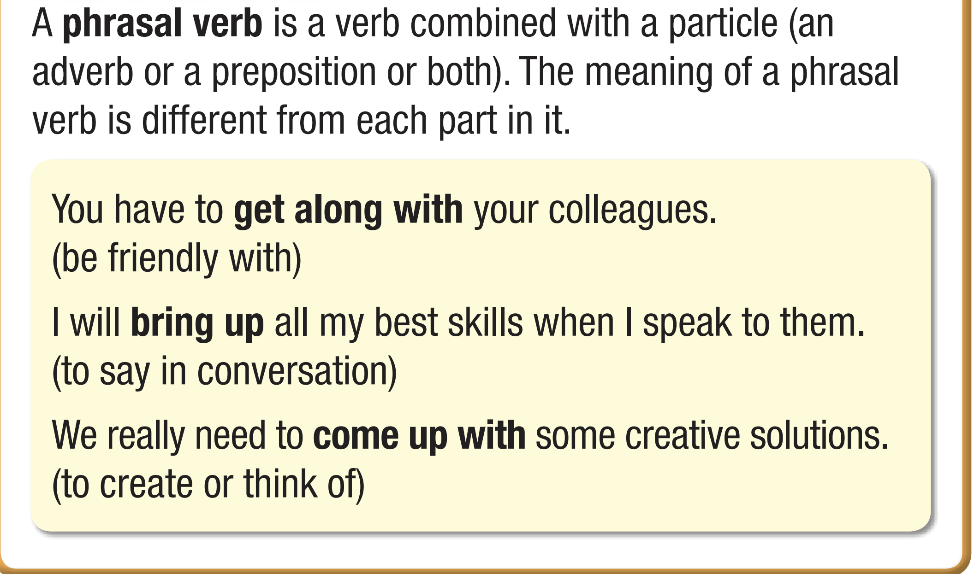


Slide 9
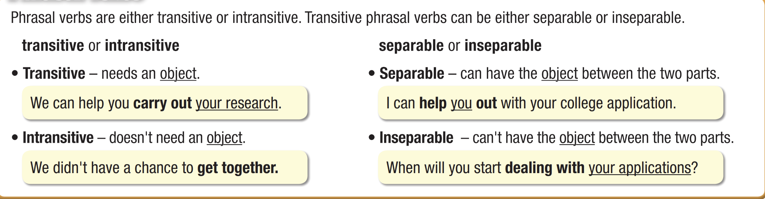

Slide 10


deal with

Slide 11
PRACTICE

Slide 12
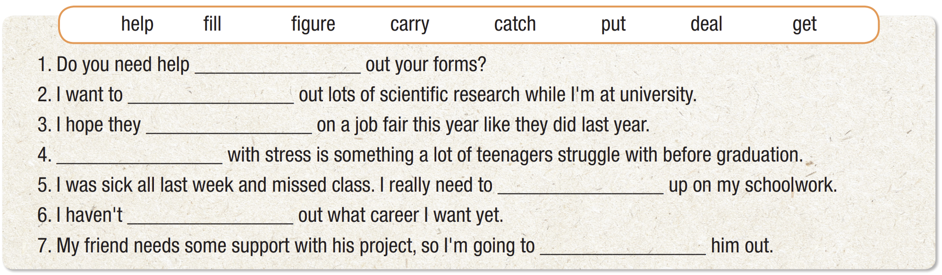
filling
carry
put
Dealing
catch
figured
help

Slide 13
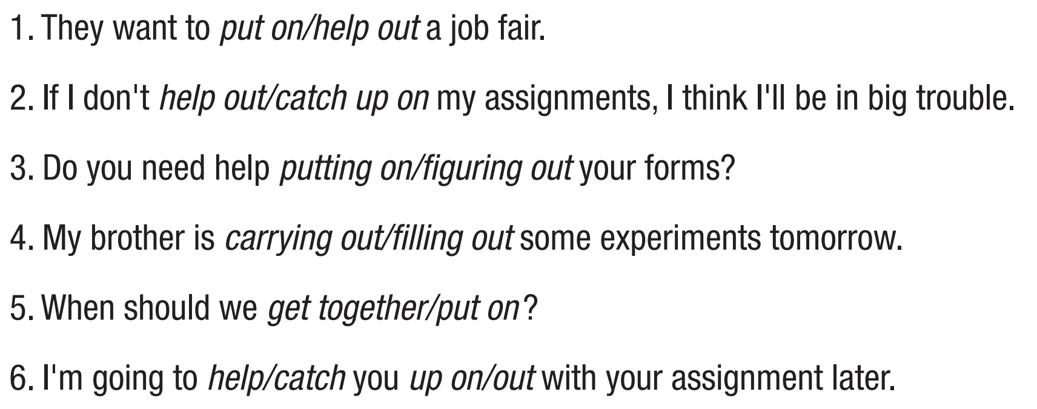

Slide 14
PRODUCTION

Slide 15
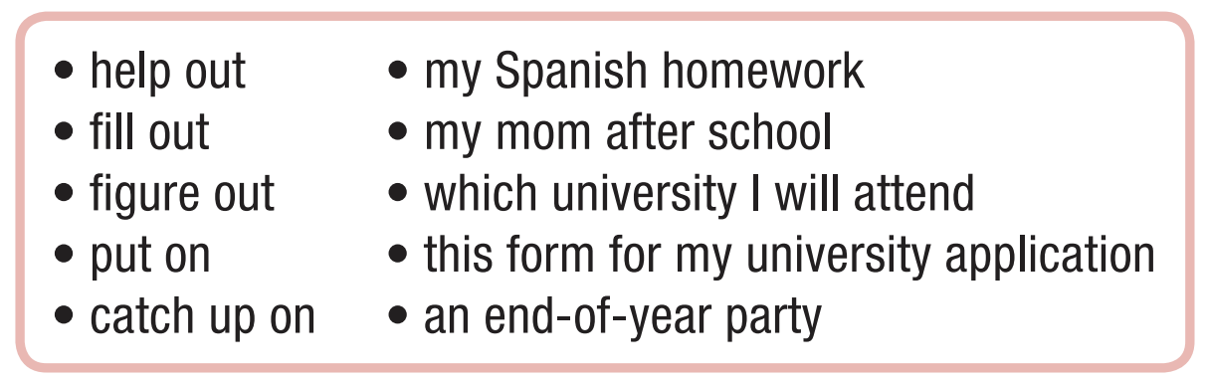


Slide 16
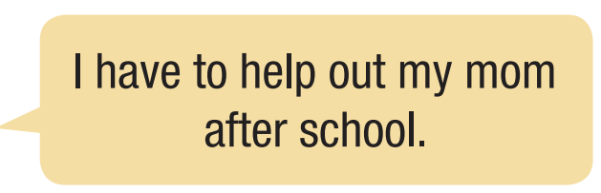
Suggested answers:
1. I need to fill out this form for my university application.
2. I can’t figure out which university I will attend.
3. My school will put on an end-of-year party.
4. I should catch up on my Spanish homework.

Slide 17

WRAP-UP

Slide 18
Today’s lesson
Grammar:
practice and use phrasal verbs
Speaking:
- practice making sentences, using phrasal verbs

Slide 19
Homework
- Grammar Point: Phrasal verbs
- Do Grammar exercises in the workbook on page 21.
- Prepare the next lesson: Lesson 1.3 – Pronunciation & Speaking, pages 41& 42
- Play the consolidation games on www.eduhome.com.vn

Slide 20
Thank you
for joining us!

