Slide 1
WELCOME TO OUR CLASS!

Slide 2
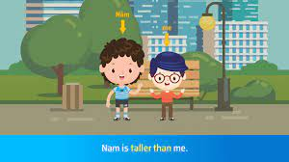
Look at the pictures and answer the questions.
Nam
1.Who is taller, Nam or me?
→Nam is taller than me.
2.Who is the tallest student in his class?
→Nam is the tallest student in his class.

Slide 3
UNIT 3: SHOPPING
Lesson 1.2 – Grammar (Page 21)

Slide 4
A.GRAMMAR

Slide 5
E.g: 1.Nam is taller than me.
2.Nam is the tallest student in his class.
1. What is the comparative adjective?
→ taller (than)
2. What is the superlative adjective?
→ the tallest
3. How can we form the comparative and superlative adjectives?
Notes:
Please, click on each phrase to hear the sound

Slide 6
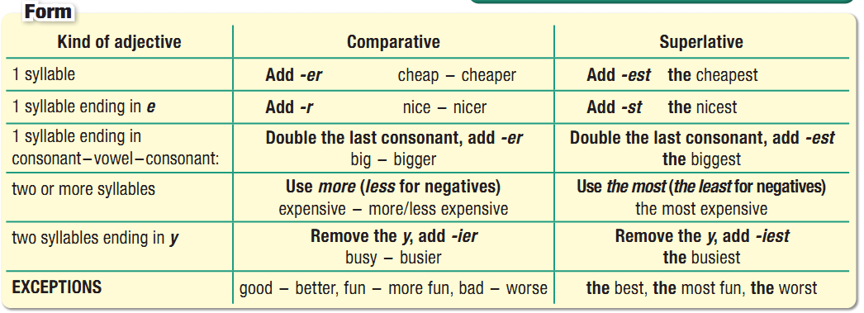
Comparative and Superlative Adjectives

Slide 7
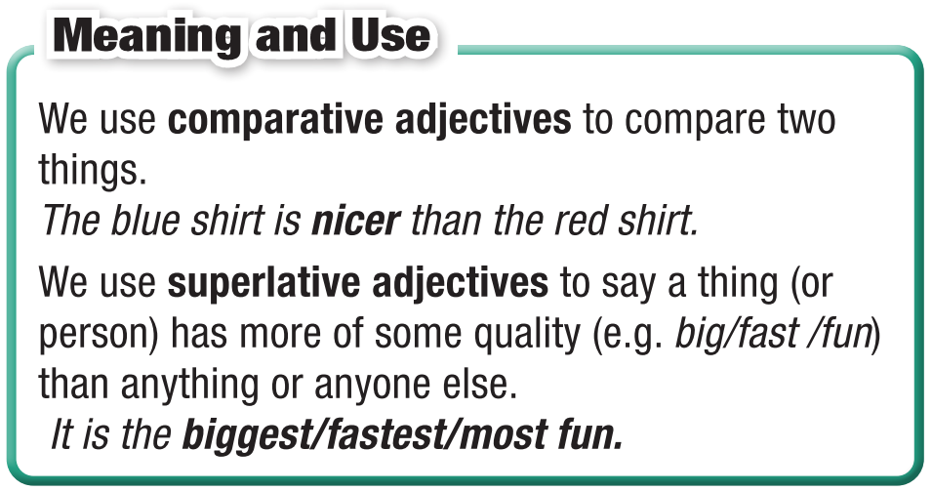
Comparative and Superlative Adjectives

Slide 8
B. PRACTICE

Slide 9
Task a. Circle the correct words.
1. I think you should buy this pair of sunglasses. It looks cooler/coolest than the other pair.
2. Can I borrow some money? This dress is more/most expensive than I thought.
3. This restaurant may not have the greatest food in town but their customer service is definitely the best/better. We eat here at least twice a month.
4. It's best if you come on Wednesday, when I'm less busy/ busiest. We'll have time to chat.
5. Shopping is my less/least favorite thing to do. It's boring and takes a lot of time.

Slide 10
Task b. Fill in the blanks with the right forms of the adjectives.
prettier than
1. I think this dress is __________ (pretty) the other one.
2. This is _________ (good) place to shop for shoes in town. All the other stores are too expensive.
3. I rarely wear my green jacket. It’s _____________________ (comfortable) my red one.
4. Do you have a _____________ (expensive) bag? This one is a bit too much.
5. We'll never go back to that restaurant. It has ______________ (bad) customer service ever.
6. The black shirt is ___________ (good) the white one, so it will last longer.
the best
less comfortable than
less expensive
the worst
better than

Slide 11
C. PRODUCTION

Slide 12
Task c. In pairs: Compare computer games.
Use the prompts from the box.

Slide 13
Task d. Play the game.
Rules: Divide the whole class into 4 groups. Each group talk about 5 sentences describing some friends or some things in our class in 1 minute, using comparative or superlative. The group with the best answers will win and receive a gift from the teacher.

Slide 14
Task e. In pairs:
Are you more similar to Sam or Alice? Why?
I am similar to Same/Alice because ……

Slide 15
Wrap-up
Today’s lesson
Grammar: Comparative and Superlative Adjectives

Slide 16
Make 10 sentences, using comparative and superlative adjectives.
Do the exercises in WB on page 15.
Do the exercises in Tiếng Anh 10 i-Learn Smart World Notebook on page 15.
Prepare the next lesson – Pronunciation, SB (page 22)
Play the consolidation games in Tiếng Anh 10 i-Learn Smart World DHA on www.eduhome.com.vn

Slide 17
Thank you for your attention!

