Slide 1
UNIT 1: MY NEW SCHOOL
Lesson 1: Getting Started

Slide 2
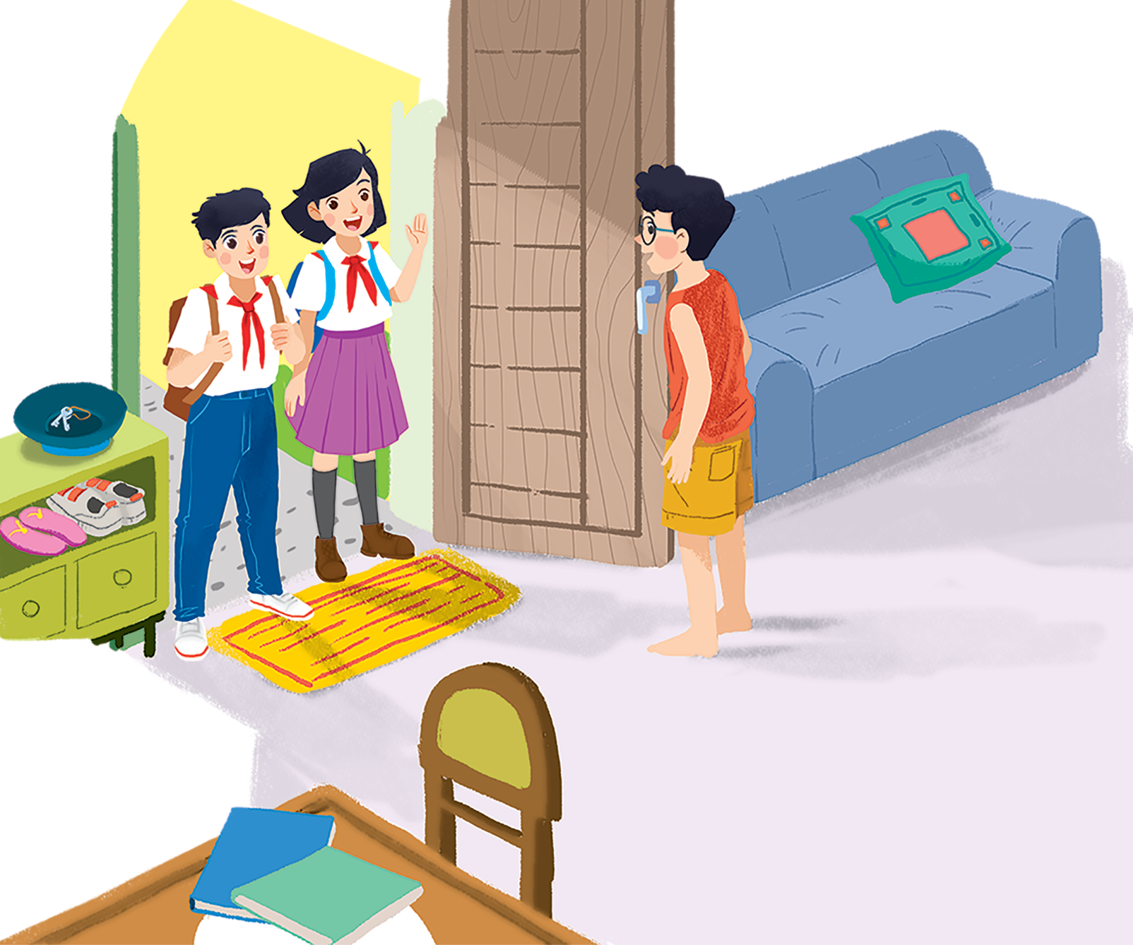
A SPECIAL DAY

Slide 3
Table of contents
I
II
Vocabulary
Tasks

Slide 4
I
Vocabulary

Slide 5
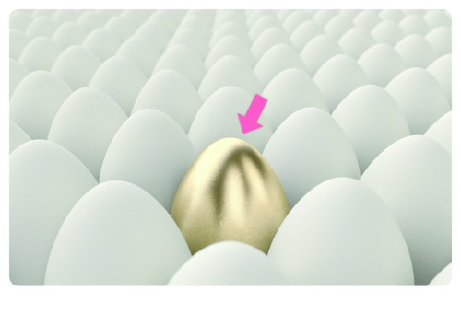
Special (adj)
Đặc biệt
This is a special egg.
(Đây là một quả trứng đặc biệt.)

Slide 6
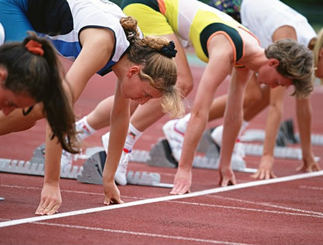
Ready (adj)
Sẵn sàng
Are you ready?
(Bạn đã sẵn sàng chưa?)

Slide 7
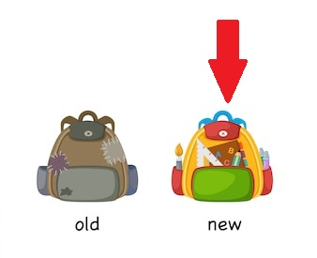
New (adj)
Mới
This is my new bag.
(Đây là cặp mới của tôi.)

Slide 8

Meet (V)
Gặp
Nice to meet you.
(Rất vui được gặp bạn.)

Slide 9
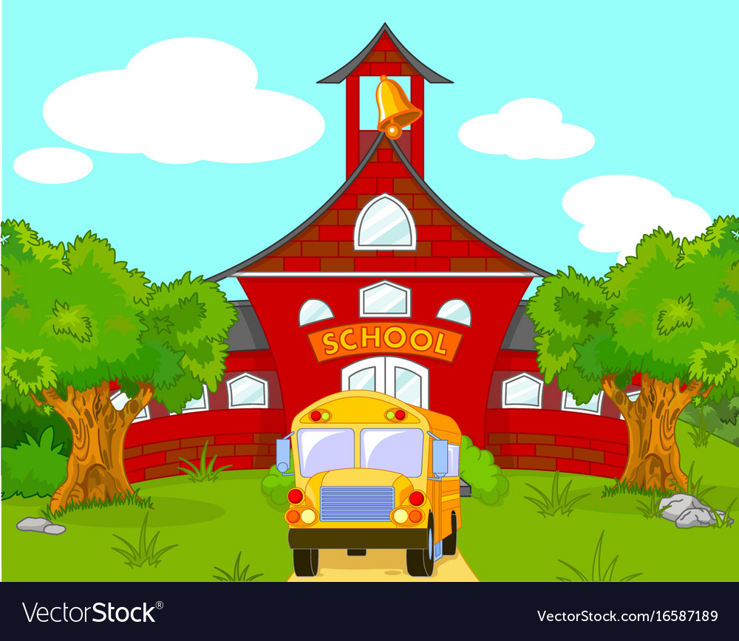
School (N)
Trường học
This is my school.
(Đây là trường học của tôi.)

Slide 10
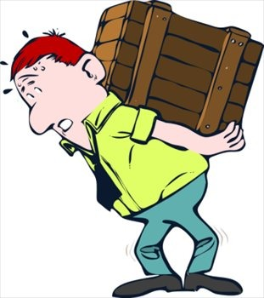
Heavy (adj)
Nặng
The box is very heavy.
(Cái hộp rất nặng.)

Slide 11

Smart (adj)
Thông minh
You look smart.
(Bạn trông thông minh đấy.)

Slide 12
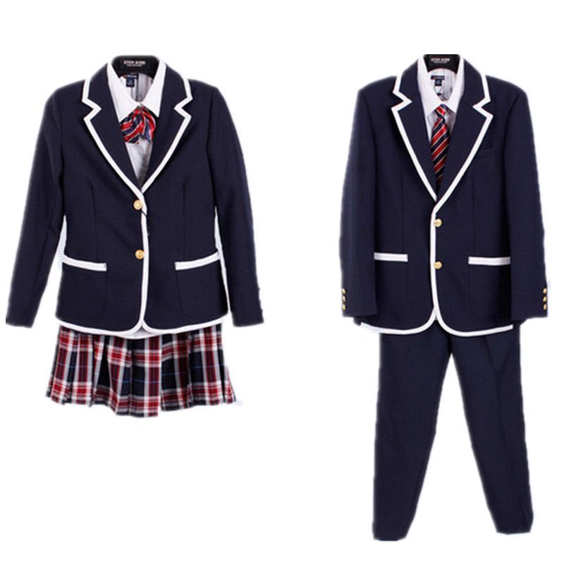
Uniform (N)
Đồng phục
Let me put on my uniform.
(Để tôi mặc đồng phục.)

Slide 13

Subjects (N)
Môn học
Math and English are my favourite subjects.
(Môn học yêu thích của bạn là gì?)

Slide 14
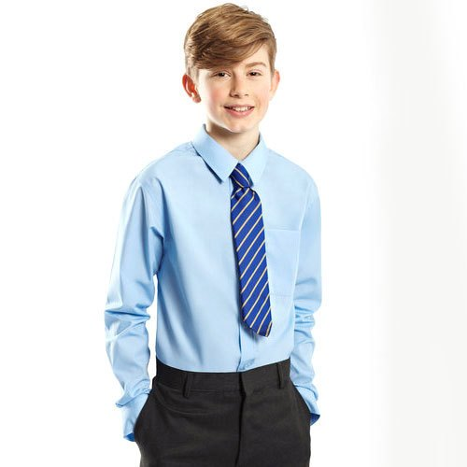
Wearing (adj)
Mặc
He is wearing, a school uniform.
(Anh ấy đang mặc đồng phục học sinh.)

Slide 15

History (N)
Lịch Sử
I like to study History.
(Tôi thích học Lịch Sử.)

Slide 16
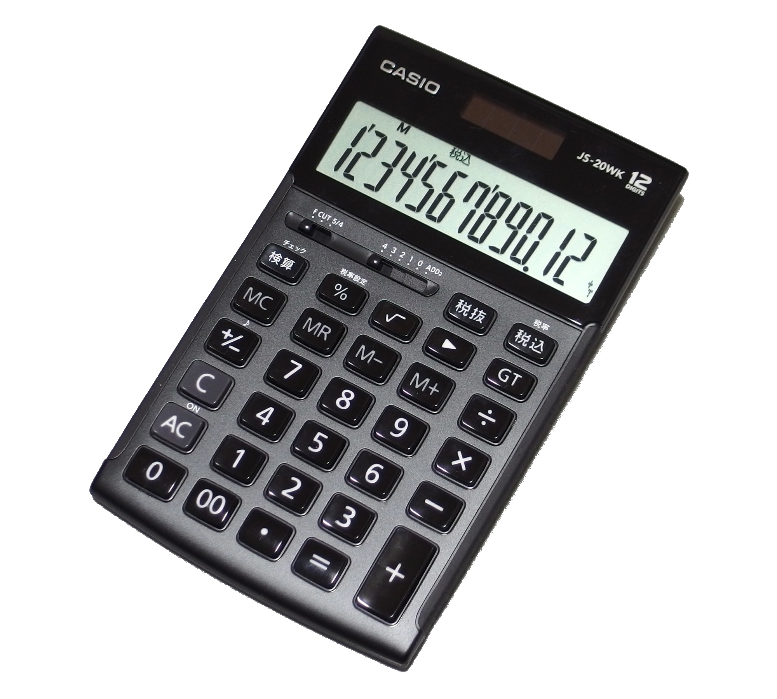
Calculator (N)
Máy tính
I have a calculator.
(Tôi có một máy tính.)

Slide 17
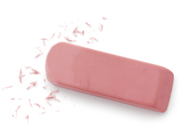
Rubber (N)
Cục tẩy
I see a rubber.
(Tôi thấy một cục tẩy.)

Slide 18
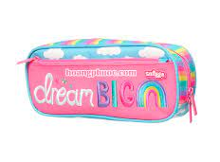
Pencil case (N)
Hộp bút
I have a new pencil case.
(Tôi có một hộp bút mới.)

Slide 19
THE MEMORY GAME

Slide 20
Calculator (N)
Máy tính

Slide 21
Smart (adj)
Thông minh

Slide 22
Uniform (N)
Đồng phục

Slide 23
Special (adj)
Đặc biệt

Slide 24
Heavy (adj)
Nặng

Slide 25
II
Tasks

Slide 26
Ex 1: Listen and read.

Slide 27

Ex 1: Listen and read.
(Loud knock)
Phong: Hi, Vy.
Vy: Hi, Phong! Are you ready?
Phong: Just a minute.
Vy: Oh, this is Duy, my new friend.
Phong: Hi, Duy. Nice to meet you.
Duy: Hi, Phong. I live near here, and we go to the same school!
Phong: Good. Hmm, your school bag looks heavy.
Duy: Yes! I have new books, and we have new subjects to study.
Phong: And a new uniform, Duy! You look smart!
Duy: Thanks, Phong. We always look smart in our uniforms.
Phong: Let me put on my uniform. Then we can go.

Slide 28
Ex 2: Read the conversation again and tick T (True) or F (False).
 | T | F
1. Vy, Phong, and Duy go to the same school.
2. Duy is Phong’s friend.
3. Phong says Duy looks smart in his uniform.
4. They have new subjects to study.
5. Phong is wearing a school uniform.






Slide 29
Ex 3: Write ONE word from the box in each gap.
go
subjects
has
wear
uniforms
Students _______ their uniforms on Monday.
Vy _____ a new friend, Duy.
- Do Phong, Vy, and Duy _____ to the same school?
- Yes, they do.
Students always look smart in their _________.
- What __________ do you like to study?
- I like to study English and history.

Slide 30
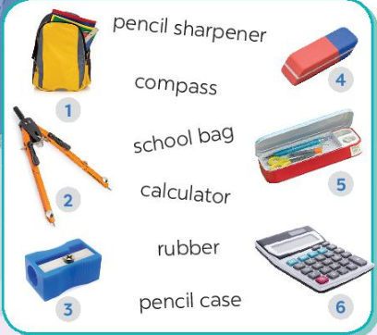
Ex 4: Match the words with the school things. Then listen and repeat.
school bag
compass
pencil sharpener
rubber
pencil case
calculator

Slide 31
THANK YOU!

