Slide 1

UNIT 1: HELLO
Lesson 3B – Grammar

Slide 2
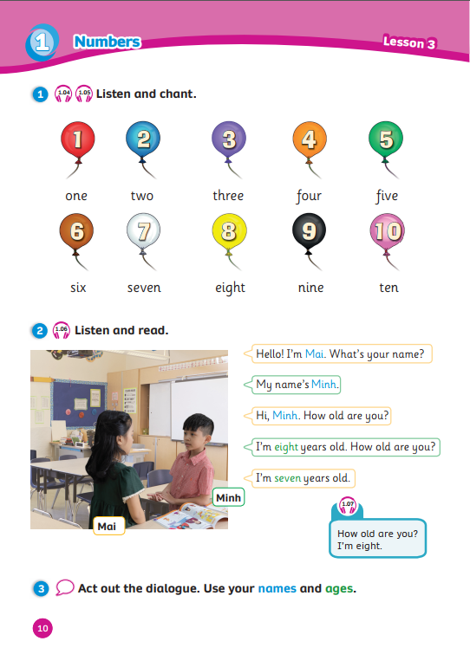
UNIT 1: HELLO
We’re learning…
ages
to ask and answer about ages
SB p.10
AB p.10

Slide 3

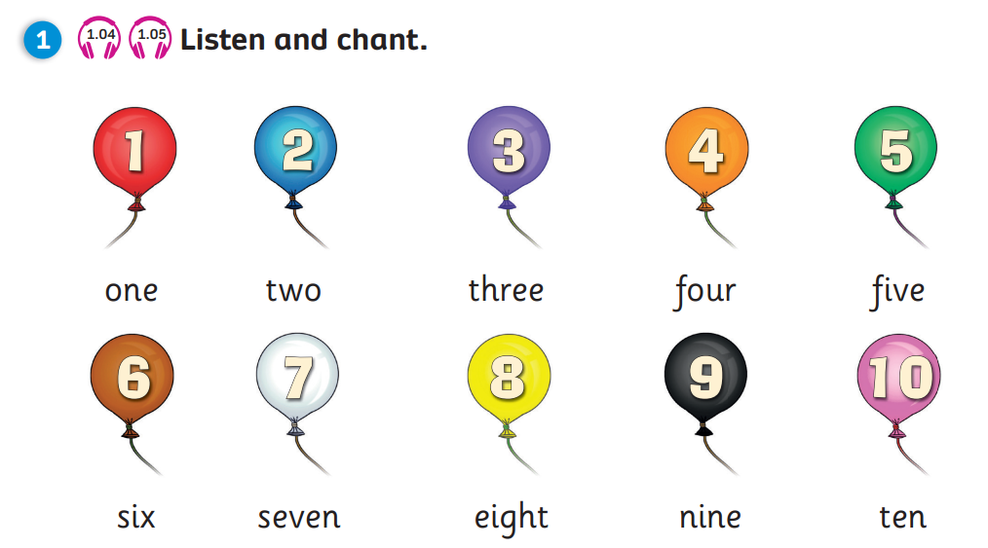

REVIEW: Numbers
one
two
three
four
five
six
seven
eight
nine
ten
Click on the cards to reveal the balloons
Click on the balloons to reveal the text
Notes:
Click on a random card to reveal the number behind it
Ask students “What number is it?” – “Number …”
Click on the balloon to reveal the text

Slide 4
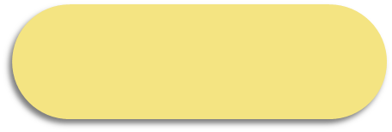
The
Lost Letter
Let’s go!

Slide 5
RULES
There are 6 words with missing letters
Students choose 1 correct letter for each word
1 correct letter = 2 points

Slide 6

The lost letter
T
O
What number is it?
H
W
K
Next

Slide 7

F
V
E
The lost letter
What number is it?
I
A
E
Next

Slide 8
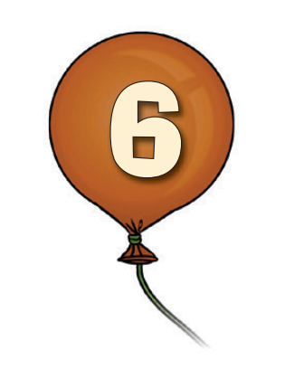
The lost letter
S
I
What number is it?
H
K
X
Next

Slide 9
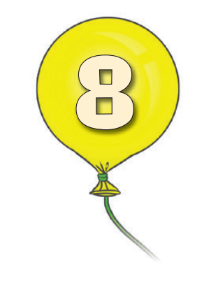
The lost letter
What number is it?
E
I
G
H
T
P
R
Next

Slide 10
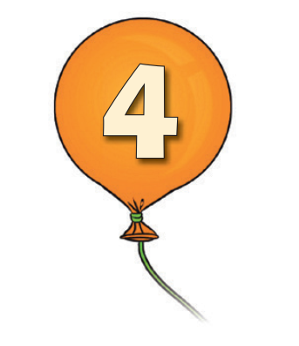
The lost letter
F
O
What number is it?
U
L
R
G
Next

Slide 11

The lost letter
What number is it?
S
E
E
N
D
F
V
Next

Slide 12


Slide 13
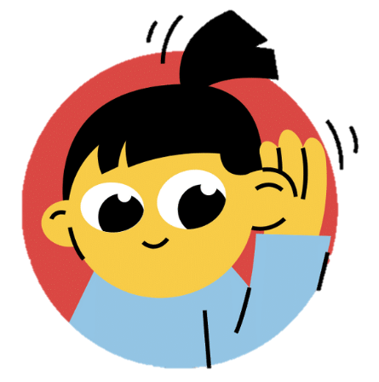
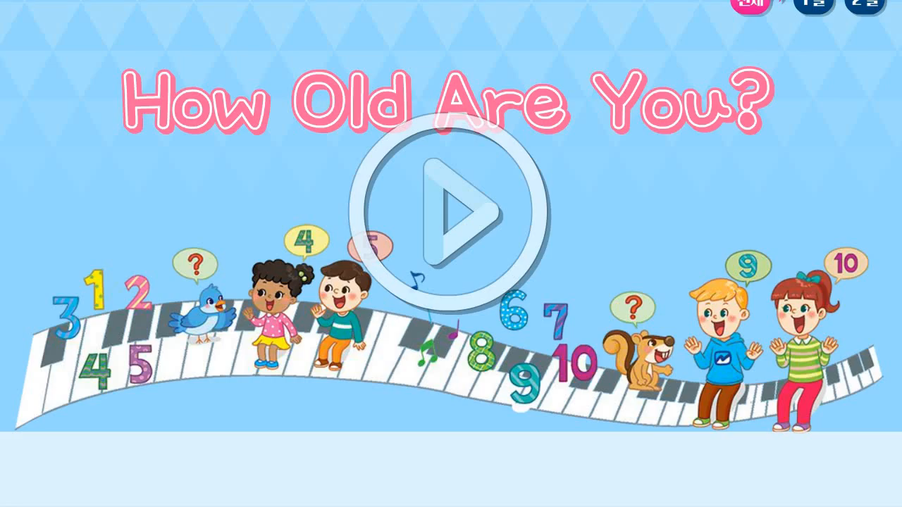
Lead-in
Song: How old are you?
Song: How old are you?
Listen for numbers.
Clap your hands when you hear the numbers.

Slide 14
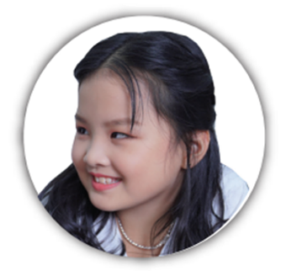
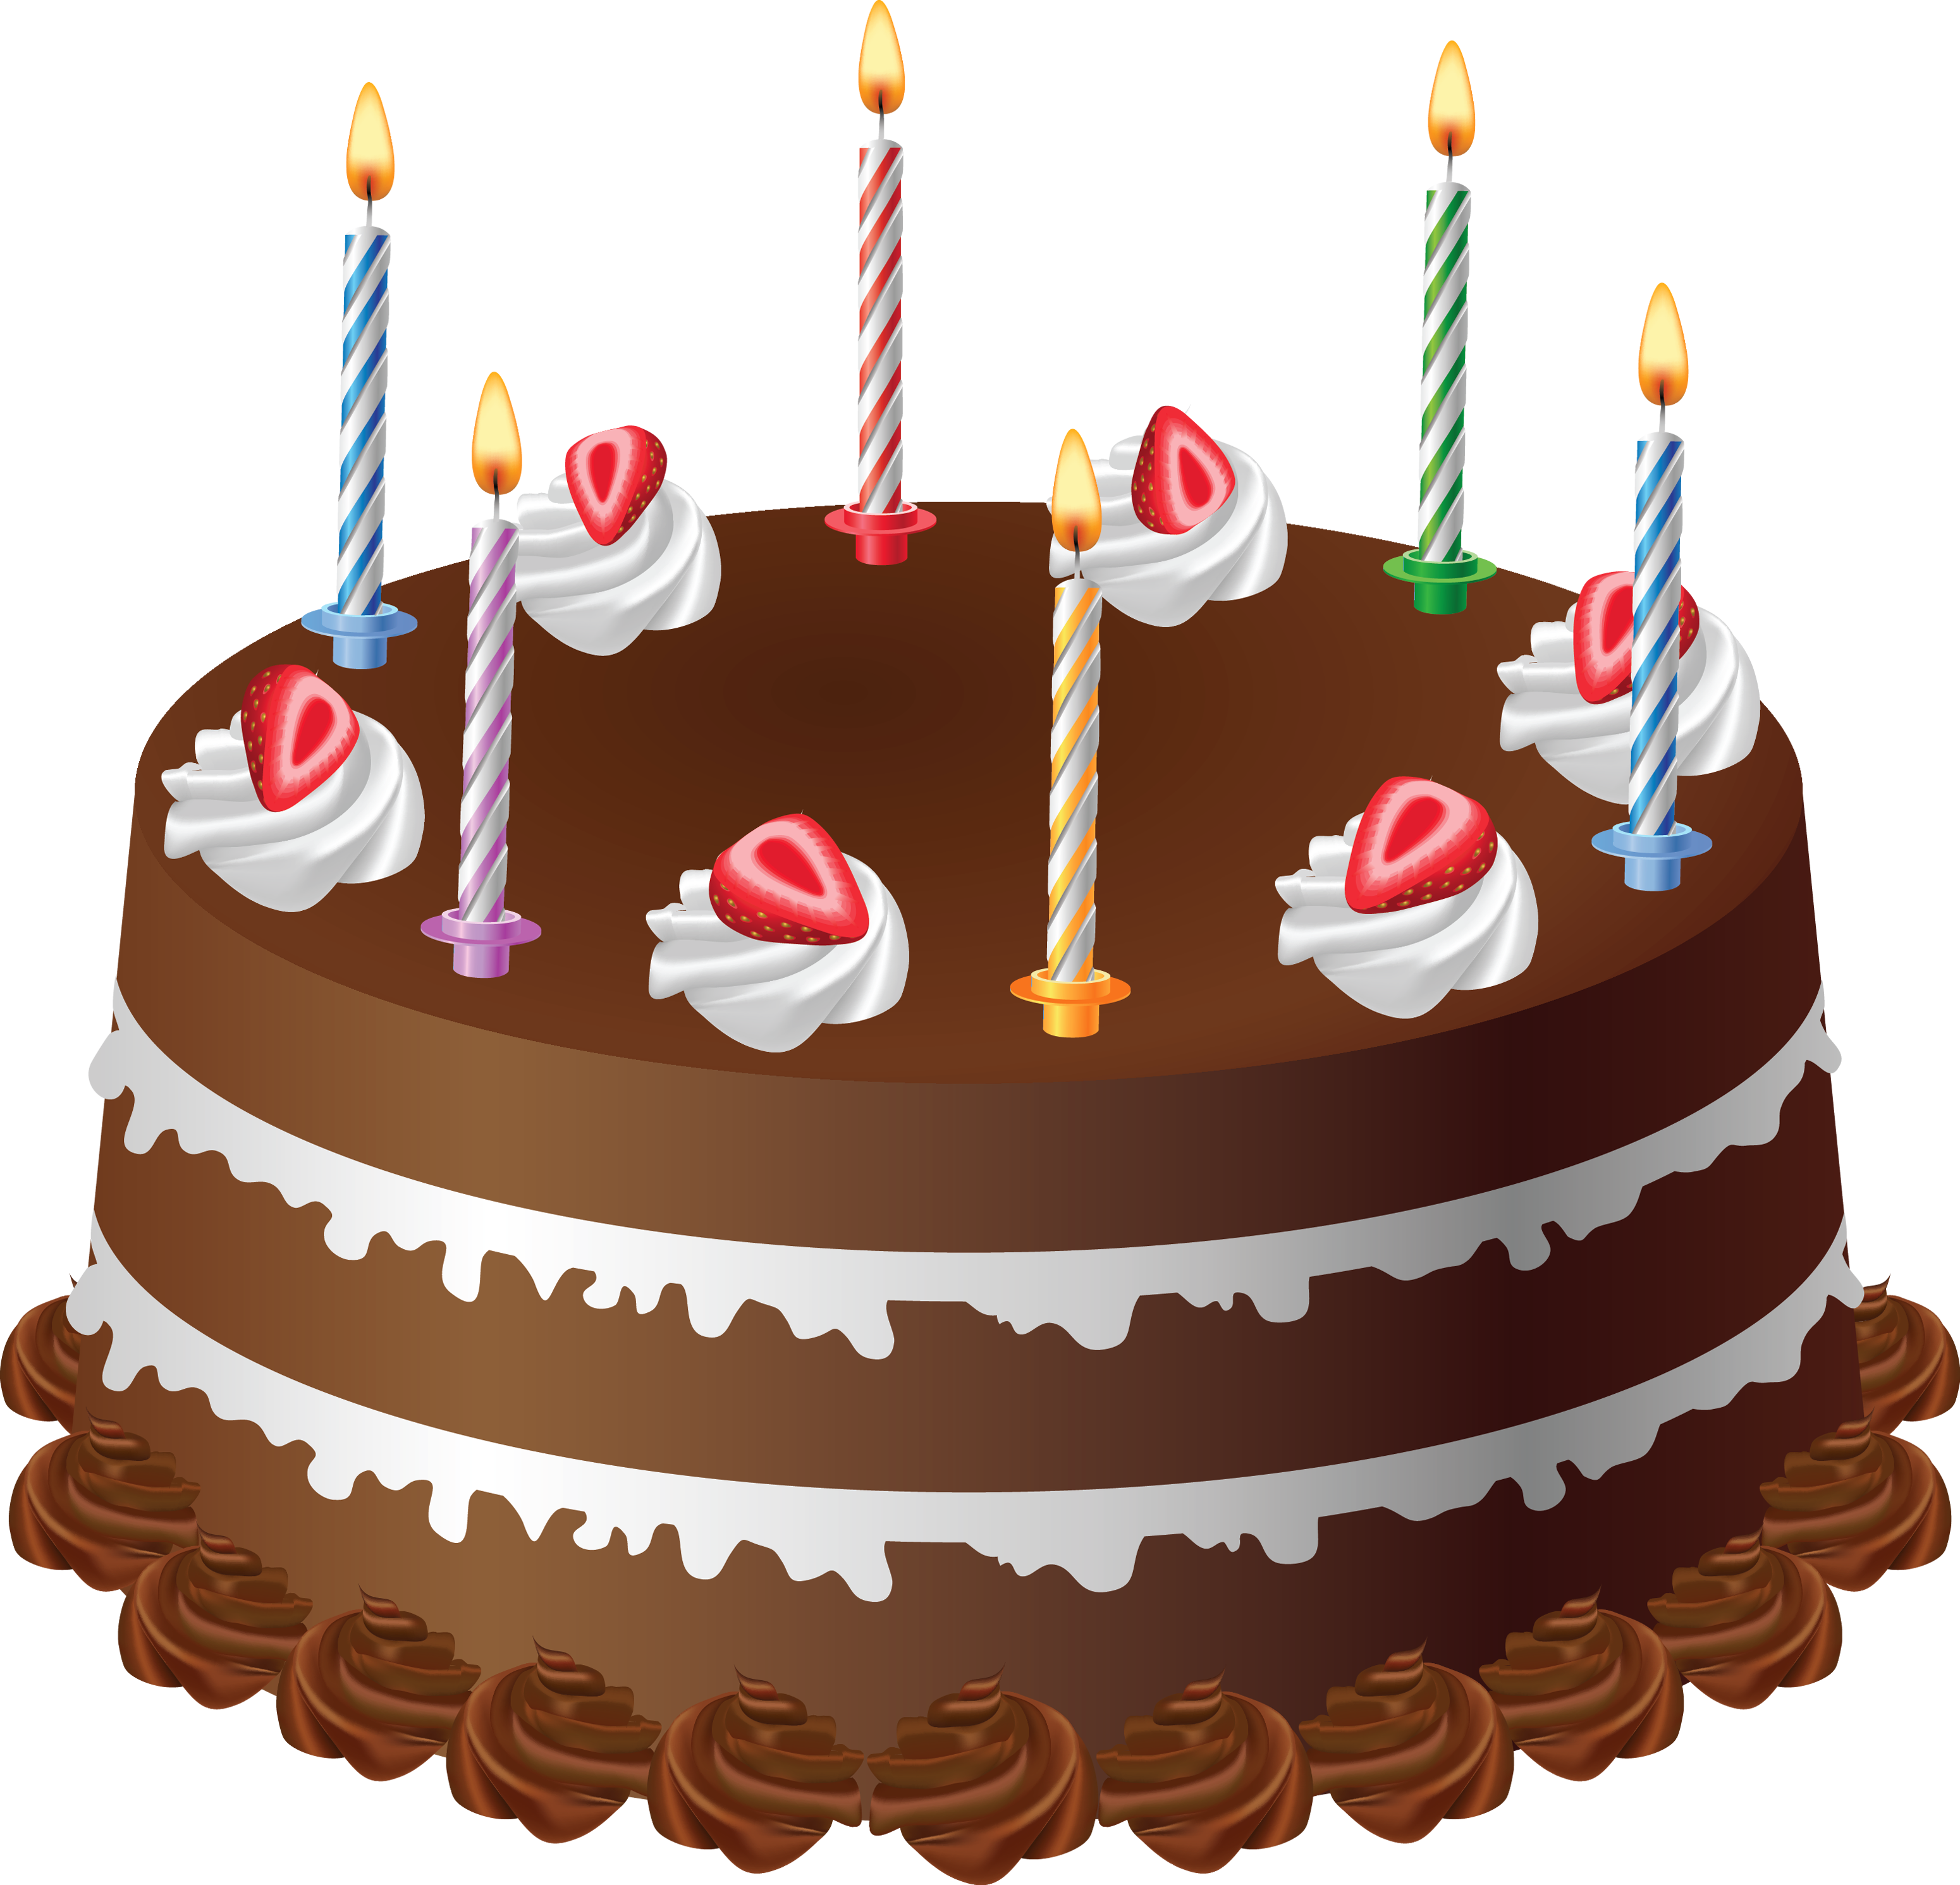
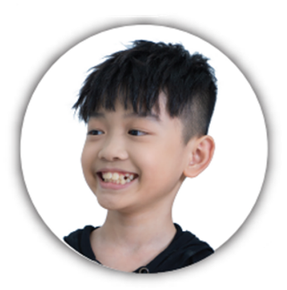
STRUCTURES
Today is my birthday.
I’m seven years old.
How old are you?
Mai
Minh
Notes:
Set the scene
Show the birthday cake & ask “What is it?”
Show pictures of Mai & Minh and ask “Who is it?”
Show the speech bubbles

Slide 15

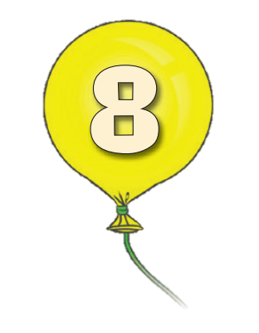
STRUCTURES
How old are you?
I’m eight years old.
…
How old are you?
I’m seven years old.
…
Mai
Minh
Click on the names to reveal the text
Notes:
Show the structures
Challenge students to fill in the ages
Click on the names to reveal the ages

Slide 16

PRACTICE
1
How old are you?
2
I’m … years old.
3
4
How old are you?
I’m … years old.
Notes:
Call out 2 students and model the structures with them in front of class
Students practice in pairs in 1 minute
Call out 3-4 pairs to say aloud their conversation

Slide 17

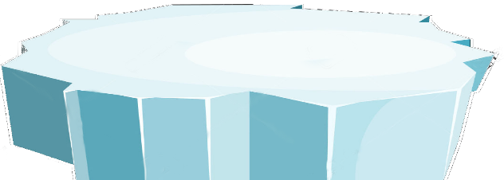



The little penguins
RULES
Students ask “How old are you?”
Look at the number and answer
1 correct answer = 2 points
PLAY

Slide 18

How old are you?
SURFING
NEXT
STOP
I’m two years old.

Slide 19

How old are you?
SURFING
NEXT
STOP
I’m seven years old.

Slide 20
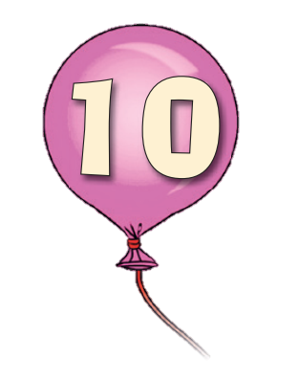
How old are you?
SURFING
NEXT
STOP
I’m ten years old.

Slide 21
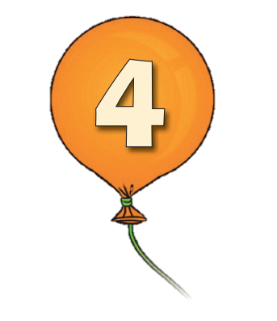
How old are you?
SURFING
NEXT
STOP
I’m four years old.

Slide 22
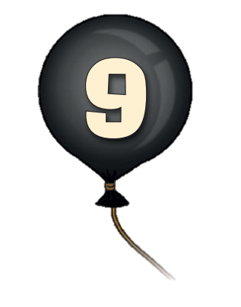
How old are you?
SURFING
NEXT
STOP
I’m nine years old.

Slide 23
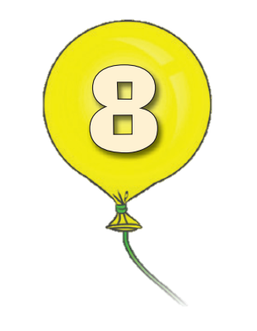
How old are you?
SURFING
NEXT
STOP
I’m eight years old.

Slide 24
Game over!
EXIT

Slide 25
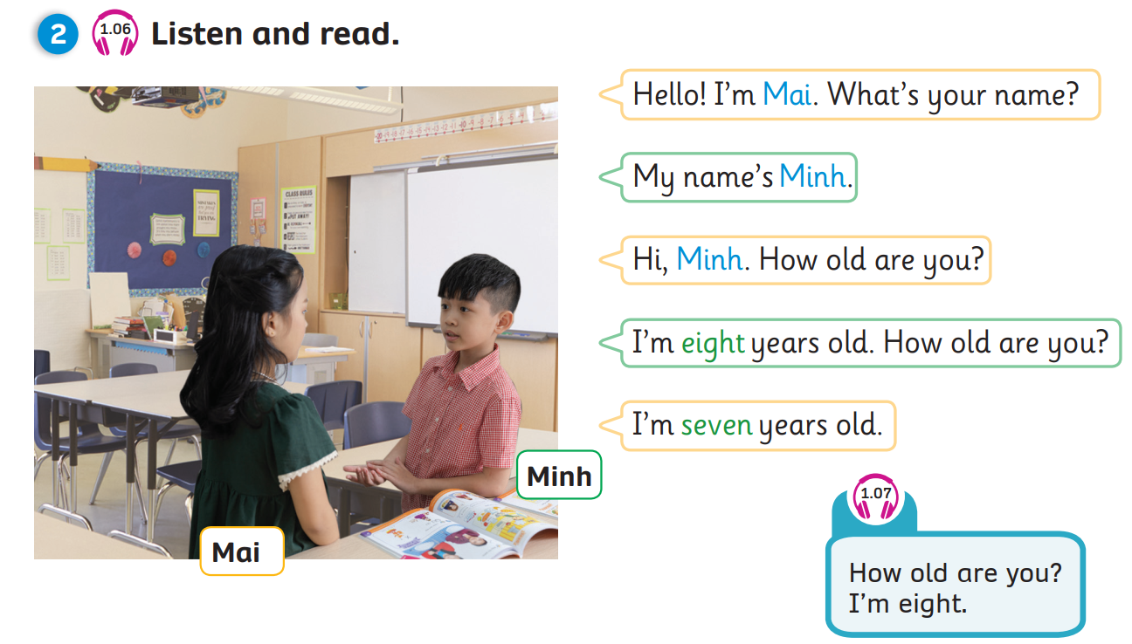
Pupil’s Book (p.10)

Slide 26
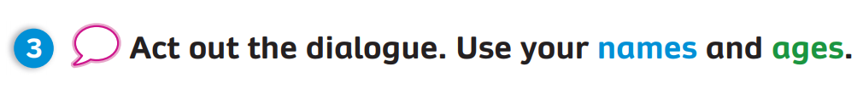
Pupil’s Book (p.10)
1
Hello! I’m …
What’s your name?
2
My name’s …
3
Hi, …
How old are you?
4
I’m … years old.
How old are you?
5
I’m … years old.

Slide 27


WRAP-UP
two
three
four
one
five
How old are you?
-> I’m … years old.
ten
six
seven
nine
eight
Notes:
Ask the question
Show the pictures and have students say aloud the answer

Slide 28

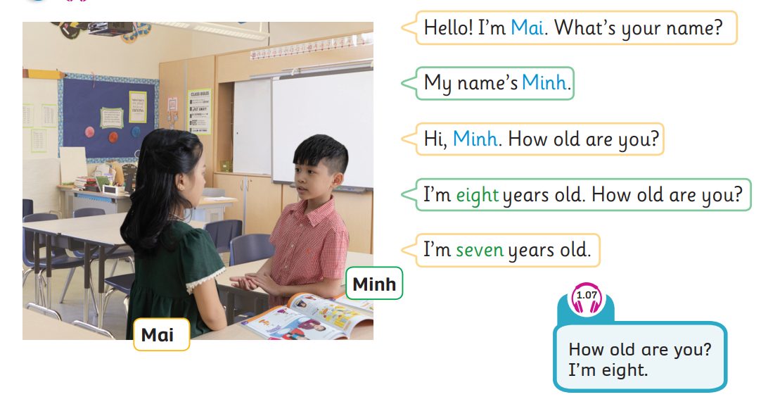

UNIT 1: Lesson 3B
We’ve learned…

