Slide 1

UNIT 1: HELLO
Lesson 3A – Vocabulary

Slide 2
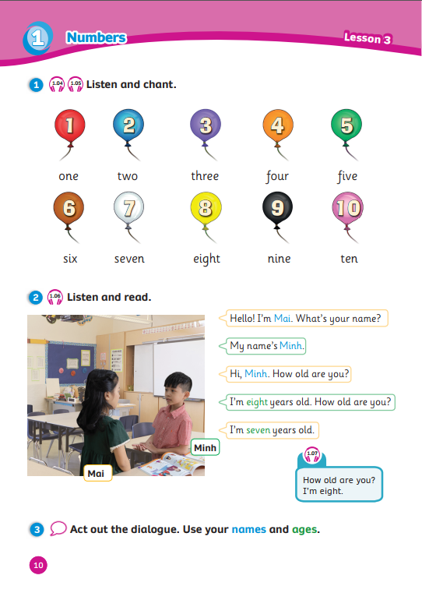
UNIT 1: HELLO
We’re learning…
- numbers
- to ask and answer about numbers
SB p.10
AB p.10

Slide 3

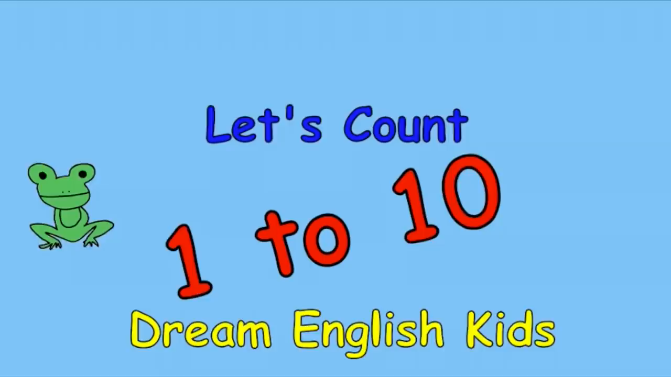
Song: Let’s Count 1-10
WARM-UP
All students stand up.
Listen to the song.
Dance along.

Slide 4

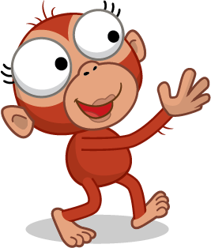

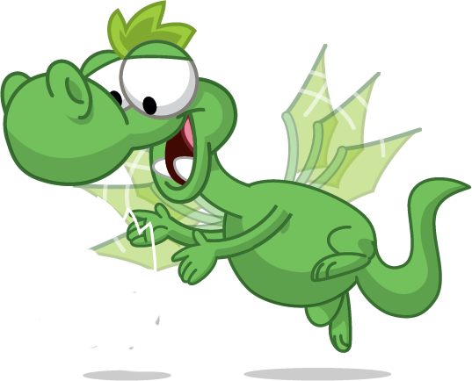
VOCABURALY: Numbers
What number is it?
Number …
one

Slide 5

VOCABURALY: Numbers
What number is it?
Number …
two

Slide 6

VOCABURALY: Numbers
What number is it?
Number …
three

Slide 7

VOCABURALY: Numbers
What number is it?
Number …
four

Slide 8

VOCABURALY: Numbers
What number is it?
Number …
five

Slide 9

VOCABURALY: Numbers
What number is it?
Number …
six

Slide 10

VOCABURALY: Numbers
What number is it?
Number …
seven

Slide 11

VOCABURALY: Numbers
What number is it?
Number …
eight

Slide 12

VOCABURALY: Numbers
What number is it?
Number …
nine

Slide 13

What number is it?
Number …
ten

Slide 14
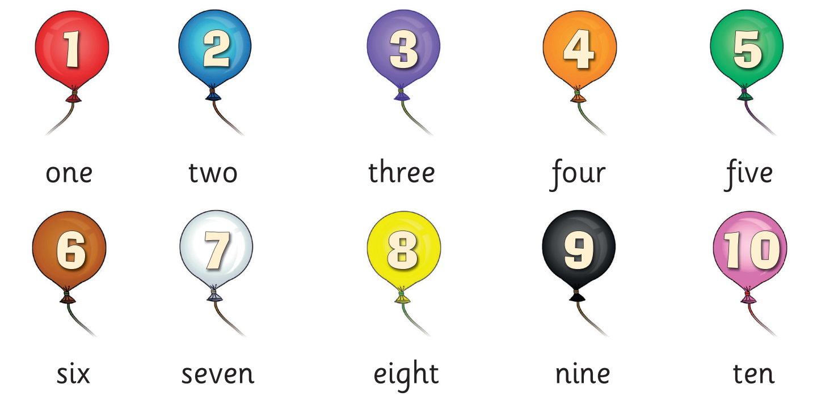
VOCABURALY: Numbers
one
two
three
four
five
six
seven
eight
nine
ten
Notes:
- Show pictures and ask “What number is it?”
- Show the words and have Ss answer “Number …”

Slide 15










W
R
O
D
U
Z
E
P
Z
L
Reorder the letters to make correct words.
2 students say the correct word and spell.
The whole class repeats the word.
1 correct word = 2 stars.
Notes:
- Introduce the activity Word Puzzle
- Instruct SS how to play

Slide 16






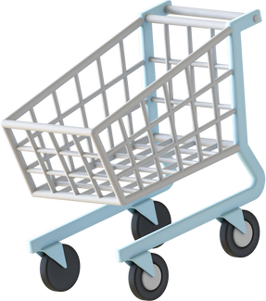


R
O
A
E
Y
U
E
Y
R
A
D
?

Slide 17



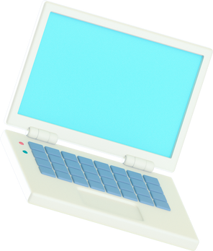

T
N
E
TEN
Click on the lightbulb to reveal the answer
Notes:
Pre-teach vocab (Review Vocab)

Slide 18

T
O
W
TWO
Click on the lightbulb to reveal the answer
Notes:
Pre-teach vocab (Review Vocab)

Slide 19

S
I
X
SIX
Click on the lightbulb to reveal the answer
Notes:
Pre-teach vocab (Review Vocab)

Slide 20

E
N
O
ONE
Click on the lightbulb to reveal the answer
Notes:
Pre-teach vocab (Review Vocab)

Slide 21

R
U
F
O
FOUR
Click on the lightbulb to reveal the answer
Notes:
Pre-teach vocab (Review Vocab)

Slide 22

I
N
N
E
NINE
Click on the lightbulb to reveal the answer
Notes:
Pre-teach vocab (Review Vocab)

Slide 23

E
V
F
I
FIVE
Click on the lightbulb to reveal the answer
Notes:
Pre-teach vocab (Review Vocab)

Slide 24

E
E
V
N
S
SEVEN
Click on the lightbulb to reveal the answer
Notes:
Pre-teach vocab (Review Vocab)

Slide 25

R
E
E
H
T
THREE
Click on the lightbulb to reveal the answer
Notes:
Pre-teach vocab (Review Vocab)

Slide 26

T
E
I
H
G
EIGHT
Click on the lightbulb to reveal the answer
Notes:
Pre-teach vocab (Review Vocab)

Slide 27
GRAMMAR
What number is it?
Number …
five
three
eight
Click on the balloons to reveal the text
Notes:
Ask Ss to tell how to ask about numbers
Show the pictures one by one and have Ss ask the question
Get 1 student answer each picture

Slide 28






The
Missing Number
1
2
4
…
Notes:
- Introduce the activity: The Missing Number

Slide 29
The
Missing Number
RULES
The whole class ask the question about the missing number
1 student answer
1 correct answer = 2 stars
What number is it?
Number …

Slide 30





The Missing Number
What number is it?
Number …
2
3
4
5
Click the smiling star to reveal the number

Slide 31




The Missing Number
What number is it?
Number …
5
6
7
8
Click the smiling star to reveal the number

Slide 32



The Missing Number
What number is it?
Number …
7
8
9
10
Click the smiling star to reveal the number

Slide 33



The Missing Number
What number is it?
Number …
1
3
5
7
Click the smiling star to reveal the number

Slide 34



The Missing Number
What number is it?
Number …
2
4
6
8
Click the smiling star to reveal the number

Slide 35
The Missing Number
What number is it?
Number …
1
4
7
10
Click the smiling star to reveal the number

Slide 36
The Missing Number
What number is it?
Number …
1
1
2
2
4
Click the smiling star to reveal the number

Slide 37
The Missing Number
What number is it?
Number …
1
2
3
5
8
Click the smiling star to reveal the number

Slide 38
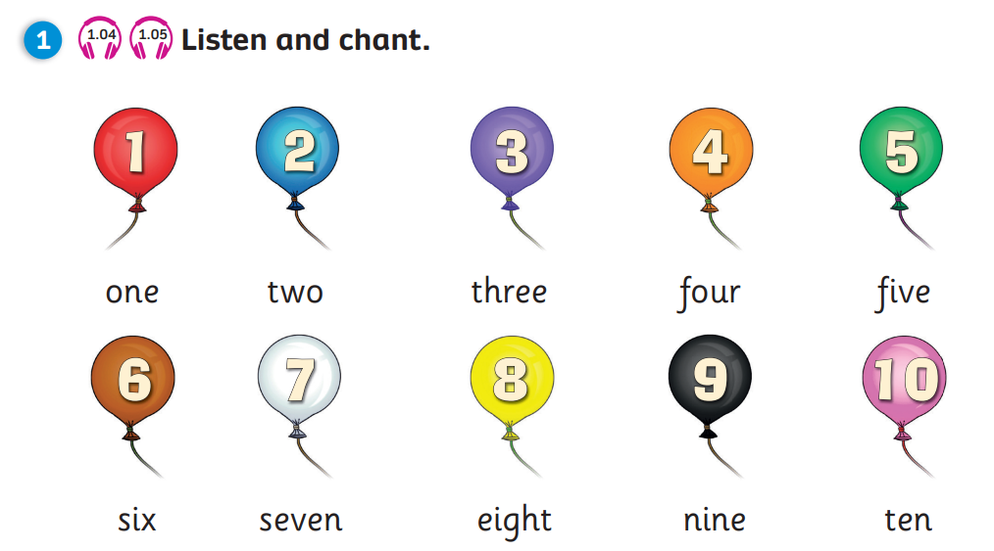

Pupil’s Book (p.10)
Click on the icons 1.04 or 1.05 to play the audios

Slide 39
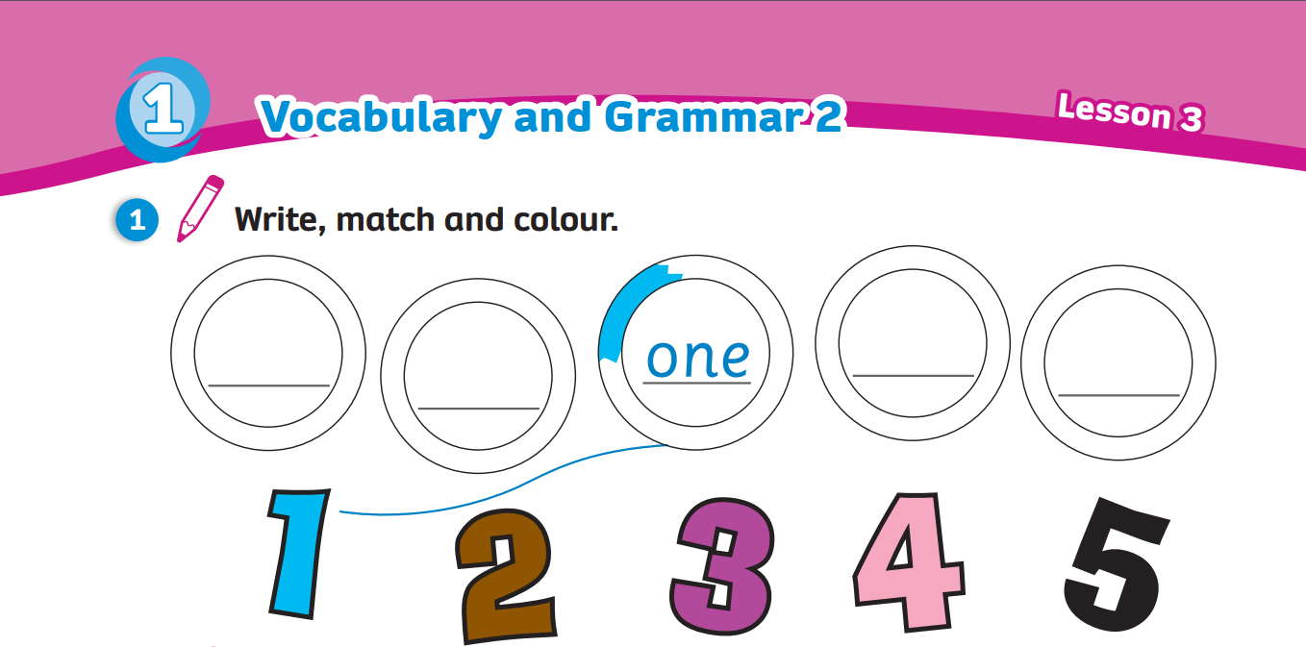
Activity Book (p.10)
Write
Match
three
five
four
two
Colour
Click on “Write, Match, Colour” to reveal the answers

Slide 40
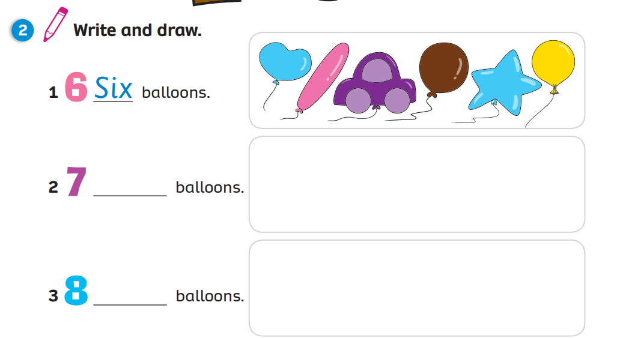


Activity Book (p.10)
1
Six
2
Seven
3
Eight
Click on the squares “1, 2, 3” to reveal the answers

Slide 41
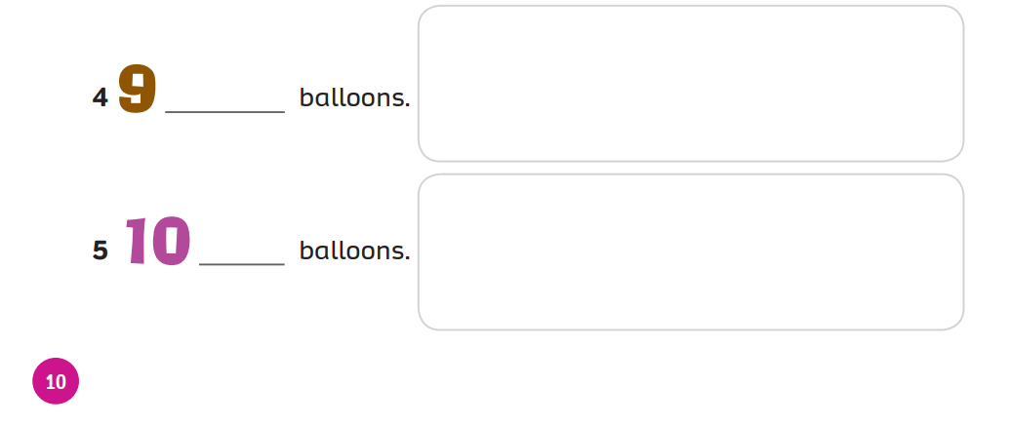
Activity Book (p.10)
Nine
4
5
Ten
Click on the squares “1, 2, 3” to reveal the answers

Slide 42
WRAP-UP
What number is it?
Number …
one
two
three
four
five
six
seven
eight
nine
ten
Click on the balloons to reveal the text
Notes:
Ask Ss “What number is it?”
Click on a random balloon to show the text and have them answer “Number…”

Slide 43


UNIT 1: Lesson 3A
We’ve learned…

