Slide 1





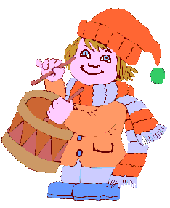
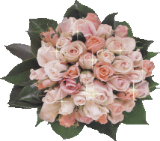


Welcome you to
class 8B
Teacher: Binh Vu

Slide 2

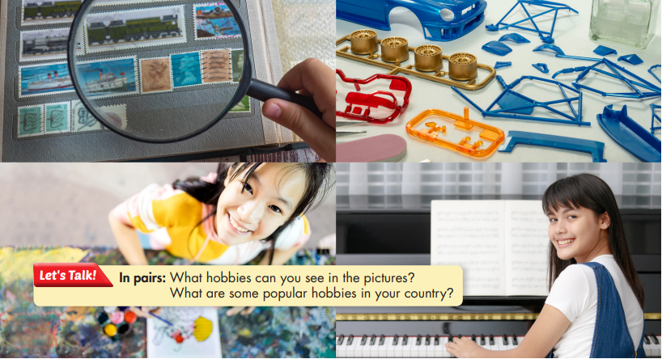
Hobbies in the pictures:
collecting stamps, building models, painting, practicing the piano.
Popular hobbies in Vietnam:
playing sports, hanging out with friends, playing computer games,…

Slide 3
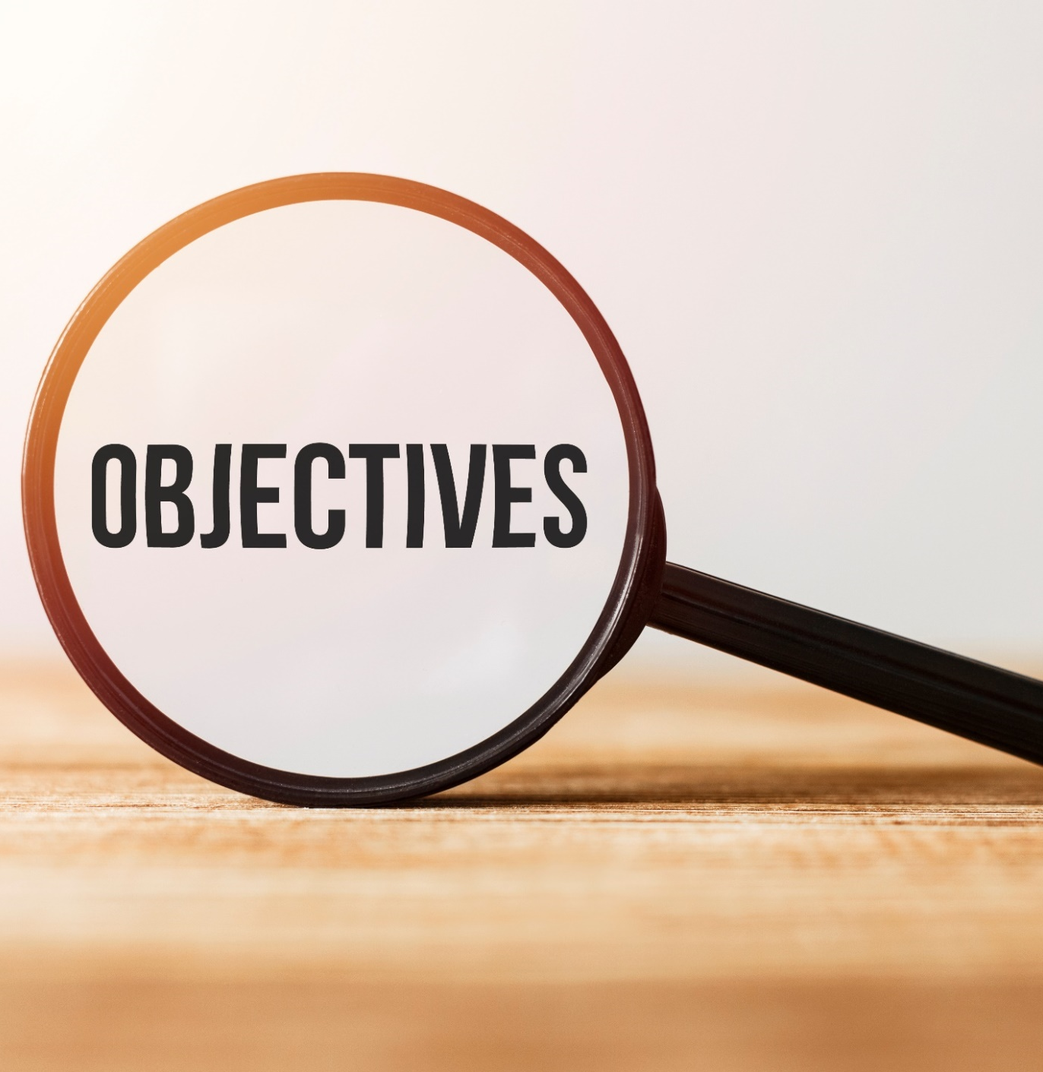
By the end of this lesson, we will be able to practice reading for gist and for detail about a hobby

Slide 4
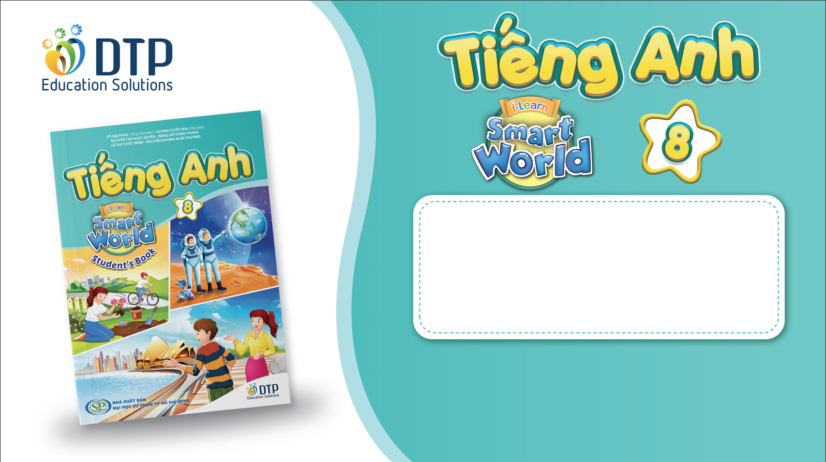
Unit 1: Free Time
Lesson 3.1: Reading
Pages 12

Slide 5


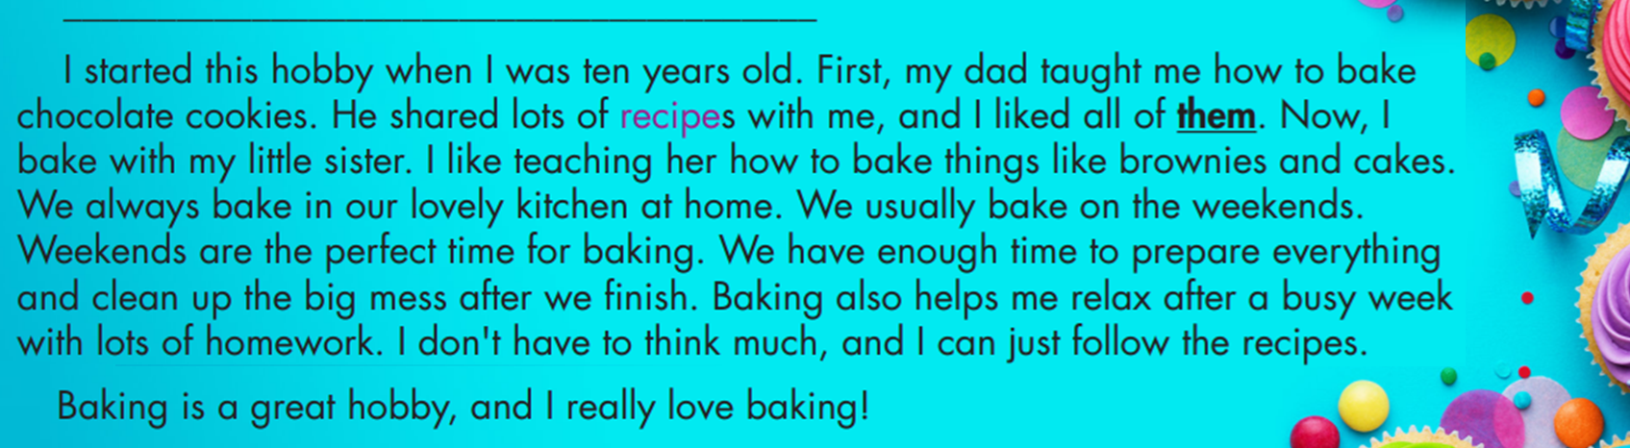
- recipe (n) /ˈresəpi/ công thức nấu ăn
- prepare (v) /prɪˈper/ chuẩn bị
- relax (v) /rɪˈlæks/ thư giãn
- brownie (v) /ˈbraʊni/ bánh socola hạnh nhân
- mess (v) /mes/ tình trạng hỗn độn

Slide 7
1. When did Linh start her favorite hobby?
2. What does the word them in paragraph 2 refer to?
3. Where does Linh do it?
4. When does Linh usually bake?
5. What does baking help Linh do?
- When she was ten.
A. chocolate cookie B. recipies C. hobbies
- She does it in her kitchen.
- She usually bakes on the weekend.
- It helps her relax.

Slide 8

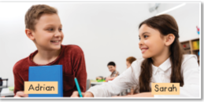
My favorite hobby is playing soccer.
I like playing in a team with my friends.
And what bout you?
What’s your favourite hobby? What do you like best about it?
My favorite hobby is cooking. I like cooking becauseI feel relax.
Suggested situation
Listening to music/relaxing
Sewing/to be a fashion designer
Painting/ to be famous artist
Doing art and craft/my hands are skilful

Slide 9
Homework
Learn the new words by heart and practice reading
Do the reading exercises in workbook (page 6)
Prepare the writing task (page 13 SB)

Slide 10
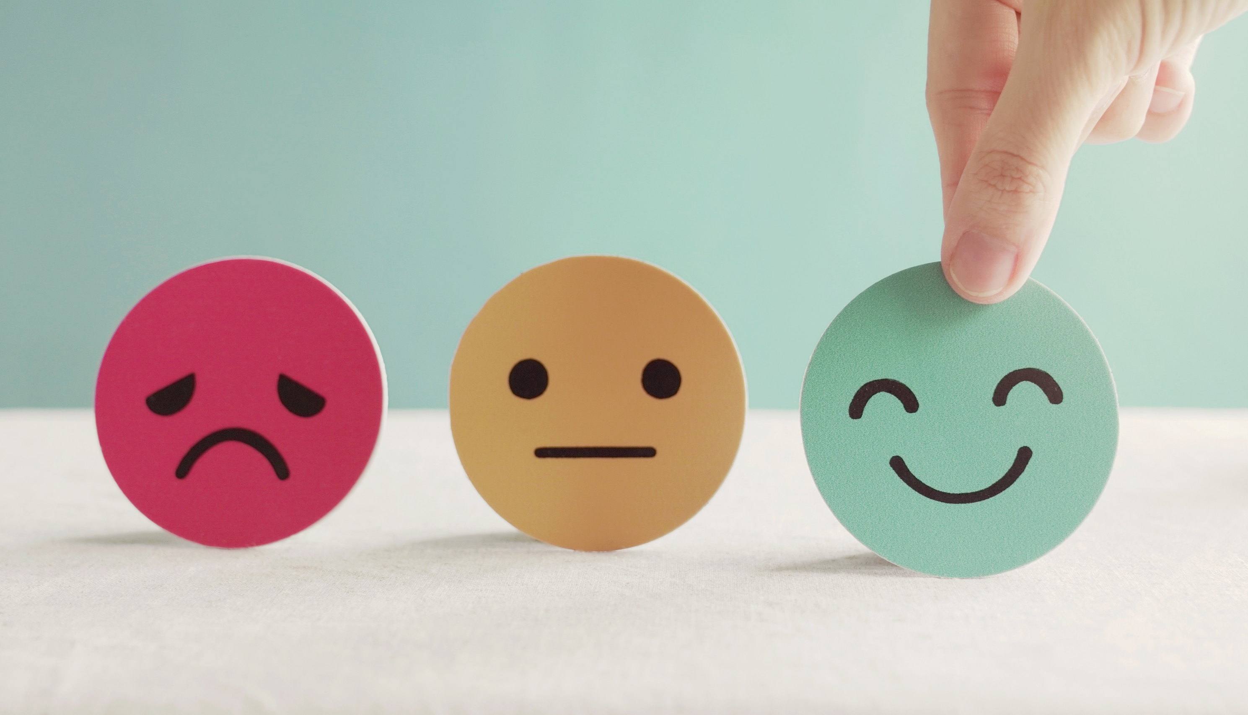
Lesson 3
Stay positive and have a nice day!
Goodbye!

