Slide 1
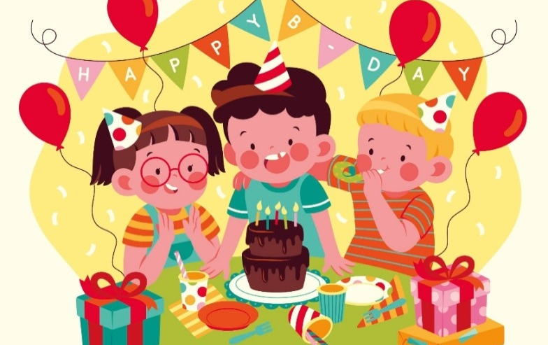
Monday, May 10th 2023
Unit
4
My birthday party
Lesson 1 (4+5+6)

Slide 2
Warm-up

Slide 3
Let’s play!

Slide 4
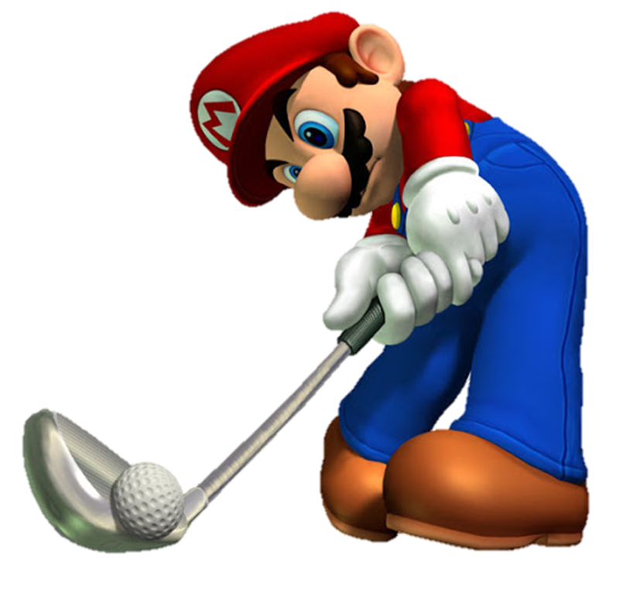
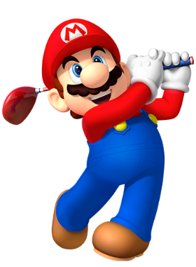
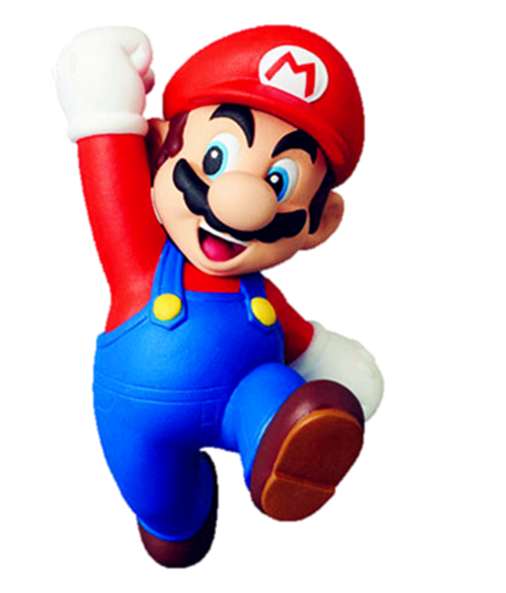

Slide 5
h_
A. et
B. at
C. ut

Slide 6
b__thday
A. ir
B. er
C. or

Slide 7
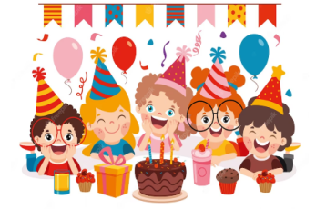
p__ty
A. as
B. ar
C. or

Slide 8
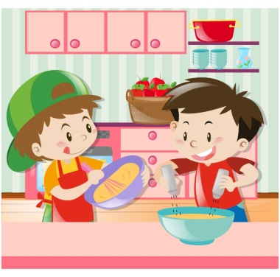
m__e
A. ad
B. ak
C. ok

Slide 9
Ap___
A. rol
B. ple
C. ril

Slide 10
A. Why
B. What
C. When

Slide 11
When’s your birthday?
It’s in __________.
A. June
B. February
C. January

Slide 12
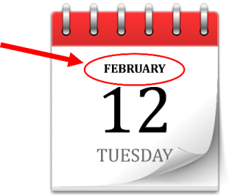
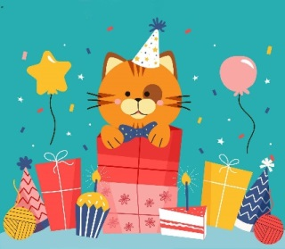
A.
B.
C.

Slide 13
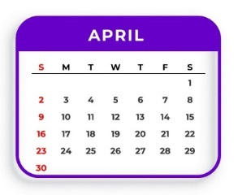
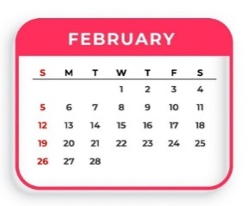
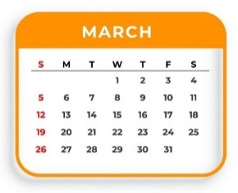
A.
B.
C.

Slide 14
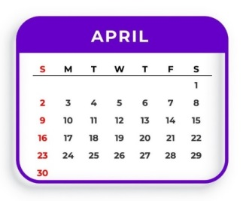
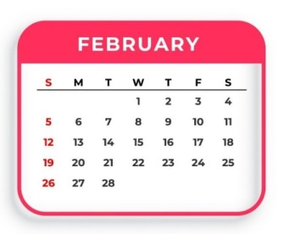
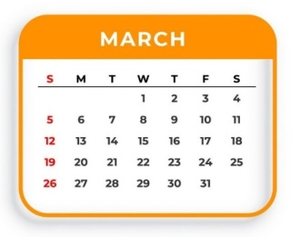
A.
B.
C.

Slide 16
Contents
4
5
6
Listen and number.
Look, complete and read.
Let’s sing.

Slide 17
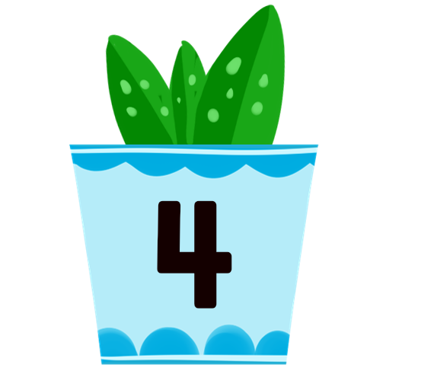
4. Listen and number.
a
b
c
d
2
1
4
3

Slide 18
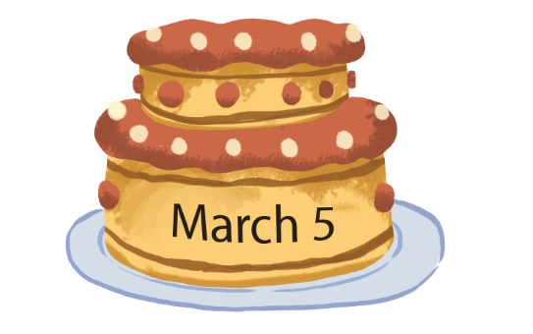
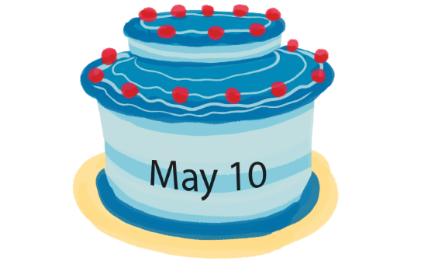
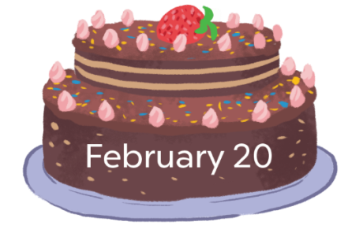
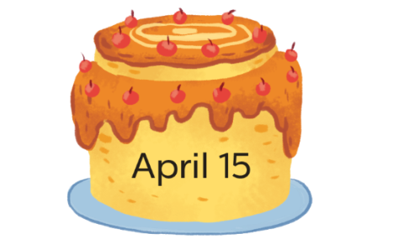
5. Look, complete and read.
1.
A: When’s your birthday?
B: It’s in __________.
2.
A: When’s your birthday?
B: It’s in________.
March
May
3.
4.
A: When’s your ________?
B: It’s in __________.
A: _______ your birthday?
B: It’s ____________.
birthday
When’s
February
in April

Slide 19
6. Let’s sing.
When’s your birthday?
When’s your birthday?
When’s your birthday?
It’s in January.
My birthday’s in January.
When’s your birthday?
When’s your birthday?
It’s in February.
My birthday’s in February.

Slide 21
6. Let’s sing.
When’s your birthday?
When’s your birthday?
When’s your birthday?
It’s in January.
My birthday’s in January.
When’s your birthday?
When’s your birthday?
It’s in February.
My birthday’s in February.

Slide 22
Wrap up

Slide 23
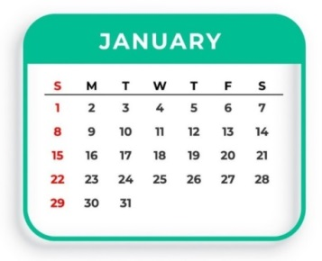
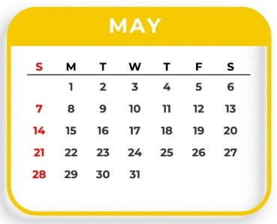
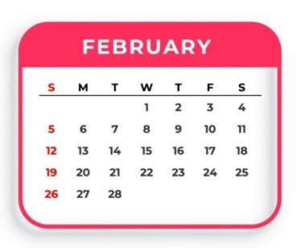
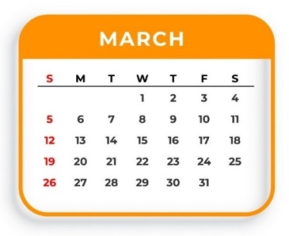
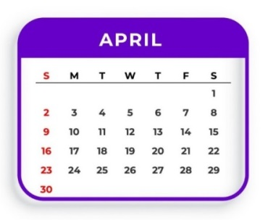
Unit 4 Lesson 1
When’s your birthday?
It’s in _______.
Bùi Liễu 0968142780
It’s = it is

Slide 24
Homework
Learn by heart all the new words.
Read again the dialogue in part 1.

Slide 25
Thank you!

