Slide 1
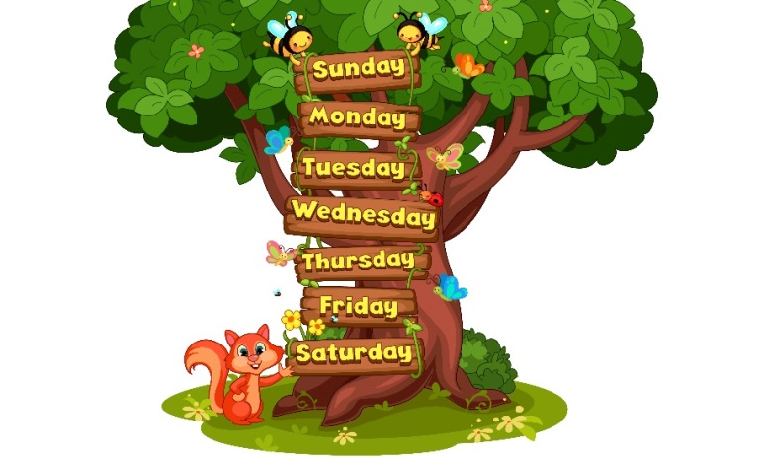
Monday, May 10th 2023
My week
Unit
3
Lesson 1 (4 + 5 + 6)

Slide 2
Warm-up

Slide 3
Let’s sing!

Slide 4
Let’s sing.

Slide 5
Contents
4
4
5
5
6
6
Listen and tick.
Look, complete and read.
Let’s play.

Slide 6
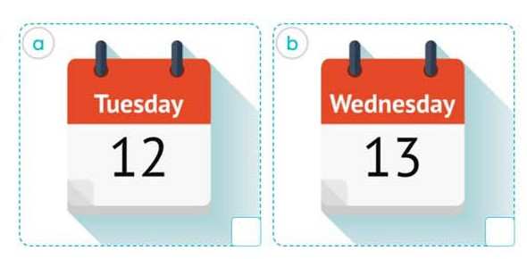
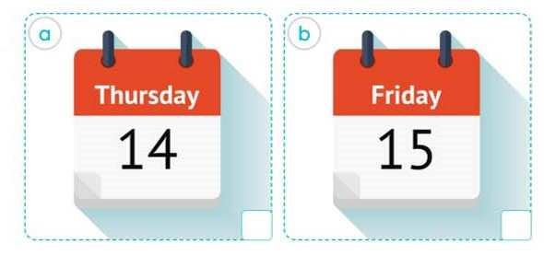
4. Listen and tick.
2.
1.
a
b
a
b
Bùi Liễu 0968142780

Slide 7
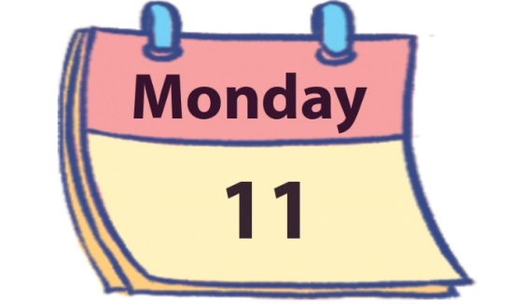
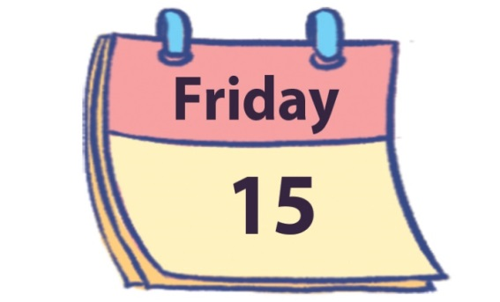
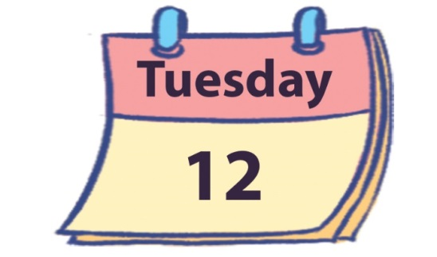
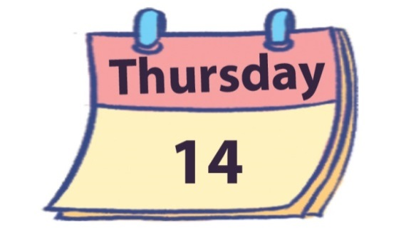
5. Look, complete and read.
1.
A: What day is it today?
B: It’s ________.
2.
A: What day is it today?
B: It’s _________.
Monday
Friday
3.
4.
today
What day
A: What day is it________?
B: _________________.
A: __________ is it today?
B: _______ Tuesday.
It’s
It’s Thursday

Slide 8
6. Let’s play.
Slap the board

Slide 9
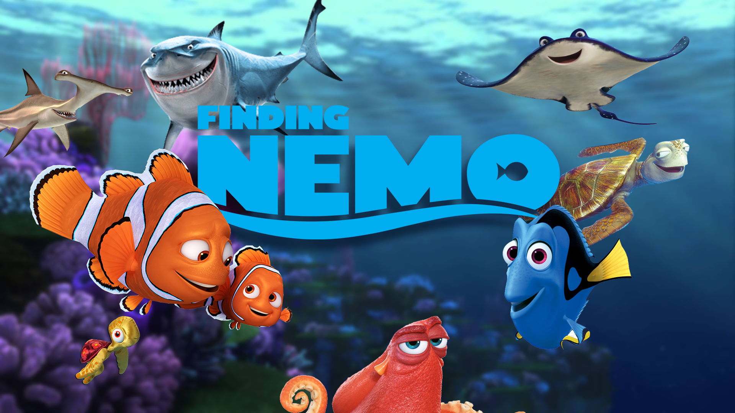

Slide 10
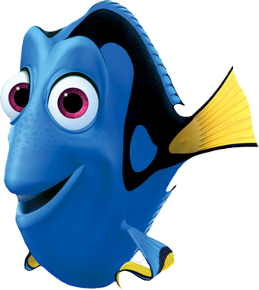
What day is it today?
It’s Thursday
It’s Monday.
It’s Sunday.

Slide 11
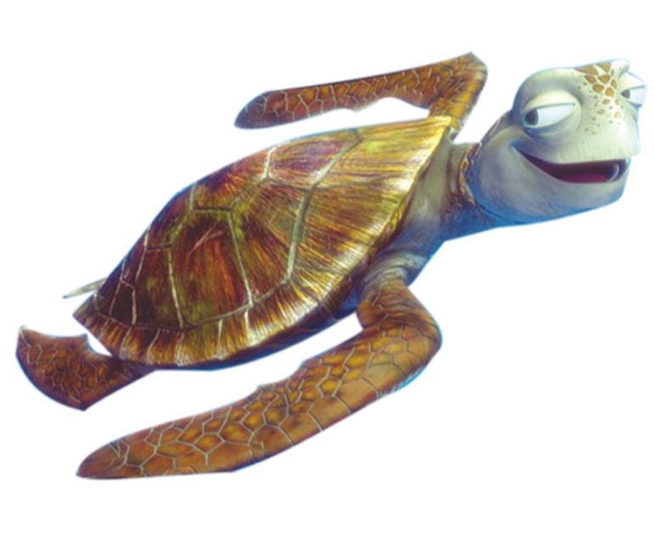
What day is it today?
It’s Wednesday.
It’s Saturday.
It’s Tuesday.

Slide 12
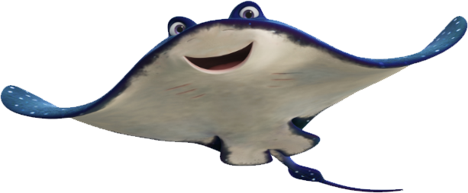
What day is it today?
It’s Sunday.
It’s Wednesday.
It’s Friday.

Slide 13
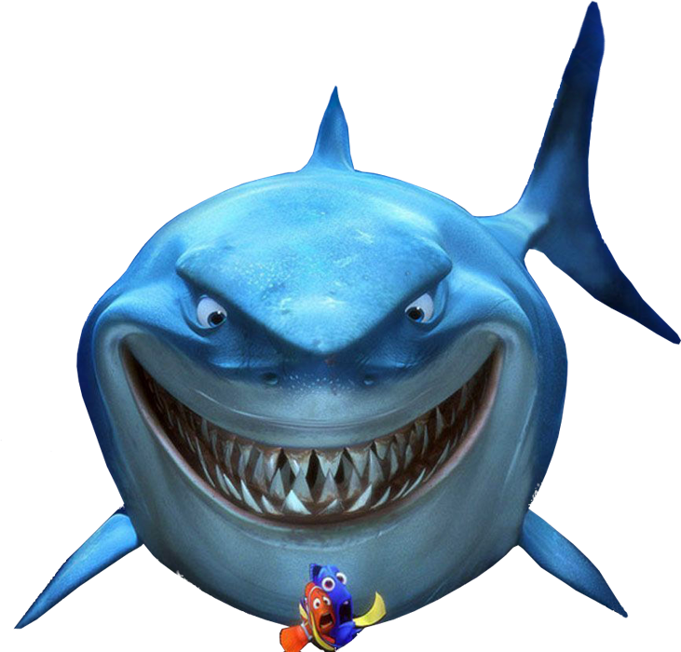
What day is it today?
It’s Monday.
True
False

Slide 14
What day is it today?
It’s Sunday.
Bùi Liễu 0968142780
False
True

Slide 15
It’s ___day.
Fri
Satur
Tues

Slide 16
Wed___day
es
nen
nes

Slide 17
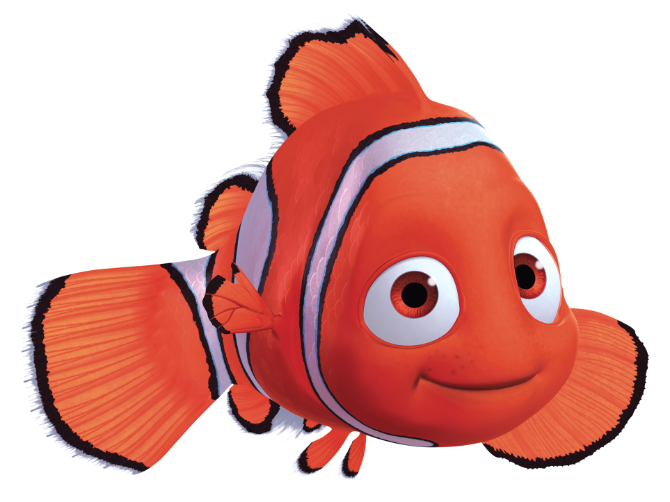
A: ______ day is it today?
B: It’s Saturday.
What
When
Where

Slide 18
Listen and choose:
A: What day is it _______?
B: It’s _________.
today / Monday
today / Thursday
yesterday / Thursday

Slide 19
Listen and choose:
A: What day _____ today?
B: It’s ___________.
is it / Saturday
are there/Wednesday
is it / Wednesday

Slide 20
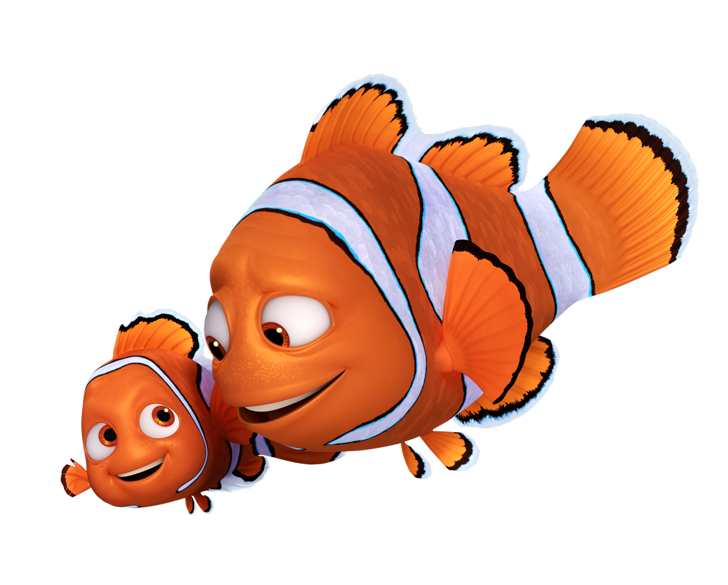

Slide 21
Wrap up

Slide 22
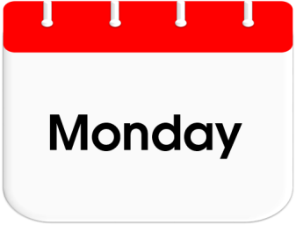
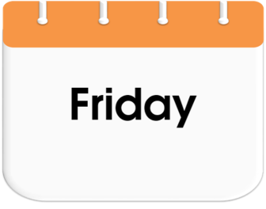
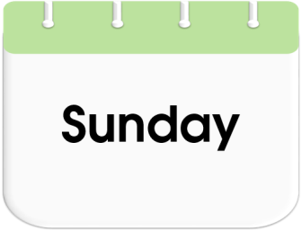
Unit 3 lesson 1
Bùi Liễu 0968142780
What day is it today?
It’s _______.
it’s = it is

Slide 23
Homework
……………………………………....
………………………………………

Slide 24
Thank you!

