Slide 2


Slide 3

Unit
5
1
Unit
FAMILY LIFE
INVENTIONS
LESSON 8
LOOKING BACK AND PROJECT

Slide 4

Unit
1
1
FAMILY LIFE
Family Life
Unit
OBJECTIVES
Review the vocabulary, pronunciation and grammar of Unit 5;
Apply what students have learnt into practice through a project.

Slide 5
LESSON 8
LOOKING BACK AND PROJECT
WARM-UP
Brainstorming
Pronunciation and vocabulary
Solve the crossword.
Grammar
Circle the correct answers.
LOOKING BACK
PROJECT
Inventions for the classroom
CONSOLIDATION
Wrap-up
Homework

Slide 6
LESSON 8
LOOKING BACK AND PROJECT
WARM-UP
Brainstorming

Slide 7

BRAINSTORMING
Brainstorm three-syllable nouns about topic Inventions
Camera
Inventor
Submarine
Invention
Telegraph
Computer
Telescope
Telephone
Beverage
Typewriter

Slide 8
LESSON 8
LOOKING BACK AND PROJECT
WARM-UP
Brainstorming
Pronunciation and vocabulary
Solve the crossword.
Grammar
Circle the correct answers.
LOOKING BACK

Slide 9
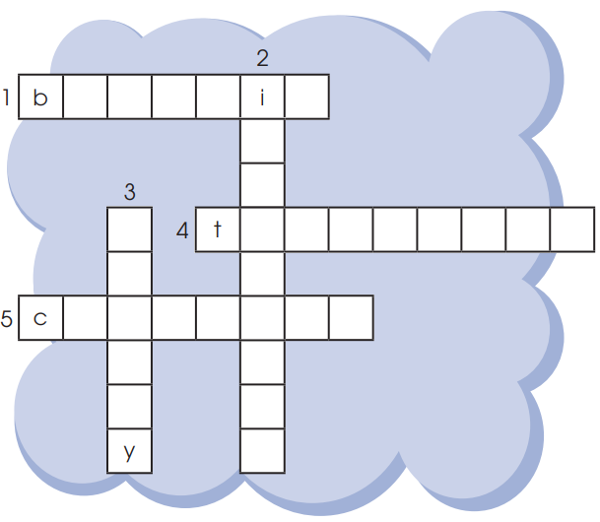
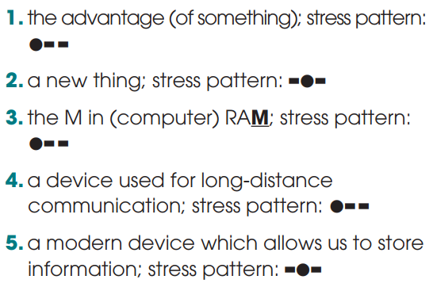
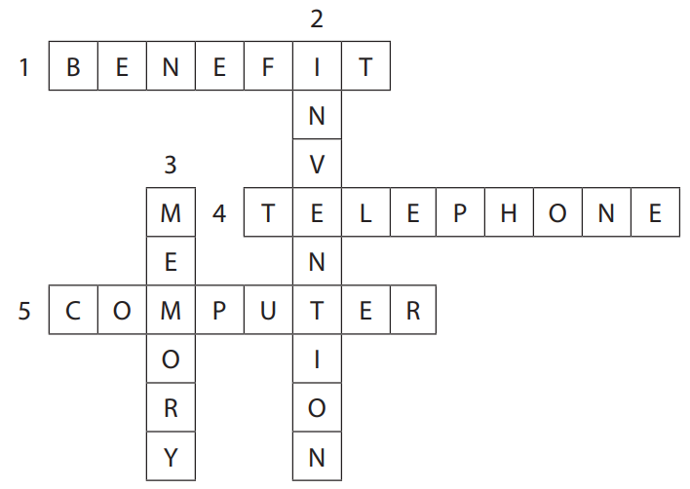
PRONUNCIATION & VOCABULARY
Solve the crossword.
benefit
invention
memory
telephone
computer

Slide 10
GRAMMAR
Circle the correct answers.
1. They just installed / have just installed some interesting software on the school computers. The programs are working very well and everyone enjoys to use / using them.
2. Smartphones allow people sending / to send information over long distances. Learn / To learn with a smartphone is fun as well.
3. Since television was invented / has been invented, TV designs changed / have changed a lot.

Slide 11
LESSON 8
LOOKING BACK AND PROJECT
WARM-UP
Brainstorming
Pronunciation and vocabulary
Solve the crossword.
Grammar
Circle the correct answers.
LOOKING BACK
PROJECT
Inventions for the classroom

Slide 12
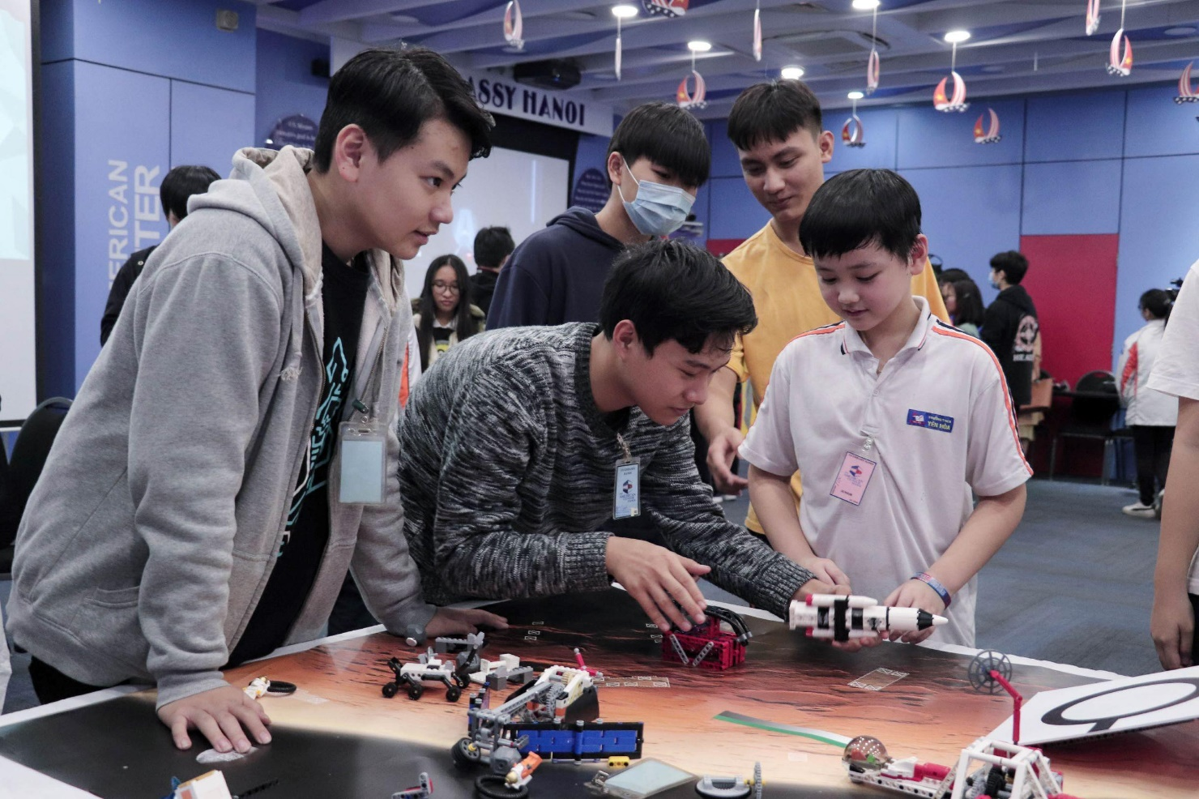
PROJECT
Inventions for the classroom

Slide 13
PROJECT
STUDENT WORK IN GROUP OF 3,4
MAKE ATLEST 5 SILDES TO PRESENT IDEAS ABOUT “inventions for the class)
Name of the invention
What is it look like?
What is/are it/ they used for)
……
Present in front of the class, the other group comment and score

Slide 14
LESSON 8
LOOKING BACK AND PROJECT
WARM-UP
Brainstorming
Pronunciation and vocabulary
Solve the crossword.
Grammar
Circle the correct answers.
LOOKING BACK
PROJECT
Inventions for the classroom
CONSOLIDATION
Wrap-up
Homework

Slide 15
CONSOLIDATION
1
Wrap-up
Review the vocabulary, pronunciation and grammar of Unit 5;
Apply what students have learnt into practice through a project.

Slide 16
CONSOLIDATION
2
Homework
Prepare for the next lesson: Unit 6_Getting started
Do exercises in the workbook

Slide 17

Website: hoclieu.vn
Fanpage: facebook.com/golbalsuccess.vn/

