Slide 1
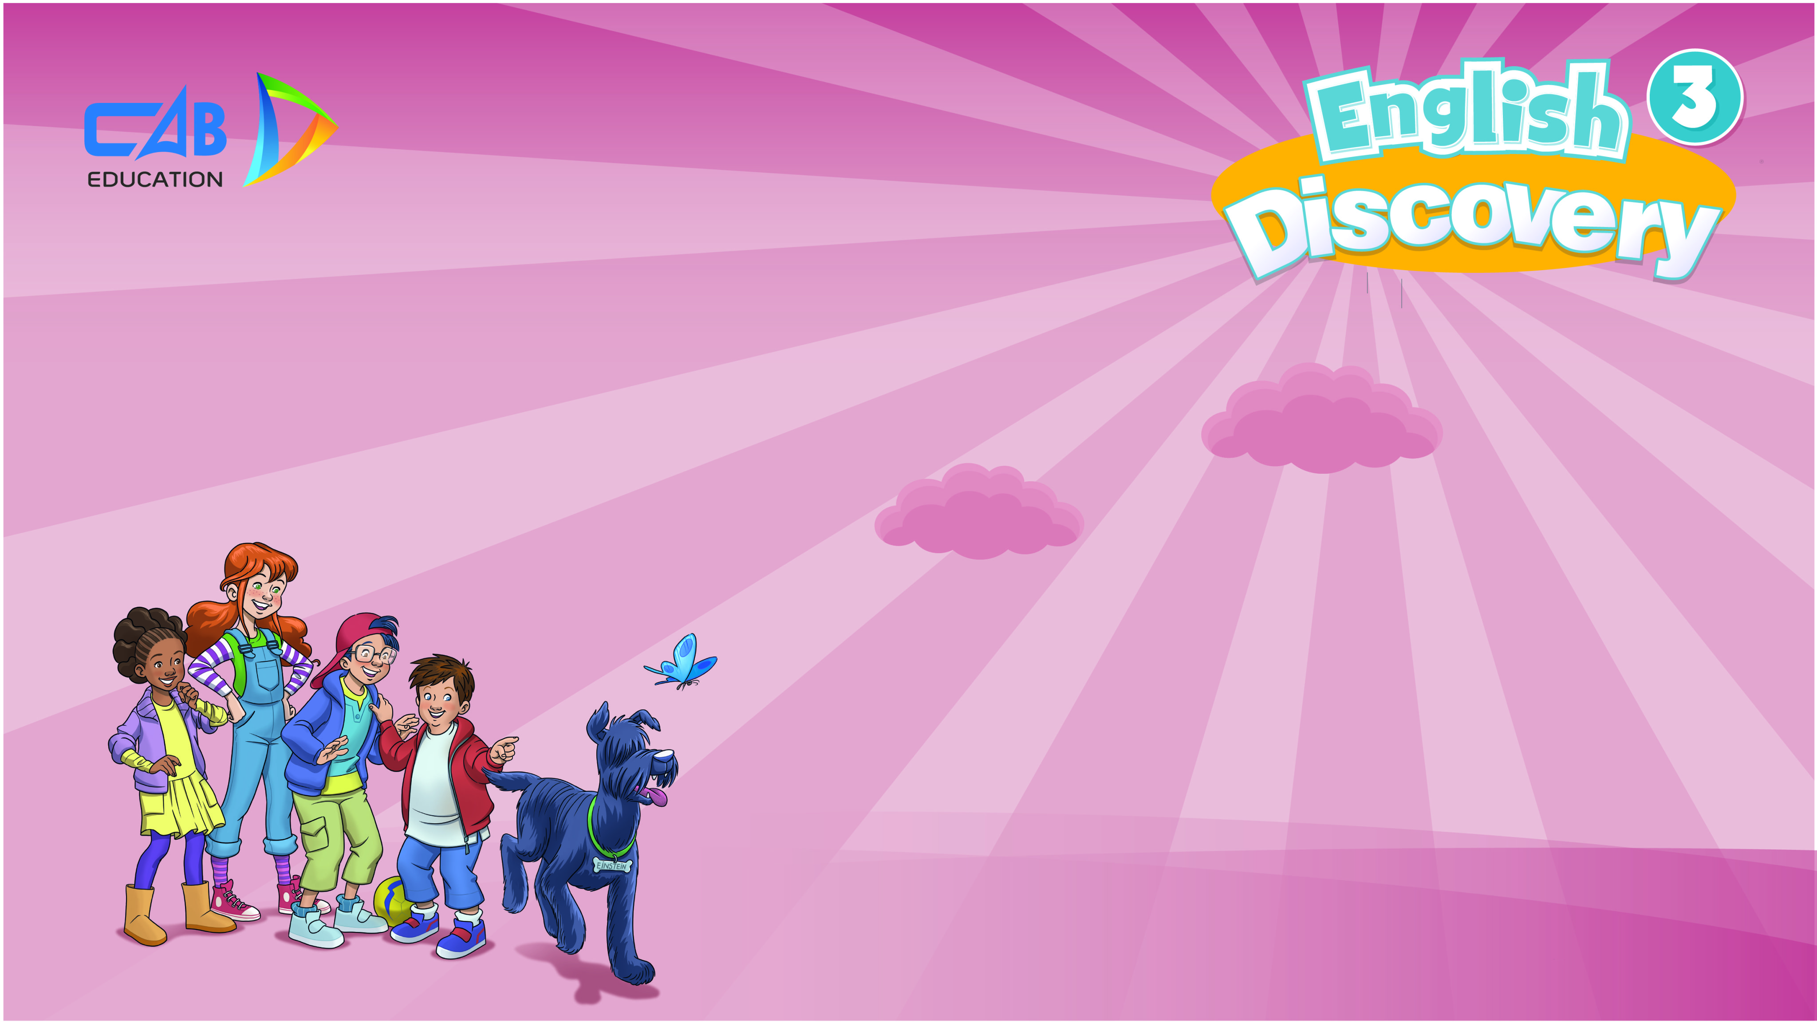
Monday, February 23rd 2026
UNIT 7: DO YOU LIKE PEAS?
Lesson 4 – Phonics

Slide 2

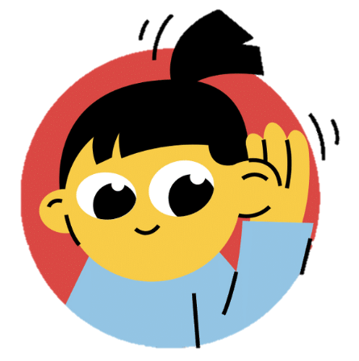
LEAD-IN
Song: Sounds of the letters
Stand up.
Listen to the song.
Clap your hands and sing along.

Slide 3
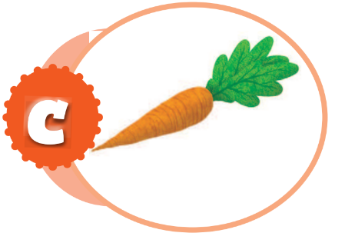
Sound of “c”
Letter
Sound
C
/k/
arrot
c

Slide 4

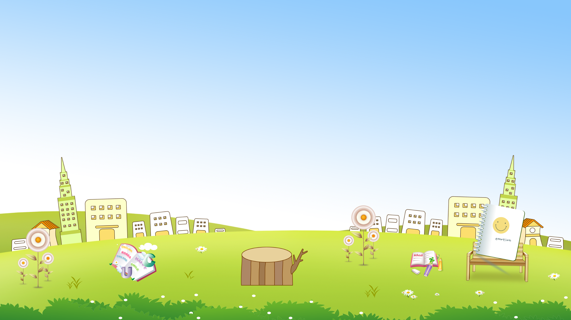

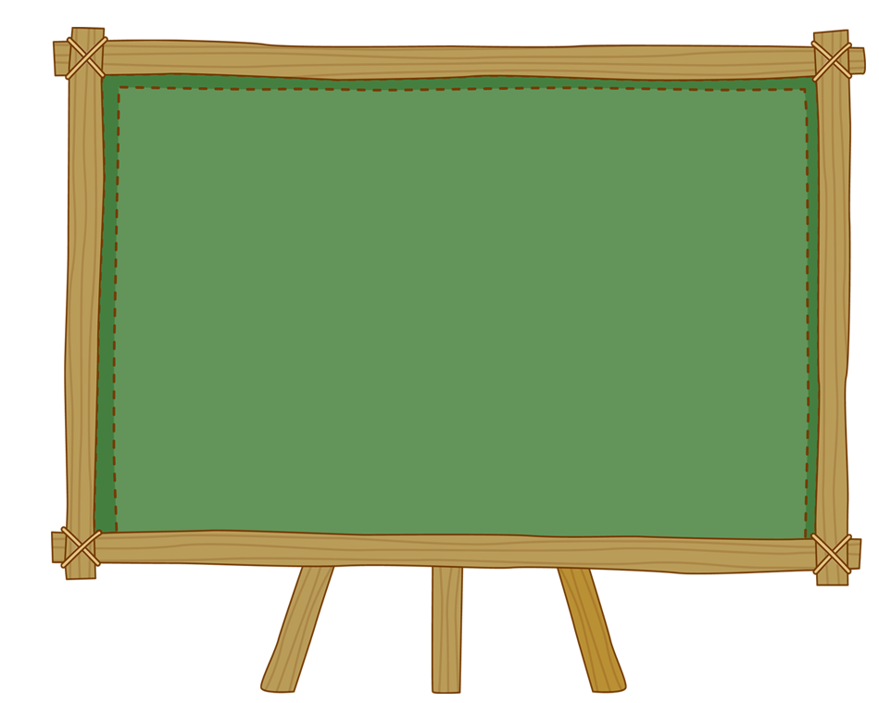



C

Slide 5
C
c

Slide 6
c c
carrot
?

Slide 7

The sound of “c”

Slide 8
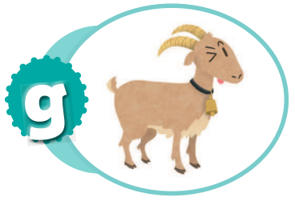
Sound of “g”
Letter
Sound
g
/g/
g
oat

Slide 9

G g

Slide 10
/g/

Slide 11
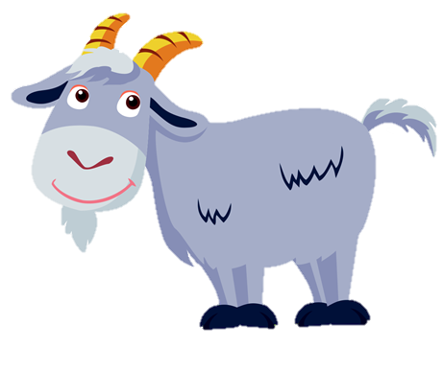
?
g g goat

Slide 12

The sound of “g”

Slide 13
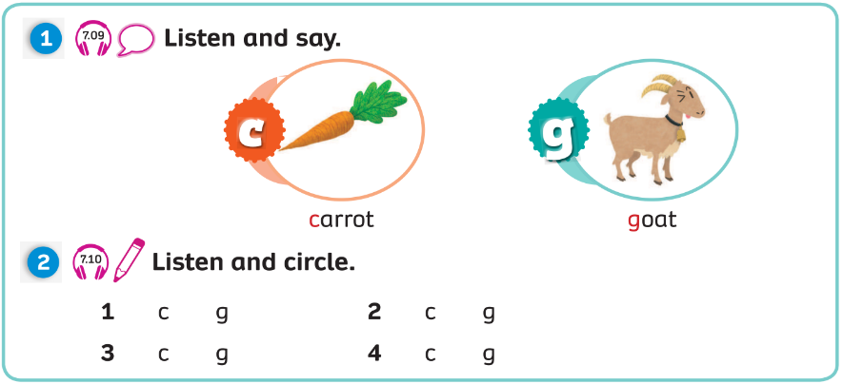
Pupils’ Book (p.92)

Slide 14
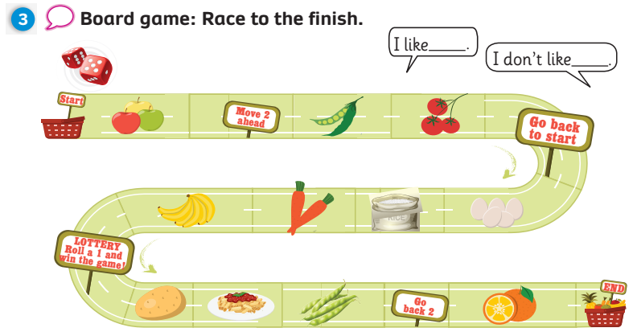
Pupil’s Book (p.92)

Slide 15
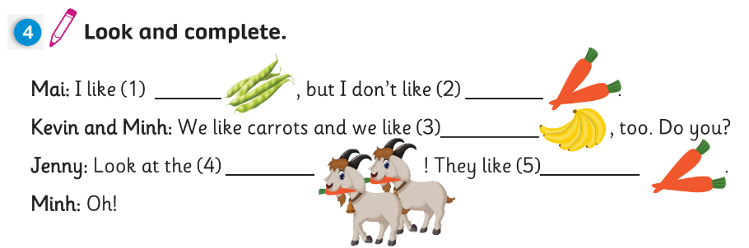
Pupil’s Book (p.92)
beans
carrots
bananas
goats
carrots

Slide 16

Activity Book (p.73)
1
1
1
1
2
0

Slide 17
Activity Book (p.73)
beans
I like pasta
I don’t like carrots

Slide 18
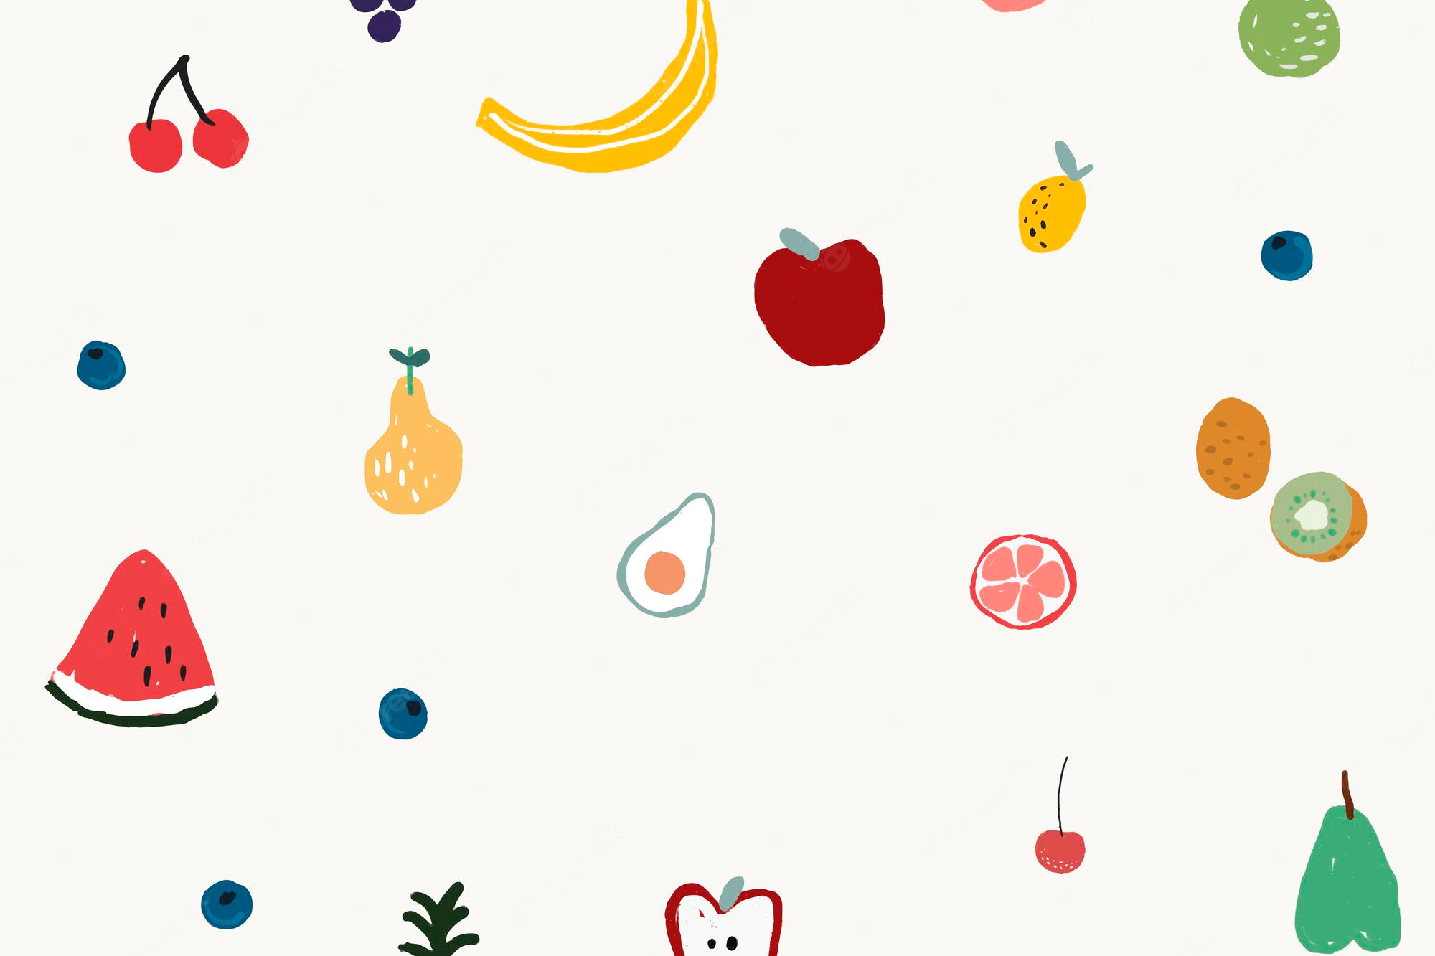
Activity Book (p.73)

Slide 19
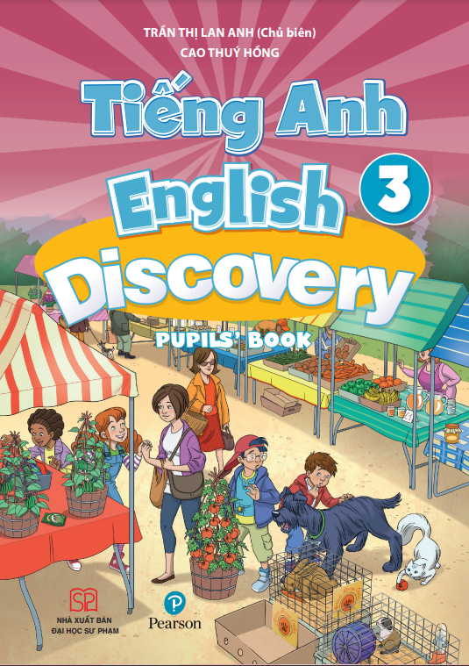

UNIT 7: Lesson 4
We’ve learnt…
- the sound of letter “c” and “g”
- Pupils’ Book p.92
- Activity Book p.73

