Slide 1

Tuesday, February 10th 2026
UNIT 7: DO YOU LIKE PEAS?
Lesson 1A – Vocabulary and Grammar 1
Teacher: Truong Vu Nhat Phuong

Slide 2

Notes:
Lead in to the topic

Slide 3
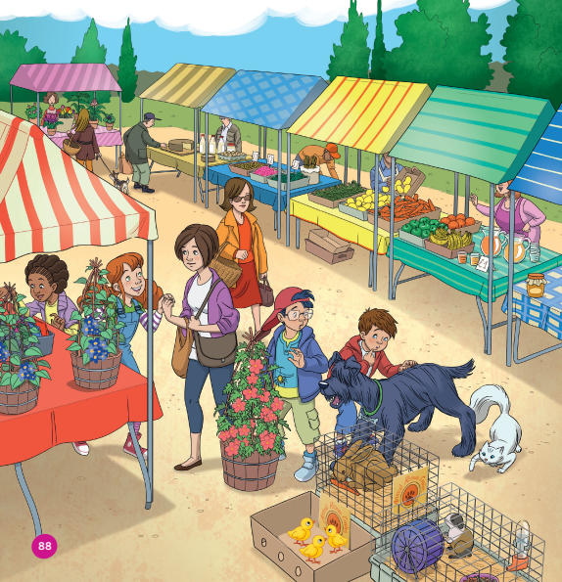
Where are they?
List out all things you can remember.
Notes:
Get Ss observe the picture in 1 minute, then list out all things they remember.

Slide 4

VOCABULARY

Slide 5



Slide 6
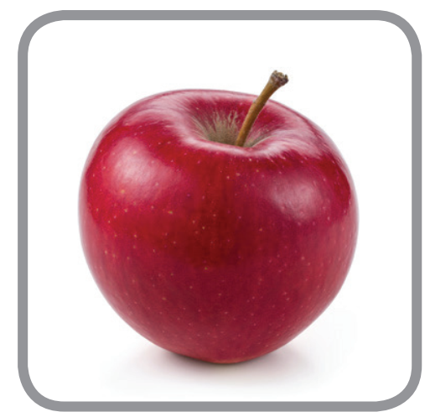
apple
Let’s spell!
a
p
p
l
e

Slide 7
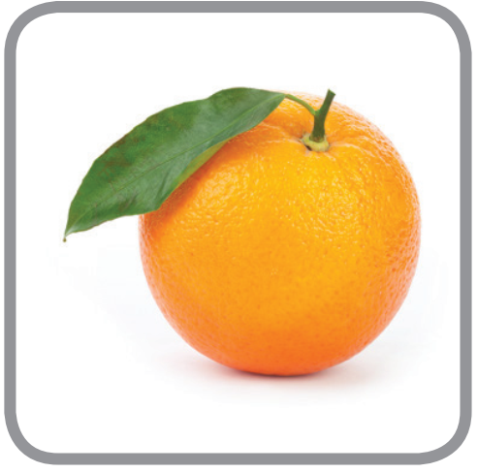
orange
Let’s spell!
o
r
a
n
g
e

Slide 8

banana
Let’s spell!
b
a
n
a
n
a

Slide 9

carrot
Let’s spell!
c
a
r
r
o
t

Slide 10
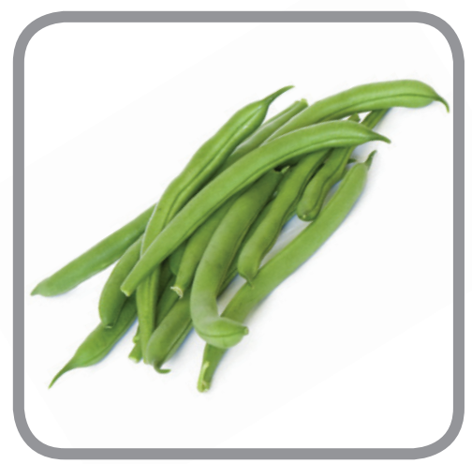
beans
Let’s spell!
b
e
a
n
s

Slide 11

What’s missing?
Let’s Play!

Slide 13
apple
banana
beans
orange
carrot

Slide 14

an apple
two apples

Slide 15

an orange
?
two oranges

Slide 16

a banana
?
two bananas

Slide 17

a carrot
two carrots
?

Slide 18
GRAMMAR

Slide 19
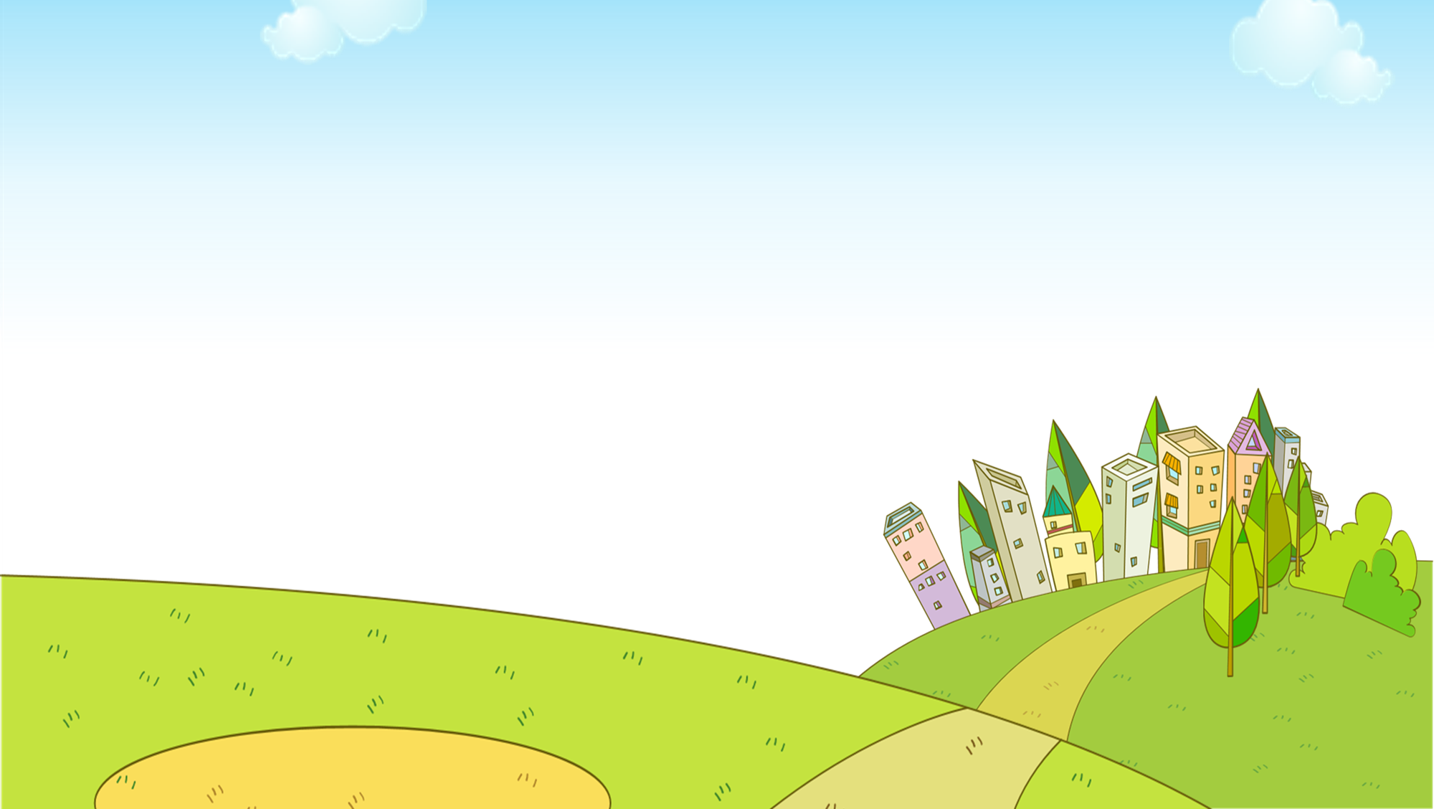

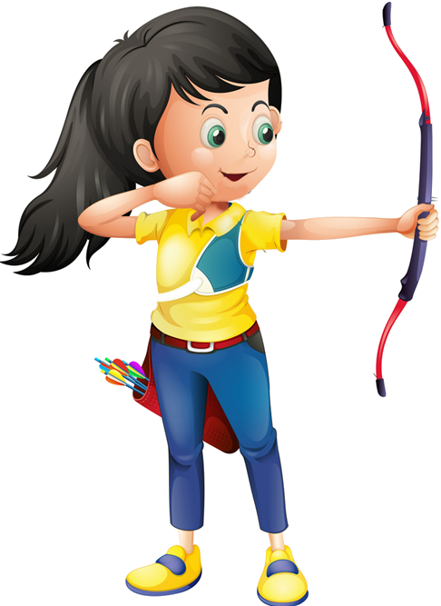





Slide 20
There are 5 sentences.
Students choose the correct answer by showing fingers.
1 student says aloud the answer.
1 correct answer = 1 point.
The whole class then says aloud the correct sentence.

Slide 21



a banana
a bananas

Slide 22
an oranges
two oranges

Slide 23
an apples
an apple

Slide 24
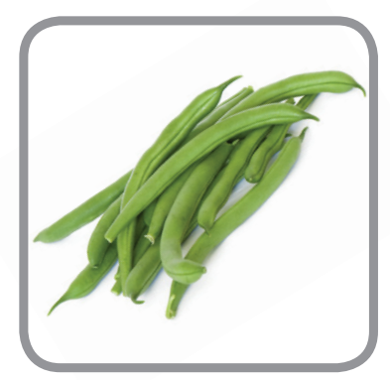
bean
beans

Slide 25
carrot
carrots

Slide 26

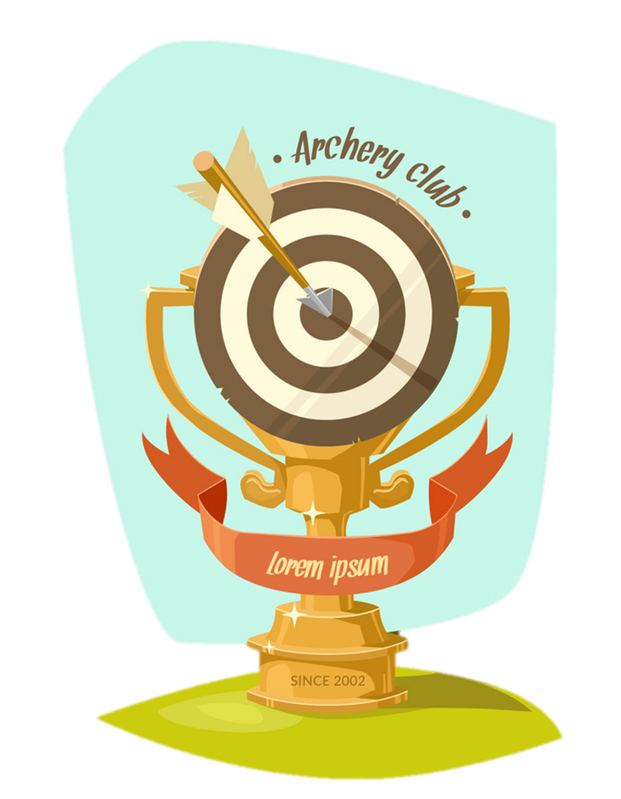
EXIT

Slide 27
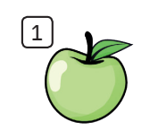
Look and complete
A
P
P
L
E

Slide 28
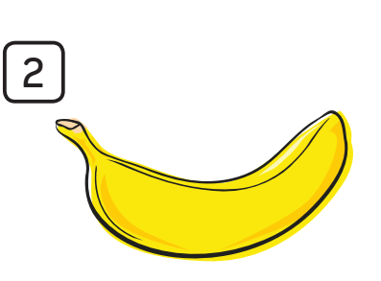
Look and complete
B
A
N
A
N
A

Slide 29
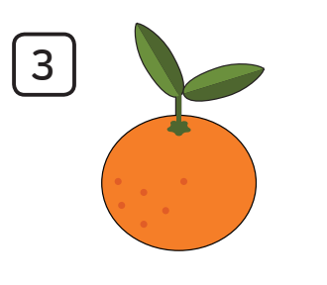
Look and complete
O
R
A
N
G
E

Slide 30
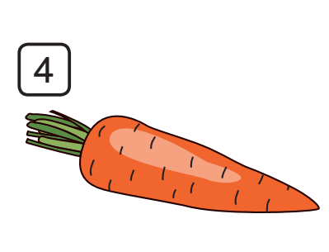
Look and complete
C
A
R
R
O
T

Slide 31
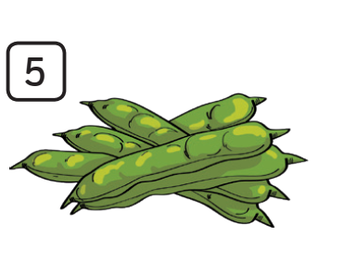
Look and complete
B
E
A
N
S

Slide 32


