Slide 1

UNIT 4: MOVE YOUR BODY!
Lesson 1A – Vocabulary and Grammar 1

Slide 2
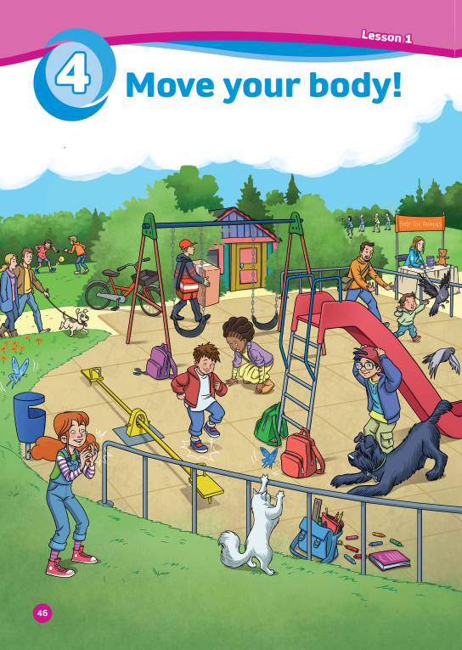
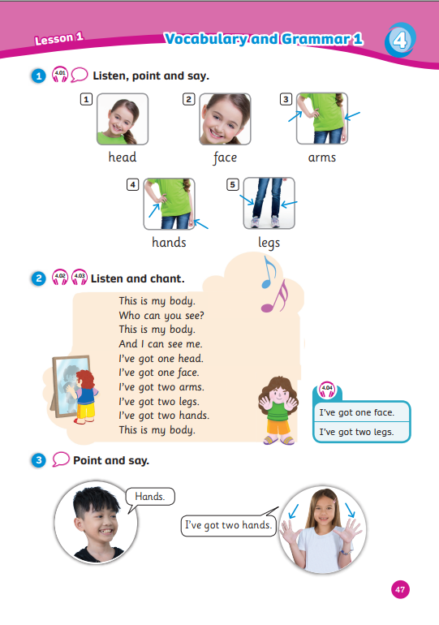
UNIT 4:
MOVE YOUR BODY!
We’re learning…
- body parts
- to ask and answer about body parts
- SB p.46 – 47
- AB p.38

Slide 3


Song: Head Shoulders Knees & Toes
WARM-UP
All students stand up.
Listen to the song.
Dance along.

Slide 4
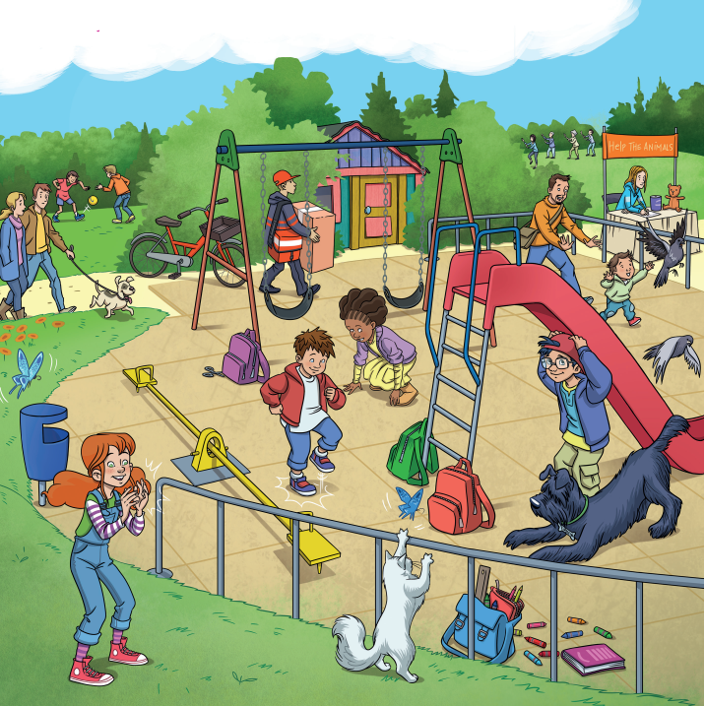
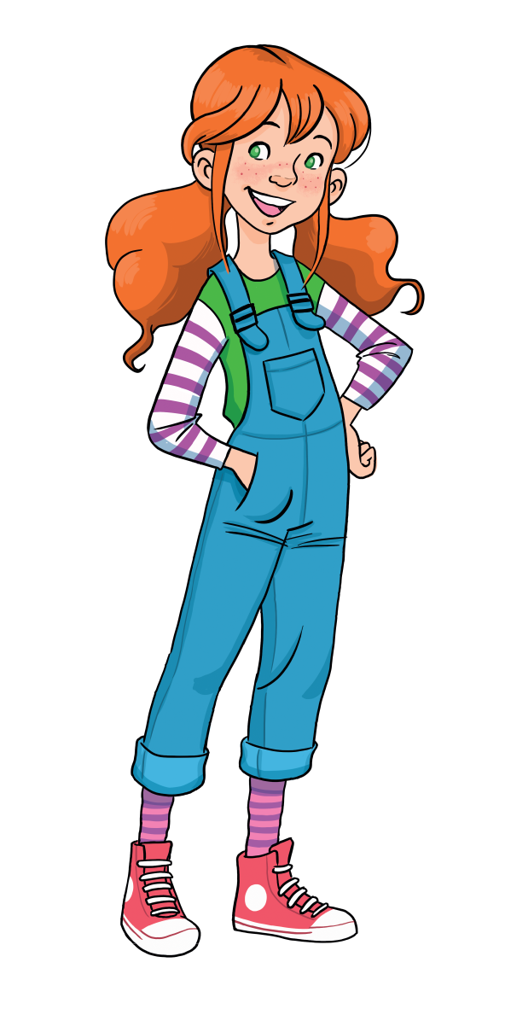
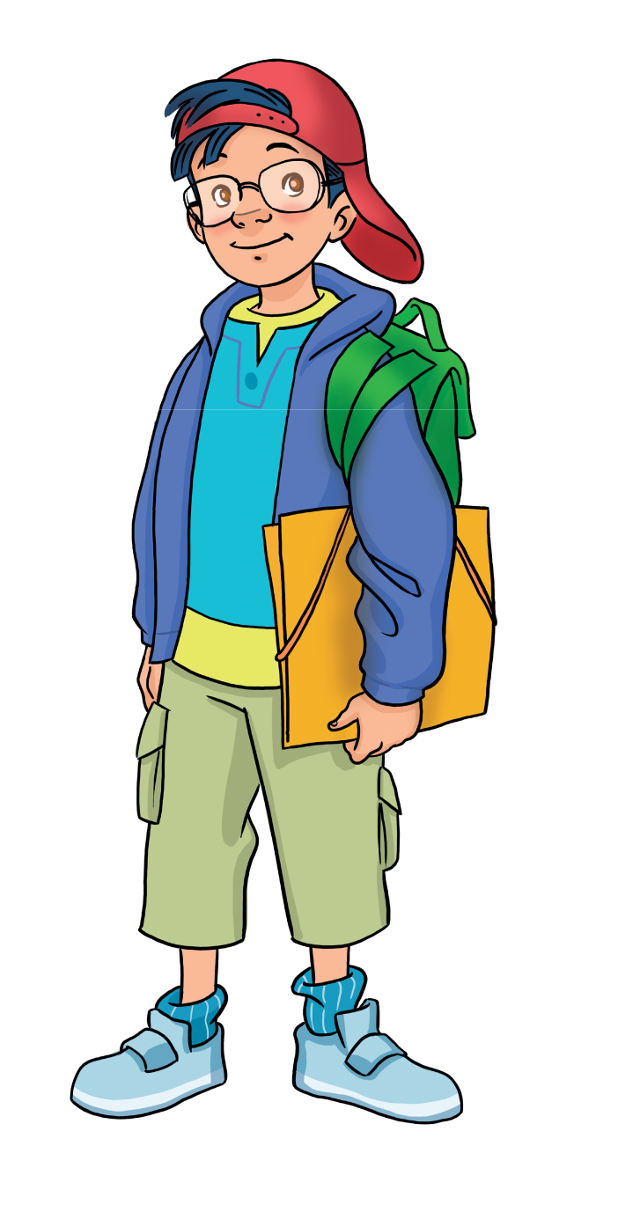
LEAD-IN
Find a book, a teddy and crayons!
What colour is the book?
Where is the teddy?
Notes:
Ask Ss to look at the picture and locate “a book, a teddy and crayons.”
Place Ss in pairs. Tell them that they have 1 minute to answer the following questions:
+ What colour is the book?
+ Where is the teddy?

Slide 5
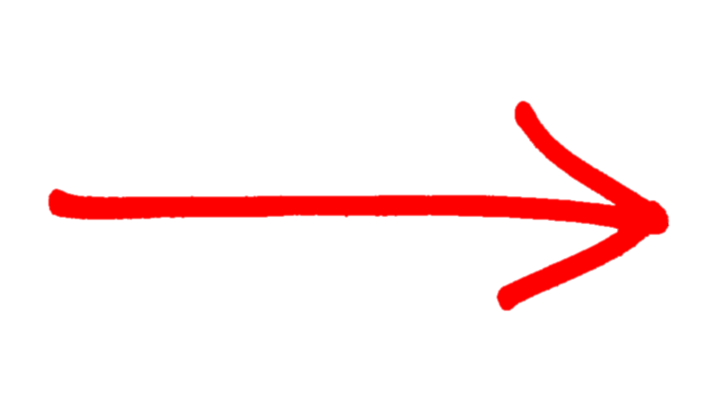
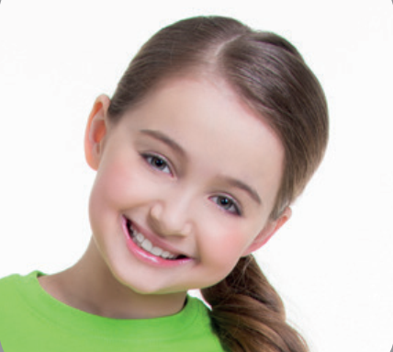

VOCABURALY: Body parts
What’s this?
This is my …
head
Let’s spell!
h
e
a
d

Slide 6
VOCABURALY: Body parts
What’s this?
This is my …
face
Let’s spell!
f
a
c
e

Slide 7
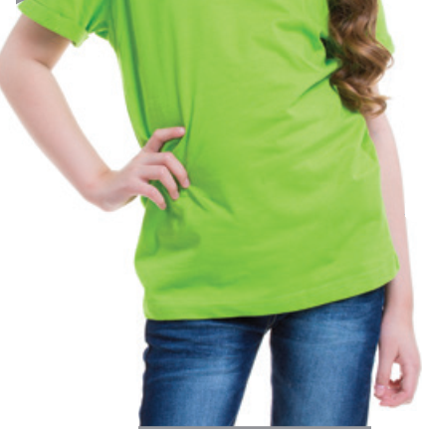
VOCABURALY: Body parts
What are these?
These are my …
arms
Let’s spell!
a
r
m
s

Slide 8
VOCABURALY: Body parts
What are these?
These are my …
hands
Let’s spell!
h
a
n
d
s

Slide 9
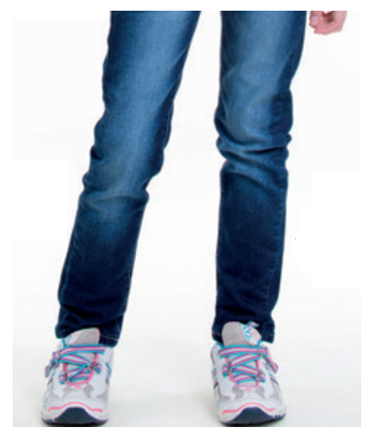
VOCABURALY: Body parts
What are these?
These are my …
legs
Let’s spell!
l
e
g
s

Slide 10
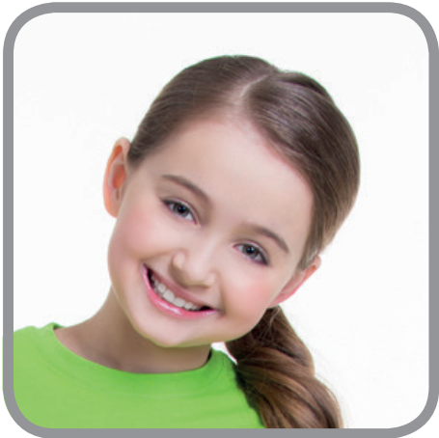
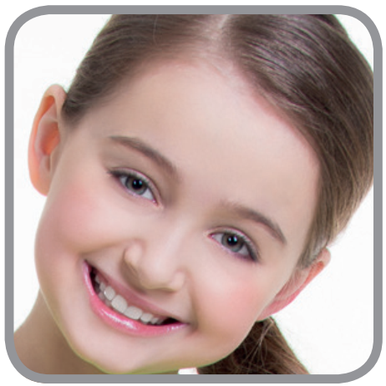
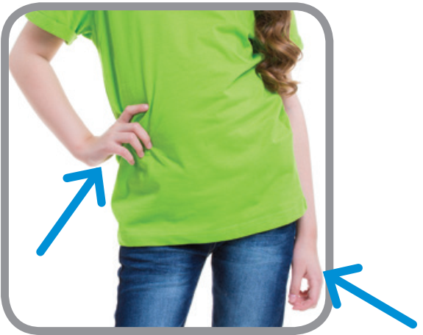
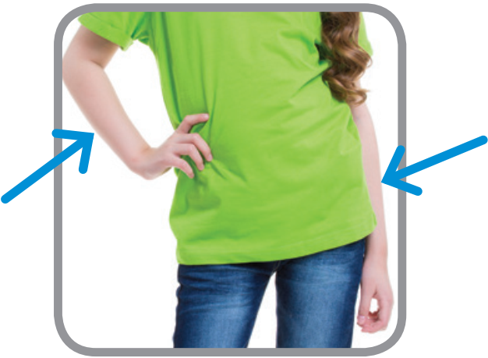
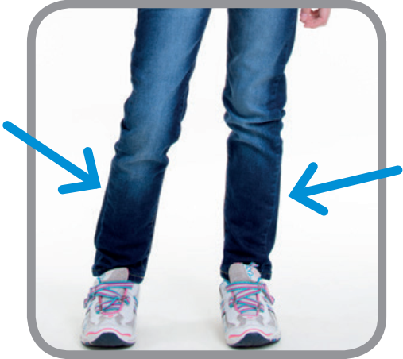
VOCABURALY: Body parts
head
face
hands
arms
legs

Slide 11

MEMORY GAME
Let’s Play!

Slide 12

MEMORY GAME
Rules
12 numbers on the slide:
  5 pictures and 5 words behind the numbers.
  2 lucky stars with given points.
Each student chooses 2 numbers and gets 1 point for a match.
1 student asks the question, the whole class answers after each match.
Note:
- Click the card or number to show a picture.
- Click the heart to hide the picture.
Let’s Play!
1

Slide 13

1. What is this? – This is my …
2. What are these? – These are my …
head
legs
+3
1
2
3
4
hands
8
5
6
7
arms
face
9
+2
12
10
11
Notes:
- Click the card or number to show a picture.
- Click the heart to hide the picture.

Slide 14
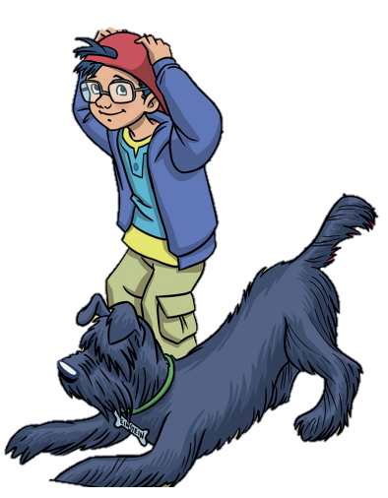
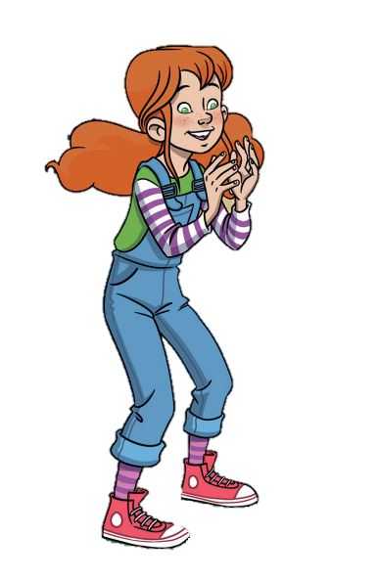
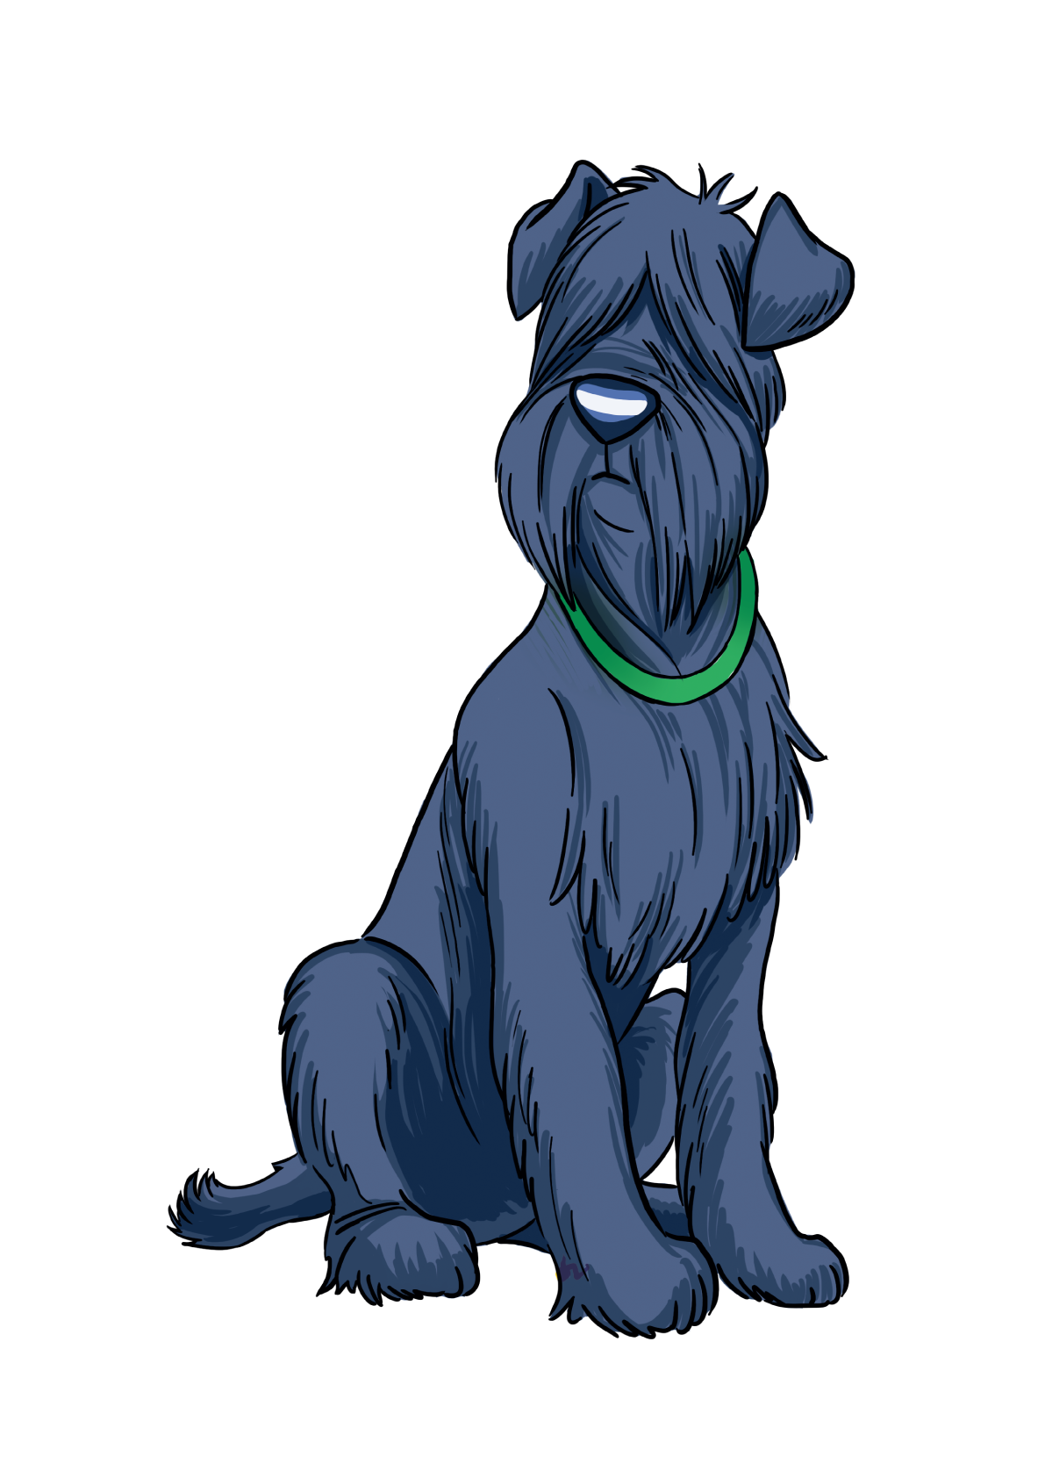
GRAMMAR: I’ve got…
I’ve got…
I’ve got
one head.
I’ve got
two hands.
Head.
Hands.
Sam
Marie
Marie
Sam
Notes:
Introduce to Ss that they are going to learn about “I’ve got…” to talk about the body parts they have. Set the scene:
Remind Ss of Sam and Marie. They are playing a game. One person says a body part, the other touches that body part and say what he/she has got.
Show the speech bubbles and have Ss say aloud.
Direct Ss attention to the number of a certain body part a normal person has (e.g. 1 head, 2 arms).

Slide 15
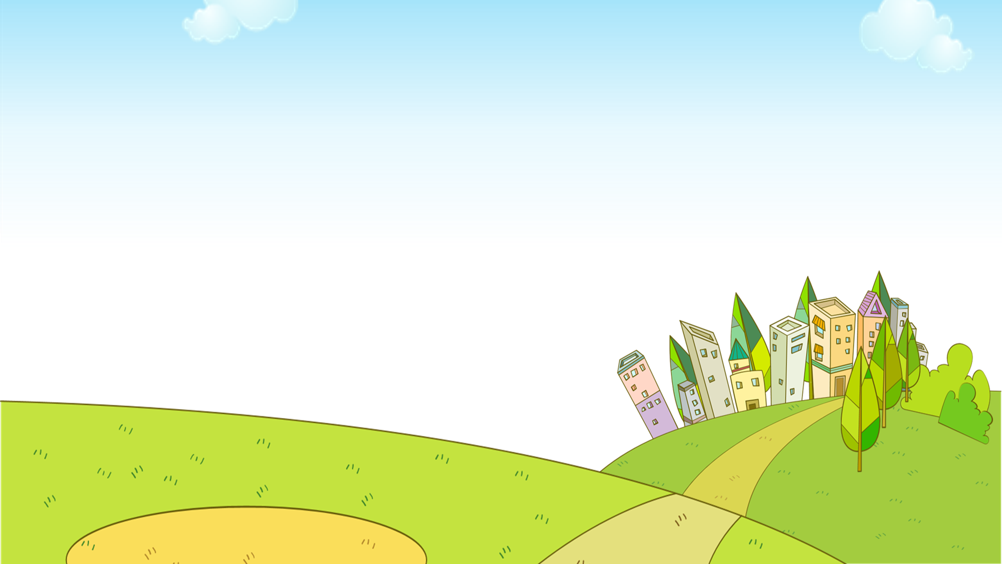

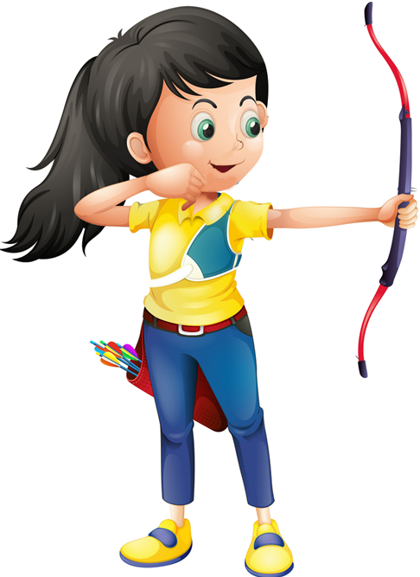

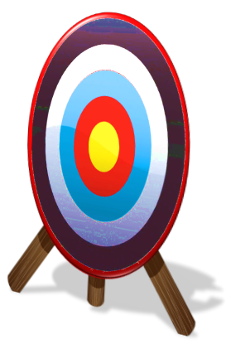



Slide 16
There are 5 questions.
Students choose the correct answer by showing fingers.
1 student says aloud the answer.
1 correct answer = 1 point.
The whole class then says aloud the correct sentence.

Slide 17

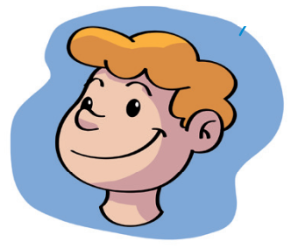


I’ve got __________.
one head
one head
one heads

Slide 18
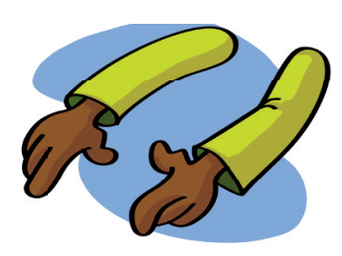
I’ve got __________.
two arms
two arm
two arms

Slide 19
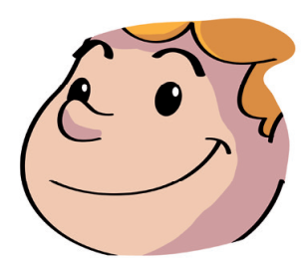
I’ve got __________.
one face
one faces
one face

Slide 20
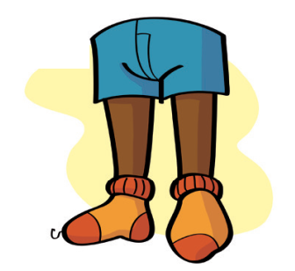
I’ve got __________.
two legs
two legs
two leg

Slide 21
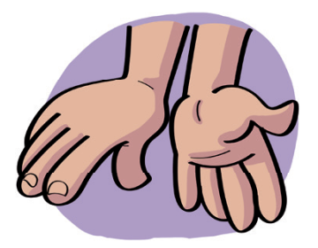
I’ve got __________.
two hands
two hand
two hands

Slide 22

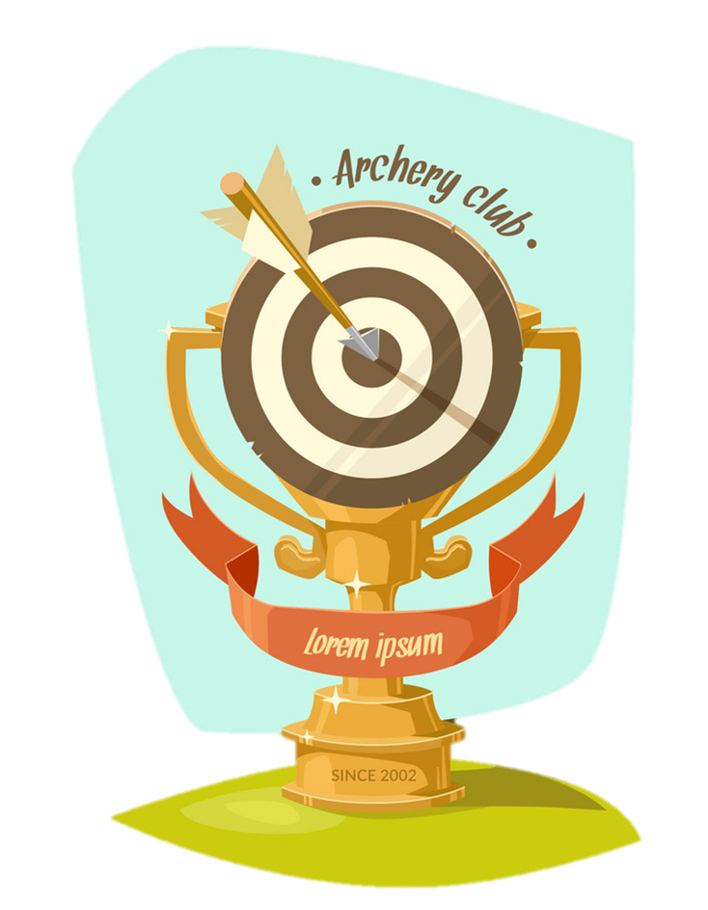
EXIT

Slide 23
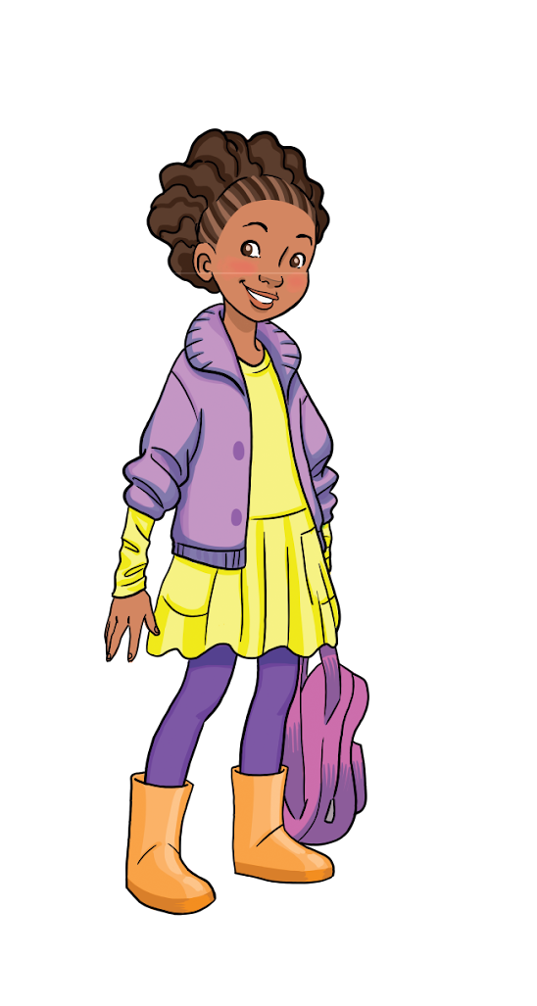
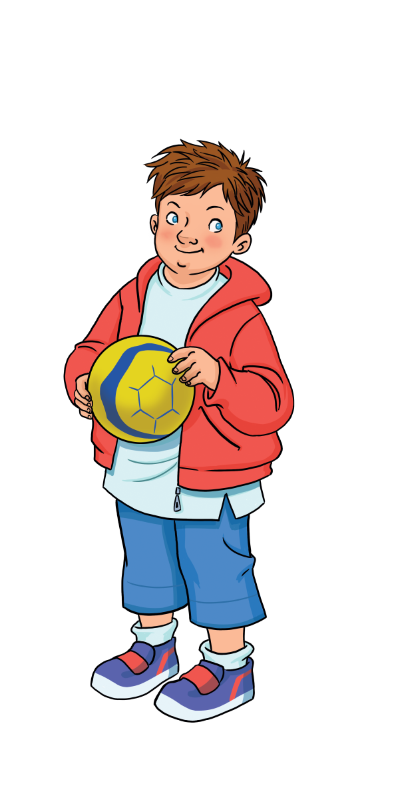
Pupils’ Book (p.46)
I’ve got
one head.
I’ve got
two arms.
I’ve got
two legs.
I’ve got
two hands.
Notes:
Ask Ss to look at the poster, point at the 4 friends and guess what each friend is talking about their body parts.
Have Ss make their guesses then show the speech bubbles and ask them to read aloud while also touching their certain body parts.

Slide 24
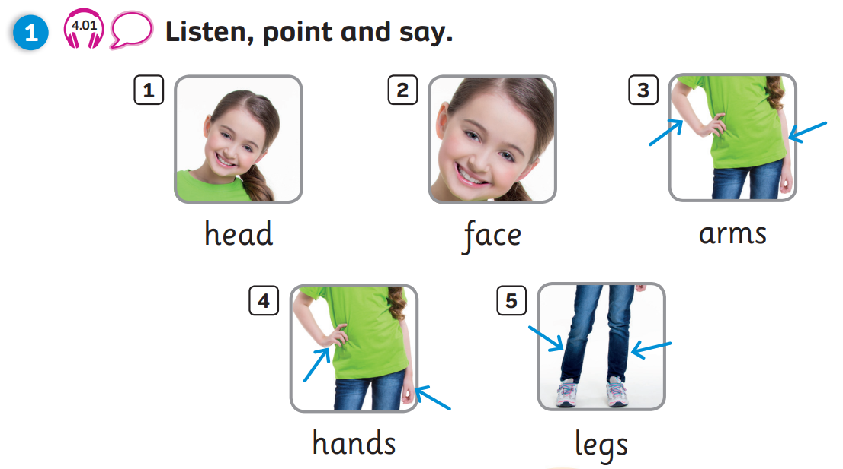
Pupils’ Book (p.47)

Slide 25
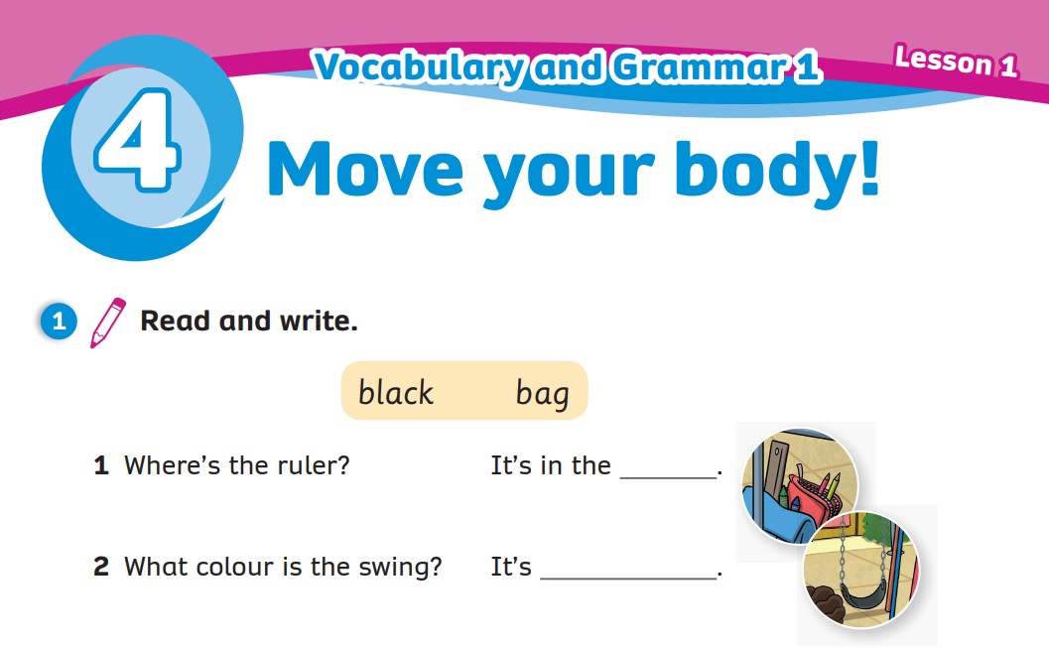
Activity Book (p.38)
Write
bag
black
Click on “Write” to show the answers

Slide 26
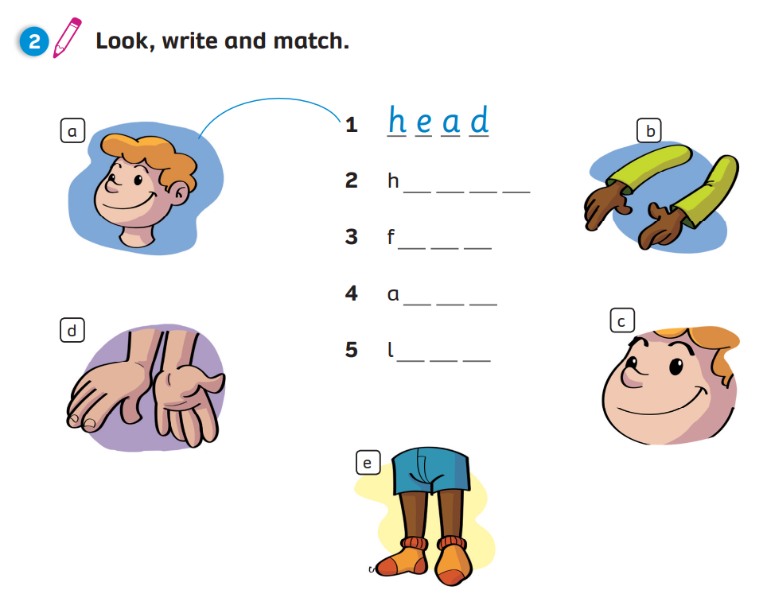
Activity Book (p.38)
Write
Match
a n d s
a c e
r m s
e g s
Click on “Write, Match” to show the answers

Slide 27



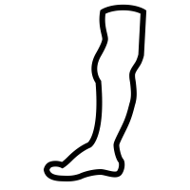

PRODUCTION
Draw 4 different body parts.
Write and tell your partner.
one face
two hands
two legs
two arms
Notes:
Give Ss instructions and show them an example.
Ask Ss to fold an A4 piece of paper twice to create 4 boxes.
Tell them to draw and write 4 different body parts. Then put Ss in to pairs and have them tell their partner about their drawing.

Slide 28
WRAP-UP
This is my…
head
face
These are my…
hands
arms
legs

Slide 29
WRAP-UP
I’ve got…
I’ve got
one head.
I’ve got
two hands.
Head.
Hands.
Sam
Marie
Marie
Sam

Slide 30
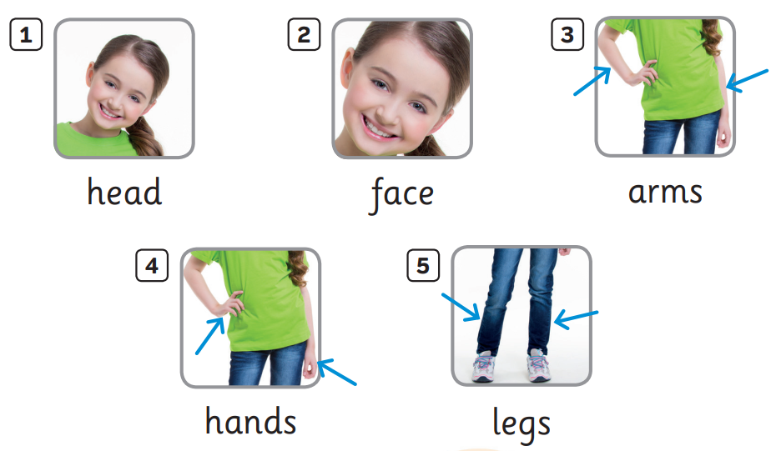

UNIT 4: Lesson 1A
We’ve learnt…

