Slide 1


Slide 2
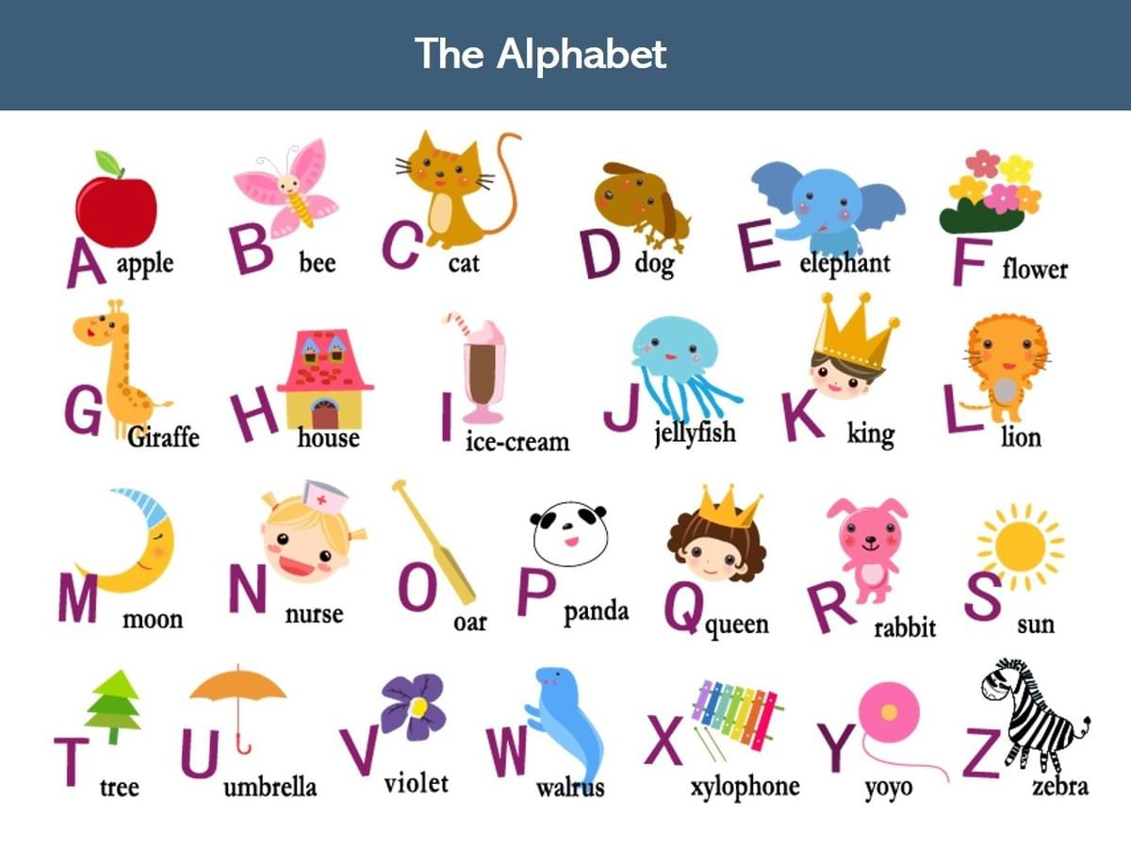



LEAD-IN
This is the Alphabet.
How many letters?
26 letters
Look.
Say the letters.
H
S
CHECK

Slide 3

Wednesday, September 23rd 2025
UNIT 1: HELLO
Lesson 4 – Phonics

Slide 4
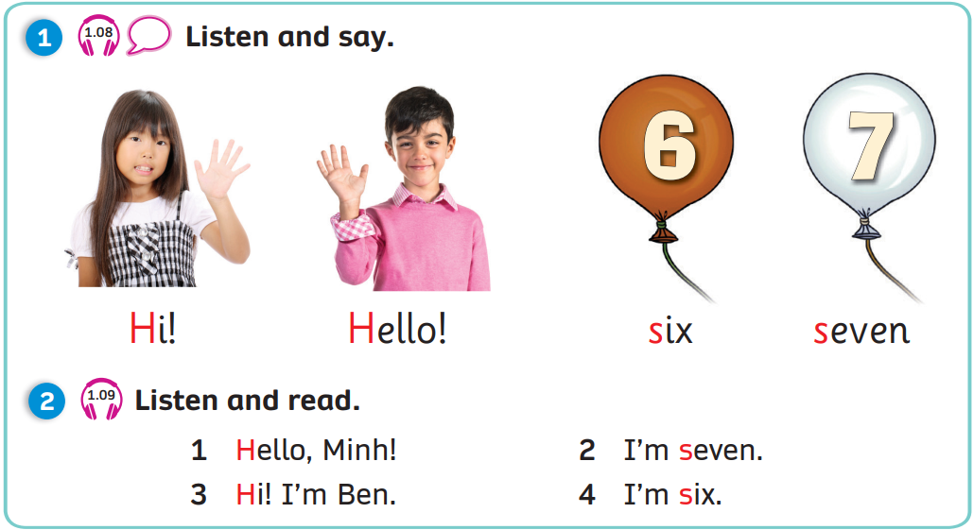


Slide 5

Sound /h/
Letter
Sound
h | h
H
i!
H h
/h/
Notes:
Show the letter, ask “What letter is it?” and have Ss answer “Letter H”
Show the sound, “What is the sound?” and have Ss answer “Sound /h/”
Show the sound in red, say aloud and have Ss repeat the sounds 3 time after each “Click”
Show the word, say aloud and have Ss repeat
Show the picture and have Ss say “h, h, Hi!”
Have Ss say aloud one more time in rhythm“ Letter Hh, Sound /h/, h… h… h… Hi!”

Slide 6

Sound /h/
Letter
Sound
h | h
H h
H
ello!
/h/
Notes:
Show the letter, ask “What letter is it?” and have Ss answer “Letter H”
Show the sound, “What is the sound?” and have Ss answer “Sound /h/”
Show the sound in red, say aloud and have Ss repeat the sounds 3 time after each “Click”
Show the word, say aloud and have Ss repeat
Show the picture and have Ss say “h, h, Hello!”
Have Ss say aloud one more time in rhythm“ Letter Hh, Sound /h/, h… h… h… Hello!”

Slide 7

Sound /s/
Letter
Sound
s | s
S s
/s/
s
ix
Notes:
Show the letter, ask “What letter is it?” and have Ss answer “Letter S”
Show the sound, “What is the sound?” and have Ss answer “Sound /s/”
Show the sound in red, say aloud and have Ss repeat the sounds 3 time after each “Click”
Show the word, say aloud and have Ss repeat
Show the picture and have Ss say “s, s, six”
Have Ss say aloud one more time in rhythm“ Letter Hh, Sound /s/, s… s… s… six”

Slide 8

Sound /s/
Letter
Sound
s | s
S s
/s/
s
even
Notes:
Show the letter, ask “What letter is it?” and have Ss answer “Letter S”
Show the sound, “What is the sound?” and have Ss answer “Sound /s/”
Show the sound in red, say aloud and have Ss repeat the sounds 3 time after each “Click”
Show the word, say aloud and have Ss repeat
Show the picture and have Ss say “s, s, six”
Have Ss say aloud one more time in rhythm“ Letter Hh, Sound /s/, s… s… s… six”

Slide 9




Sounds /h/ & /s/
Letter
Sound
h | h
Letter
Sound
s | s
H h
S s
/h/
/s/
Notes:
Show the letter, ask “What letter is it?” and have Ss answer “Letter S”
Show the sound, “What is the sound?” and have Ss answer “Sound /s/”
Show the sound in red, say aloud and have Ss repeat the sounds 3 time after each “Click”
Show the word, say aloud and have Ss repeat
Show the picture and have Ss say “s, s, six”
Have Ss say aloud one more time in rhythm“ Letter Hh, Sound /s/, s… s… s… six”

Slide 10



What
is this picture?
1
2
3
4
5
6
seven
six
Hi!

Slide 11

What about this one?
1
2
3
4
5
6
seven
Hi!
six

Slide 12

This one is easy.
1
2
3
4
5
6
Hi!
Hello!
six

Slide 13

Look carefully!
1
2
3
4
5
6
seven
Hello!
six

Slide 14



Well done!

Slide 15
Pupil’s Book (p.11)
Click on numbers “1, 2” to play the audio tracks

Slide 16
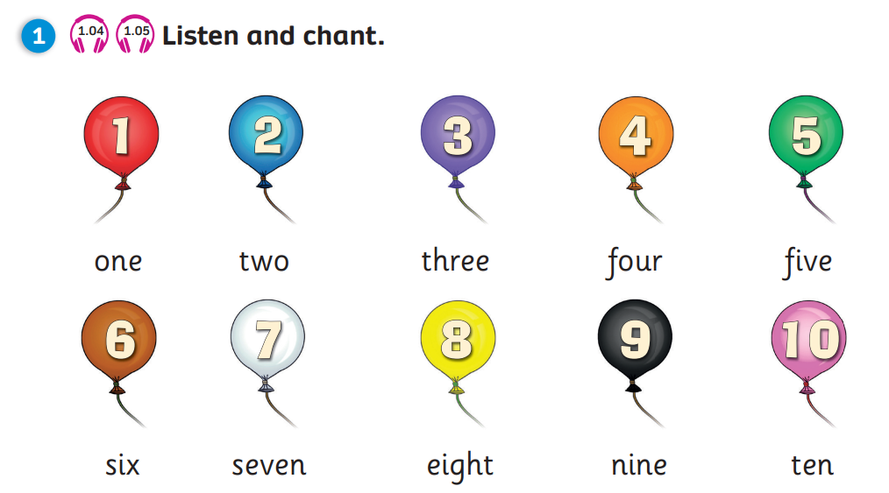


REVIEW: Ages
How old are you?
-> I’m …
Notes:
Ask Ss to recall how to ask and answer about ages
Show the pictures and have students say aloud the answer

Slide 17
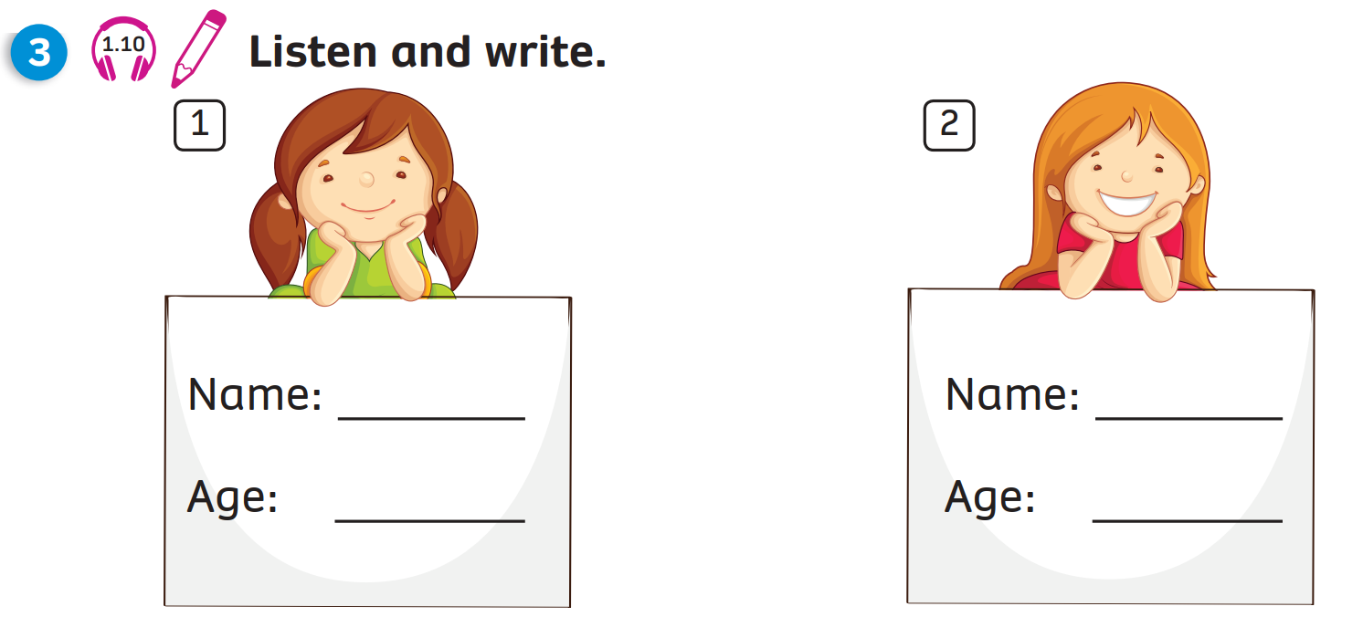
Pupil’s Book (p.11)
1
2
Mai
Mary
seven
eight
Click on numbers “1, 2” to play the audio tracks
and reveal the answers

Slide 18
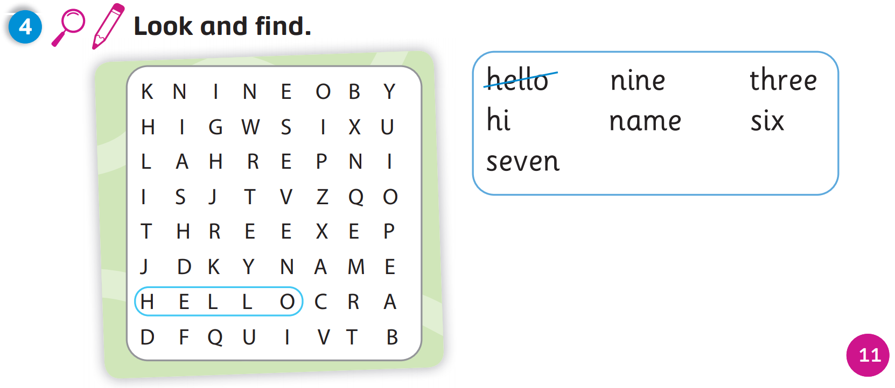
Pupil’s Book (p.11)
Answers
Click on “Answers” to reveal the answers

Slide 19
WRAP-UP
Letter
Sound
h | h
Letter
Sound
s | s
H h
S s
/h/
/s/
Notes:
Show the letter, ask “What letter is it?” and have Ss answer “Letter S”
Show the sound, “What is the sound?” and have Ss answer “Sound /s/”
Show the sound in red, say aloud and have Ss repeat the sounds 3 time after each “Click”
Show the word, say aloud and have Ss repeat
Show the picture and have Ss say “s, s, six”
Have Ss say aloud one more time in rhythm“ Letter Hh, Sound /s/, s… s… s… six”

Slide 20

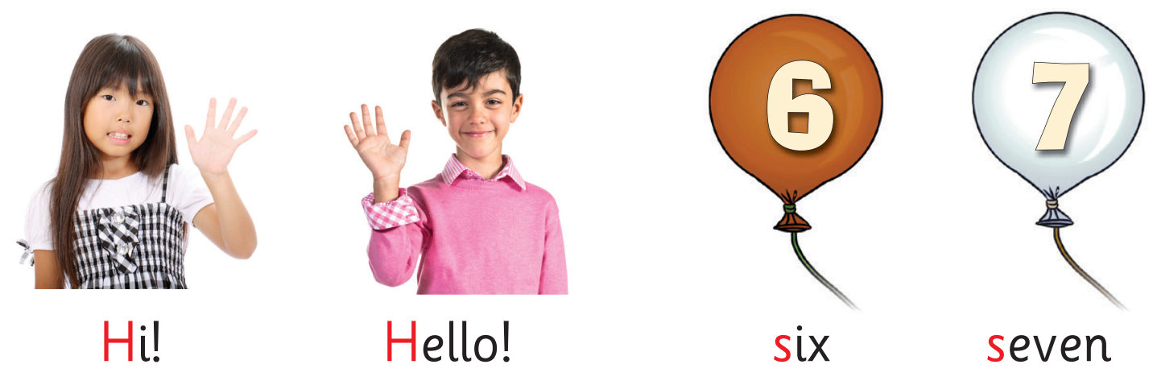

UNIT 1: Lesson 4
We’ve learnt…

