Slide 1


Slide 3






LET’S SING TOGETHER.
Notes:
Link video bài hát: https://www.youtube.com/watch?v=yWvuxazCX8s

Slide 4






Slide 5




My foreign friends
Unit 3
Lesson 3 (4,5,6)

Slide 6
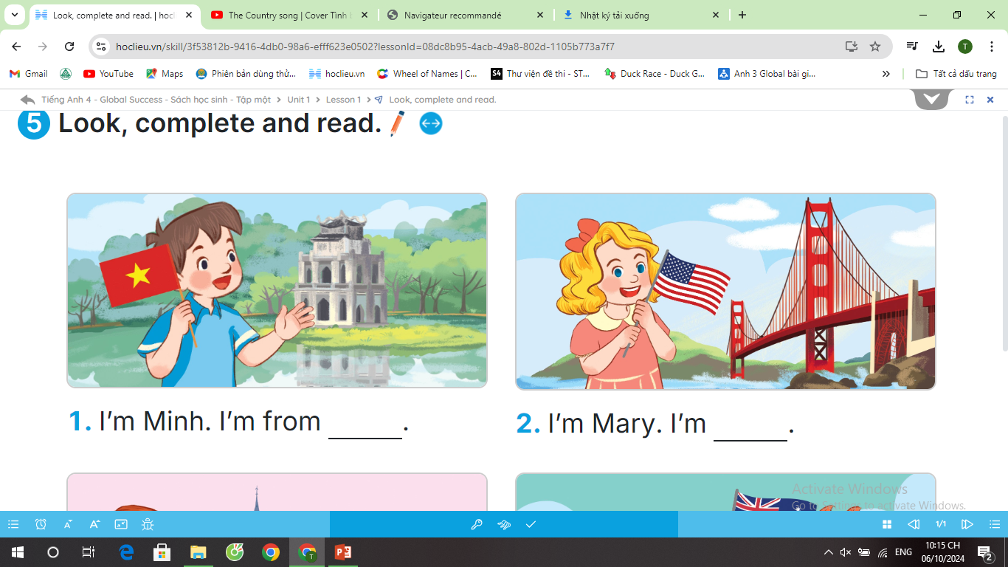
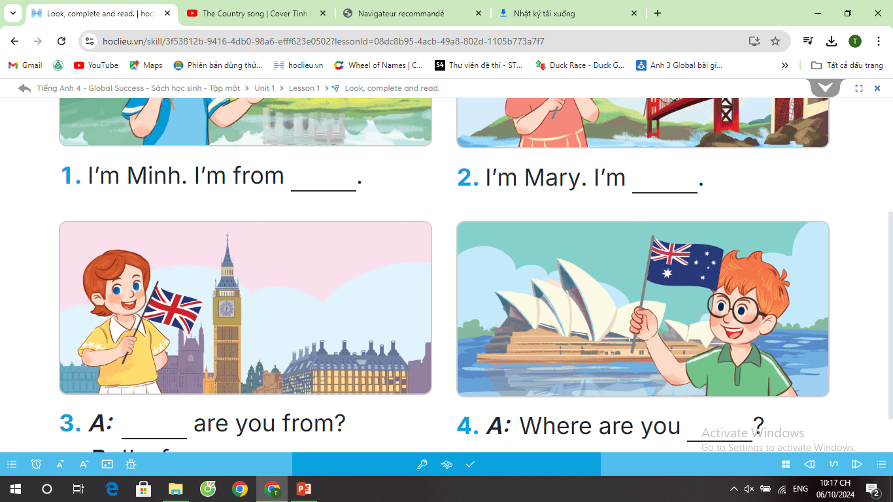

Slide 7

3
Read and complete.

Slide 8


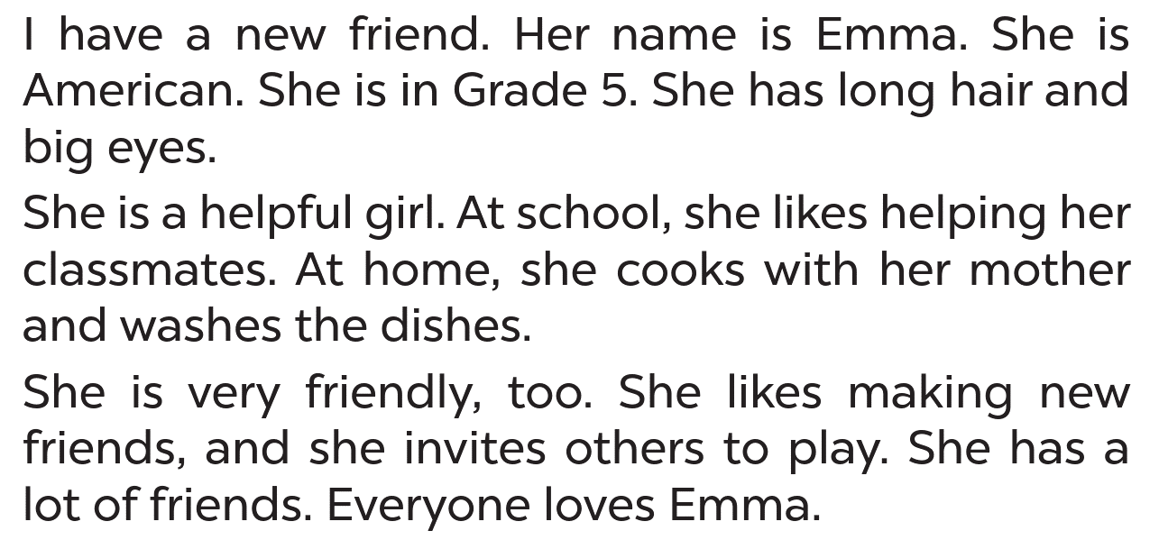


Emma

Slide 9



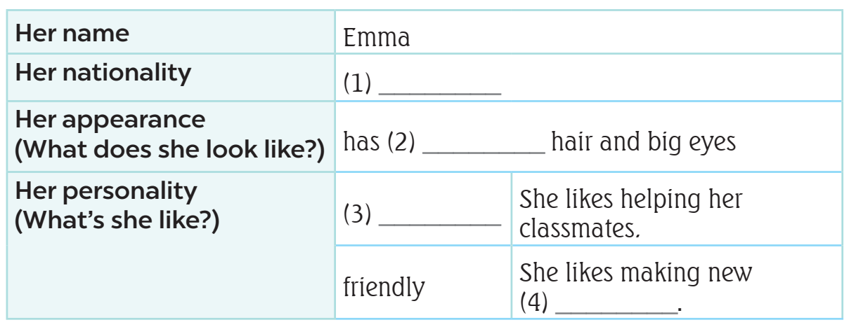

What’s
the information?
main
information

Slide 10


SWAP YOUR BOOKS.

Slide 11


READ AND ANSWER.

Slide 12
LET’S CHECK!
.
nationality
Emma

Slide 13
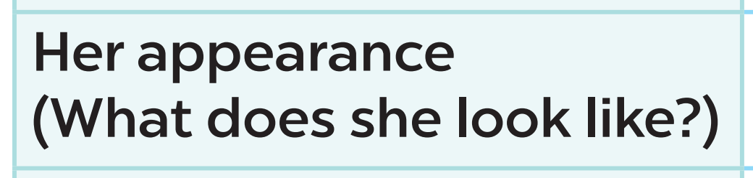

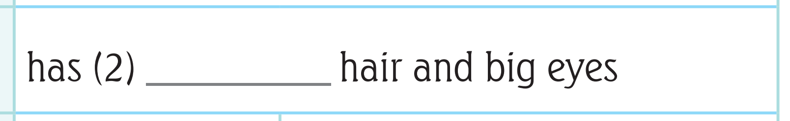


LET’S CHECK!
long

Slide 14
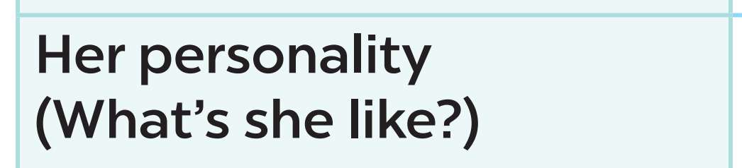
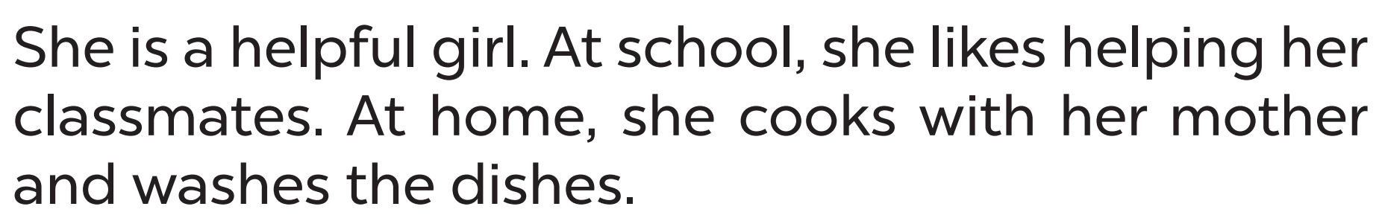
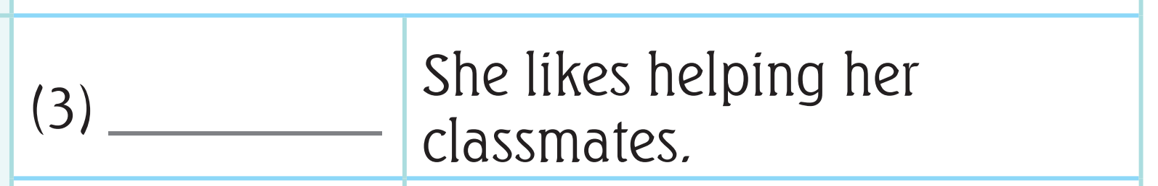



LET’S CHECK!
helpful

Slide 15
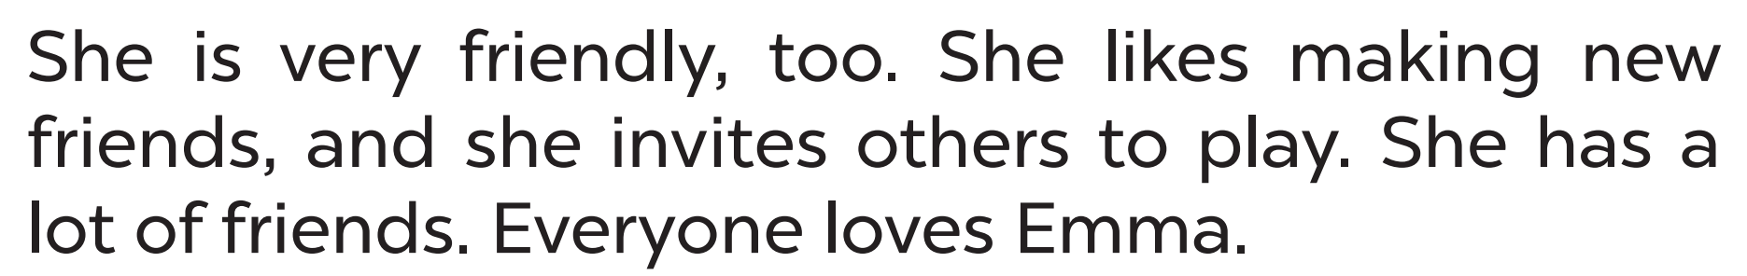



LET’S CHECK!
friends

Slide 16
ASK AND ANSWER ABOUT EMMA.
American
friendly
long hair
5

Slide 18
5
Let’s write.

Slide 19

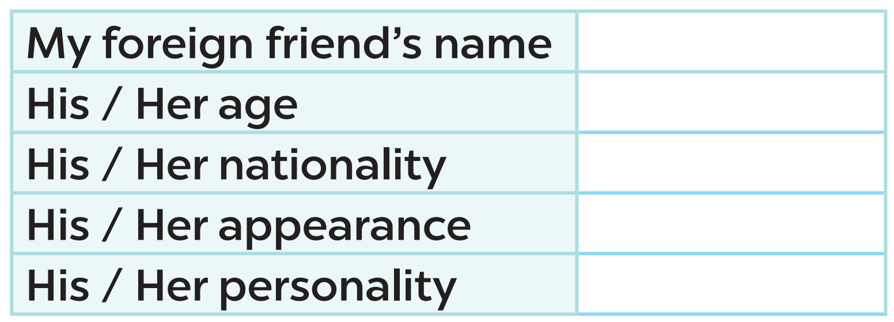


Slide 21
6
Project

Slide 22
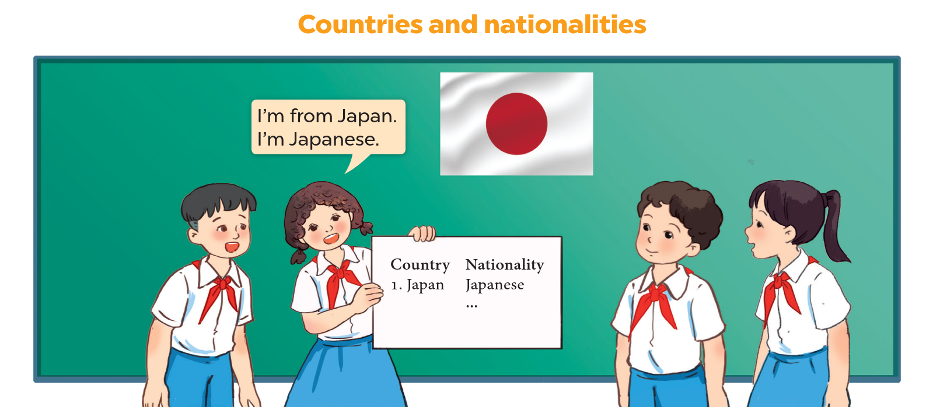
LET’S CHECK YOUR POSTERS!
*countries
*nationalities

Slide 23


WORK IN GROUPS.
Talk about your poster!!!!

Slide 25
Fun corner
and Wrap-up

Slide 26
Play game:
Slap the board

Slide 27








Slide 28


Slide 29







LET’S SING .

