Slide 1
WELCOME
TO OUR CLASS!

Slide 2
WARM UP
+ How long have you learnt English?
+ In your opinion how many types of English are there?
+ Do you know any differences between American English and British English?

Slide 3

American English and British English

Slide 4
UNIT 9
WORLD ENGLISHES
Lesson 1: Getting started

Slide 5
01
NEW WODS

Slide 6


New words
exchange student
a student from one country who attends a school in another country
/ɪksˈtʃeɪndʒ
stjuːdnt/
học sinh trao đổi

Slide 7

a person who has come to a different country in order to live there permanently.
immigrant (n)
/ˈɪmɪɡrənt/
người nhập cư

Slide 8
New words
New words | Pronunciation | Meaning
1. Exchange student | /ɪksˈtʃeɪndʒ stjuːdnt/ | học sinh trao đổi
2. immigrant (n) | /ˈɪmɪɡrənt/ | người nhập cư

Slide 9
02
LISTENING
READING
WORLD ENGLISHES

Slide 10

Look and guess.
Who do you see in the picture?
What does the picture show?

Slide 11
1. Listen,read and choose the correct answer
01
What do most American students wear to school?
A. School uniforms
B. Pants and T-shirts
C. Dresses and skirts
02
Are all students in Jack's school American?
A. Yes, all of them are American.
B. No, some are immigrants from other countries.
C. Only a few are American.

Slide 12
Teacher: Hi class. I’d like to introduce an exchange student who comes from New York. Welcome Jack!
Students: Hello, Jack. Nice to meet you.
Jack: Nice to meet you all. This is my first time in Viet Nam.
Teacher: Now you can ask Jack any questions you would like to ask.
Phong: Do American students wear school uniforms every day, Jack?
Jack: No, most American students don’t wear school uniforms. Most students at my school wear pants and T-shirts.
Phong: What do you mean by ‘pants’, Jack?
Jack: Ah, I mean trousers. In American English, ‘pants’ mean ‘trousers’.
Phong: I see.
Teacher: Yeah, there are some differences in vocabulary between American English and British English. Are there any more questions?
Mi: Yes. I want to know about the students in your school. Are all of you
American? And do all of you speak English?
Jack: Good question. Most of us are American, but some are immigrants
from other countries like Viet Nam, India, and Mexico. Their first language is not English, but they all speak English at school.
Mi: That’s interesting!

Slide 13
2. Read the conversation again. Fill in each blank with no more than TWO words from the conversation
Jack is an exchange student from ______________.
This is the ____________ Jack has visited Viet Nam.
Most students at Jack’s school wear _________ and T-shirts.
American English and British English have __________ in vocabulary
Not all students in Jack’s school are _________, but they all speak English.

Slide 14
Check the answers
Jack is an exchange student from ______________.
This is the ____________ Jack has visited Viet Nam.
Most students at Jack’s school wear _________ and T-shirts.
American English and British English have __________ in vocabulary
Not all students in Jack’s school are _________, but they all speak English.
New York
Teacher: Hi class. I’d like to introduce an exchange student who comes from New York. Welcome Jack!

Slide 15
Check the answers
Jack is an exchange student from ______________.
This is the ____________ Jack has visited Viet Nam.
Most students at Jack’s school wear _________ and T-shirts.
American English and British English have __________ in vocabulary
Not all students in Jack’s school are _________, but they all speak English.
Jack: Nice to meet you all. This is my first time in Viet Nam.
New York
first time

Slide 16
Check the answers
Jack is an exchange student from ______________.
This is the ____________ Jack has visited Viet Nam.
Most students at Jack’s school wear _________ and T-shirts.
American English and British English have __________ in vocabulary
Not all students in Jack’s school are _________, but they all speak English.
Jack: No, most American students don’t wear school uniforms. Most students at my school wear pants and T-shirts.
New York
first time
pants

Slide 17
Check the answers
Jack is an exchange student from ______________.
This is the ____________ Jack has visited Viet Nam.
Most students at Jack’s school wear _________ and T-shirts.
American English and British English have ______________ in vocabulary
Not all students in Jack’s school are _________, but they all speak English.
New York
Teacher: Yeah, there are some differences in vocabulary between American English and British English. Are there any more questions?
first time
pants
some differences

Slide 18
Check the answers
Jack is an exchange student from ______________.
This is the ____________ Jack has visited Viet Nam.
Most students at Jack’s school wear _________ and T-shirts.
American English and British English have ______________ in vocabulary
Not all students in Jack’s school are _________, but they all speak English.
Jack: Good question. Most of us are American, but some are immigrants from other countries like Viet Nam, India, and Mexico. Their first language is not English, but they all speak English at school.
New York
first time
pants
some differences
American

Slide 19

3. Match the words and phrases with their definitions
1. exchange student | a. all the words in a language | 1.
2. mean | b. a student who attends a school in a foreign country for a period of time | 2.
3. vocabulary | c. people who have come to live permanently in a different country | 3.
4. immigrants | d. the language someone learns to speak from birth | 4.
5. first language | e. to express or represent something | 5.
b
e
a
c
d

Slide 20
4. Fill in each blank with a word or phrase from 3
mean
1. – What does your name ____________, Mi?
– It’s the name of a bird.
2. English ____________ is increasing because it borrows words from other languages.
3. In Australia, there are a lot of ___________ who have come from other countries.
4. His _______________is Vietnamese, but he can speak English and French fluently.
5. This year our school has a(n) _______________ from Britain. She will study with us for one month.
vocabulary
immigrants
first language
exchange student

Slide 21

5. Match the words in British English with those in American English so that they mean the same.
BRITISH ENGLISH
flat
holiday
jumper
chips
football
AMERICAN ENGLISH
sweater
apartment
soccer
vacation
French fries

Slide 22

* PELMANISM
* Example: Candy Sweets
1
2
flat
Holiday
3
4
Jumper
chips
football
5
Vacation
8
7
Apartment
9
French fries
soccer
sweater
10
11

Slide 23
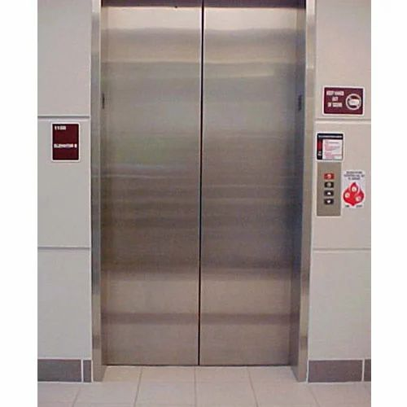
LOOK AT THE PICTURES
lift
elevator

Slide 24
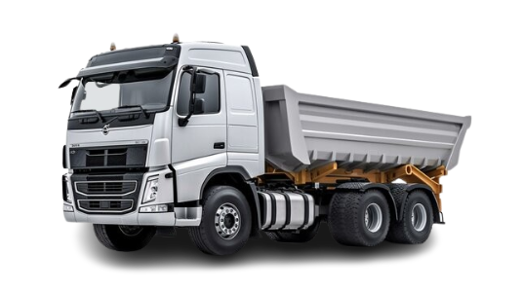
LOOK AT THE PICTURES
lorry
truck

Slide 25
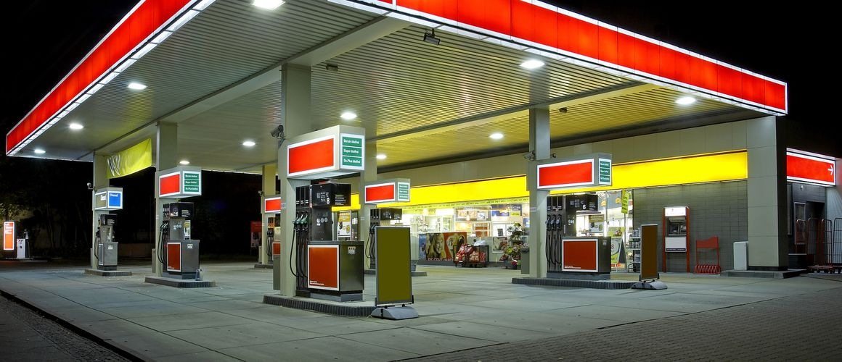
LOOK AT THE PICTURES
petrol station
gas station

Slide 26
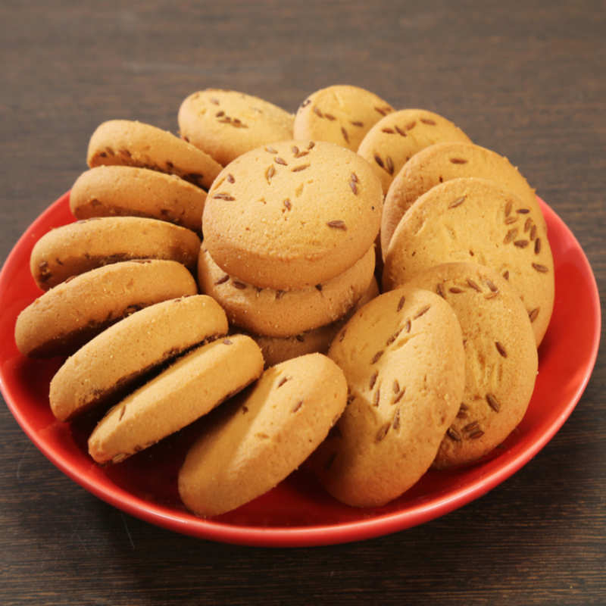
LOOK AT THE PICTURES
biscuit
cookie

Slide 27
HOMEWORK
Learn by heart vocabulary
Prepare: A Closer Look 1
Prepare: Project P.101

Slide 28
THANKS FOR YOUR ATTENTION!

