Slide 2
Unit
8
FILMS
LESSON 7: LOOKING BACK & PROJECT
Vocabulary review
Grammar review
Unit
Project: Design film posters

Slide 3
OBJECTIVES
By the end of the lesson, students will be able to:
review the vocabulary and grammar of Unit 8
apply what they have learnt (vocabulary and grammar) into practice through a project

Slide 4
LESSON 7: LOOKING BACK & PROJECT
WARM-UP
Spin the wheel: Types of films
(Task 2: Give an example for every film type in the box.)
Game: Tug of war
Task 1: Match the types of film in column A with their descriptions in column B.
Task 3: Choose the correct answer (A, B, or C) to complete each of the following sentences.
VOCABULARY REVIEW
GRAMMAR REVIEW
Task 4: Match the sentences or sentence halves in columns A and B.
PROJECT
Project: Posters exhibition
CONSOLIDATION
Wrap-up
Homework

Slide 5
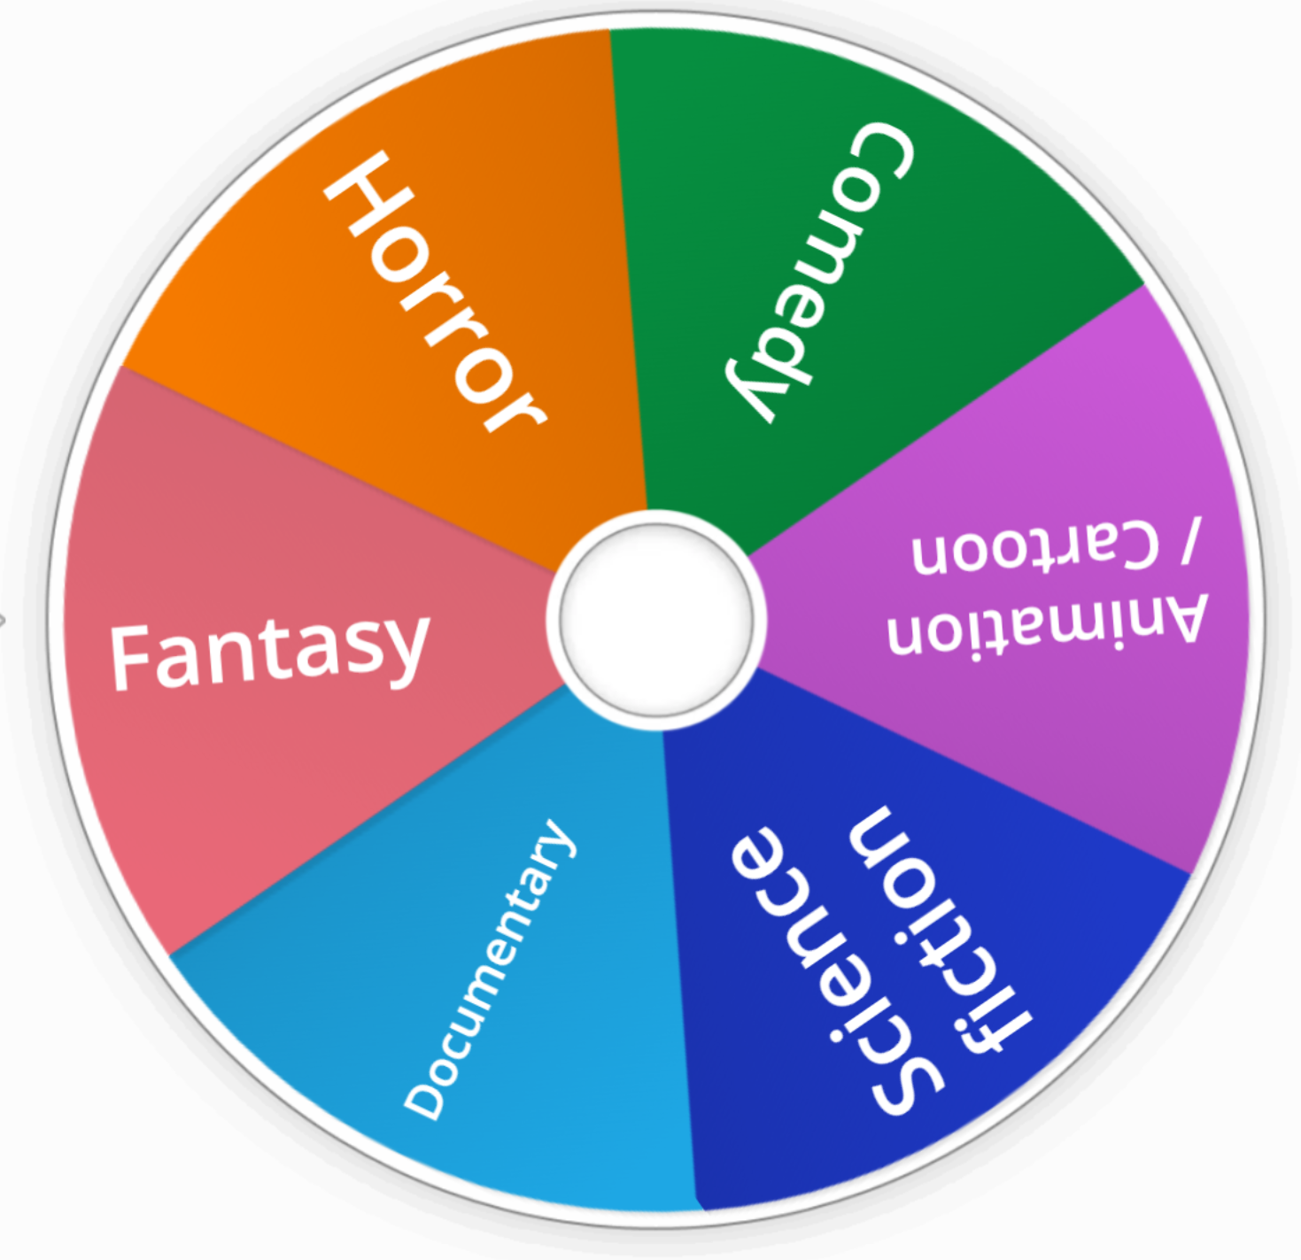
LESSON 7: LOOKING BACK & PROJECT
WARM-UP
Spin the wheel: Types of films
2
Give an example for every film type in the box.
Aims of the stage:
To revise the vocabulary related to the topic and lead in the next part of the lesson.
To enhance students’ skills of cooperating with team mates.
Notes:
Wordwall link to spin the wheel in real time: https://wordwall.net/resource/27022823

Slide 6
LESSON 7: LOOKING BACK & PROJECT
WARM-UP
Spin the wheel: Types of films
(Task 2: Give an example for every film type in the box.)
Game: Tug of war
Task 1: Match the types of film in column A with their descriptions in column B.
Task 3: Choose the correct answer (A, B, or C) to complete each of the following sentences.
VOCABULARY REVIEW

Slide 7
Tug of war
PLAY

Slide 8
This type of film makes you laugh.
documentary
horror
science fiction
comedy
fantasy
NEXT

Slide 9
This type of film has supernatural events.
fantasy
horror
science fiction
documentary
comedy
NEXT

Slide 10
This type of film gives us useful information about animals, science or technology.
science fiction
documentary
horror
fantasy
comedy
NEXT

Slide 11
This type of film is about life in the future, robots, and space travel
fantasy
comedy
horror
documentary
science fiction
NEXT

Slide 12
This is a frightening type of film.
science fiction
comedy
horror
fantasy
documentary
NEXT

Slide 13
The film was long and _____. Many people went home before it ended.
dull
dull
funny
shocking
NEXT

Slide 14
The film is too_________with a lot of fighting and killing scenes.
violent
violent
funny
interesting
NEXT

Slide 15
A____________story often makes us feel afraid.
frightening
frightening
moving
interesting
NEXT

Slide 16
The news was___________. I couldn’t believe it.
shocking
shocking
funny
confusing
NEXT

Slide 17
moving
_________ films often make us cry.
moving
funny
amusing
EXIT

Slide 18
The road signs were_________ and we soon got lost.
confusing
confusing
interesting
shocking
EXIT

Slide 19
LESSON 7: LOOKING BACK & PROJECT
WARM-UP
Spin the wheel: Types of films
(Task 2: Give an example for every film type in the box.)
Game: Tug of war
Task 1: Match the types of film in column A with their descriptions in column B.
Task 3: Choose the correct answer (A, B, or C) to complete each of the following sentences.
VOCABULARY REVIEW
GRAMMAR REVIEW
Task 4: Match the sentences or sentence halves in columns A and B.

Slide 20
GRAMMAR REVIEW
4
Match the sentences or sentence halves in columns A and B.
Aim of the task:
To help students revise the connectors: although/though and however.

Slide 21
GRAMMAR REVIEW
4
Match the sentences or sentence halves in columns A and B.
A | B
1. Although he arrived late, | a. people still buy them.
2. The film received good reviews. | b. However, the number of people going to cinemas is increasing.
3. Though popcorn and other snacks in the cinema are very expensive, | c. I don’t want to stay home tonight.
4. Cinema tickets are expensive. | d. he left the cinema early.
5. Although I don’t really like to go to the cinema, | e. However, only a few people saw it.
1. d
2. e
3.a
4. b
5. c

Slide 22
LESSON 7: LOOKING BACK & PROJECT
WARM-UP
Spin the wheel: Types of films
(Task 2: Give an example for every film type in the box.)
Game: Tug of war
Task 1: Match the types of film in column A with their descriptions in column B.
Task 3: Choose the correct answer (A, B, or C) to complete each of the following sentences.
VOCABULARY REVIEW
GRAMMAR REVIEW
Task 4: Match the sentences or sentence halves in columns A and B.
PROJECT
Project: Posters exhibition

Slide 23
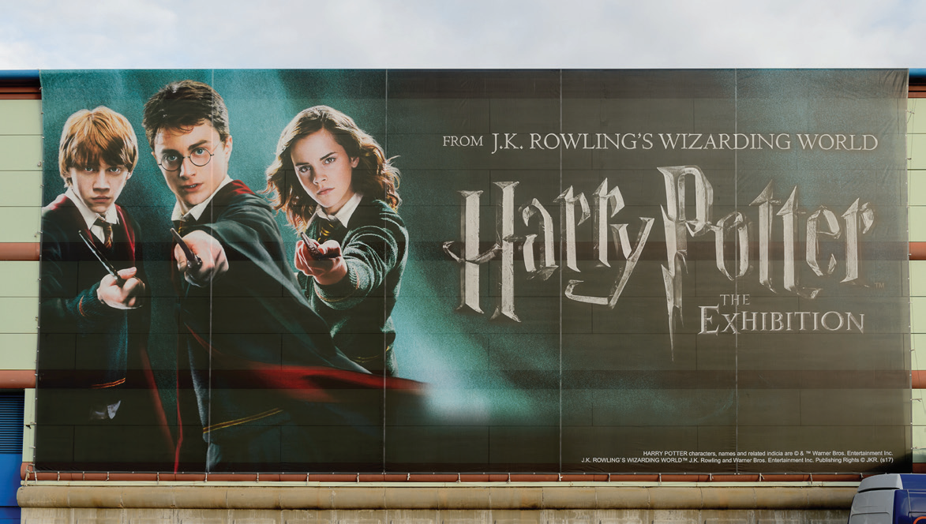
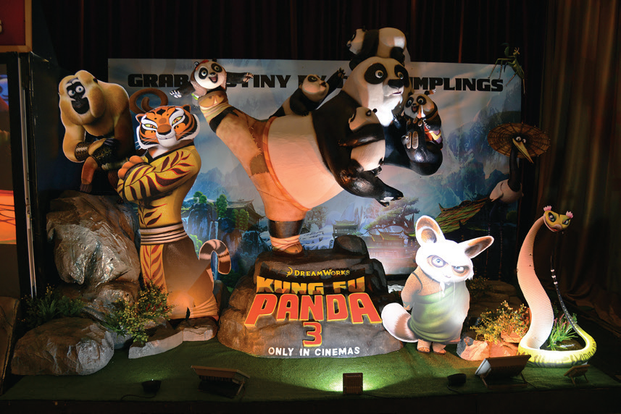
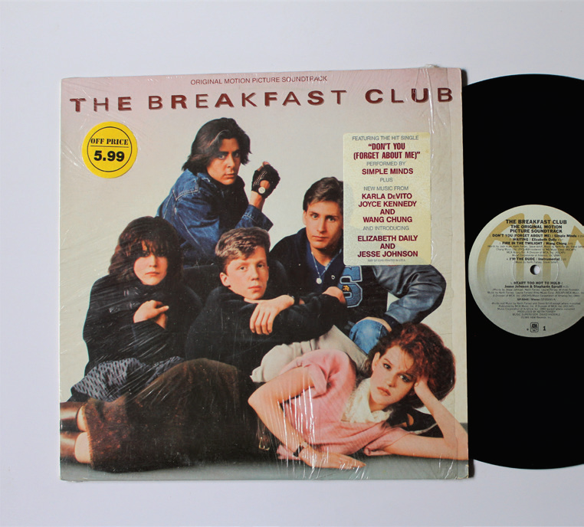
PROJECT
Posters exhibition
5
Work in groups.
1
Choose one of your favourite films and design a poster for it, including:
- name of the film; - type of film; - its director and main actors / actresses; - a short summary; - your overall opinions about the film; - the showtime and cinema; - pictures or photos to illustrate the film.
2
Organise them into an exhibition.
3
Vote for the best poster.

Slide 24
LESSON 7: LOOKING BACK & PROJECT
WARM-UP
Spin the wheel: Types of films
(Task 2: Give an example for every film type in the box.)
Game: Tug of war
Task 1: Match the types of film in column A with their descriptions in column B.
Task 3: Choose the correct answer (A, B, or C) to complete each of the following sentences.
VOCABULARY REVIEW
GRAMMAR REVIEW
Task 4: Match the sentences or sentence halves in columns A and B.
PROJECT
Project: Posters exhibition
CONSOLIDATION
Wrap-up
Homework

Slide 25
CONSOLIDATION
1
Wrap-up
Vocabulary review
Grammar review
Project: Design film posters

Slide 26
CONSOLIDATION
2
Homework
Prepare for the next lesson: Unit 9: Festivals around the world Lesson 1: Getting started

Slide 27
Website: hoclieu.vn
Fanpage: facebook.com/www.tienganhglobalsuccess.vn/

