Slide 1
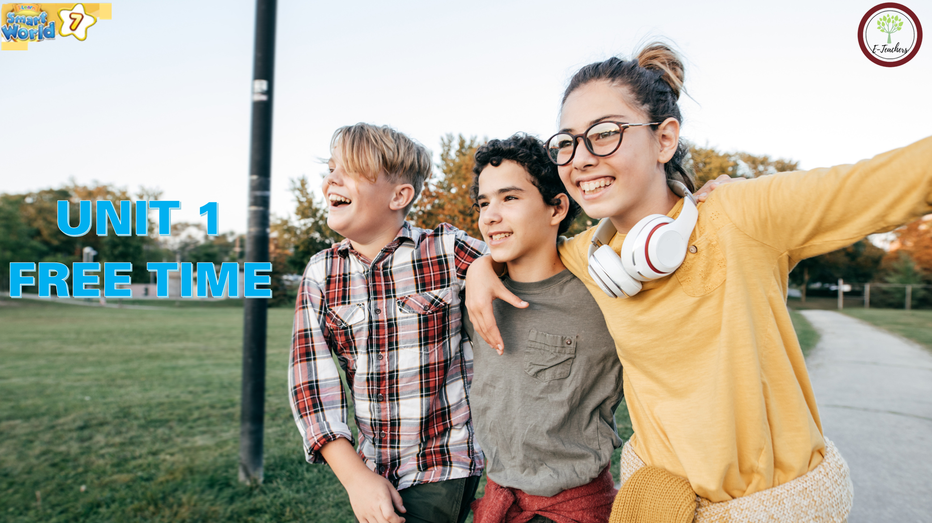


Slide 2




LESSON 2
Ms Phương
Zalo: 0966765064
GRAMMAR

Slide 3



BÀI GIẢNG THUỘC QUYỀN SỞ HỮU TRÍ TUỆ CỦA E-TEACHERS. NGHIÊM CẤM MỌI HÀNH VI SAO CHÉP, PHÁT TÁN CHIA SẺ , MUA ĐI BÁN LẠI KHI CHƯA ĐƯỢC SỰ ĐỒNG Ý CỦA E-TEACHERS
ỦNG HỘ CHẤT XÁM CỦA ĐỒNG NGHIỆP LÀ ĐANG TẠO NHÂN QUẢ TỐT CHO BẢN THÂN VÀ GIA ĐÌNH CỦA CHÍNH MÌNH. E-TEACHERS CẢM ƠN VÌ BẠN ĐÃ ĐỒNG HÀNH.
PHONE /ZALO: 0966765064
https://www.facebook.com/maiphuongdo.dhnn/
SỬ DỤNG TÀI LIỆU CHÍNH CHỦ BẠN SẼ NHẬN ĐƯỢC SỰ TẬN TÂM VÀ CHÚNG TÔI SẼ PHỤC VỤ CÁC BẠN TẬN TÌNH.
TÀI LIỆU ĐƯỢC UPDATE VÀO MAIL CÁ NHÂN NGAY KHI UPDATE VÀ ĐƯỢC GIẢI ĐÁP MỌI THẮC MẮC VỀ KỸ THUẬT HOẶC CHUYÊN MÔN MỘT CÁCH KỊP THỜI NHẤT
TK: 3614689 ĐỖ MAI PHƯƠNG
NGÂN HÀNG VPBAK VIÊT NAM THỊNH VƯỢNG CHI NHÁNH HÀ NỘI.

Slide 4
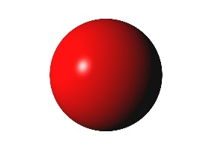

WARM UP
Review prepositions of place.
Ms Phương
Zalo: 0966765064
in
on
behind
next to
in front of
between
under
opposite

Slide 5
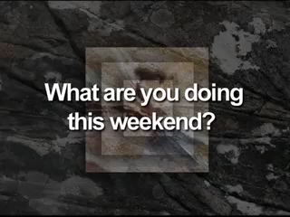
Watch a video and say the activities that you hear.
1. What activities can you hear in the video?
2. Which tense do they use to make plans in the future?

Slide 6
PRESENT CONTINUOUS TENSE
FIXED FUTURE PLANS
Thì hiện tại tiếp diễn thường được sử dụng khi nói về một kế hoạch sẽ làm trong tương lai và đã có sắp xếp , dự định trước một cách chắc chắn
I am watching a movie tonight.
He is making a cake tomorrow.
We are visiting our grandparents next weekend.

Slide 7



Khẳng định: S + am/is/are + V-ing
I am watching a movie tonight.
He is making a cake tomorrow.
They are playing soccer on the weekend.
Phủ định: S + am not /isn’t/aren’t + V-ing
I am not watching a movie tonight.
He is not making a cake tomorrow.
They are not playing soccer on the weekend.
STRUCTURE
Câu hỏi: (Wh) Am/Is/Are + S+ V-ing?
What are you doing tomorrow/next week?
Are you playing badminton tomorrow?
Is she making a cake tonight?

Slide 8

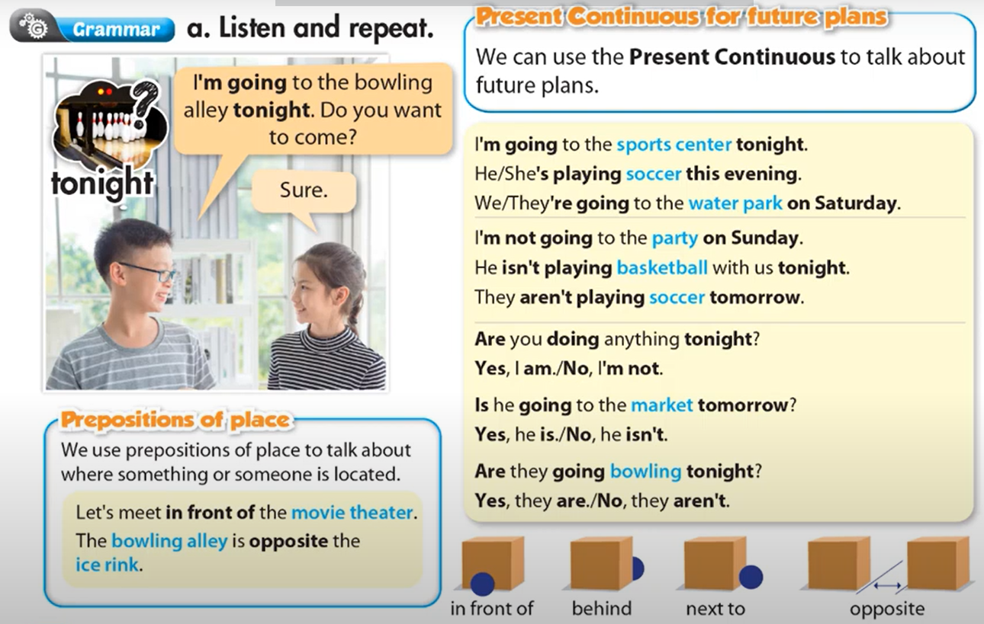

Slide 9
b. Circle the correct words.
1. I’m watch/I’m watching a movie tonight.
2. She is going/going bowling on Sunday night.
3. Let’s meet in/ on front of the theater.
4. I’m meeting/meeting Sam at the water park tomorrow.
5. Is/Are you going shopping this evening?
6. We’re meeting next/ opposite the restaurant on Wednesday at 6 p.m

Slide 10
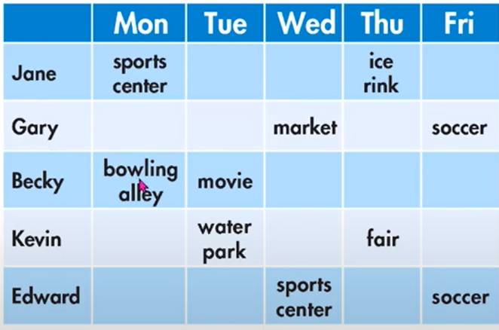
1.When/Jane /go/ ice rink/?
________________________________________________________________________
C. Look at next week’s plan. Write questions using the prompts, then answer the questions.
When is Jane going to the ice rink?
She is going to the ice rink on Thursday.
2.What/Becky/do/Tuesday/?
________________________________________________________________________
What is Becky doing on Tuesday?
She is watching a movie.
3. When/Gary and Edward/ play/soccer/?
____________________________________________________________________
When are Garya and Edward playing soccer?
They are playing soccer on Friday.
4. When/Kevin/go/fair/?
____________________________________________________________________
When is Kenvin going to the fair?
He is going to the fair on Thusday.
5.What/Gary/do/Wednesday?
____________________________________________________________________
What is Gary doing on Wednesday?
She is going to the market.

Slide 11
d. In pairs: Make a plan to go out with your friend.
Sample answer
Are you doing anything next week/next Sundays…?
I’m going to the theater. Do you want to come?
Sure! Where should we meet?
Let’s meet at my house/ in front of the water park…

Slide 12
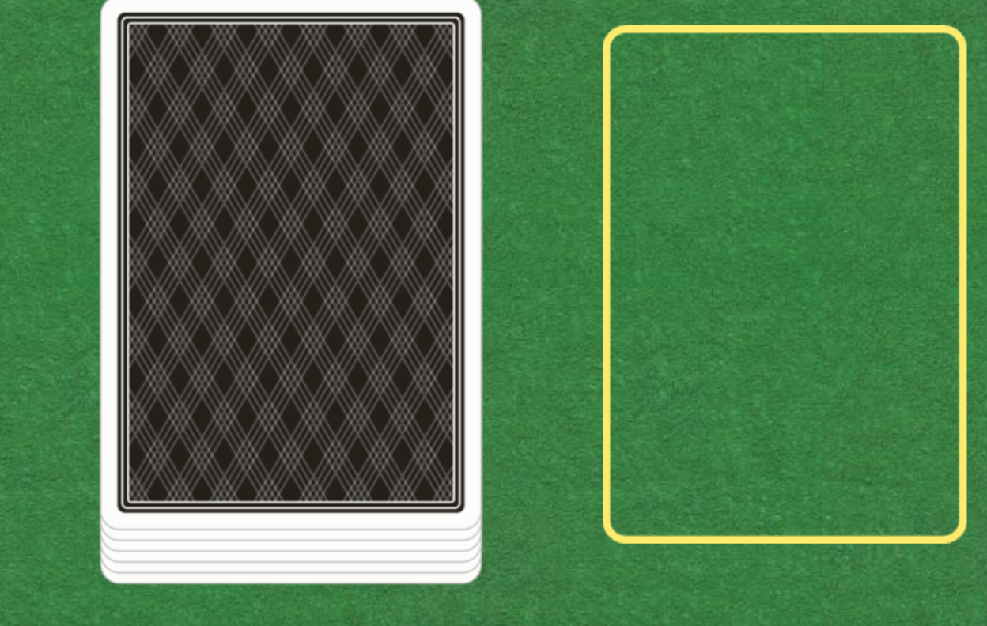
Turn the cards and make a sentence using present continuous.
Online game
Click here

Slide 13
Unit 1: Free time
Lesson 5: Grammar
- Present Continuous ( Hiện tại tiếp diễn nói về dự định trong tương lai)
Form:
(+) S + am / is / are + V-ing …
(-) S + am / is / are + not + …
(?) Am / Is / Are + S + V-ing …
Usage: to talk about future plans.
- Prepositions of place: in front of, behind, next to, opposite, on, under, …
( Giới từ chỉ thời gian)
Ms Phương
Zalo: 0966765064

Slide 14
HOMEWORK
- Make 2 sentences, use the Present Continuous to talk about your future plans.
- Make 2 sentences with prepositions of place.
- Do the exercises in WB: Grammar & Writing (page 5).

