Slide 1




Slide 2




LESSON 2
GRAMMAR

Slide 3
WARM-UP
Work in pair and reorder the word to make a meaningful sentence.
1. do / do / free time / What / you / your / in?
2. play / you / Do / soccer?
3. reading / like / comics / I
4. online / He / on / plays / games / Sundays
5. We / on / like / movies / the / watching / weekends.
1. What do you do in your free time?
2. Do you play soccer?
3. I like reading comics.
4. He plays online games on Sundays.
5. We like watching movies on the weekends

Slide 4
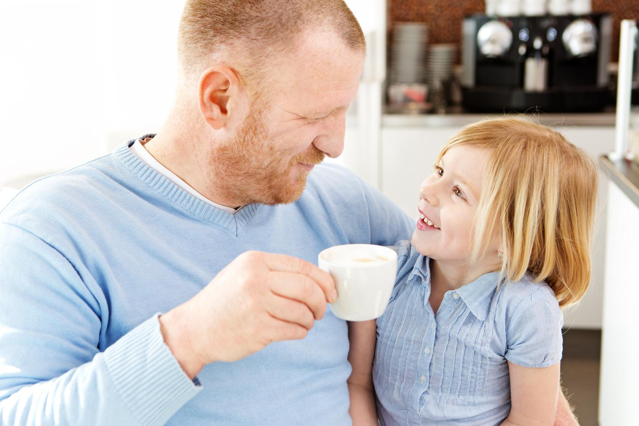
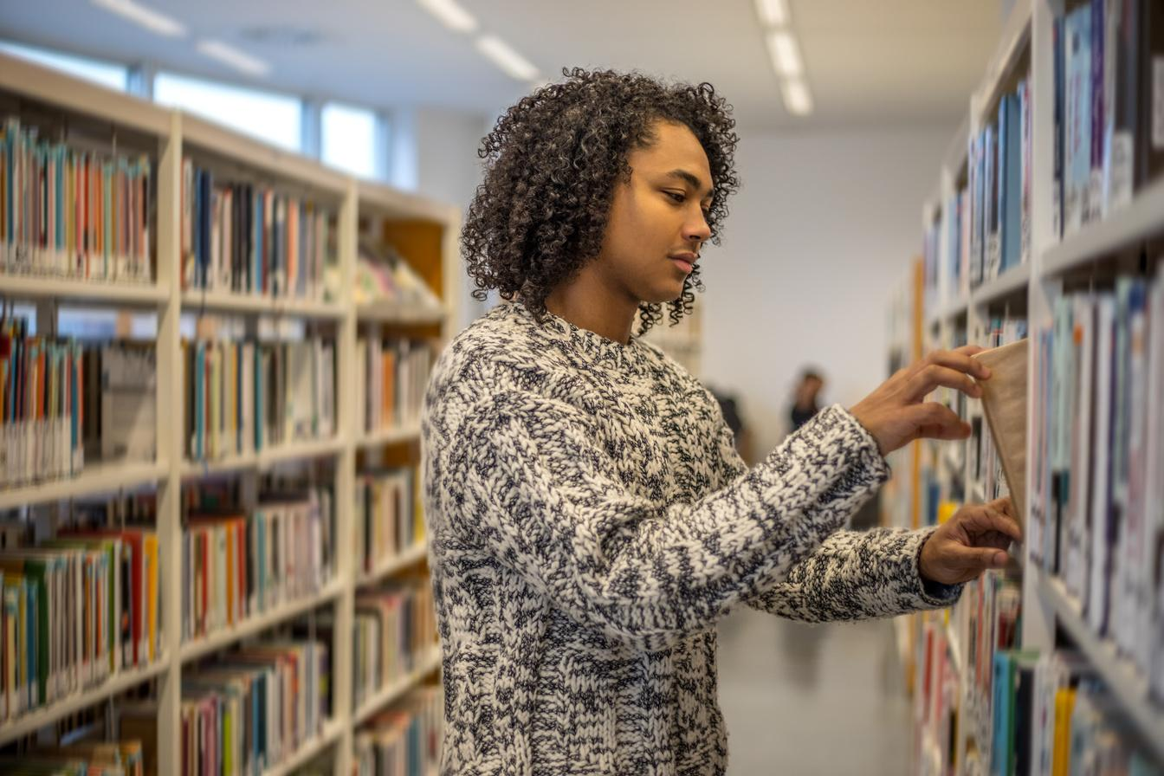
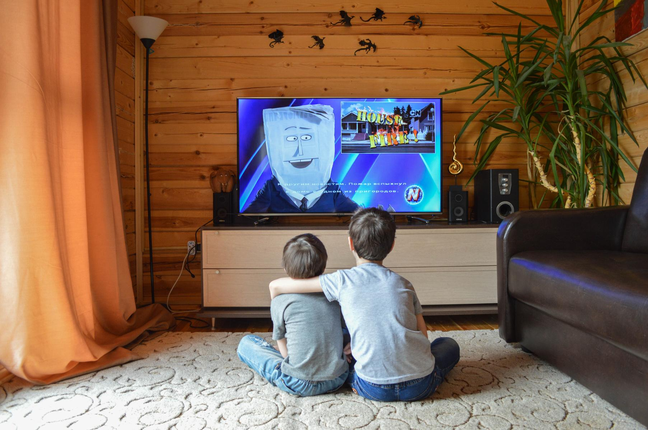
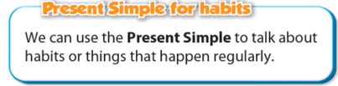
1.My father often has a cup of coffee every morning.
2.We go to the library every Saturday.
3. 1.I always watch TV after I finish my exercises.

Slide 5



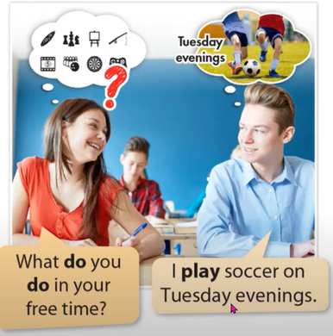
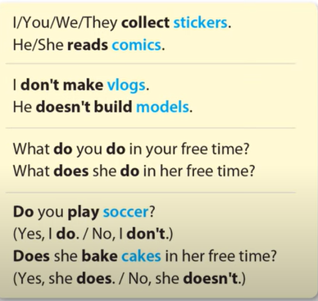
Grammar
a. Listen and repeat.

Slide 6
b. Fill in the blanks with the correct form of the verbs.
play
I (play)_____________________soccer in my free time.
My friends often ( play)___________games online together on the weekends.
My brother ( like)_______________ building models.
Lisa and Molly ( read) ____________comics every night.
________you (bake)____________cakes on the weekends?
Lucas ( not make) ______________vlogs about his garden.
_____________Fiona ( watch) ___________fashion show in her free time?
play
likes
read
Do
bake
doesn’t make
Does
watch

Slide 7
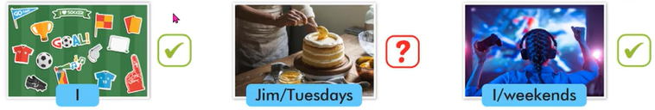
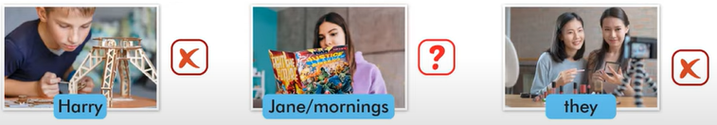
b. Write sentences about habits using pictures and prompts.
I collect soccer stickers.
Does Jim bake cakes on Tuesdays?
I play computer games on the weekends.
Harry doesn’t make models.
Does Jane read comics in the morning?
They don’t make vlogs.

Slide 8
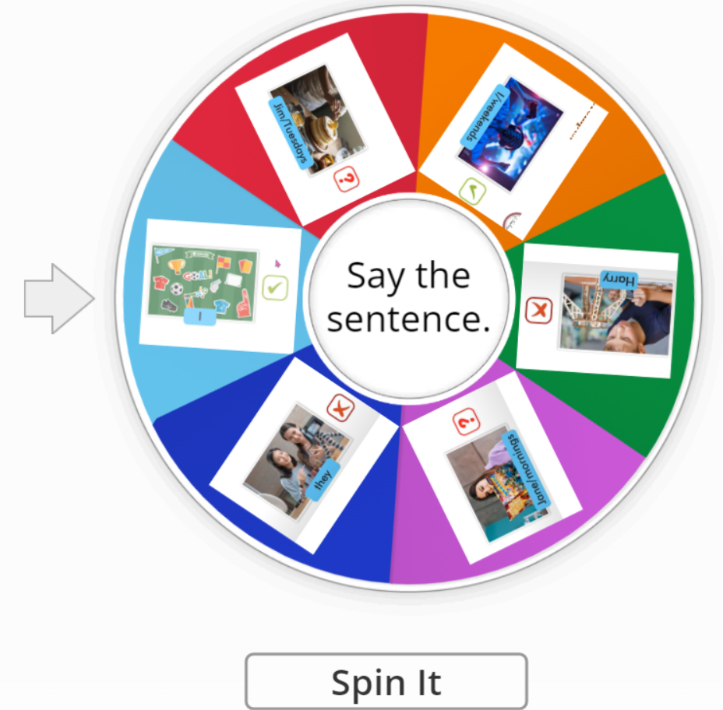
ONLINE GAME

Slide 9
D. In pair ask your partner about what they do and don’t in their free time.
What do you do in your free time? | What don’t you do in your free time?

Slide 10
WARP-UP
Unit 1
Free time
Lesson 2: Grammar
Form and usage of the Present Simple:
Form:
Be: (+) S + am / is / are + …
(-) S + am / is / are + not + …
(?) Am / Is / Are + S + …
Normal verb: (+) S + V _{s/es}
(-) S + don’t / doesn’t + V _{bare infinitive}
(?)Do / Does + S + V _{bare infinitive}
Usage: to talk about habits or things that happen regularly.

Slide 11

HOMEWORK
01
02
03
Make 3 sentences, use the Present Simple to talk about your habits.
- Do the exercises in WB: Lesson 1 - Grammar (page 5).
- Prepare: Lesson 1 – Pronunciation and Speaking (page 6 – SB)

