Slide 1
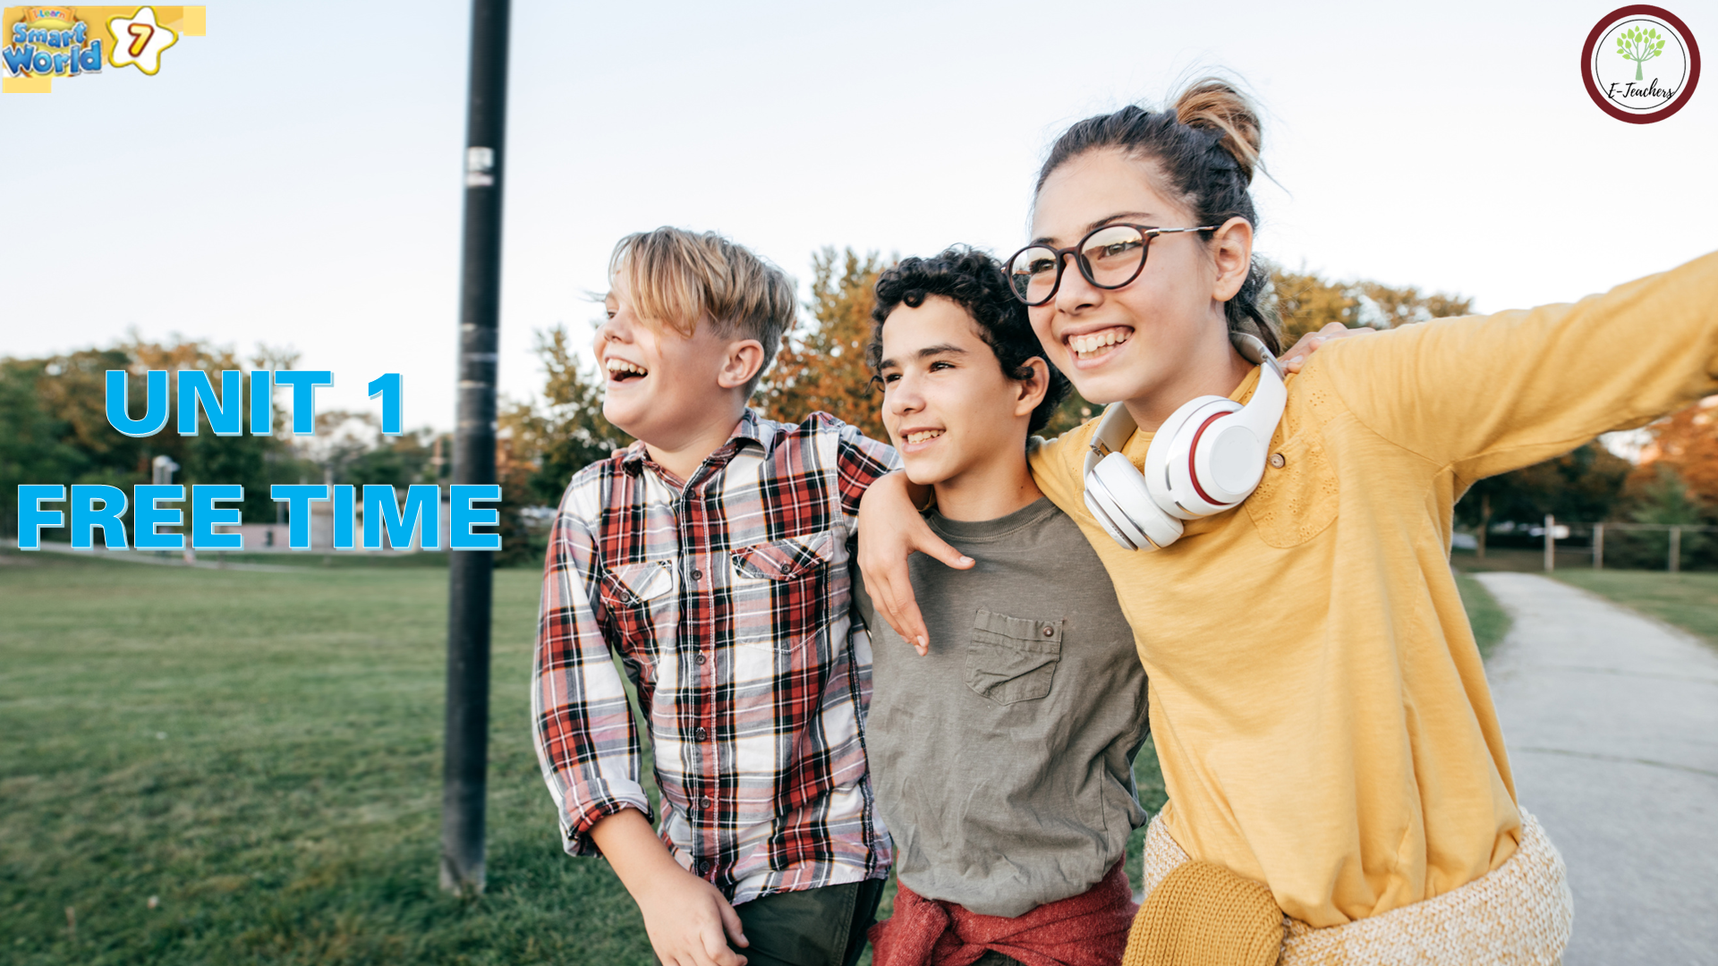



Slide 2

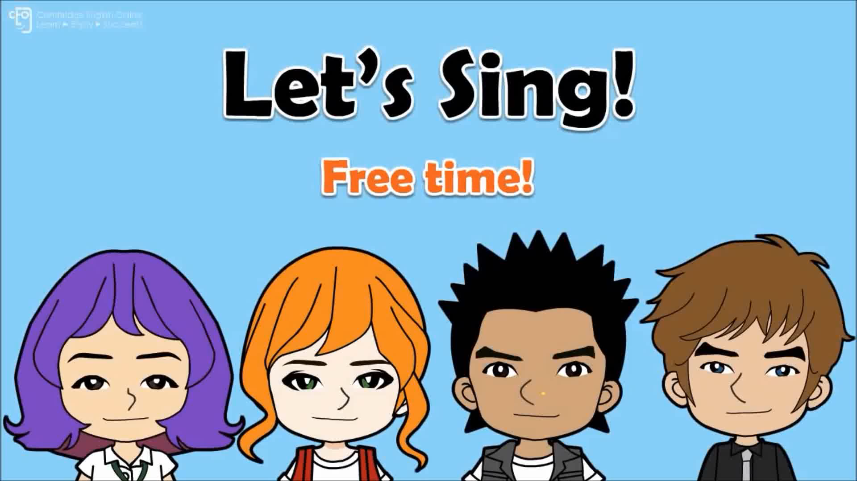
WARM-UP

Slide 3




NEW WORDS
LESSON 1
READING

Slide 4



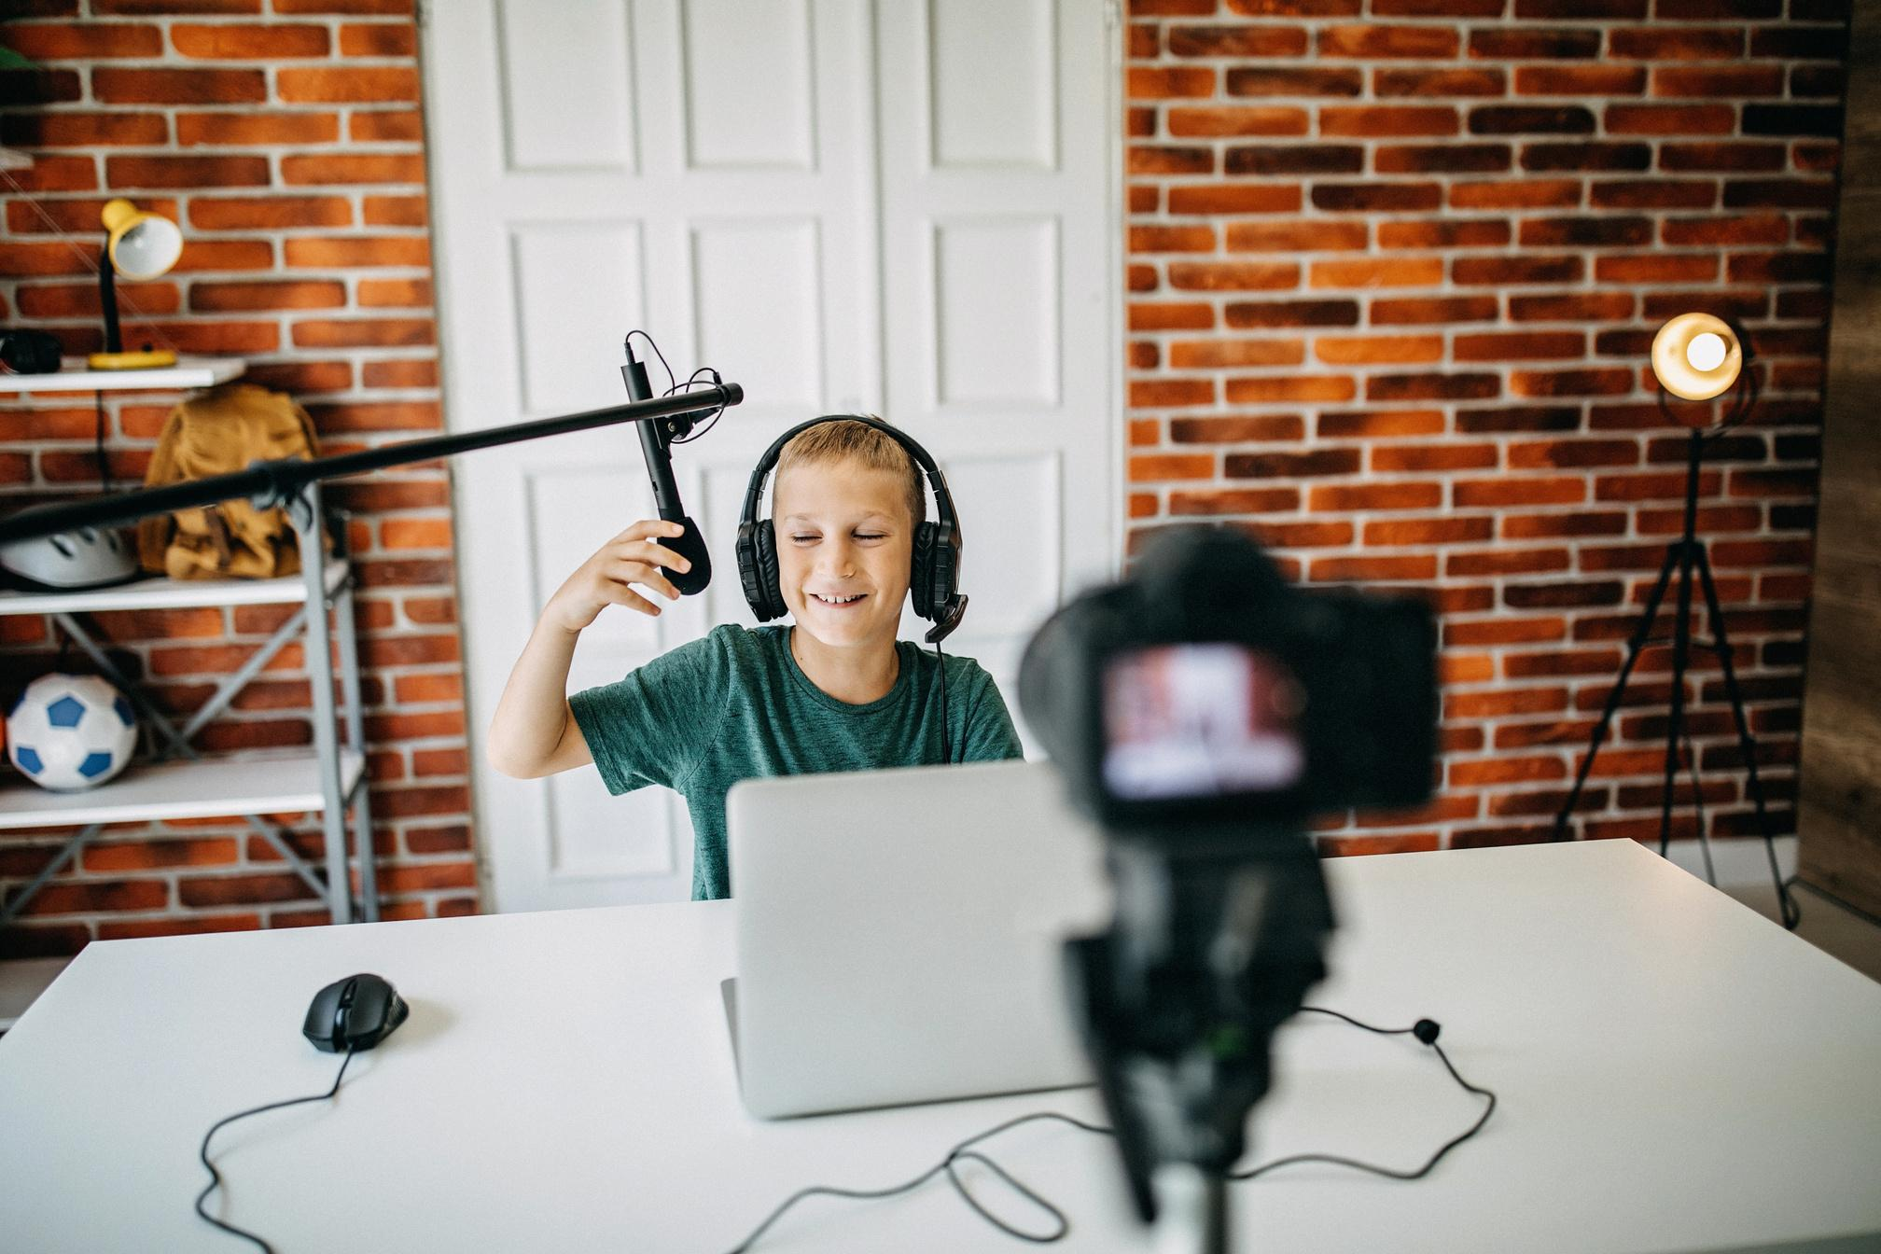
make vlogs
/meɪk vlogs/
Làm vlog
My brother often makes vlogs in his free time.
Anh trai tôi thường làm vlog trong thời gian rảnh rỗi.

Slide 5
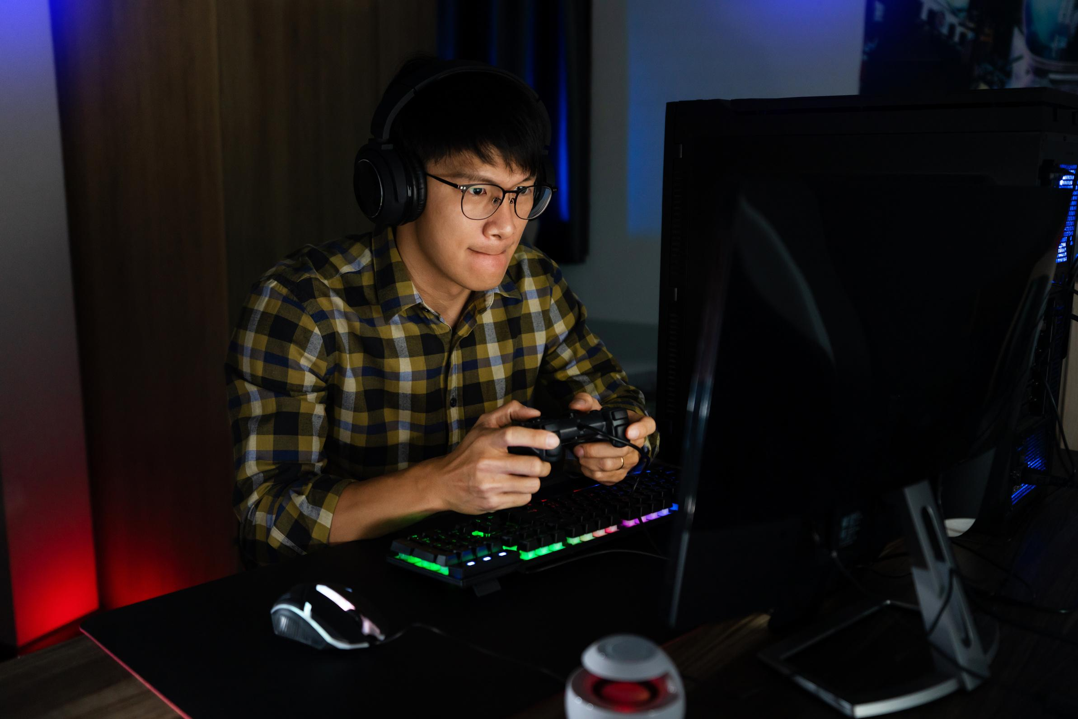
play online games
/pleɪ ˈɒnˌlaɪn geɪmz/
Chơi trò chơi điện tử.
Playing too much online games is very bad for your health.
Chơi nhiều trò chơi điện tử thì rất không tốt cho sức khoẻ.

Slide 6
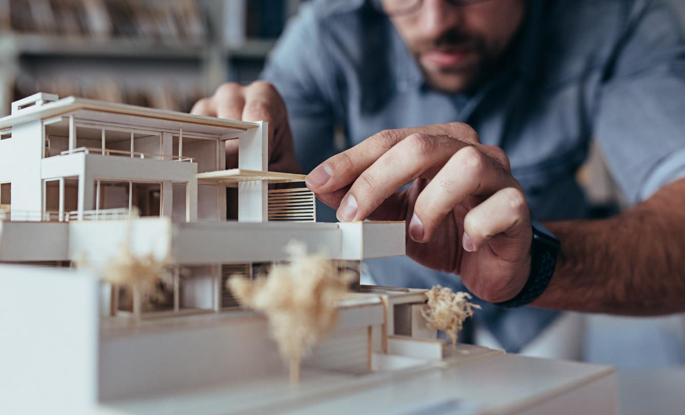
build models
/bɪld ˈmɒdlz/
Làm mô hình
Building models is one of my favorite activities.
Làm mô hình là một trong các hoạt động yêu thích của tôi.

Slide 7
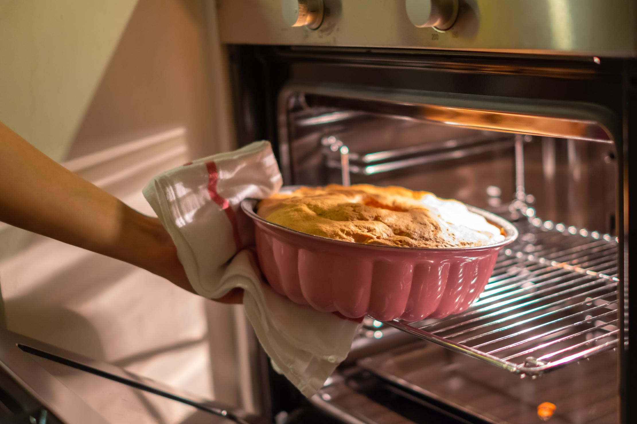
bake cakes
/beɪk keɪks/
Nướng bánh
My mother enjoys baking cakes at the weekend.
Mẹ tôi thích nướng bánh vào cuối tuần.

Slide 8
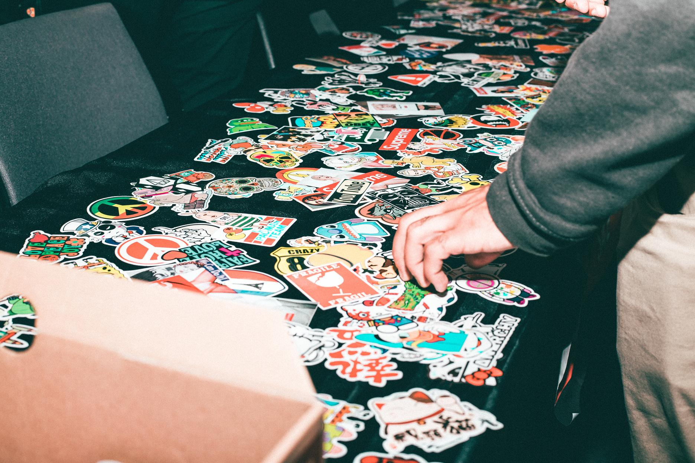
collect soccer stickers
/kəˈlɛkt ˈsɒkə ˈstɪkəz/
Sưu tầm hình dán bóng đá
My brother likes sports, so he often collects soccer stickers.
Em trai tôi thích thể thao vì thế cậu ấy thường sưu tầm hình dán bóng đá.

Slide 9

read comics
/riːd ˈkɒmɪks/
đọc truyện tranh
He is interested in reading comics on Sundays.
Cậu ấy thích thú đọc truyện tranh vào những ngày chủ nhật.

Slide 10
make vlog
play online games
build models
bake cakes
collect soccer stickers
read comics

Slide 11
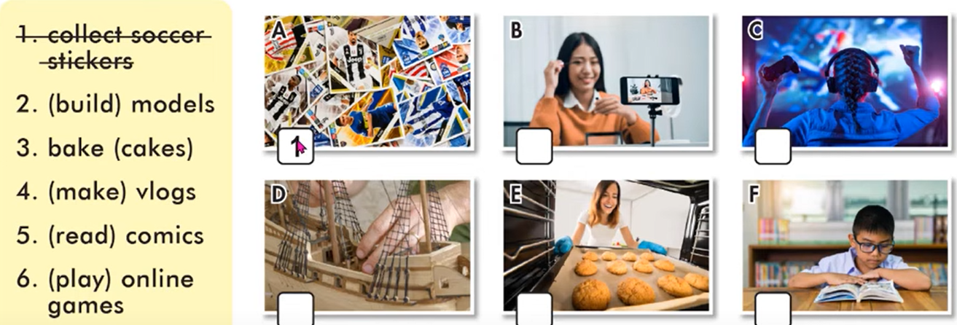
New Words
a. Number the pictures. Listen and repeat.
4
6
2
3
5

Slide 12

B. Work in pair and add three more hobbies you know.
Hobbies

Slide 13


Yes, I do
Do you like………..?
No, I don’t
Do you like…………………….?
Do you like…………………….?
Do you like…………………….?
Do you like…………………….?
Do you like…………………….?
Do you like…………………….?

Slide 14
Complete the blanks with more hobbies and ask your partner.
1.Do you like…………………….?
4. Do you like…………………….?
2. Do you like…………………….?
5. Do you like…………………..?
3. Do you like…………………….?
6. Do you like……………………?

Slide 15
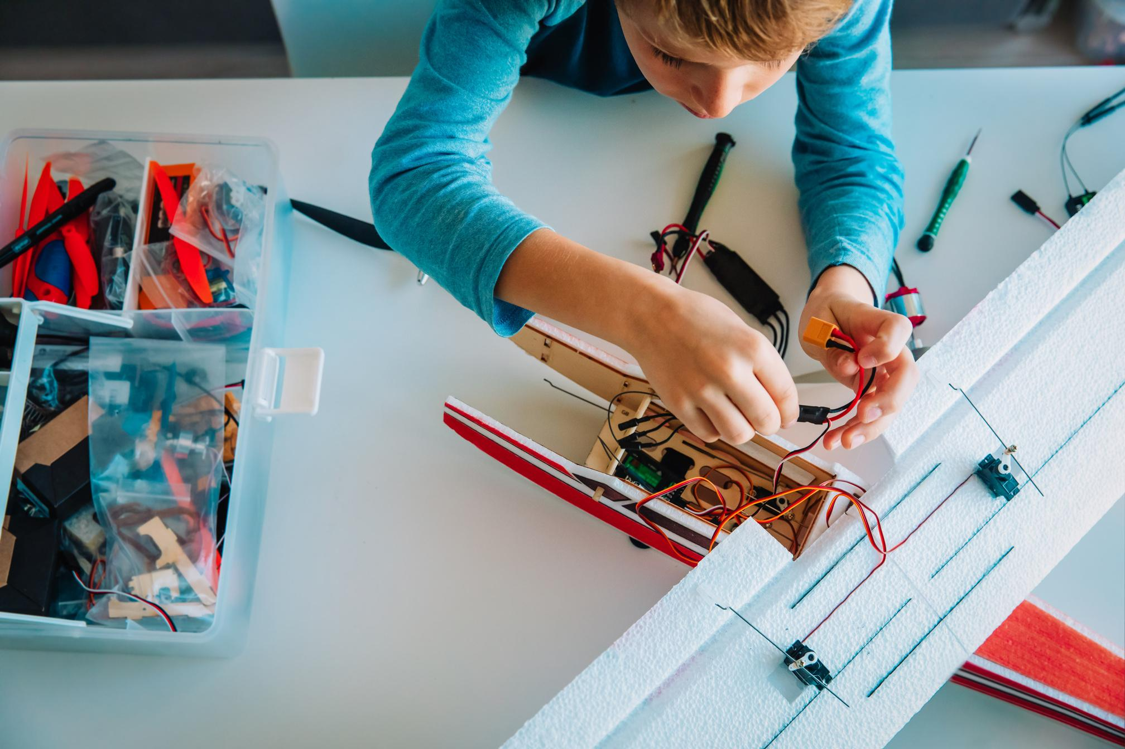

Look at the picture and guess what are they doing?
He is making models.
He is writing his blog.

Slide 16

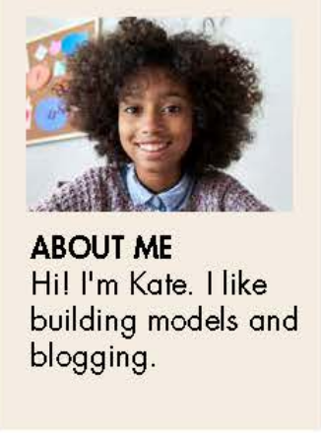
Look at the picture and answer the questions.
What’s her name?
What does she like?
I build models in my free time. I have fifteen models. Some of them were gifts from my friends and family, but I bough most of them. I mostly build planes and cars, but I have a few ship models, too. My favorite one is my MGA car model. The real MGA was a cool sports car from England. I think it’s very cute.
I often spend one hour or two hours a day building my models. Sometime my sister Alice does it with me and films us building models for her vlogs. She makes vlogs every week and it helps her make new friends.
What about you? What do you do in your free time? Leave a comment and tell me.

Slide 17
a. Read Kate’s blog and choose the best title.
1. My Model Collection
2. Building Model Cars is fun
I build models in my free time. I have fifteen models. Some of them were gifts from my friends and family, but I bough most of them. I mostly build planes and cars, but I have a few ship models, too. My favorite one is my MGA car model. The real MGA was a cool sports car from England. I think it’s very cute.
I often spend one hour or two hours a day building my models. Sometime my sister Alice does it with me and films us building models for her vlogs. She makes vlogs every week and it helps her make new friends.
What about you? What do you do in your free time? Leave a comment and tell me.

Slide 18
1. How did Kate get most for her model?
c. She found them.
b. She bought them.
They were gifts.
2. What is her favorite model?
a car
a ship
a plane
3. Who does Kate build her models with?
her friend
b. her teacher
c. her sister
4. Why does Alice film them to building models?
for school
b. for her vlogs
b. for her friends

Slide 19
C. In pair. What cool things can you make?
1. What do you do in your free time?
2. What cool things can you make?

Slide 20
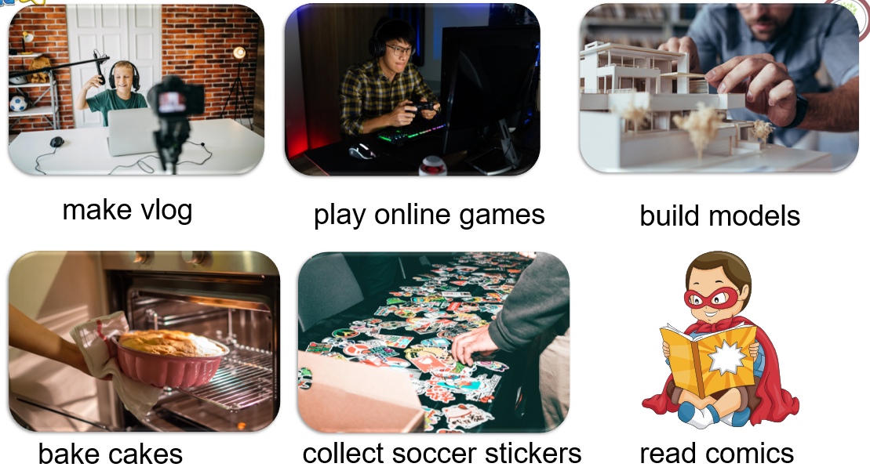
WARP-UP
Unit 1
Free time
Lesson 1: New words + reading

Slide 21
CHECKING MEMORY
v.phr
làm vlog
1. make vlogs
v.phr
Chơi trò chơi qua mạng
2.play online games
3. build models
v.phr
dựng mô hình
4. bake cakes
v.phr
nướng bánh
5. collect soccer stickers
v.phr
sưu tầm hình dán bóng đá.
v.phr
đọc truyện tranh
6.read comics

Slide 22

https://wordwall.net/resource/33946321

Slide 23

HOMEWORK
01
02
03
04
Learn the new words by heart.
- Practice talking about your hobby.
- Do the exercises in Workbook: Lesson 1 - New words (page 2).
- Prepare: Lesson 1 – Grammar (page 5 – SB).

