Slide 1
UNIT 5
AROUND TOWN

Slide 2
LESSON 8

Slide 3
WARM UP

Slide 4
READING

Slide 5

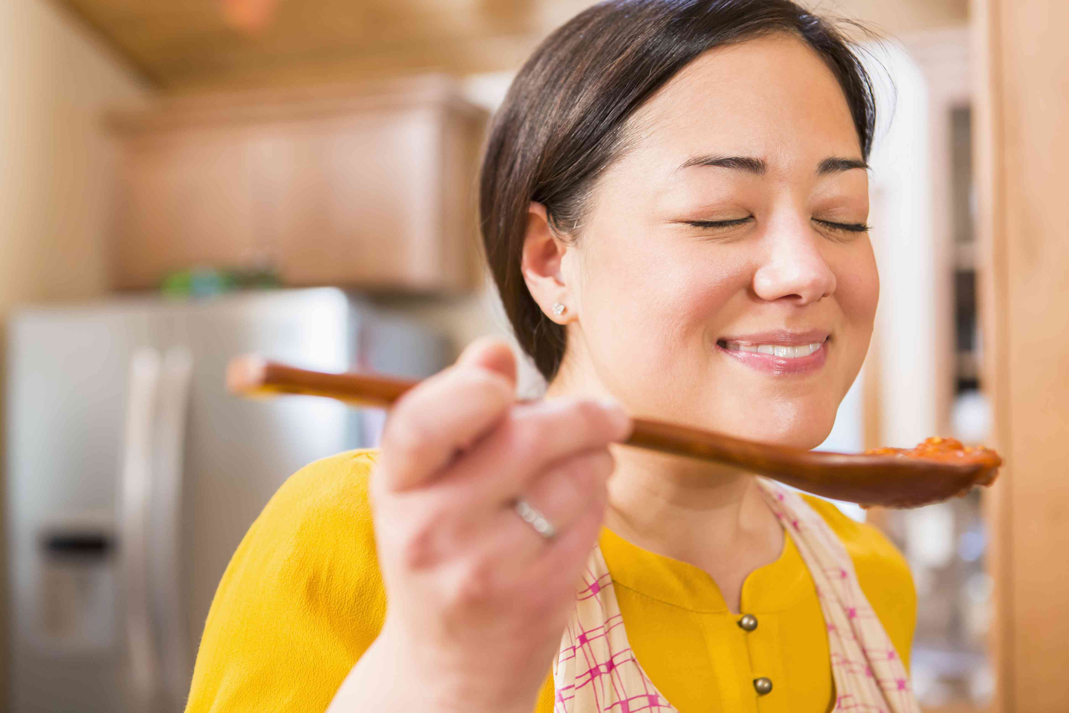

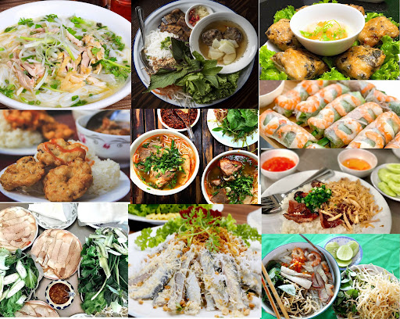
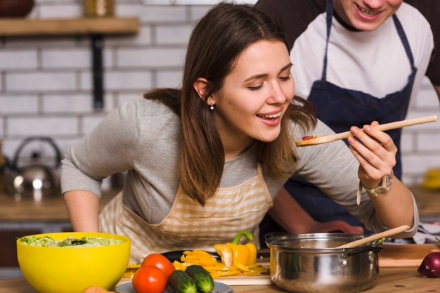
popular dishes
delicious
amazing
taste
smell
smell
amazing
taste
delicious
popular dishes
Match the words with the pictures.

Slide 6
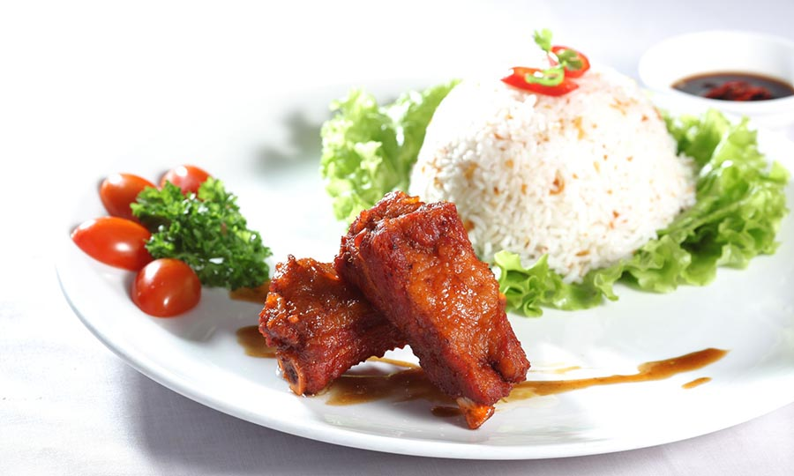
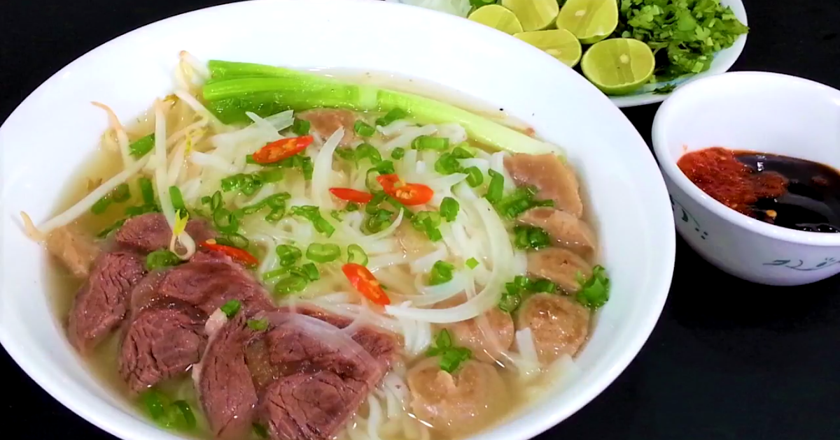
1. Do you know the name of the dishes in Vietnam?
2. When do people often eat them? in the morning or afternoon?
3. Do you like eating them?

Slide 7
Read the article and circle the best headline.
1. Food around the world
2. A Taste of Vietnam
3. My favourite Food
Louis Wilson, March 18
There are many popular dishes in Vietnam and you will find rice or noodles in most of them. Phở is a famous noodle dish from Vietnam. People make it with chicken or beef. They put onions and herbs in it. It smells and tastes wonderful.
Another amazing dish is cơm tấm. It is a rice dish with grilled pork adn fried eggs. People often eat it with fish sauce on top. I love eating it for breakfast. It is delicious! Food in Vietnnam is popular all over the world

Slide 8
Read the article and answer the questions.
Louis Wilson, March 18
There are many popular dishes in Vietnam and you will find rice or noodles in most of them. Phở is a famous noodle dish from Vietnam. People make it with chicken or beef. They put onions and herbs in it. It smells and tastes wonderful.
Another amazing dish is cơm tấm. It is a rice dish with grilled pork and ried eggs. People often eat it with fish sauce on top. I love eating it for breakfast. It is delicious! Food in Vietnnam is popular all over the world
1. What foods are in most Vietnam dishes?
Rice and noodles are most in Vietnam dishes.
2. What kind of dish is phở?
It’s a noodle soup dish.
3. What is Cơm tấm?
It’s a rice dish with grilled pork and fried eggs.
4. What do people often eat with Cơm tấm
People often eat with fish sauce on top.

Slide 9
Read the article again and fill in the blanks.
1. Phở and Cơm tấm are popular ______of Vietnam.
2. People make ______ with chicken or beef.
3. There are ______ and ______ in Phở.
4. The ingredients of Cơm tấm are rice, egg and ______ pork.
5. There is _______________ on the top of Cơm tấm.
6. Phở and Cơm tấm are very __________.
dishes
Phở
onions
herbs
grilled
fish sauce
delicious

Slide 10


SPEAKING
WARM UP
Look at the pictures and guess the names of the dishes and where they come from.

Slide 11
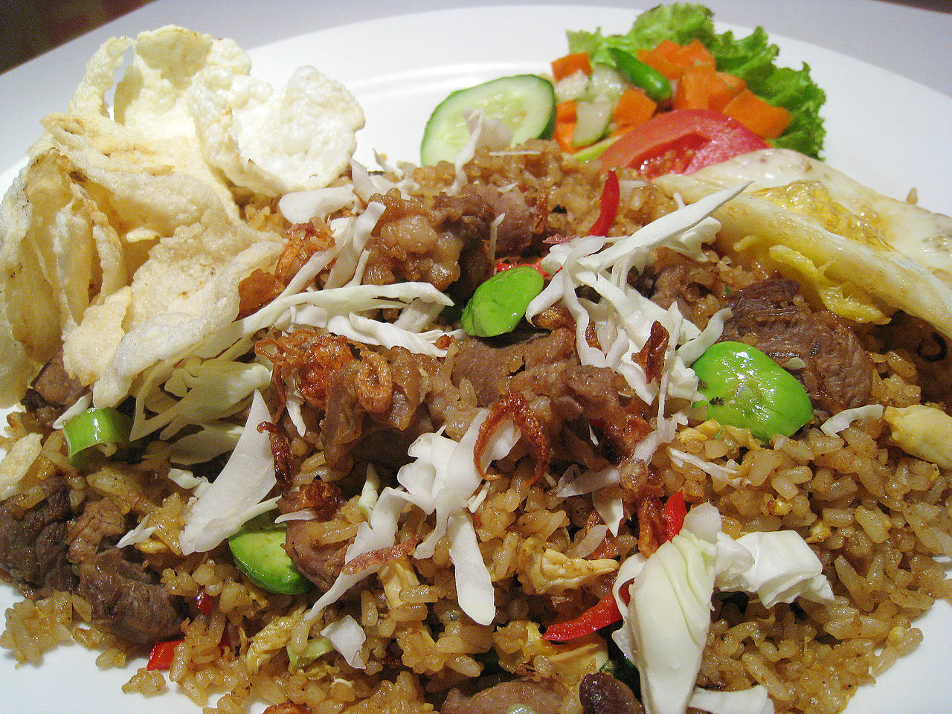
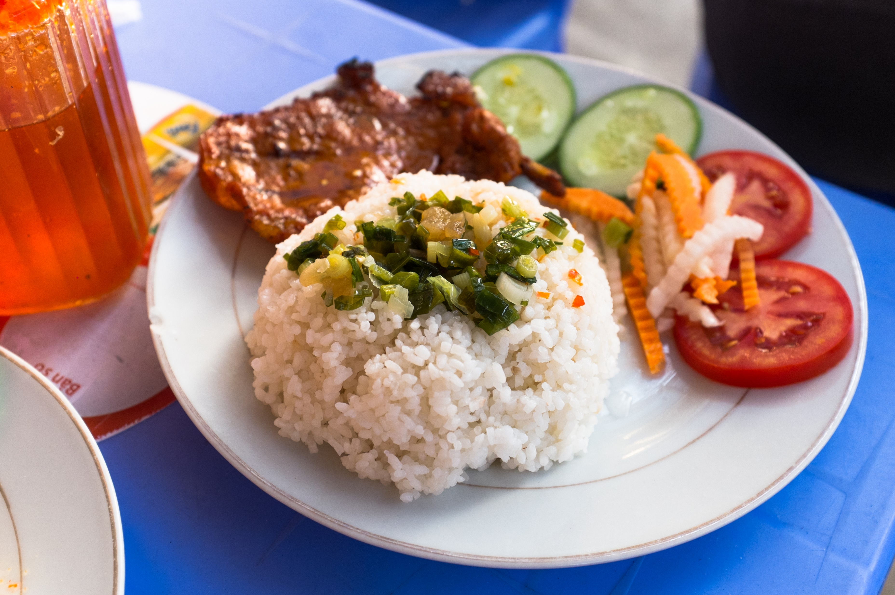
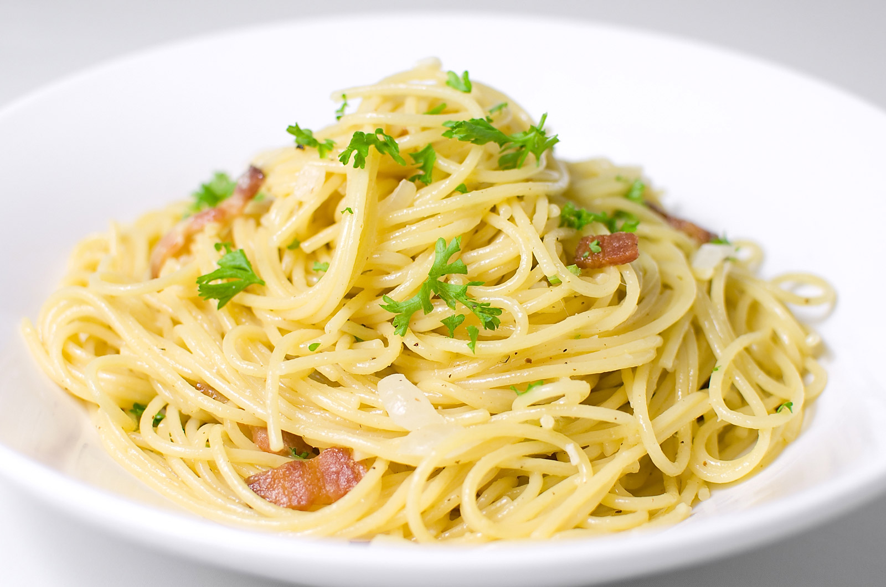
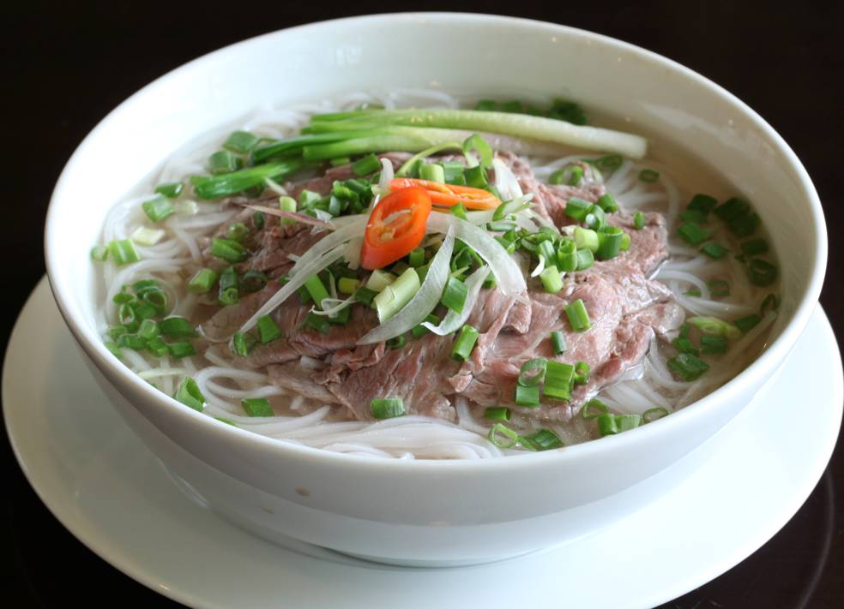
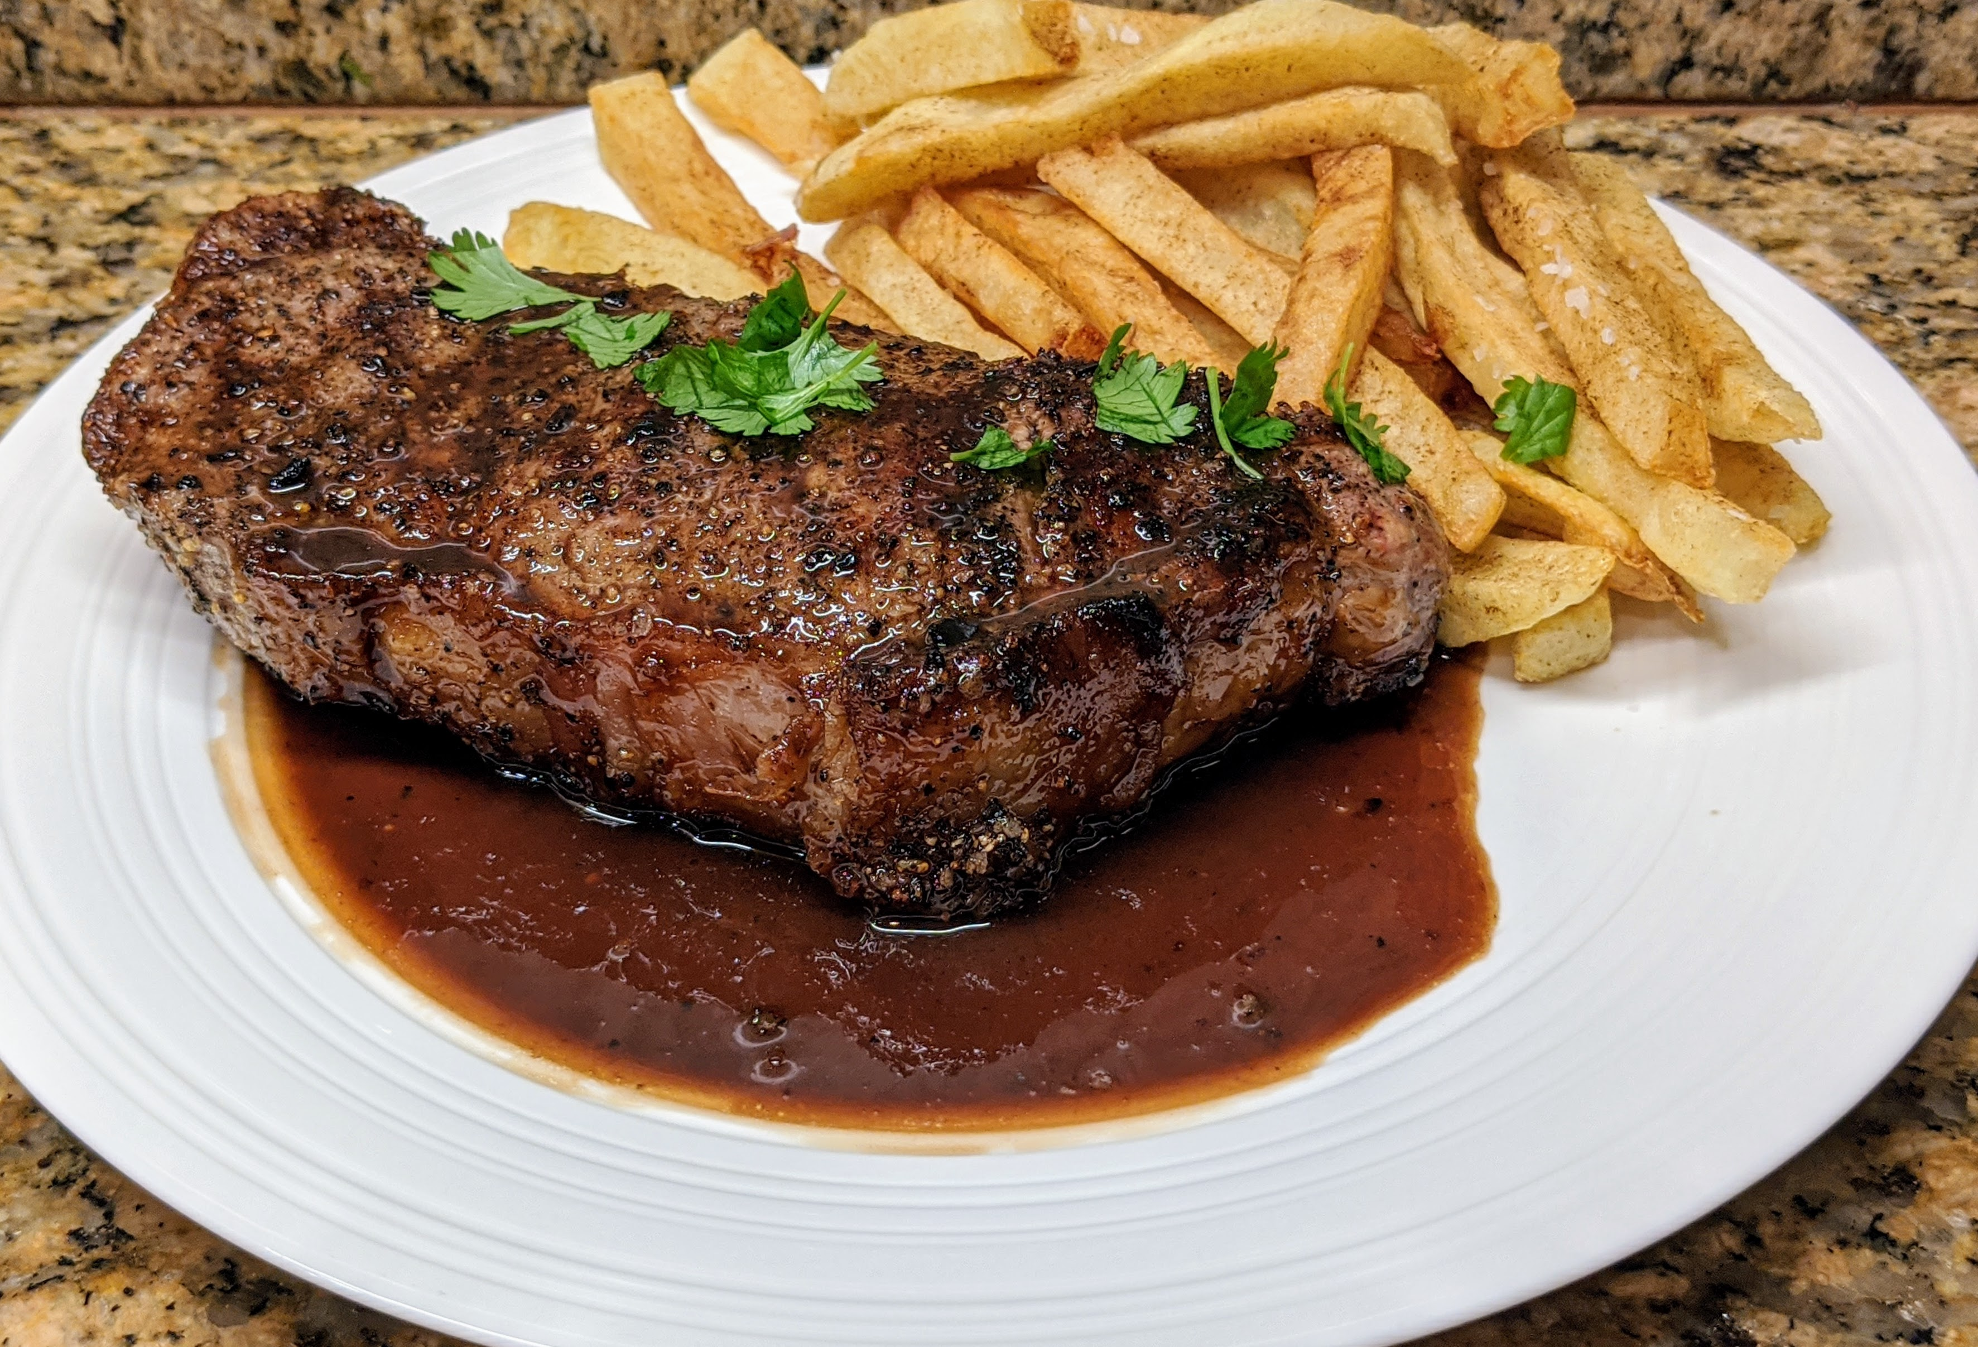
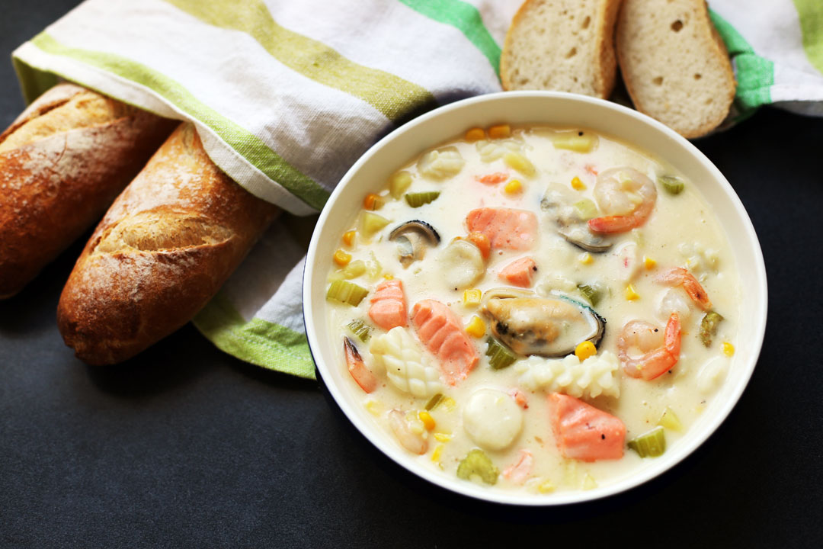
Cơm tấm - Vietnam
Spaghetti- Italy
Nasi goreng - Indonesia
Phở - Vietnam
Steak frites - France
Chowder – the USA

Slide 12

Food around the world
You’re visiting an international food festival. Work in pairs. Student A, ask student B about four of the dishes below and tick the ones you would like to try. Student B, answer the questions.
It’s a rice dish from Vietnam
What do people make it with?
Grilled pork, fried eggs, and fish sauce.
What’s cơm tấm?
VIETNAM
ITALY
VIETNAM
INDONESIA
Cơm Tấm
rice dish
grilled pork, fried eggs, fish sauce
Nasi goreng
rice dish
rice, chicken,
eggs
phở
noodle soup
noodles, herbs, beef or chicken
spaghetti carbonara
pasta dish
pasta, pork, eggs, cheese.
The USA
FRANCE
chowder
soup
seafood, potatoes, onions, cream
Steak frites
meat dish
beef, french fries

Slide 13
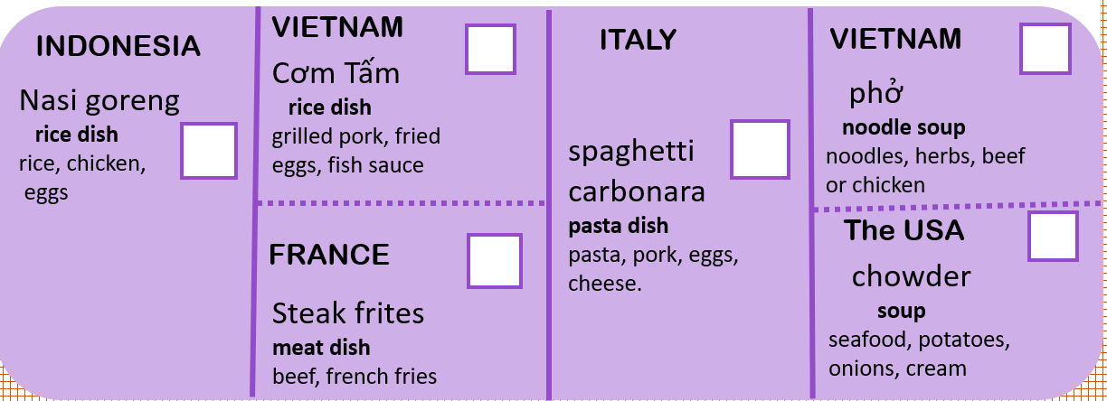
Sample conversation
A: What’s nasi goreng?
B: It’s a rice dish from Indonesia
A: What do people make it with?
B: rice, chicken and eggs

Slide 14
WRITING
WARM UP

Slide 15
a. With your partner, choose two of the dishes from your country and make note.
Talk about :
The name and the kind of dish
What people make it with
When people eat it
How it tastes
Notes
- Bún chả
- People make it with grilled pork and noodles.
- People often eat it for breakfast.
- It taste so delicous

Slide 16
Write a paragraph about your choices. Write 50 to 60 words.
Your writing
SAMPLE ANSWER
Bún thịt nướng is a noodle dish from Vietnam. People make it with noodle, pork, and salad. Some people eat it for lunch. I eat it for
breakfast. It tastes great.
_________________________________________________________________________________________________________________________________________________________________________________________________________________________________________________________________________________________________________________________________________________________________________________

Slide 17
WARM UP
WRAP-UP

Slide 18
HOMEWORK

