Slide 1
UNIT 5
AROUND TOWN

Slide 2
LESSON 7

Slide 3


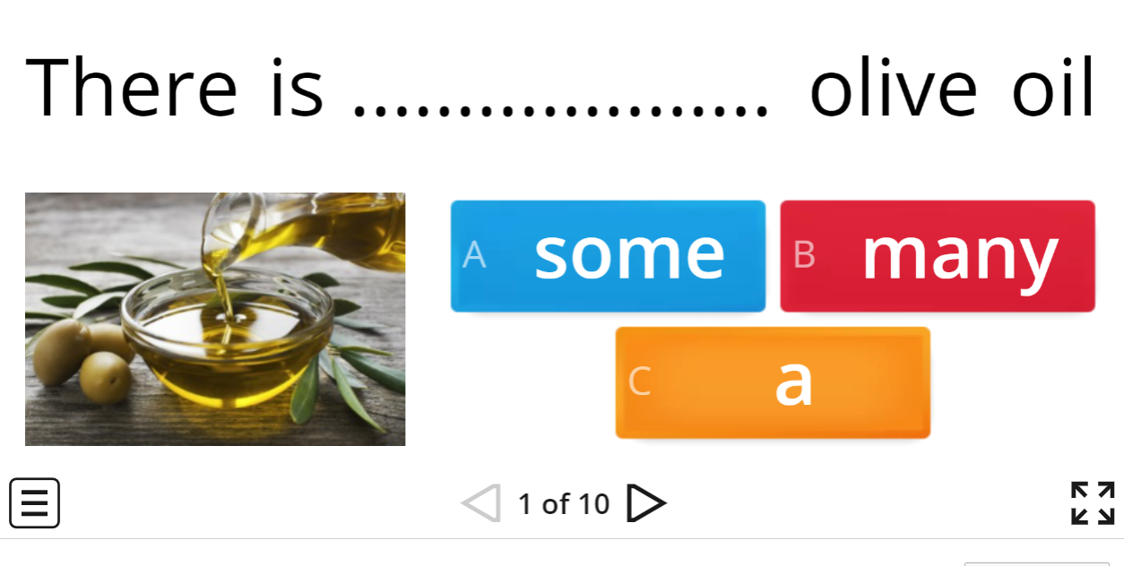

WARM UP
https://wordwall.net/resource/21288648/countable-and-uncountable-nouns
WARM UP

Slide 4
NEW WORDS

Slide 5
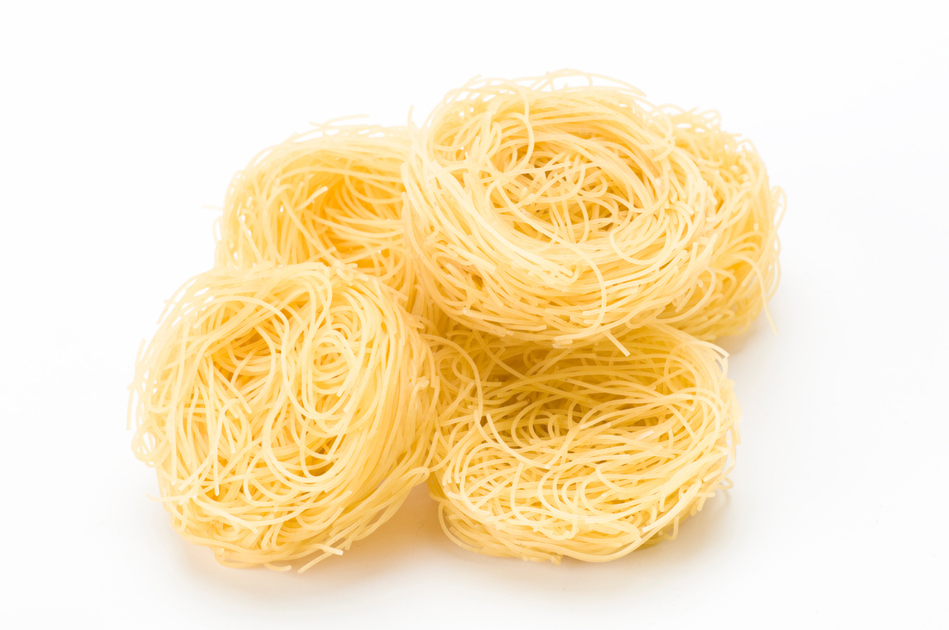
noodle
/ˈɔːdə(r)/
mì
He often eats noodles for breakfast.
Anh ấy thường ăn mì vào bữa sáng.

Slide 6
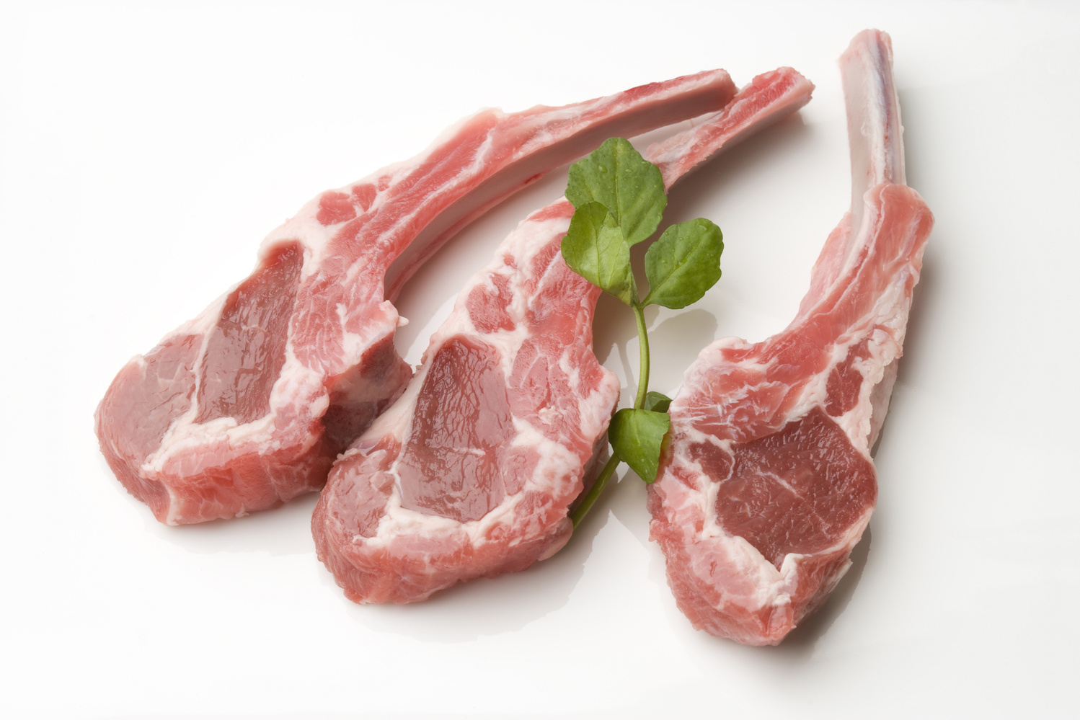
lamb
/læm/
thịt cừu
Lamb is popular food in my country
Thịt cừu là món ăn phổ biến ở đất nước của tôi.

Slide 7
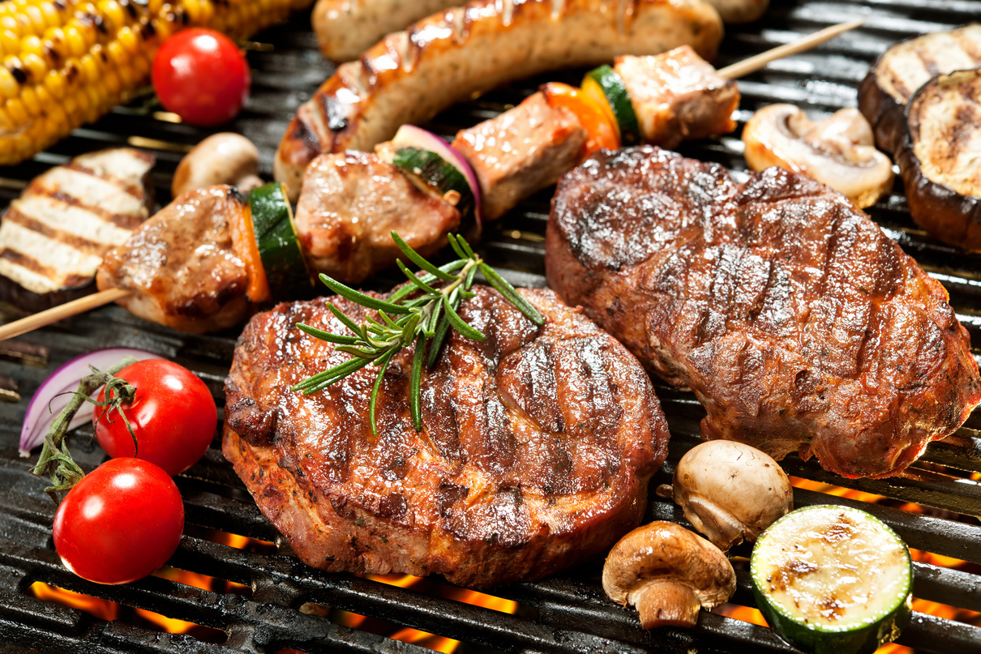
grill
/ɡrɪl/
đồ nướng
Grilled food is really suitable for cold weather.
Thức ăn nướng rất thích hợp cho thời tiết lạnh.

Slide 8
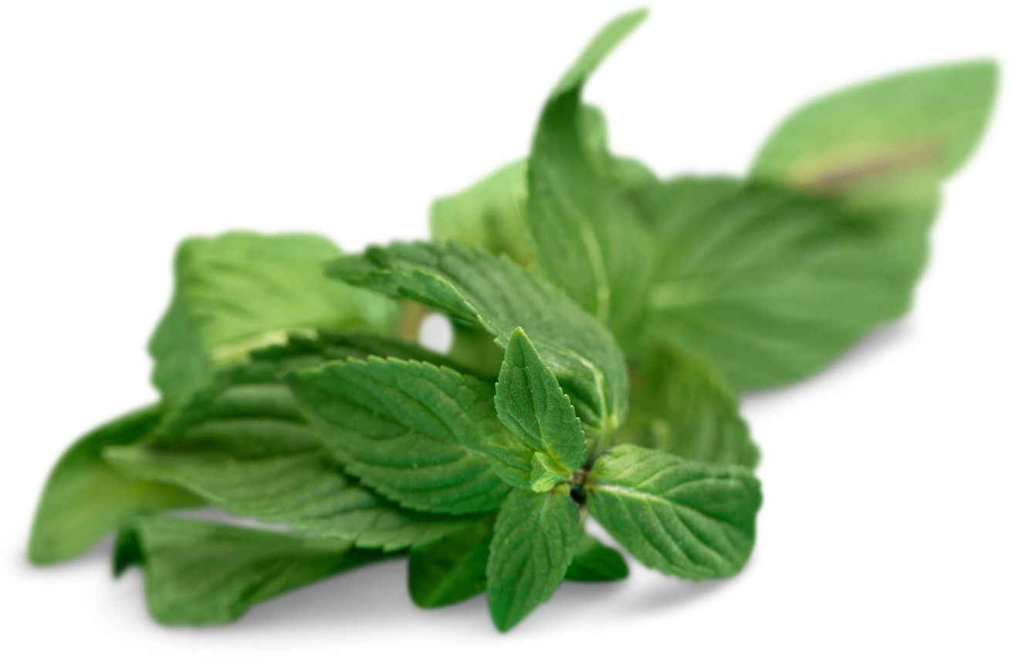
herb
/hɜːb/
rau thơm
This food is served with fish sauce and herbs.
Món ăn này được phục vụ kèm cùng nước mắm và rau thơm.

Slide 9
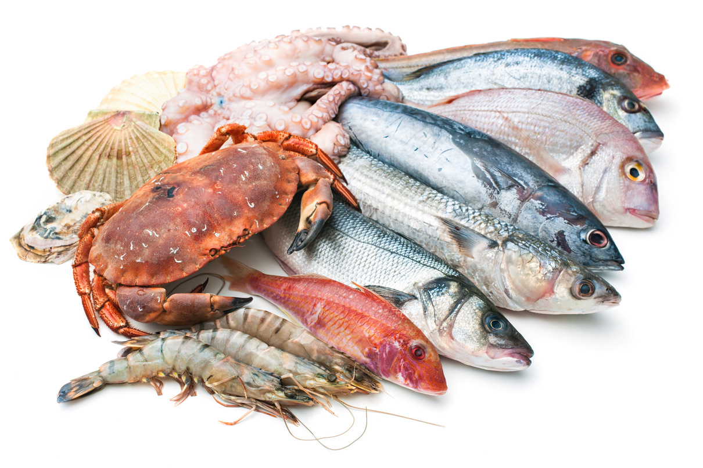
seafood
/ˈsiːfuːd/
Hải sản
This place is famous for seafood.
Nơi nay rất nổi tiếng với hải sản.

Slide 10
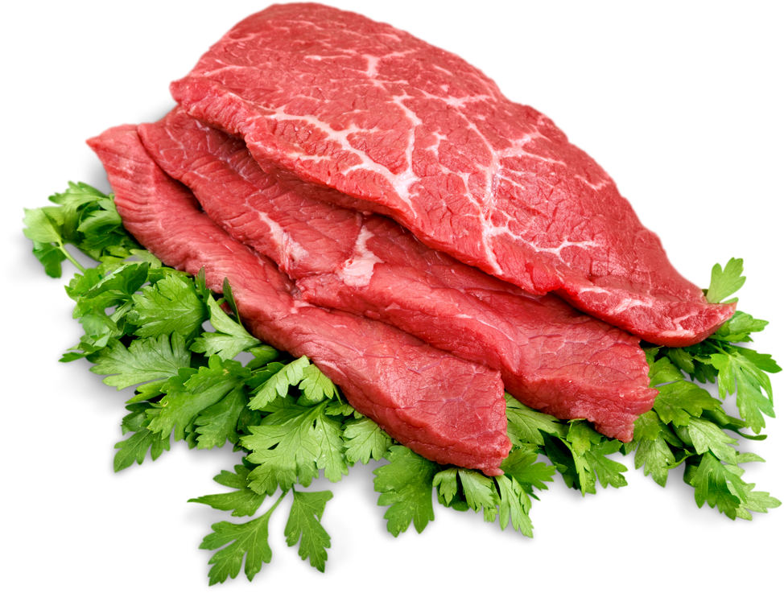
beef
/biːf/
thịt bò
Beef is really nutrious food.
Thịt bò là một món ăn rất bổ dưỡng.

Slide 11
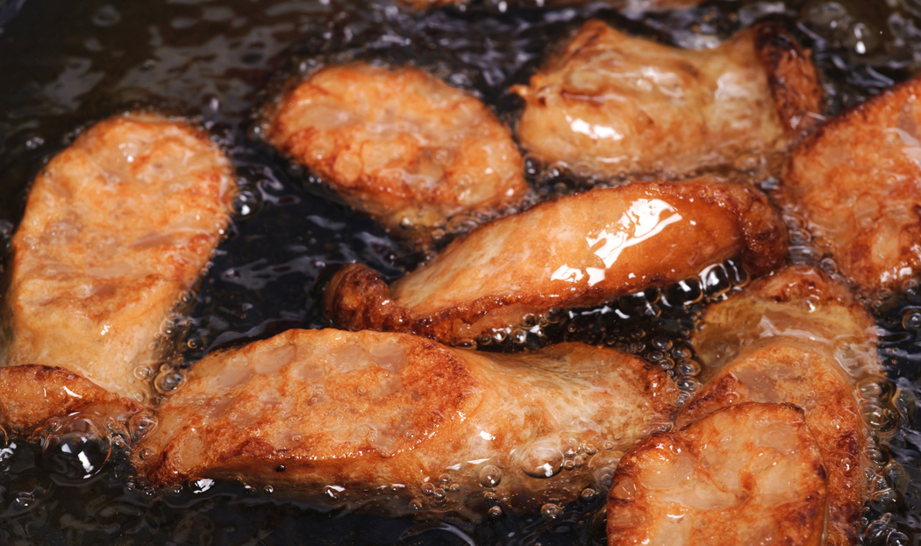
fry
/fraɪ/
chiên, rán
Fried chicken is unhealthy food.
Gà chiên là một món đồ không lành mạnh.

Slide 12
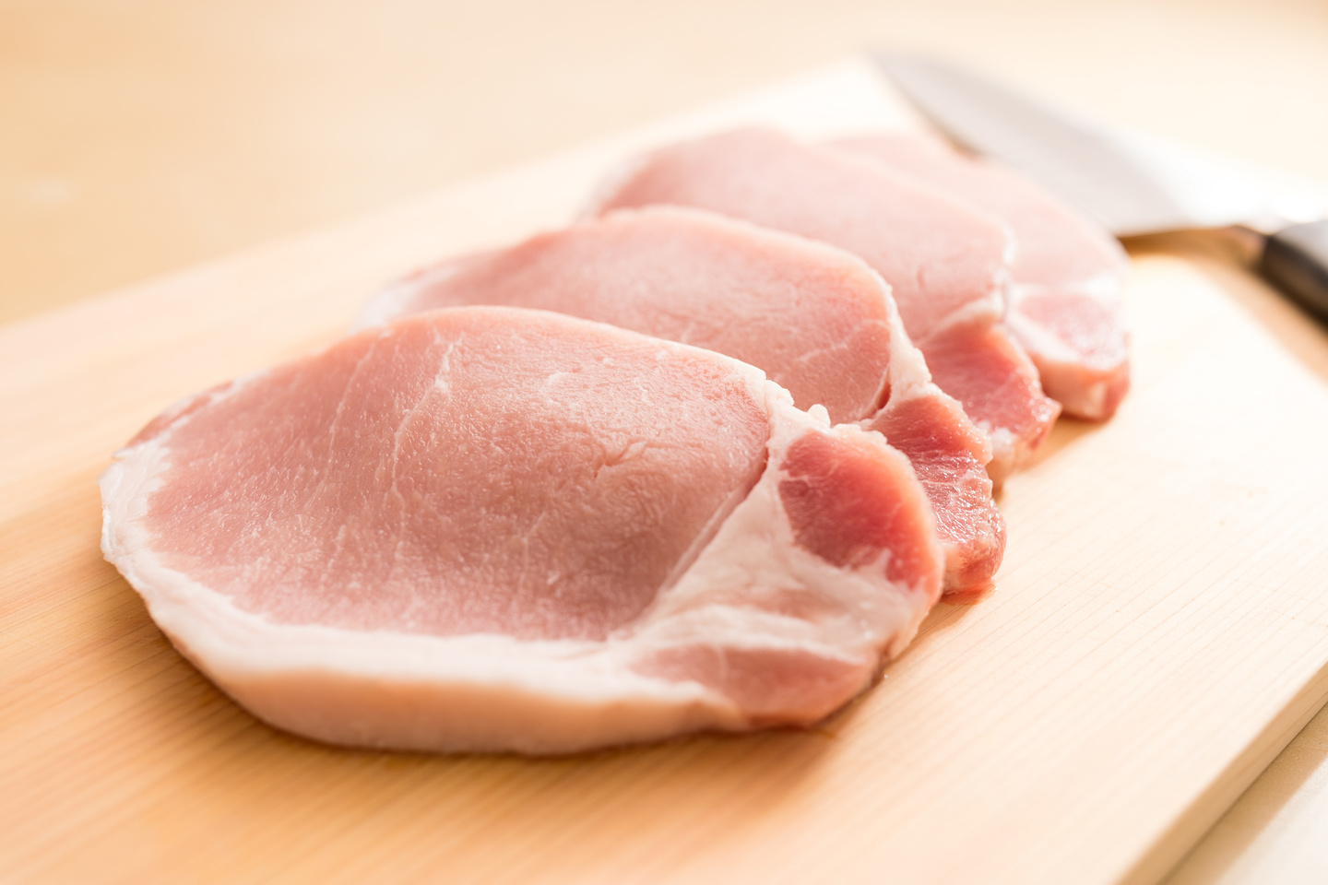
pork
/pɔːk/
Thịt lợn
We shouldn’t eat to much meat pork.
Chúng ta không nên ăn quá nhiều thịt lợn.

Slide 13
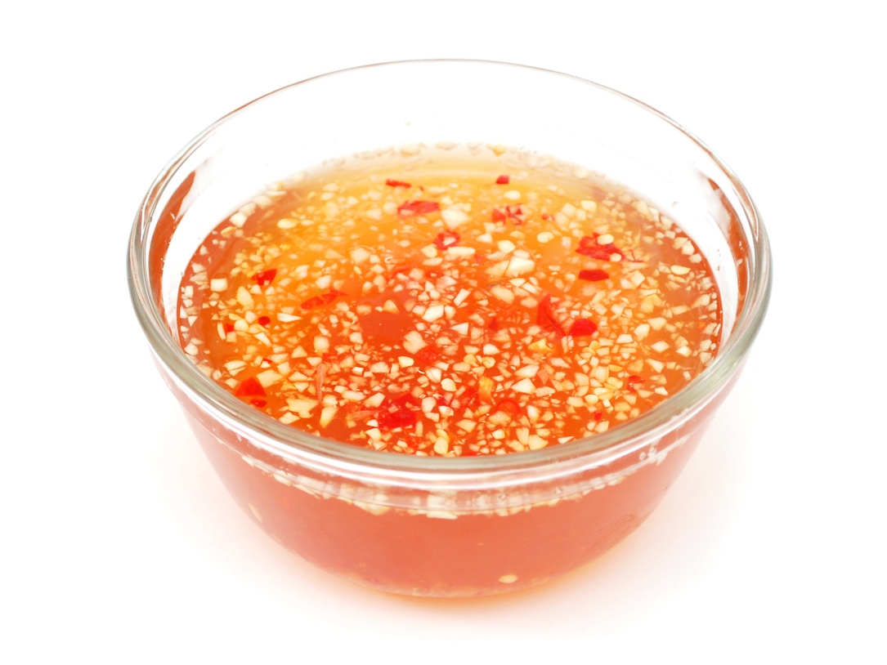
fish sauce
/fɪʃ sɔːs/
Nước mắm
I need some fish sauce for the food.
Tôi cần một chút nước mắm cho thức ăn này.

Slide 14
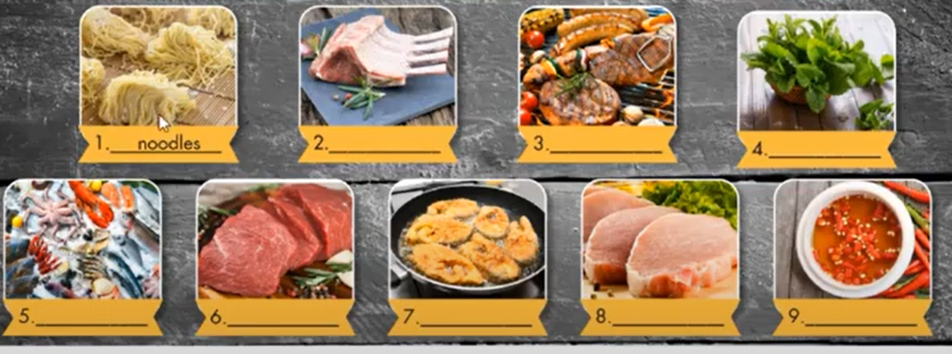
Fill in the blanks. Listen and repeat.
fish sauce fry noodle grill beef seafood lamb herbs pork
noodles
lamb
grill
herbs
seafood
beef
fry
pork
fish sauce

Slide 15
LISTENING

Slide 16
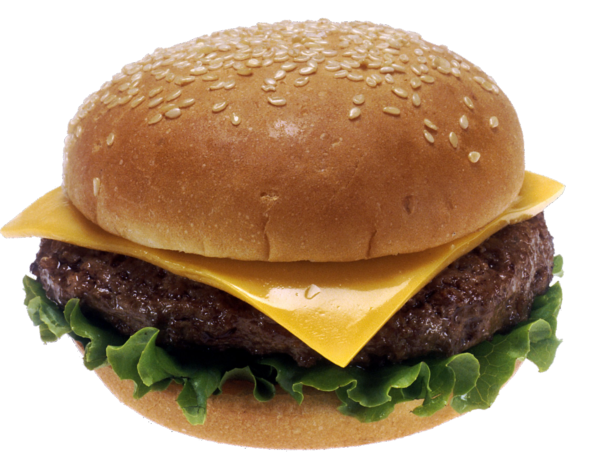
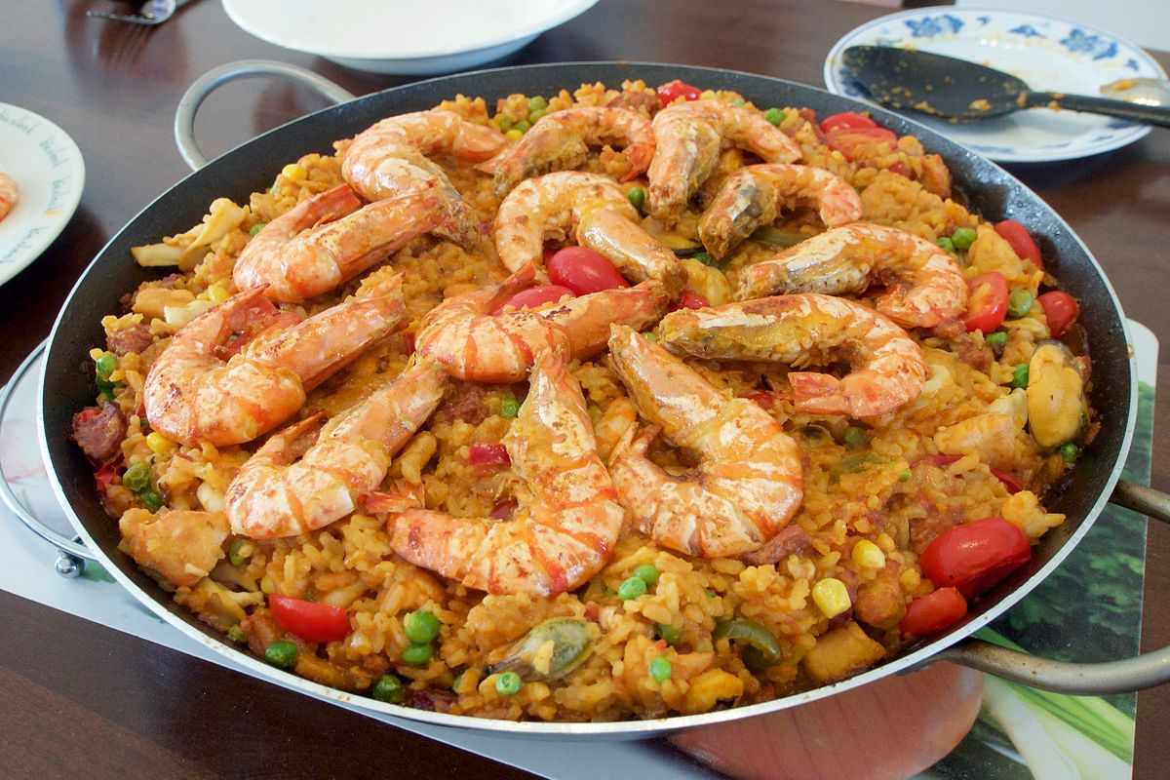
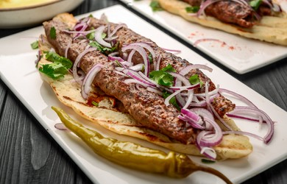

Do you know the name of the food?
paella
kebab
Cheeseburger

Slide 17

Listen to a man taking about popular food from around the world. Who is the speaker?
a student a customer a chef
b. Now, listen and fill in the blanks, then match with the correct pictures.
Cheeseburger
kebab
paella
from_________
from__________
from Spain
the USA
Turkey
made with grilled
made with grilled meat on a stick, usually ________
made with________rice, and ________.
__________, onions, and cheese
seafood
beef
lamb
some vegetables

Slide 18
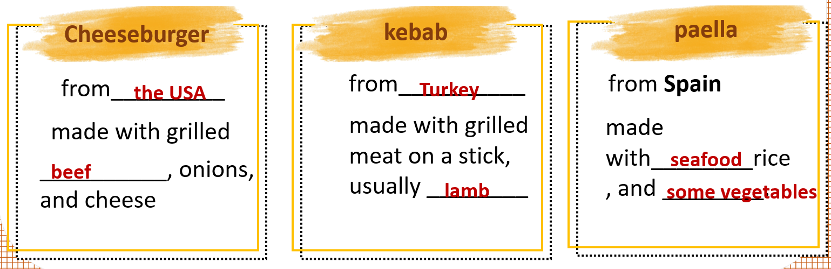

Slide 19
USEFUL
LANGUAGE

Slide 20
Listen and practice
What is “ Bún Bò Huế”?
What do people make it with?
- It’s a noodle dish from Vietnam.
- Noodles, beef, and herbs.
Suggested conversation
A: What’s cheese burger?
B: It’s a dish from the USA
A: What do people make it with?
B: grilled beef / pork, onions and cheese

Slide 21
WRAP-UP
* Vocabularies about dishes and ingredients
* Structures:
What is + name of the dish?
What do people make it with?

Slide 22
WORD | CLASS | MEANING
n
mì
noodle
n
lamb
thịt cừu
grill
n
đồ nướng
n
rau thơm
herb
pork
n
thịt lợn
beef
n
thịt bò
seafood
n
hải sản

Slide 23
WORD | CLASS | MEANING
n
nước mắm
fish sauce
n
fries
Khoai tây chiên
onion
n
hành
cheese
n
bơ

Slide 24
HOMEWORK
- Practice asking and answering about dishes and ingredients.
- Do exercises in Workbook: Lesson 3 - New words – Listening (page 30).
- Prepare: Lesson 3 – Reading, Speaking and Writing (page 45 – SB).

