Slide 1
UNIT 5
AROUND TOWN

Slide 2
LESSON 3

Slide 3


WARM UP
WARM UP

Slide 4
The teacher say some sentences. If the sentence is correct, student put the thumb nail, if the sentence is incorrect, the students say “ ố ồ”
1. We would like to drink a orange juice , please
2. I don’t have any eggs left.
3. We drinks a lot of milks for breakfast every day.
4. Sorry! There aren’t some water left.
5. Would you like some chicken pasta?

Slide 5
PRONUNCIATION

Slide 6

sound change
a/ Do you have.......? often sound like/ ʤə hæv /
b. Listen. Notice the sound changes of the underlined words.
Do you have these pants in blue?
Do you have this jacket in green?
c. Listen and cross out the one with the wrong sound changes.
Do you have these sockes in red?
Do you have this shirt in pink?
d. Read the sentences with the correct sound changes to a partner.

Slide 7
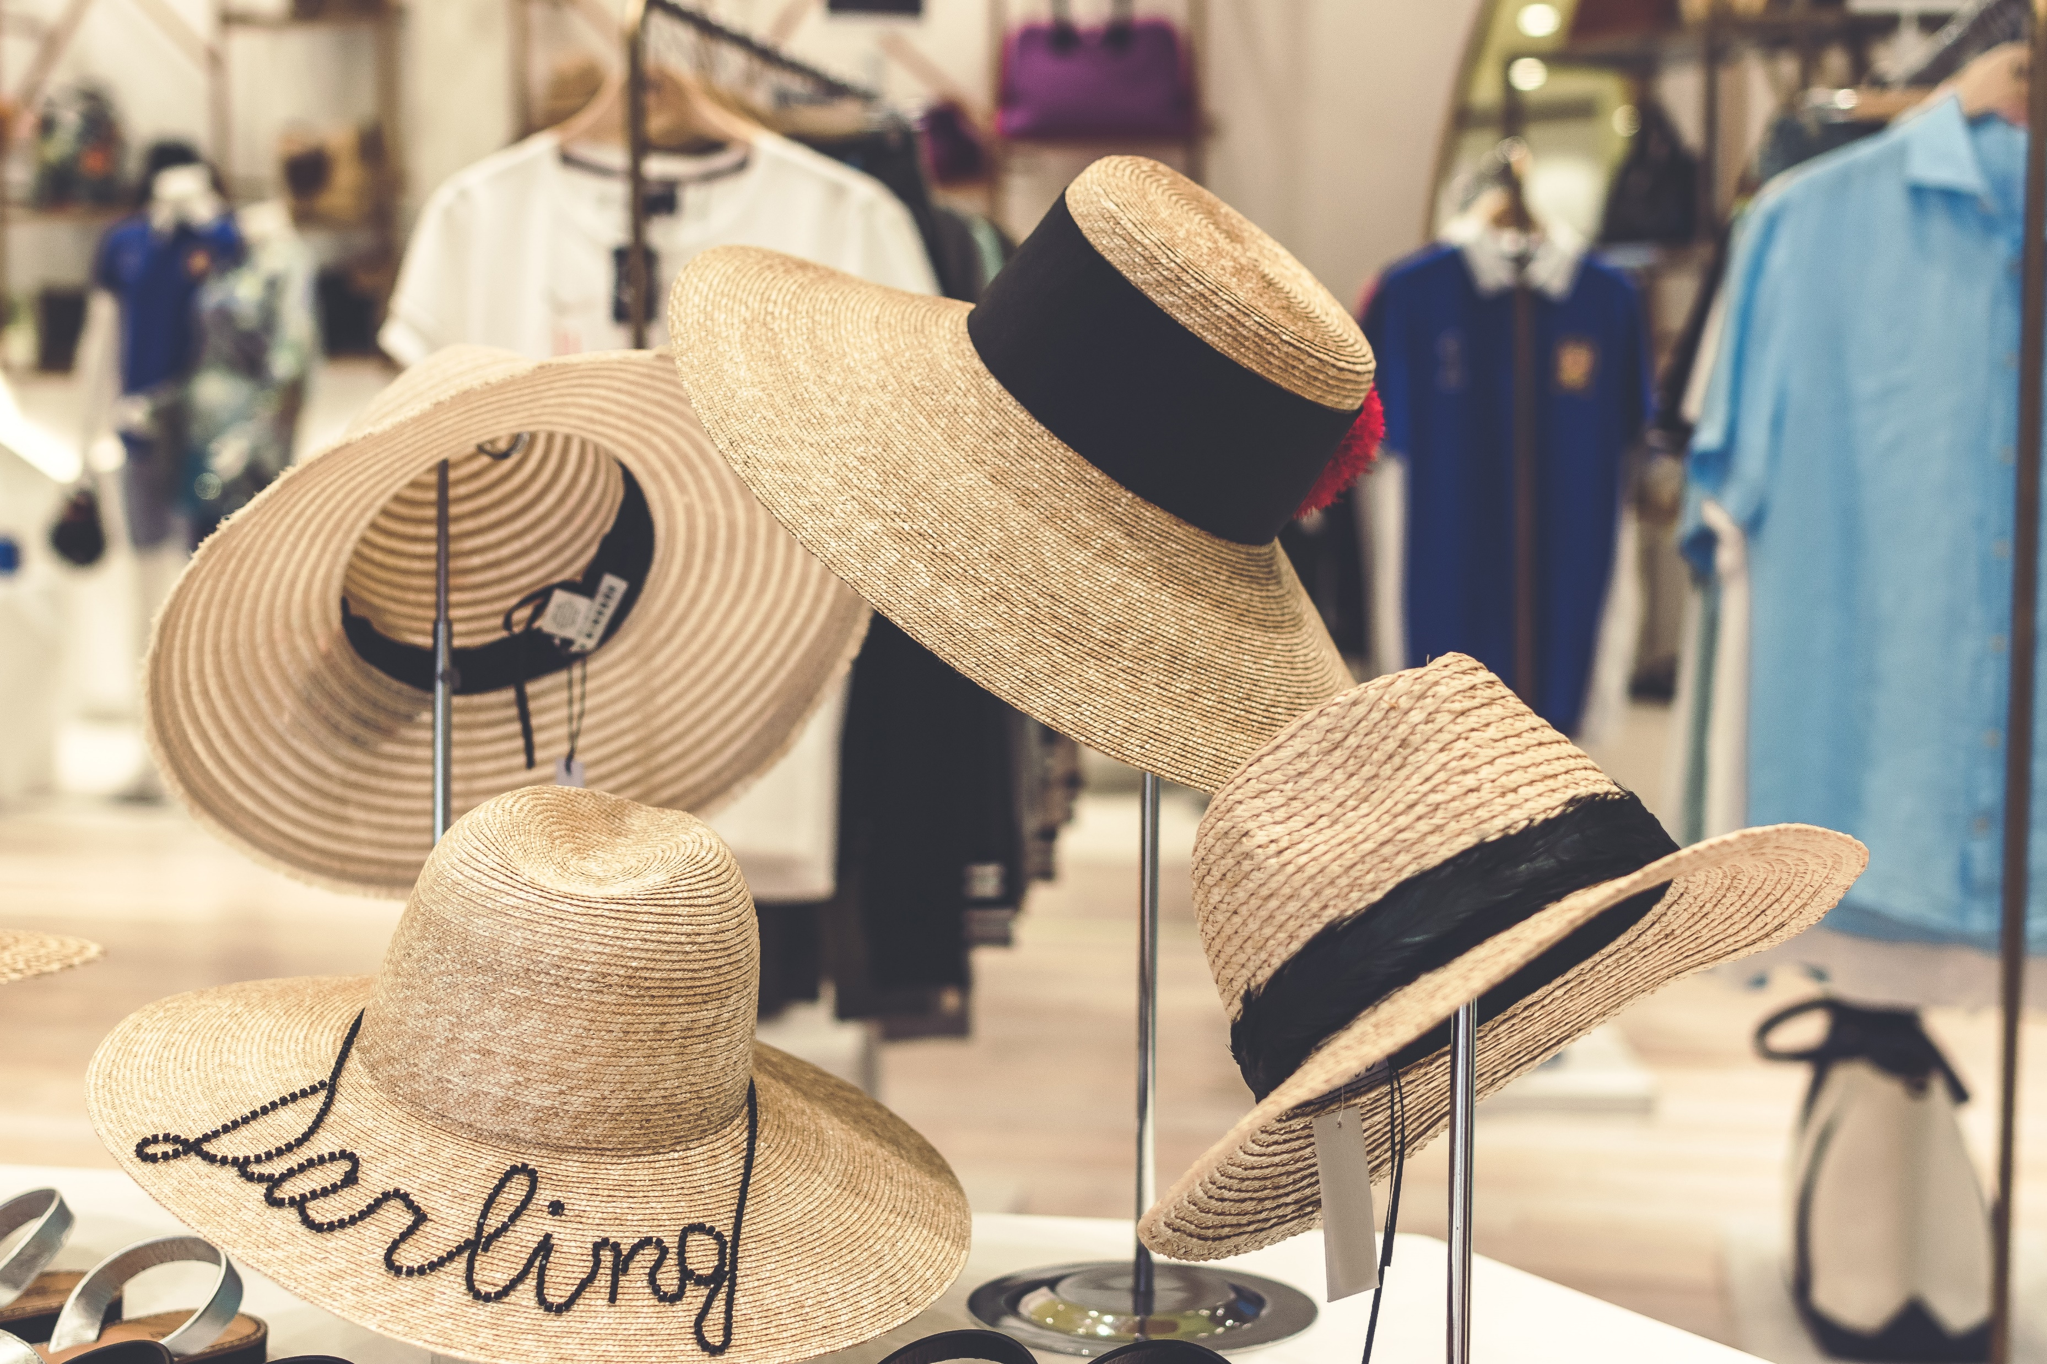
Practice
Sales assistant : Hi, can I help you?
Customer: Yes, do you have this shirt in blue?
Sales assistant: Yes, here you are.
Customer: Do you have it in a medium size?
Customer: Can I try it on?/
Sales assistant: Yes, the changing rooms over there.....( Later...)
Sale assistant: Is it ok?
Customer: Yes, how much is it?
Sale assistant: It’s 20 dollars.
Practice the conversation. Swap roles and repeat.

Slide 8
Practice
Change the words and practice with your partner.
Sales assistant : Hi, can I help you?
Customer: Yes, do you have this shirt in blue?
Sales assistant: Yes, here you are.
Customer: Do you have it in a medium size?
Customer: Can I try it on?/
Sales assistant: Yes, the changing room’s over there.....( Later...)
Sale assistant: Is it ok?
Customer: Yes, how much is it?
Sale assistant: It’s 20 dollarts.
These jeans/this dress
black and white
them in a small size/ it in an extra large size
them/it
Are they/Is it
Are they/Is it
They’re/It’s

Slide 9
SPEAKING

Slide 10
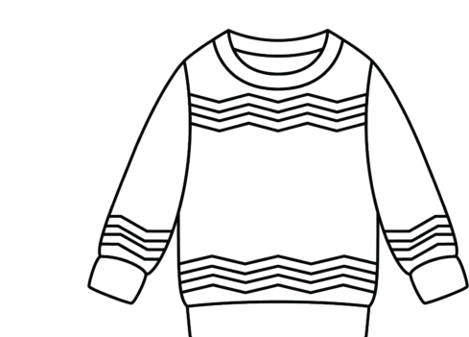
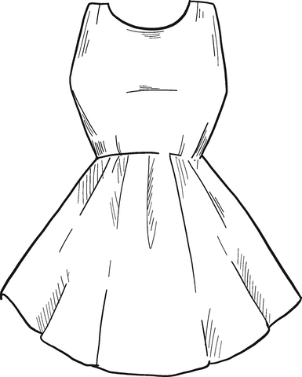
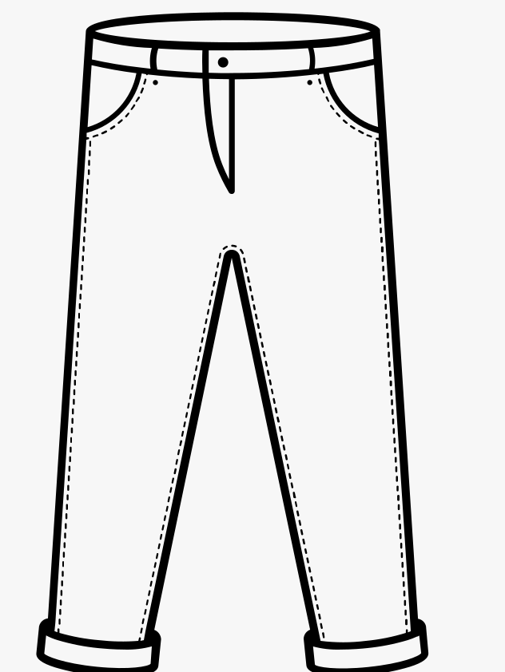
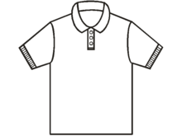
Sweater
Dress
jeans
shirt

Slide 11
speaking
clothes shopping
STUDENT A
a. You are shopping for clothes . Work in pairs. Student B p121. File 4. Student A, you’re a customer. Choose three items below and note the size and color you want. Ask the sales assistant
________________
________________
________________
________________
b.Swap roles and repeat. You’re a sales assistant at a store. You have the clothes below.
Dress
Price: $ 45
Sizes: S,M,L
Color
Sweater
Price: $ 25
Sizes: S,M,XL
Color
Jeans
Price: $ 35
Sizes: S,M,XL
Color
Shirt
Price: $ 45
Sizes: S,M,L
Color

Slide 12
Sales assistant : Hi, can I help you?
Customer: Yes, do you have this shirt in blue?
Sales assistant: Yes, here you are.
Customer: Do you have it in a medium size?
Customer: Can I try it on?/
Sales assistant: Yes, the changing rooms over there.....( Later...)
Sale assistant: Is it ok?
Customer: Yes, how much is it?
Sale assistant: It’s 20 dollars.

Slide 13
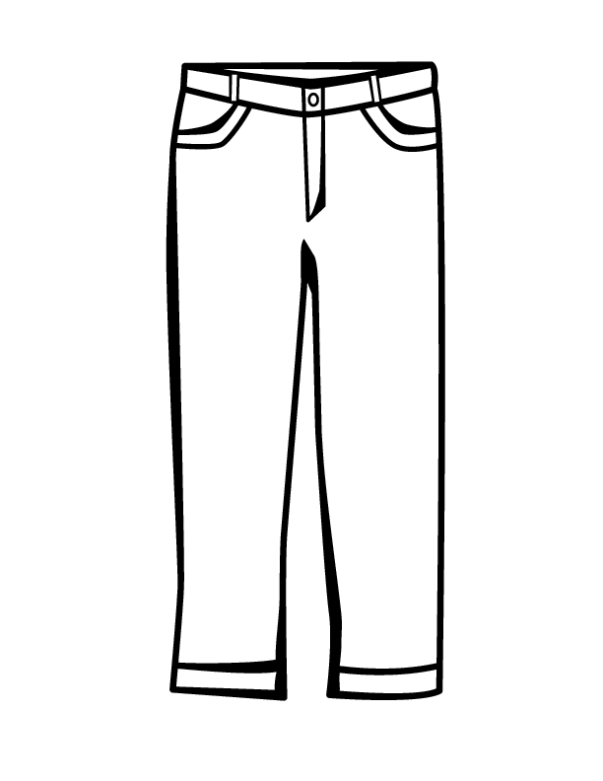
clothes shopping
speaking
STUDENT B
a. You are shopping for clothes . Work in pairs. Student B p121. File 4. Student A, you’re a customer. Choose three items below and note the size and color you want. Ask the sales assistant
________________
________________
________________
________________
b.Swap roles and repeat. You’re a sales assistant at a store. You have the clothes below.
Dress
Price: $ 45
Sizes: S,M,L
Color
Sweater
Price: $ 25
Sizes: S,M,XL
Color
Pants
Price: $ 35
Sizes: S,M,XL
Color
Shirt
Price: $ 45
Sizes: S,M,L
Color

Slide 14
WRAP-UP
* Pronunciation: “Do you have …?” often sounds like /dʒə hӕv/
* Some useful languages
Can I help you?
Here you are
Try it on

Slide 15
HOMEWORK
- Practice using sound changes in the question: “Do you have …?”
- Practice asking and answering about buying clothes.
- Prepare: Lesson 2: New Words and Reading (page 41 – SB).

