Slide 1
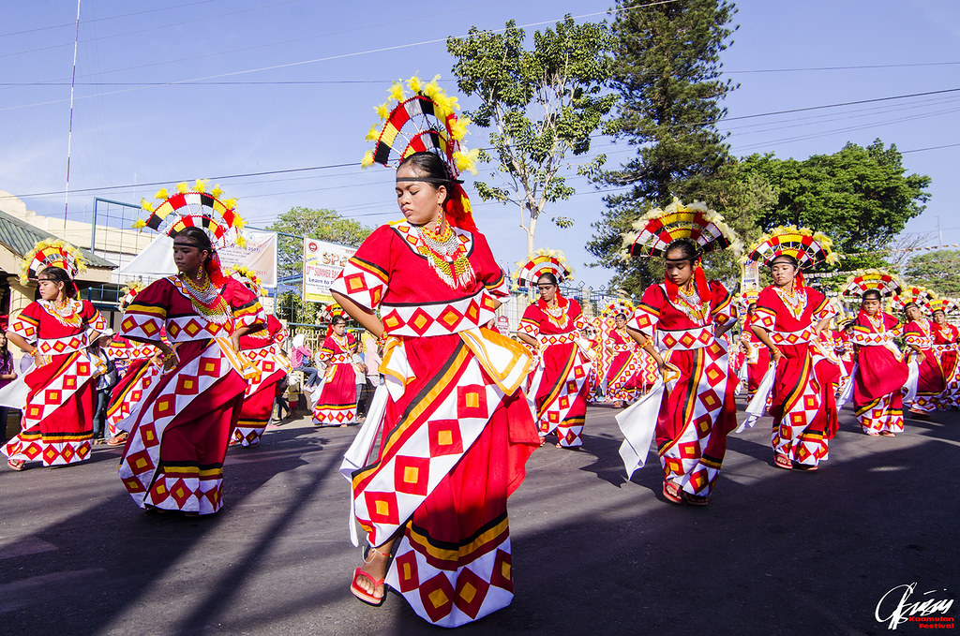
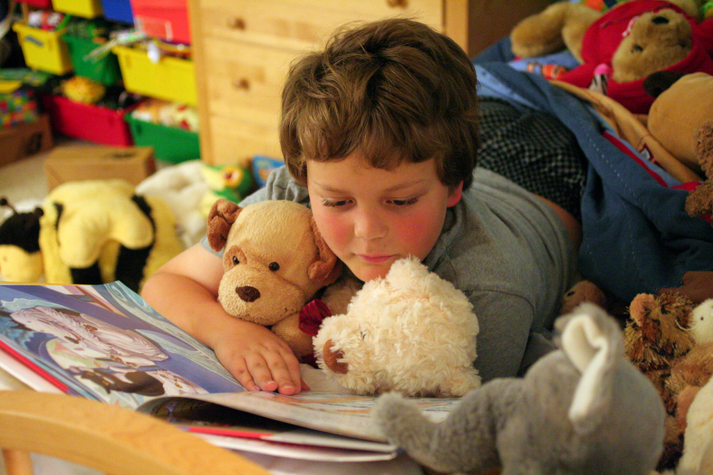
UNIT 4
Festivals &
Free time

Slide 2
WARM UP

Slide 3

LET’S SING A SONG

Slide 4
PRONUNCIATION

Slide 5

Sentence stress
Stress the adverbs for emphasis.
I sometimes play badminton on the weekends.
c. Listen and cross out the one with wrong sentences stress.
I often watch movie on weekends.
I usually play soccer on Sundays.
b. Listen to the sentences and focus on the underline words.
d. Read the sentences with the correct sentence stress to a partner.
I sometimes play badminton on the weekends.
I always go swimming after school.

Slide 6

Listen and practice these sentences

Slide 7
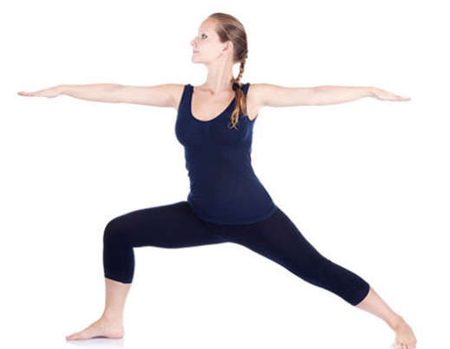



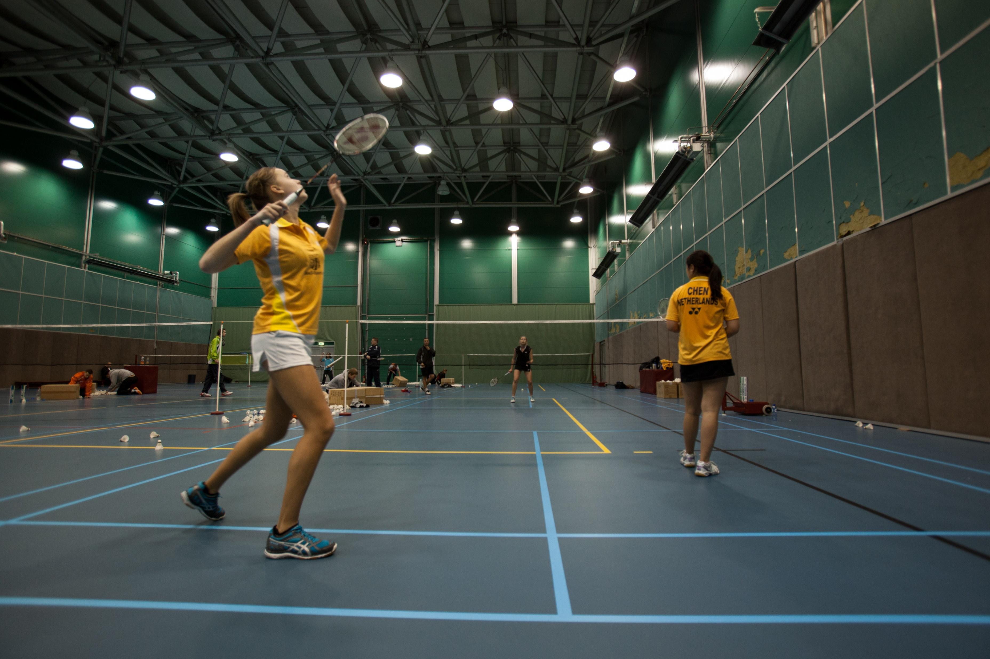
Choose a number and see what activities are?
2
3
4
5
1
go running
play computer games
play badminton
do yoga
go swimming

Slide 8

Use the words to ask your partner. Pay attention to the stress of the adverbs
STUDENT A
STUDENT B
always
sometimes
rarely
often
usually
after school on the weekends
in the afternoons
In the mornings on Saturdays.
How often do you….?
I

Slide 9
Look at the sample conversation and change your own words and practice with your partners.
A: How often do you go swimming?
B: I often go swimming on the weekends.
A: How often do you play video games?
B: I sometimes play video games after school.
A: How often do you do yoga?
B: I usually do yoga in the afternoons.
A: How often do you play tennis?
B: I always play tennis on Saturdays.

Slide 10
SPEAKING

Slide 11

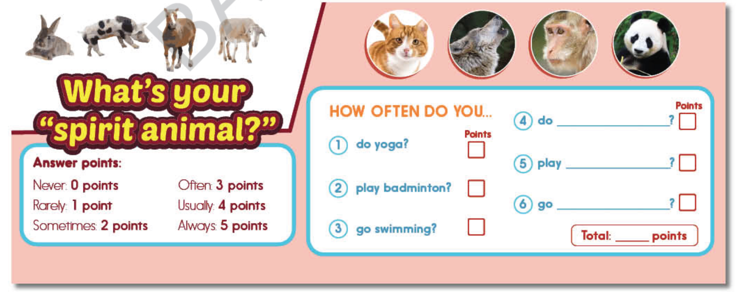
Do you know what your “ SPIRIT ANIMALS?”
You’re doing a quiz about your free time activities to find out your “ spirit animals”. Work in pairs. Add more activities and then ask your friend to complete the quiz.
Find out what partner’s “ spirit animal” is. Share with the class

Slide 12
WRAP-UP

Slide 13




Listen to music
Do the dishes
Circle the wheel and answer the questions.
How often do you….?
I rarely/never/…..
Make dinner
Play footbal
Do the laundry
go swimming
Do exercise
do the shopping
NEXT
SPIN

Slide 14
HOMEWORK
- Practice the Stress on the adverbs for emphasis.
- Review the structures used to ask and answer about frequency.
- Do exercises in WB: Writing, page 21.
- Prepare: Lesson 2 – New Words and Reading (page 33 – SB).

Slide 15




BÀI GIẢNG THUỘC QUYỀN SỞ HỮU TRÍ TUỆ CỦA E-TEACHERS. NGHIÊM CẤM MỌI HÀNH VI SAO CHÉP, PHÁT TÁN CHIA SẺ , MUA ĐI BÁN LẠI KHI CHƯA ĐƯỢC SỰ ĐỒNG Ý CỦA E-TEACHERS
PHONE /ZALO: 0966765064
https://www.facebook.com/maiphuongdo.dhnn/
SỬ DỤNG TÀI LIỆU CHÍNH CHỦ BẠN SẼ NHẬN ĐƯỢC SỰ TẬN TÂM VÀ CHÚNG TÔI SẼ PHỤC VỤ CÁC BẠN TẬN TÌNH.
TÀI LIỆU ĐƯỢC UPDATE VÀO MAIL CÁ NHÂN NGAY KHI UPDATE VÀ ĐƯỢC GIẢI ĐÁP MỌI THẮC MẮC VỀ KỸ THUẬT HOẶC CHUYÊN MÔN MỘT CÁCH KỊP THỜI NHẤT
TK: 3614689 ĐỖ MAI PHƯƠNG
NGÂN HÀNG VPBAK VIÊT NAM THỊNH VƯỢNG CHI NHÁNH HÀ NỘI.

