Slide 1
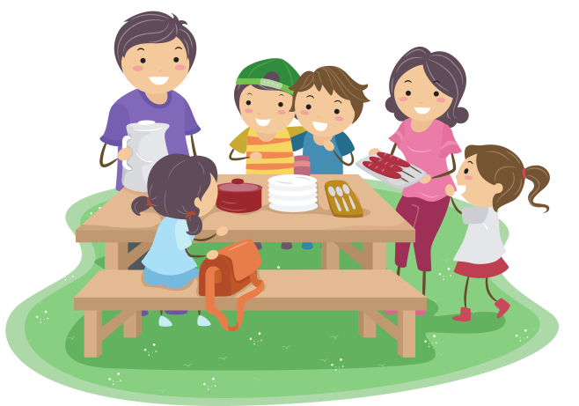
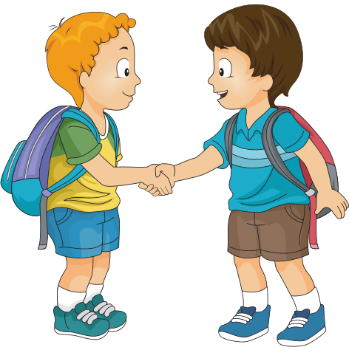

UNIT 3
Friends

Slide 2


blond hair (n)
/blɒnd heə/
Tóc vàng hoe

Slide 3
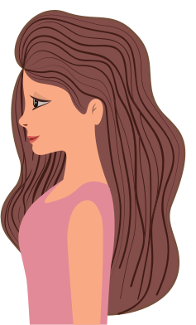
Long hair
(n)
/lɒŋ heə /
Tóc dài

Slide 4

Short hair
(n)
/ʃɔːt heə /
Tóc ngắn

Slide 5
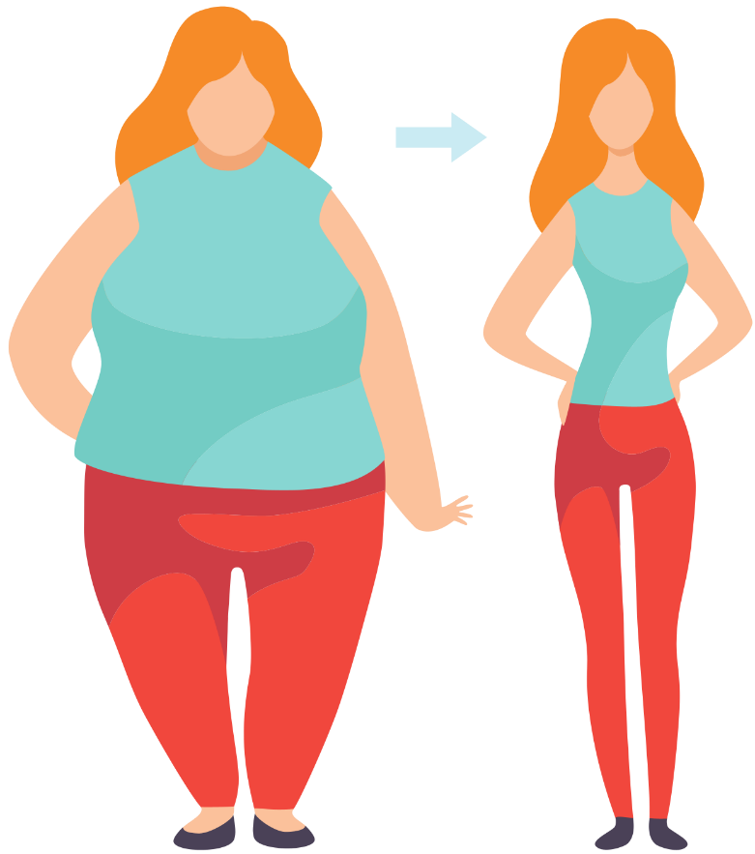
Slim
(adj)
/slɪm/
Thon thả

Slide 6

Tall
(adj)
/tɔːl/
Cao

Slide 7
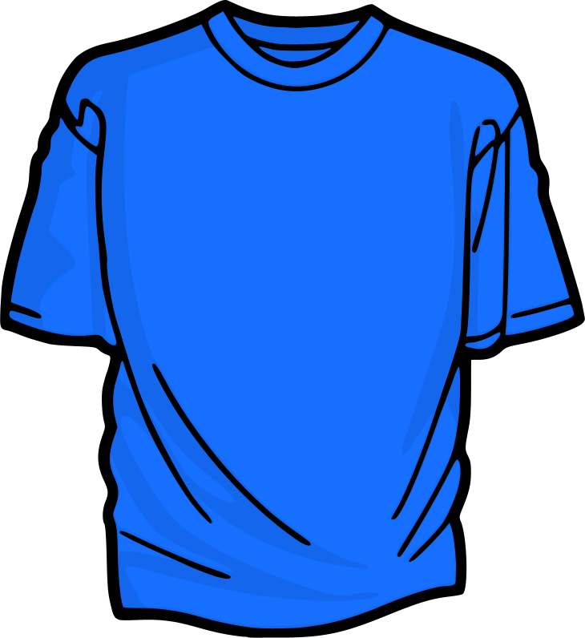
Blue Shirt (n)
/ bluː ʃɜːt/
Áo phông xanh

Slide 8
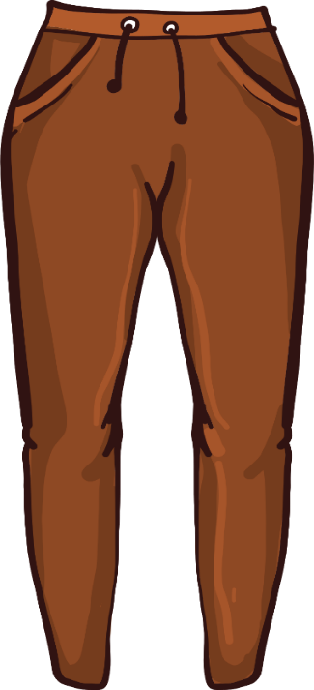
Brown pants
(n)
/ braʊn pænts /
Quần âu màu nâu

Slide 9

Glasses
(n)
/ˈglɑːsɪz/
Kính

Slide 10
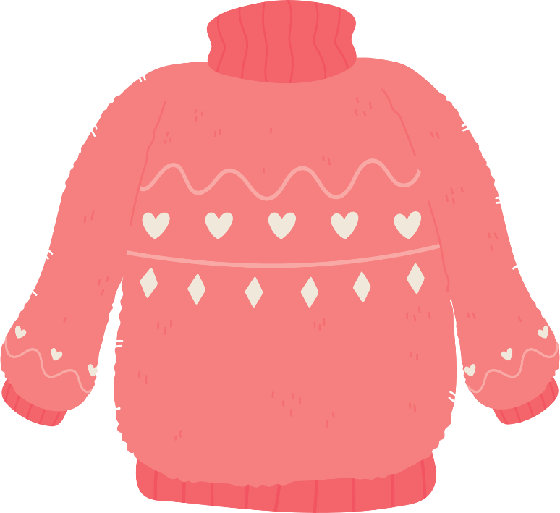
Pink sweater (n)
/ pɪŋk ˈswɛtər/
Áo len màu hồng

Slide 11
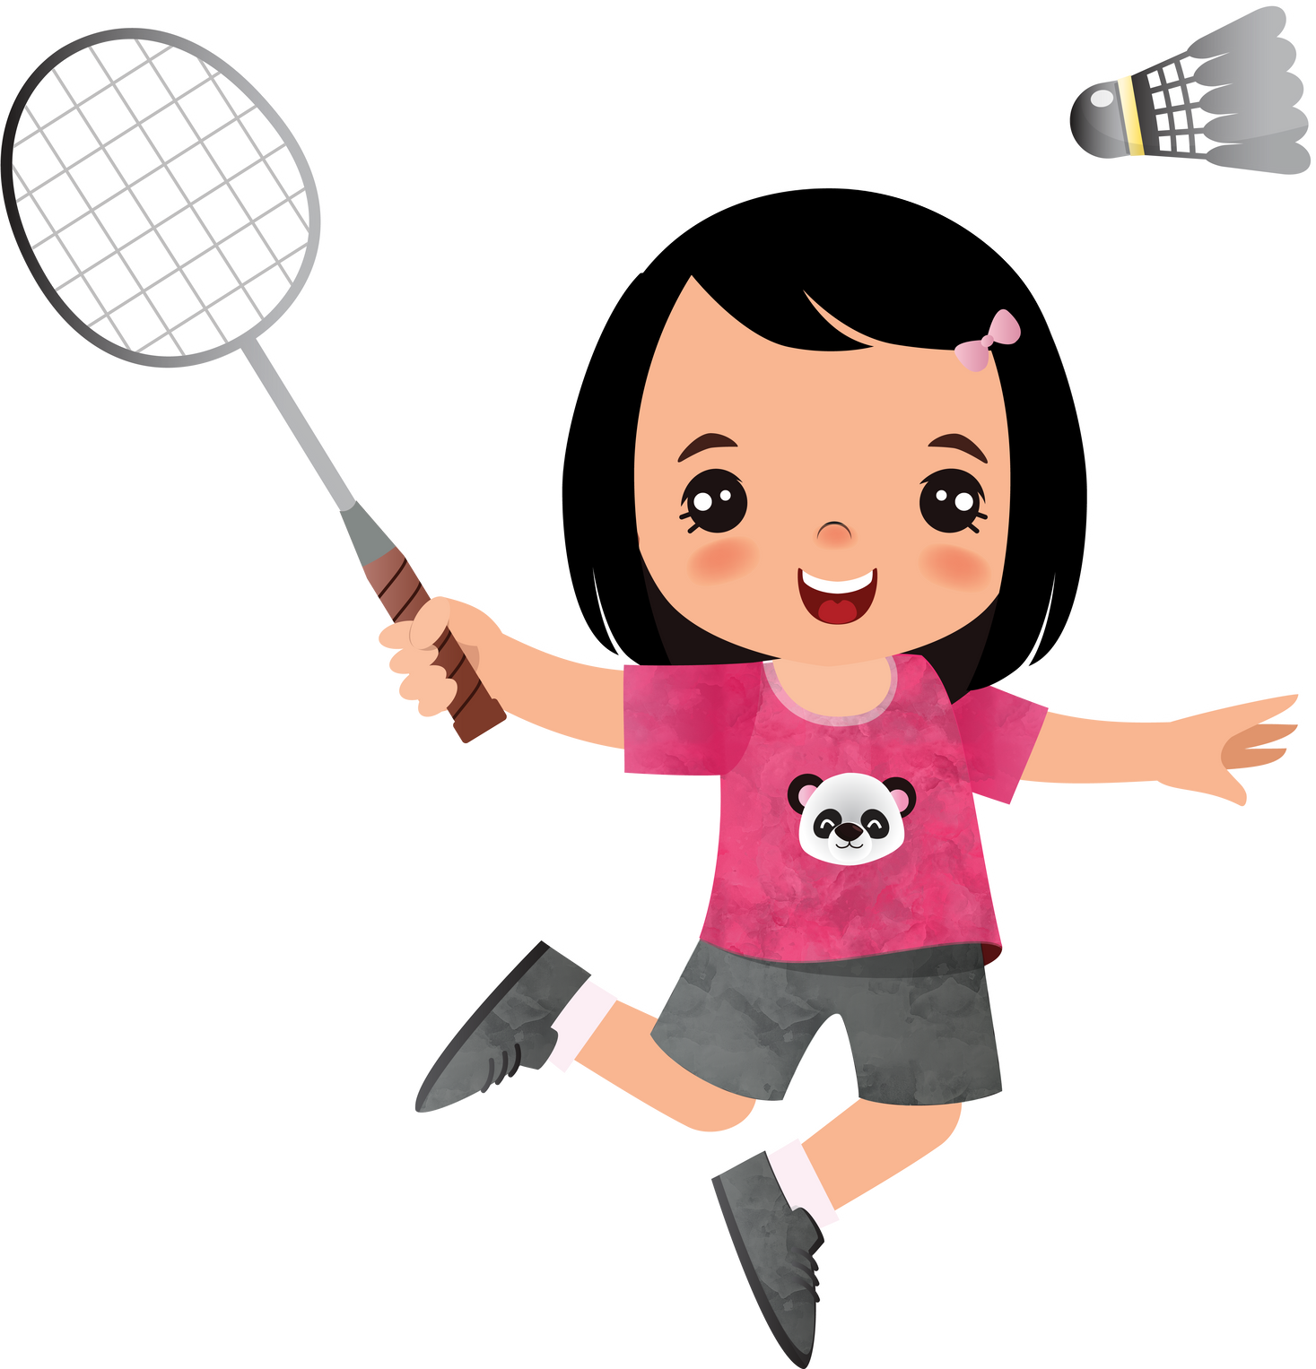
Play badminton
(v)
/pleɪ ˈbædmɪntən/
Chơi cầu lông

Slide 12
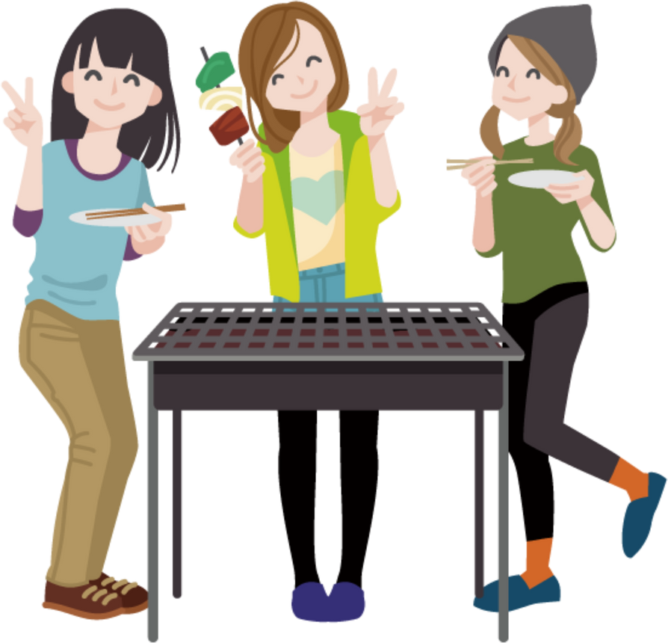
Have barbecue
(v)
/hæv ˈbɑːbɪkjuː/
Ăn thịt nướng

Slide 13

Beach
(n)
/biːʧ/
Bãi biển

Slide 14
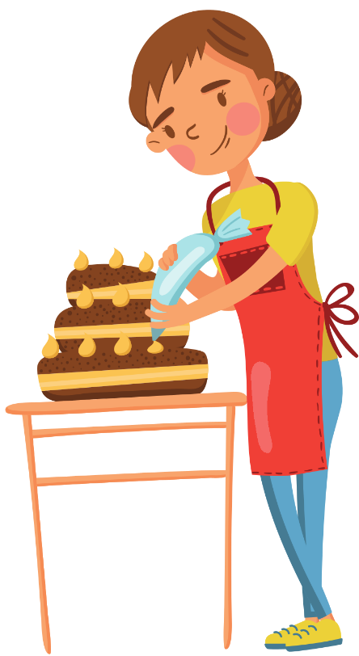
Make a cake
(v)
/meɪk ə keɪk/
Làm bánh

Slide 15
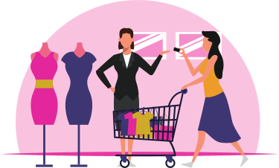
Go to the mall
/gəʊ tuː ðə mɔːl/
Đi trung tâm thương mại

Slide 16
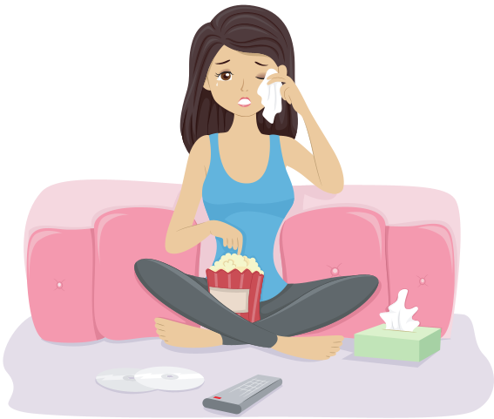
Watch a movie
(v)
/wɒʧ ə ˈmuːvi/
Xem phim

Slide 17
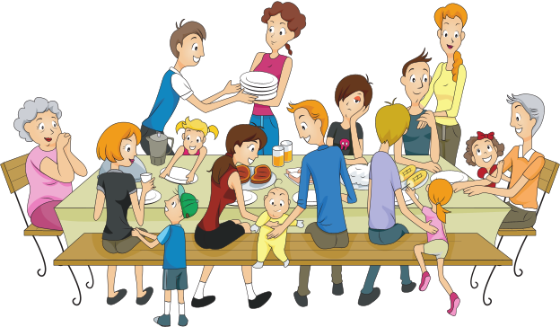
Have a party
(v)
/hæv ə ˈpɑːti/
Có 1 bữa tiệc

Slide 18
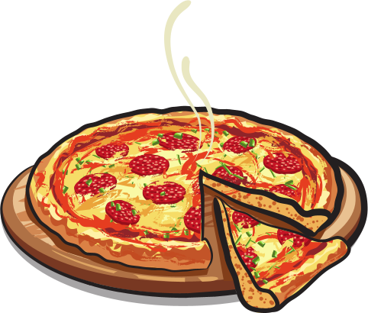
Pizza
(n)
ˈpiːtsə/
Bánh pizza

Slide 19
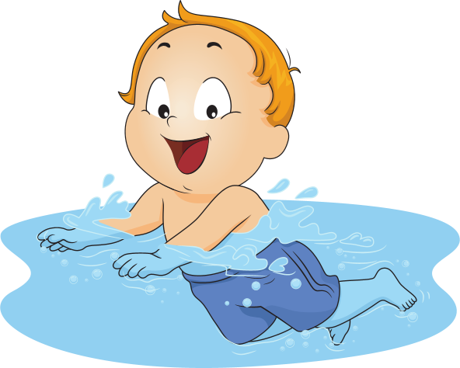
Go swimming
(v)
/gəʊ ˈswɪmɪŋ/
Đi bơi

Slide 20
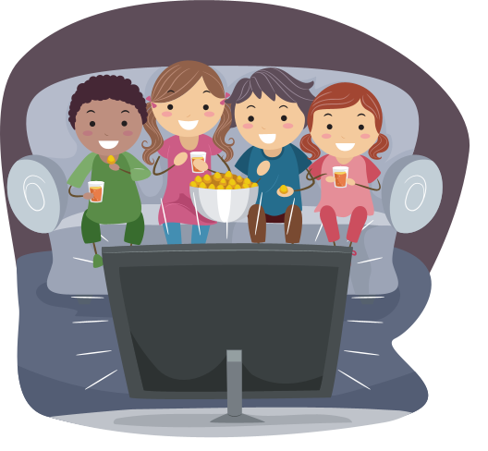
Watch television
(v)
/wɒʧ ˈtɛlɪˌvɪʒən /
Xem ti vi

Slide 21
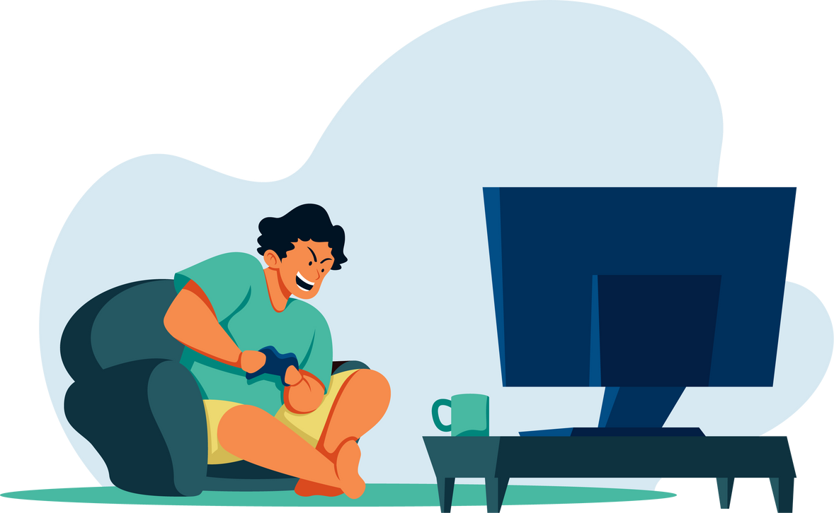
Play video games
(v)
/pleɪ ˈvɪdɪəʊ geɪm/
Chơi điện tử

Slide 22
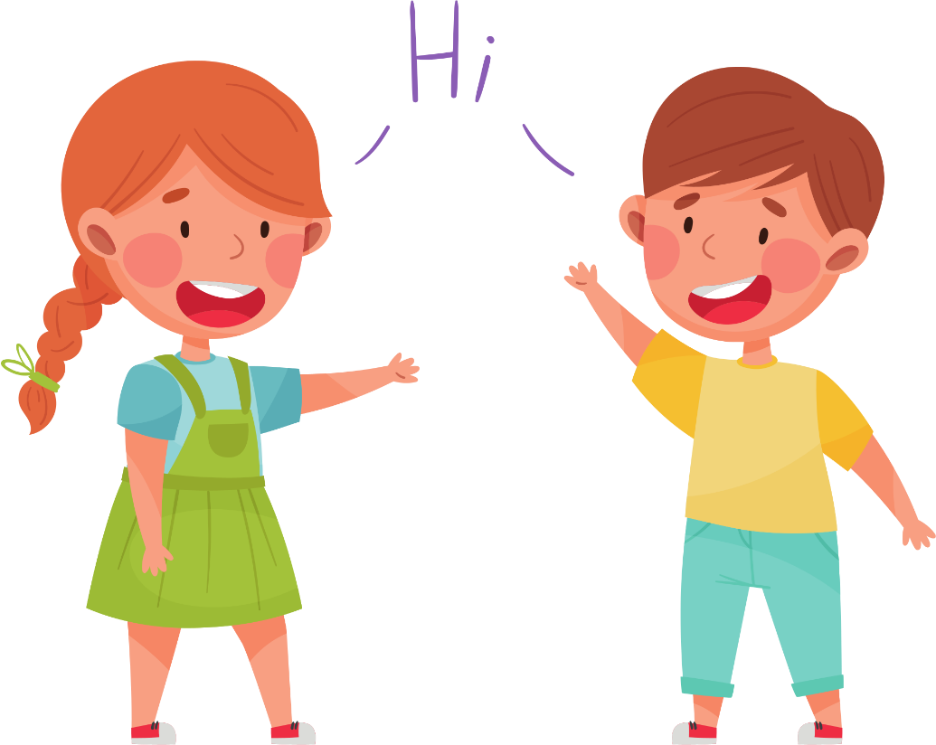
Friendly
(adj)
/ˈfrɛndli/
Thân thiện

Slide 23
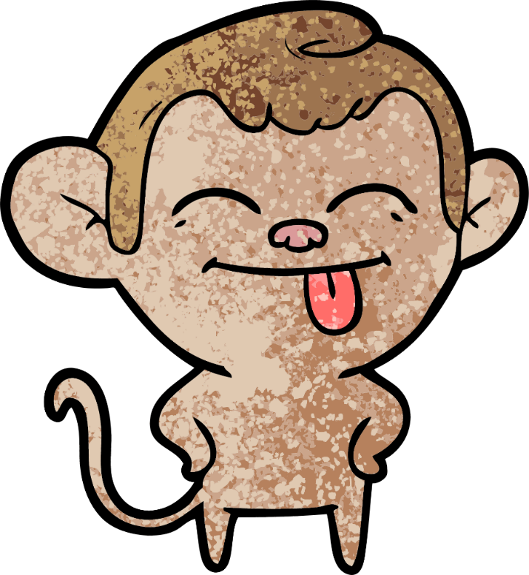
Funny
(adj)
/ˈfʌni/
Vui nhộn/ Buồn cười

Slide 24
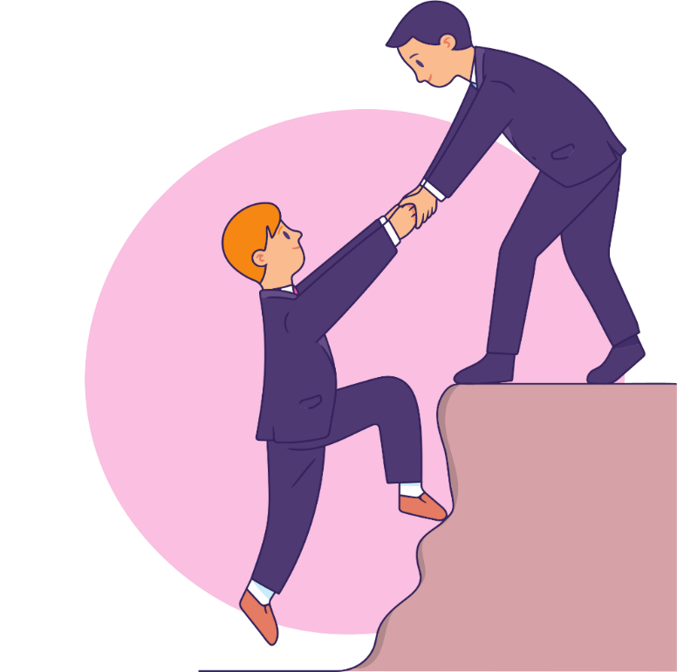
Helpful
(adj)
/ˈhɛlpfʊl/
Có ích/ hay giúp đỡ

Slide 25
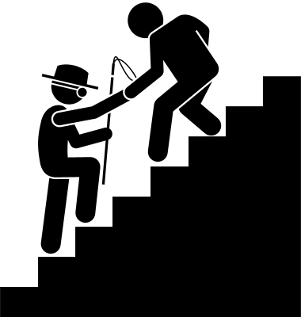
Kind
(adj)
/kaɪnd/
Tốt bụng

Slide 26
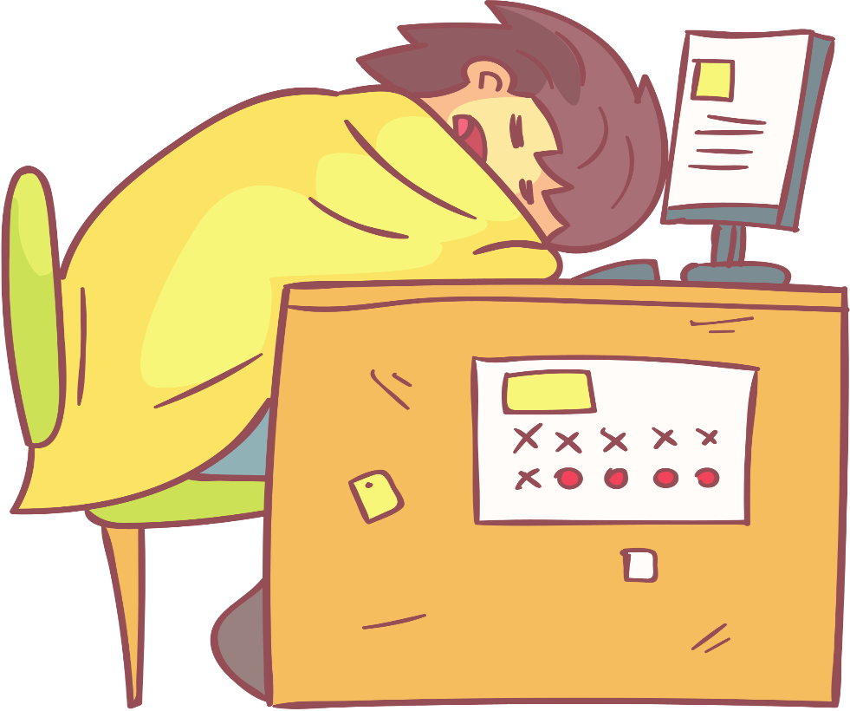
Lazy
(adj)
/ˈleɪzi/
Lười nhác

Slide 27
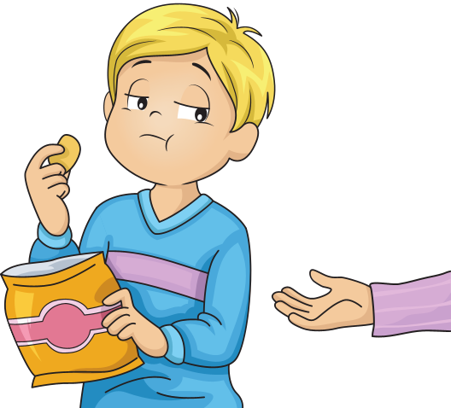
Selfish
(adj)
/ˈsɛlfɪʃ/
Ích kỷ

Slide 28
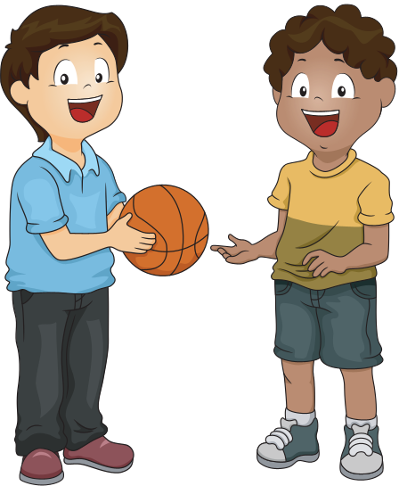
Share (v)
/ʃeə/
Chia sẻ

Slide 29
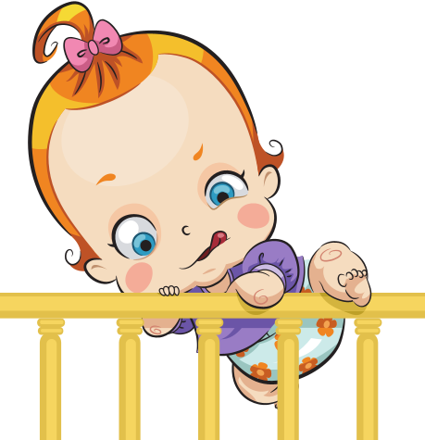
Try to do st
(v)
/traɪ tuː duː st/
Cố gắng làm st

Slide 30
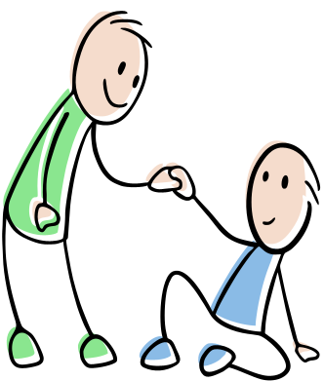
Help sb (to) do st
(v)
/hɛlp sb (tuː) duː st/
Giúp ai làm gì

Slide 31
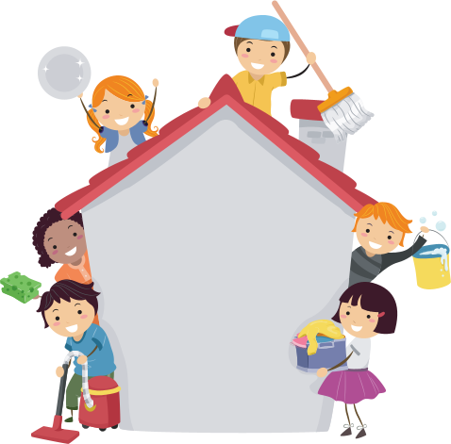
Chore
(n)
/ʧɔː/
Việc vặt ở nhà

Slide 32

Different from/to…
(adj)
/ˈdɪfrənt frɒm (tuː)/
Khác biệt/ khác với

Slide 33

Review
………………………….
………………………….
………………………….
………………………….
glasses
pants
shirt
Go to the mall
sweater
Have a party
Watch a movie

Slide 34
Review
Play video games
Play badminton
Try to do st
………………………….
………………………….
………………………….
Watch television
Have barbecue
Help sb to do st
………………………….
………………………….
………………………….

Slide 35

Listening
You will hear Jenny and Tom talking about their brothers and sisters. For each question, choose the correct answer ( A,B, or C). You will hear the conversation twice.
0. Tom’s brother is A. tall
B. shy
C. short
3. Jenny’s sister is A. tall
B. slim
C. short
1. Tom’s brother is wearing A. a blue T-shirt
B. glasses
C. a green T-shirt
4. Jenny’s sister has A. short hair
B. brown hair
C. long hair
2. Tom’s brother is A. kind
B. lazy
C. friendly
5. Jenny’s sister is A. kind and helpful
B. kind and friendly
C. friendly and helpful

Slide 36
READING
Read the text. Choose the best word ( A,B, or C) for each space.
MY NEW FRIEND
Kim is a new girl in my class. We’re friends now. Kim is tall with (0)_____________blond hair and blue eyes. We (1) _____________ badminton together after school. At school, she always wears a uniform but today is Saturday so she is (2) __________________ a yellow T-shirt and pink sneakers. I think Kim is very funny and kind, and she thinks (3) ___________other people. We are going shopping at the mall this afternoon because she’s (4) ________________a party tonight. After that, we are making pizza for the party and watching TV. Tomorrow we are (5) ______________swimming at the beach.
0. A. tall B. slim C. long
3. A. about B. to C. for
1. A. play B. playing C. plays
4. A. making B. doing C. having
2. A. wear B. wears C. wearing
5. A. playing B. going C. doing

Slide 37
VOCABULARY
Write the correct words from the unit on the lines. The first letter is already there.
______________________________________________________________________________________________________________________________________________________________________________________________________
kind
This kind of person thinks about other people all the time.
This is a big building with a lot of shops, restaurants , and cafe
People often have one for their birthday.
This is a sport we play with a racket and shuttlecock.
This is when someone’s color hair is yellow.
This kind of person doesn’t like doing housework or school work.
People wear these on their eyes to help them see.
mall
present
badminton
blond
lazy
glasses

Slide 38
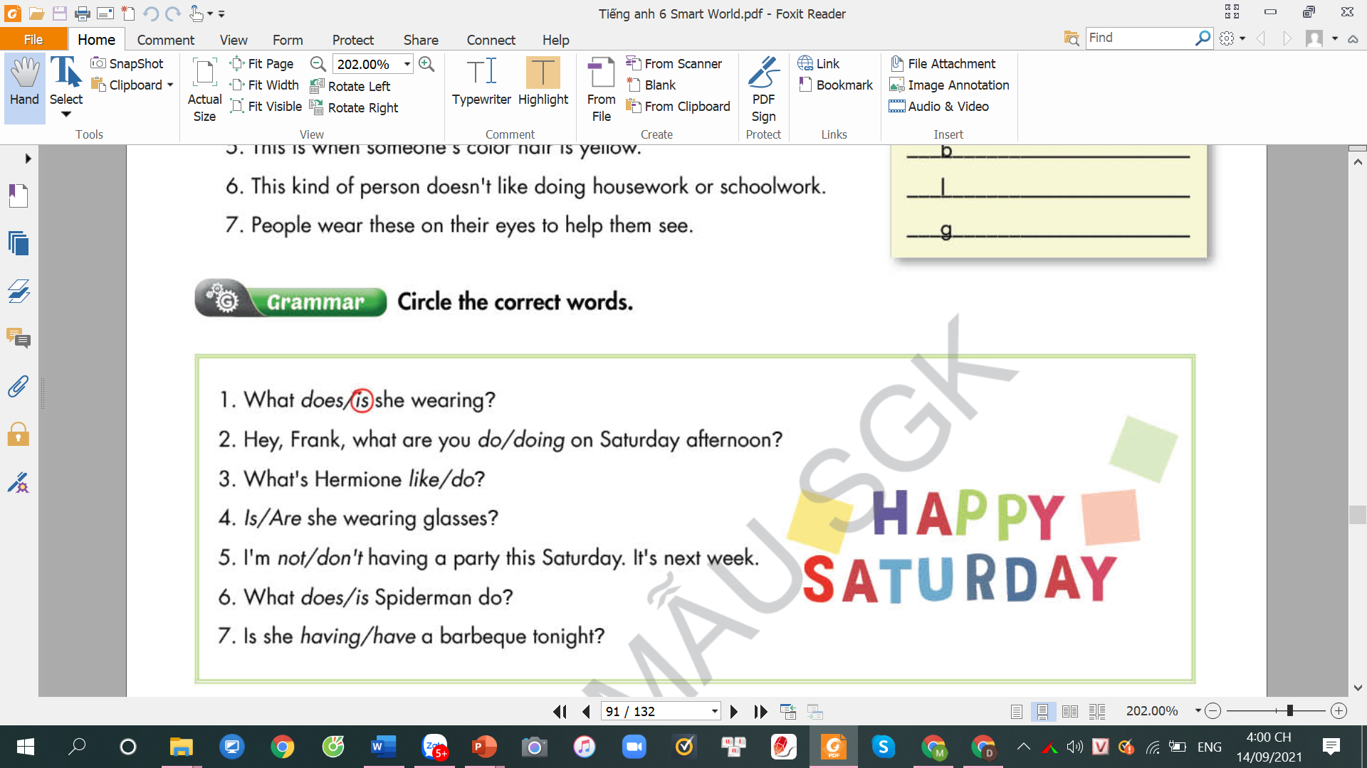
GRAMMAR
Circle the correct words.
What does/is she wearing?
Hey, Frank, what are you do/doing on Saturday afternoon?
What’s Hermone like/do?
Is/Are she wearing glasses?
I’m not /don’t having a party this Saturday. It’s next week.
What does/is Spiderman do?
Is she having/have a barbeque tonight?

Slide 39
PRONUNCIATION
Circle the word that has the underlined part pronounced differently from others.
1. A. blond B. vegetable C. black D. blanket
2. A. light B. stripe C. slim D. fine
3. A. terrible B. cable C. syllable D. block
Circle the word that has the underlined part pronounced differently from others.
1. A. decide B. always C. lazy D. fishing
2. A. babecue B. vacation C. balcony D. average
3. A. sneakers B. glasses C. describe D. selfish

Slide 40
Exercise 1: Choose the correct adjective for each sentence.
1. Donata is very friendly/ rude. She has a lot of friends.
2. Mona is very reliable/ kind. She always helps her classmates.
3. Ann is a bit interesting/ boring. She never has anything interesting to say.
4. Jully is very funny/ shy. She likes telling jokes.
5. Anna is very selfish/ kind. She never shares any things with her friends.
6. Lucy is very helpful/ lazy. She always helps others.
7. Joana is very hard-working/ lazy. She never does her housework.

Slide 41
Exercise 2: Listen and fill in the blanks
bedroom
1. The children are watching television in the ………………………..
2. She is going to the ………. to buy a dress for her mother.
mall
lazy
3. Mark is so ……………... He doesn’t like doing his homework.
selfish
4. Minh is s………... He doesn’t want to share his food with his sister.
barbecue
5. We are having ………………… now. Do you want to come with us?
6. She likes monkeys because they are very …………………..
funny
7. My classmates are very ………………..
friendly
8. My baby sister is wearing a ……………………….
pink sweater
9. My brother likes playing …………………….
video games
10. They are going to the ………….. this weekend.
beach

Slide 42
Thank you!

Slide 43



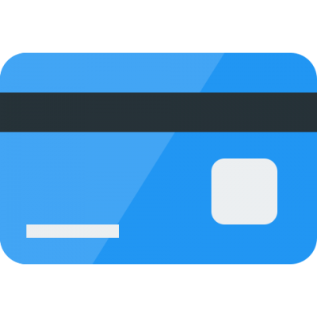
BÀI GIẢNG THUỘC QUYỀN SỞ HỮU TRÍ TUỆ CỦA E-TEACHERS. NGHIÊM CẤM MỌI HÀNH VI SAO CHÉP, PHÁT TÁN CHIA SẺ , MUA ĐI BÁN LẠI KHI CHƯA ĐƯỢC SỰ ĐỒNG Ý CỦA E-TEACHERS
PHONE /ZALO: 0966765064
https://www.facebook.com/maiphuongdo.dhnn/
SỬ DỤNG TÀI LIỆU CHÍNH CHỦ BẠN SẼ NHẬN ĐƯỢC SỰ TẬN TÂM VÀ CHÚNG TÔI SẼ PHỤC VỤ CÁC BẠN TẬN TÌNH.
TÀI LIỆU ĐƯỢC UPDATE VÀO MAIL CÁ NHÂN NGAY KHI UPDATE VÀ ĐƯỢC GIẢI ĐÁP MỌI THẮC MẮC VỀ KỸ THUẬT HOẶC CHUYÊN MÔN MỘT CÁCH KỊP THỜI NHẤT
TK: 3614689 ĐỖ MAI PHƯƠNG
NGÂN HÀNG VPBAK VIÊT NAM THỊNH VƯỢNG CHI NHÁNH HÀ NỘI.

