Slide 1




BÀI GIẢNG THUỘC QUYỀN SỞ HỮU TRÍ TUỆ CỦA E-TEACHERS. NGHIÊM CẤM MỌI HÀNH VI SAO CHÉP, PHÁT TÁN CHIA SẺ , MUA ĐI BÁN LẠI KHI CHƯA ĐƯỢC SỰ ĐỒNG Ý CỦA E-TEACHERS
PHONE /ZALO: 0966765064
https://www.facebook.com/maiphuongdo.dhnn/
SỬ DỤNG TÀI LIỆU CHÍNH CHỦ BẠN SẼ NHẬN ĐƯỢC SỰ TẬN TÂM VÀ CHÚNG TÔI SẼ PHỤC VỤ CÁC BẠN TẬN TÌNH.
TÀI LIỆU ĐƯỢC UPDATE VÀO MAIL CÁ NHÂN NGAY KHI UPDATE VÀ ĐƯỢC GIẢI ĐÁP MỌI THẮC MẮC VỀ KỸ THUẬT HOẶC CHUYÊN MÔN MỘT CÁCH KỊP THỜI NHẤT
TK: 3614689 ĐỖ MAI PHƯƠNG
NGÂN HÀNG VPBAK VIÊT NAM THỊNH VƯỢNG CHI NHÁNH HÀ NỘI.

Slide 2
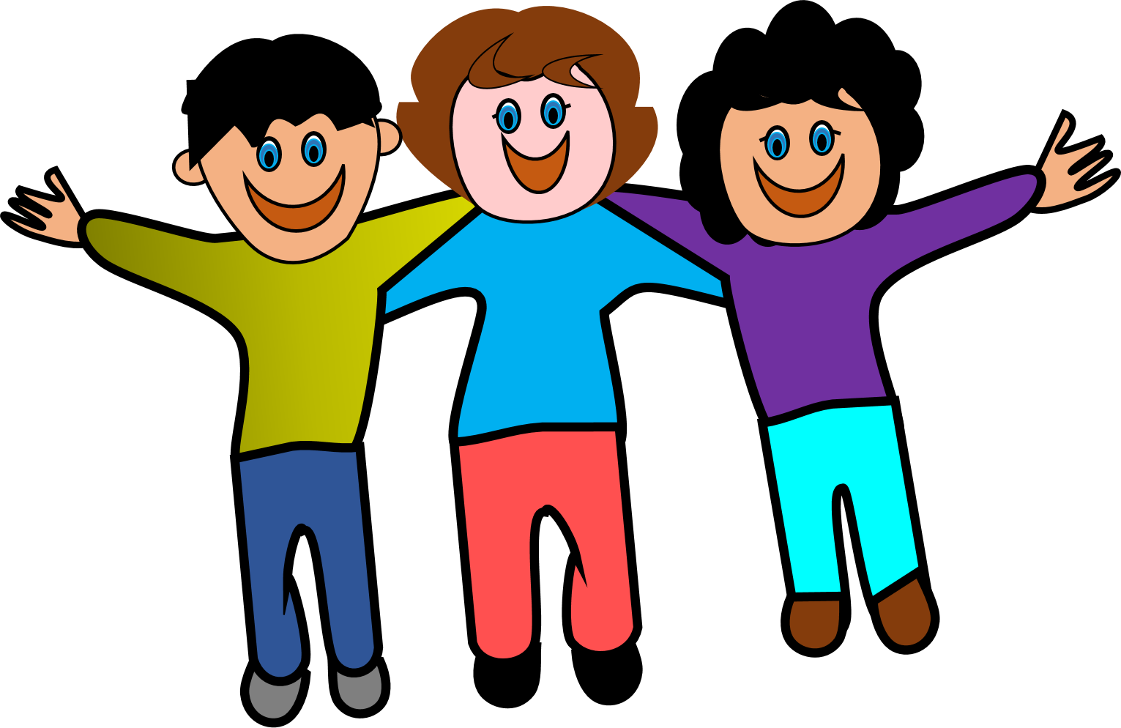
UNIT 3
FRIENDS

Slide 3
LESSON 8

Slide 4
WARM UP

Slide 5

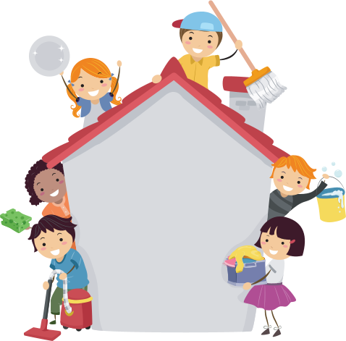
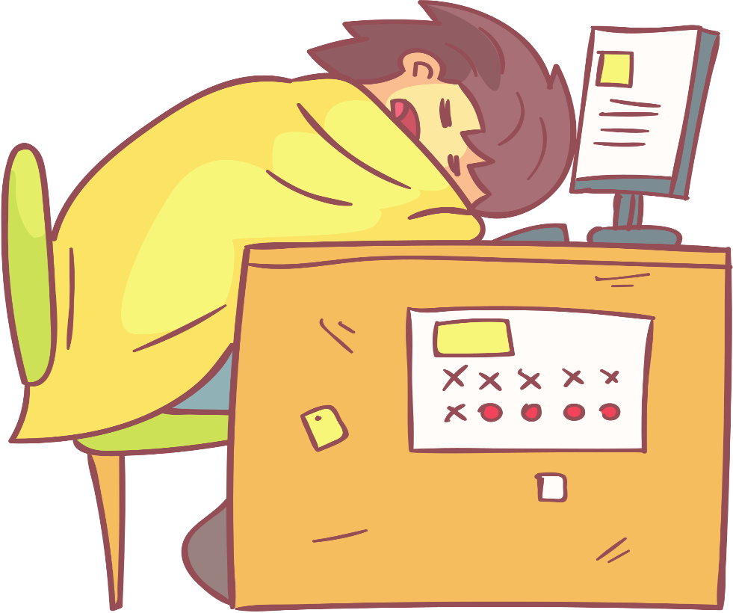
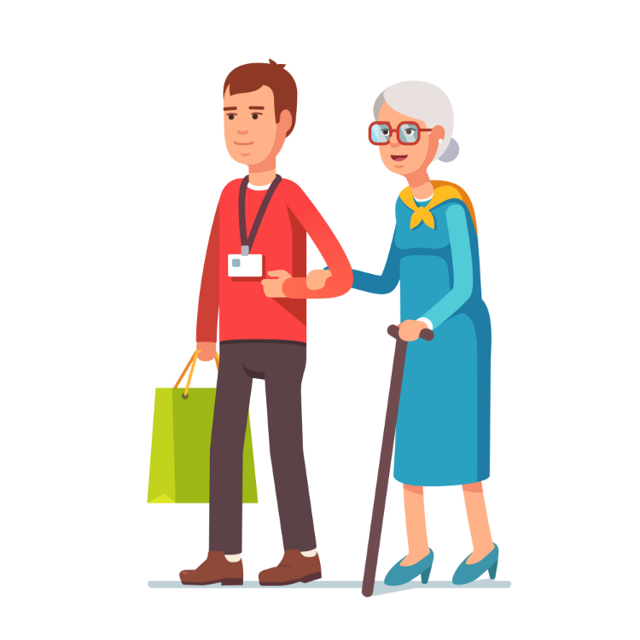

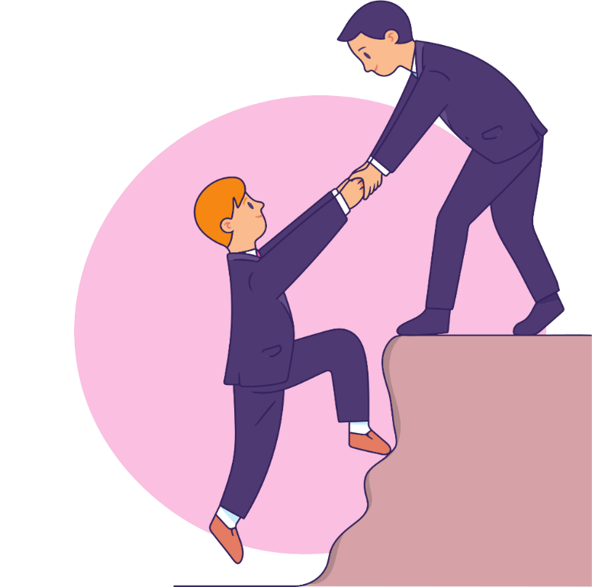
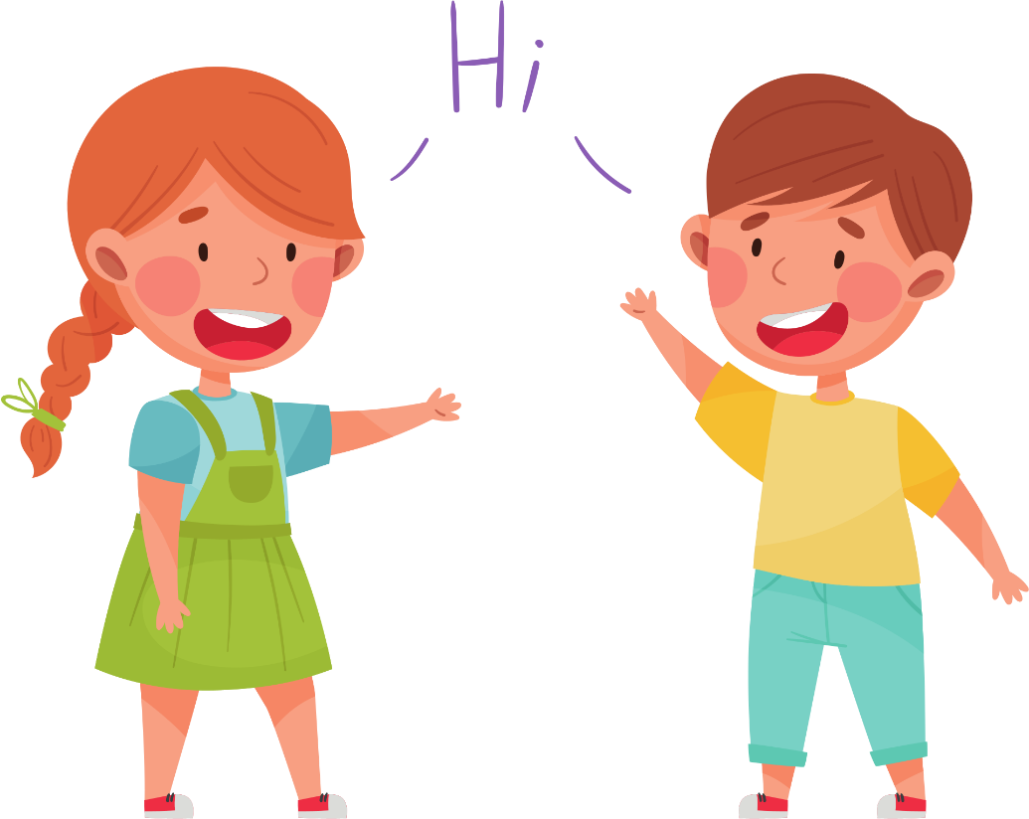
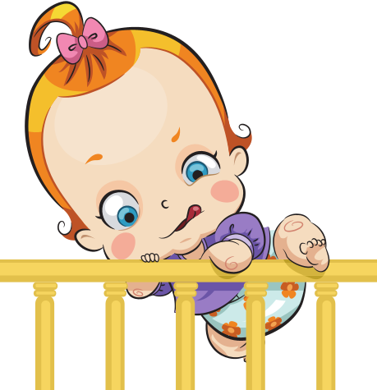
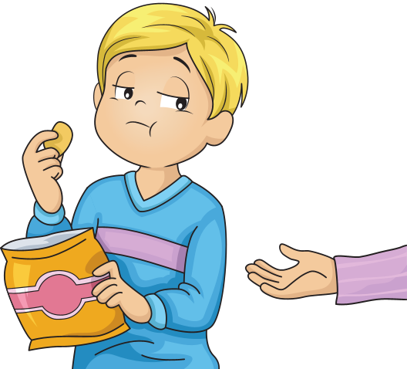
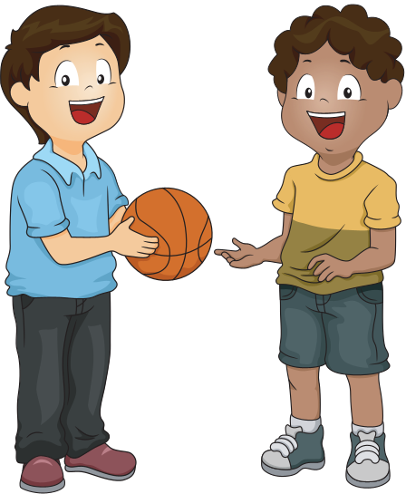

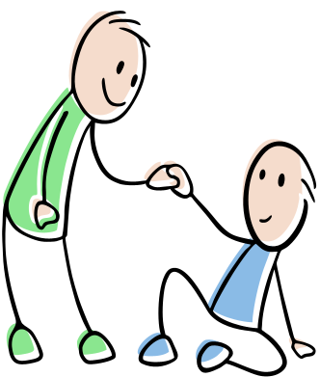
DICE GAME
https://freeonlinedice.com/
3
5
6
1
2
4
7
8
9
10
11

Slide 6
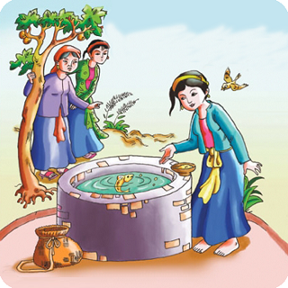
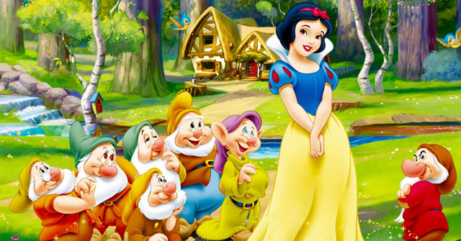
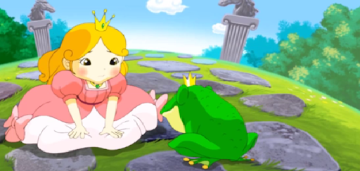
Look at the three pictures and can you guess what is the name of the film and the kind of the story
The frog princess
Tấm Cám
The snow white and the seven drwafs

Slide 7

READING
1. Good sister, Bad sister
2. Two means sister
3. How I meet the King
One of my favorite stories is from Vietnam. It’s about two sisters, Tấm and Cám. The two sisters are very different. Tấm works hard every day helping to cook and clean the house. She always thinks about other people and tries to help her family. Cám is very different to Tấm. She never does any chores and she doesn’t share anything. Cám does lots of bad things to Tấm. It’s not a nice story , but in the end, Tấm’s life is very good. I like this story because after such a hard life she is happy.
Read and find things that show Tấm and Cám’s personalities.
1. Tấm
2. Cám
______________________
- lazy
never does chore
- helpful:
______________________________
helping to cook and clean the house.
______________________
- kind:
_______________________________
- selfish
doesn’t share anything
always thinks about other people

Slide 8
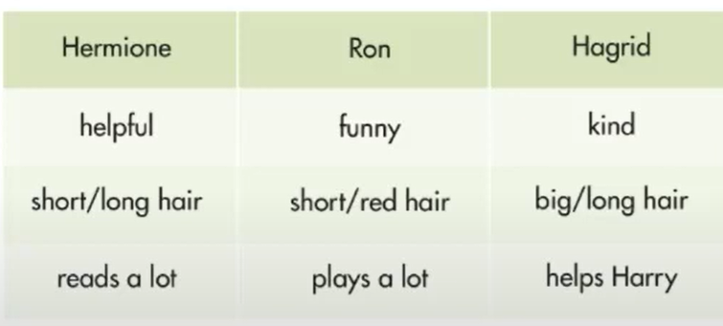
DESCRIBE CHARACTERS
( Miêu tả nhân vật)
Hỏi và trả lời về ngoại hình
- What does he look like?
- He’s tall and has glasses.
Hỏi và trả lời về Tính cách
- What is he like?
- He’s very friendly.
Look at the information above. Complete the table and interview your partner.
Question | Hermione | Ron | Hagrid
1. What’s he like? | ____________________ | _____________________ | ______________________
2. What does he look like? | _____________________ | ______________________ | ______________________
3. What does he do? | ______________________ | _____________________ | ______________________
He’s helpful
He’s funny
He’s kind
He has short hair
He has short red hair
He has long hair
He reads a lot
He plays a lot
He helps Harry

Slide 9

WRITING
Think about your best friend and complete the mind map
tall, short hair
Name : Lan
friendly, kind
Create the same mind map about best friend
My best friend
like listening to music
Helps other
good at : maths, …

Slide 10

WRITING
Using your mind map and write to email to a friend to tell a bout your best friend.
New message
To: peterf@frienzmail.com
Subject : R.E : My best friend
Dear, Peter,
Thank for your email. Your best friend seems really nice. Let me tell you about my best friend.
______________________________________________________________________________________________________________________________________________________________________________________________________________________________________________________________________________
Write back soon ,
_______________
send

Slide 11
WRAP-UP
Asking about personal appearance: What does he / she look like?
* Asking about personal character: How is he / she like?
* Writing an email about your best friend: Name, age, characteristics, appearance and activities of your best friend

Slide 12
HOMEWORK
- Finish the writing part.
- Read more books for children.
- Do exercises in Workbook: Reading and Writing (page 19).
- Prepare: Unit 3 - Review (page 90 – SB).

