Slide 1

UNIT 3
FRIENDS

Slide 2
LESSON 5

Slide 3

WARM-UP

Slide 4

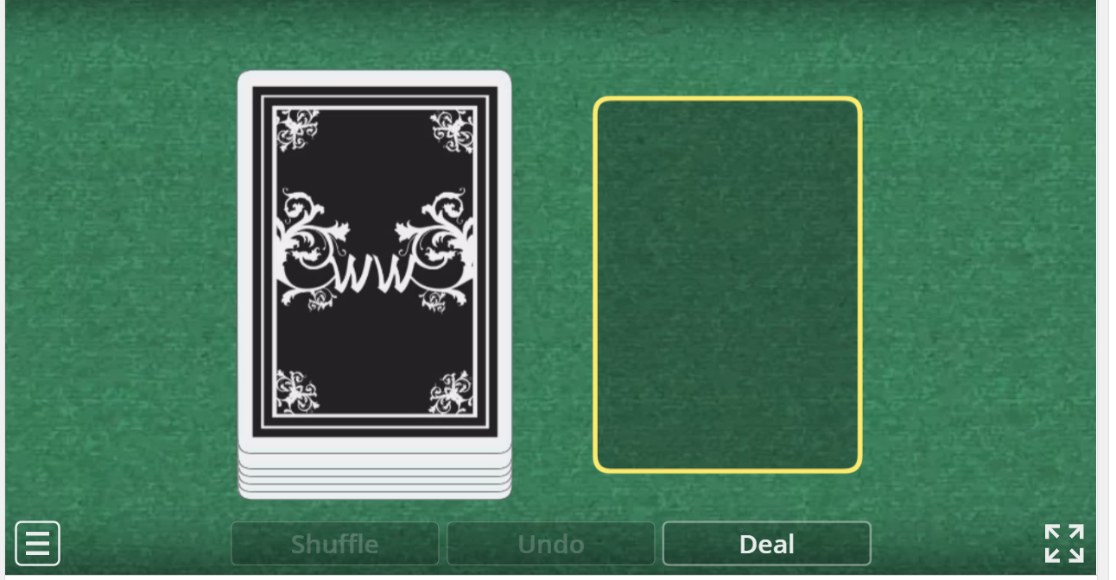
Online game : Open the cards and make a positive,
negative or question using present continuous.
https://wordwall.net/resource/20413026

Slide 5
GRAMMAR

Slide 6
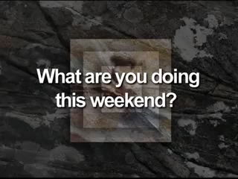
Watch a video and say the activities that you hear.
1. What activities can you hear in the video?
2. Which tense do they use to make plans in the future?

Slide 7
PRESENT CONTINUOUS TENSE
FIXED FUTURE PLANS
Thì hiện tại tiếp diễn thường được sử dụng khi nói về một kế hoạch sẽ làm trong tương lai và đã có sắp xếp , dự định trước một cách chắc chắn
I am watching a movie tonight.
He is making a cake tomorrow.
We are visiting our grandparents next weekend.

Slide 8



Khẳng định: S + am/is/are + V-ing
I am watching a movie tonight.
He is making a cake tomorrow.
They are playing soccer on the weekend.
Phủ định: S + am not /isn’t/aren’t + V-ing
I am not watching a movie tonight.
He is not making a cake tomorrow.
They are not playing soccer on the weekend.
STRUCTURE
Câu hỏi: (Wh) Am/Is/Are + S+ V-ing?
What are you doing tomorrow/next week?
Are you playing badminton tomorrow?
Is she making a cake tonight?

Slide 9
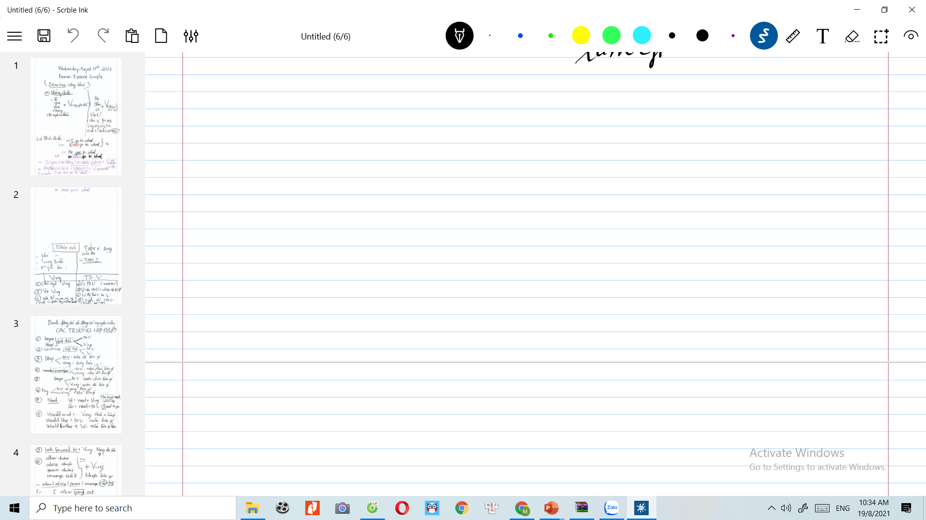
PRACTICE
Fill in the blanks using the Present Continuous
1. My brother ______________________(go) shopping on Friday.
is going
2. What ______you (do)________________tomorrow?
are
doing
am making
3. I ________________(make) a pizza tomorrow.
4. ___________they (have) ______________a picnic in the park this weekend?
Are
having
5. She _________________(go) to the mall with Mark on Saturday.
is going
6. We ____________( play) basketball this evening.
are playing
7. ______________he _____________(watch) a movie at home tonight ?
Is
watching
Gợi ý hoạt động: Cho học sinh thời gian 5 phút hoàn thành bài tập sau đó check chéo với bạn khác.

Slide 10

Write full sentences using the Present Continuous.
1. He/not/have a picnic/ this Saturday.
He isn’t having a picnic this Saturday.
2. I/ have a barbecue/ today.
I am having a barbecue today.
3. Emma and Jane / not watch a movie / on next Sunday.
Emma and Jane aren’t watching a movie on next Sunday.
4. We / make a pizza/ this weekend.
We are making a pizza this weekend.
5. David / play/ badminton/this afternoon
David is playing badminton this afternoon.
6. Maria/watch TV/ with her sister/ tonight.
Maria is watching TV with her sister tonight.

Slide 11
WRAP-UP
* Present Continuous for future action:
Form: (-) S + am / is / are + V-ing
(-) S + am / is / are + not + V-ing
(?) Am / Is / Are + S + V-ing
Future time expressions: this weekend, on the weekend, on Saturday, tomorrow, tonight, this week, …

Slide 12

HOMEWORK
MAKE A PLAN FOR YOUR WEEKEND USING PRESENT CONTINUOUS
- Make 2 sentences, using the Present Continuous for future use.
- Do exercises in WB: Lesson 2 - Grammar – Part a, b, c (page 17).
- Prepare: Lesson 2 – Pronunciation and Speaking (page 27 – SB).

