Slide 1
UNIT 2
SCHOOL

Slide 2
LESSON 9

Slide 3

WARM UP
- Lớp được chia thành 2 đội A,B. Trong 5 phút mỗi đội lần lượt lên viết tất cả những từ mới đã học. Đội nào viết được nhiều từ nhất trong khi 5 phút kết thúc là đội đó thắng.
A
B

Slide 4
VOCABULARY REVIEW

Slide 5

01
02
03
Subjects
(n)
04
/ˈsʌbʤɪkts/
05
Môn học
06

Slide 6


01
02
03
biology
(n)
04
/baɪˈɒləʤi/
05
Môn Sinh học
06

Slide 7


01
02
Geography
03
(n)
/ʤɪˈɒgrəfi/
04
Môn Địa lí
05
06

Slide 8
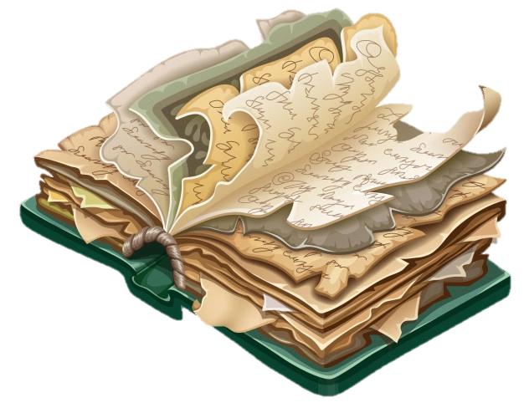

01
02
03
History
(n)
04
/ˈhɪstəri/
05
Môn Lịch sử
06

Slide 9


01
02
Information technology = IT
03
(n)
04
/ˌɪnfəˈmeɪʃən tɛkˈnɒləʤi/
05
Môn Tin học
06

Slide 10


01
02
Literature
(n)
03
/ˈlɪtərɪʧə/
04
Môn Ngữ văn
05
06

Slide 11


01
02
03
Music
(n)
04
/ˈmjuːzɪk/
Môn Âm nhạc
05
06

Slide 12


01
02
Physical education
(n)
03
04
/ˈfɪzɪkəl ˌɛdju(ː)ˈkeɪʃən/
05
Môn Thể dục
06

Slide 13

01
02
Maths
(n)
03
/mæθs/
04
Môn Toán
05
06

Slide 14


01
02
Physics
03
(n)
04
/ˈfɪzɪks/
Môn Vật lí
05
06

Slide 15
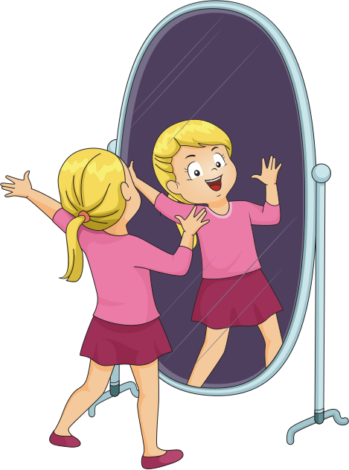
01
act
02
(v)
03
/ækt/
diễn xuất
04
05
06

Slide 16
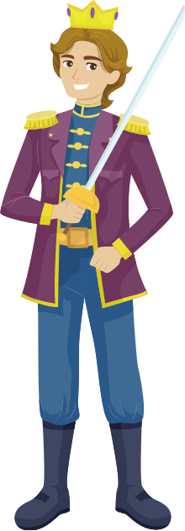
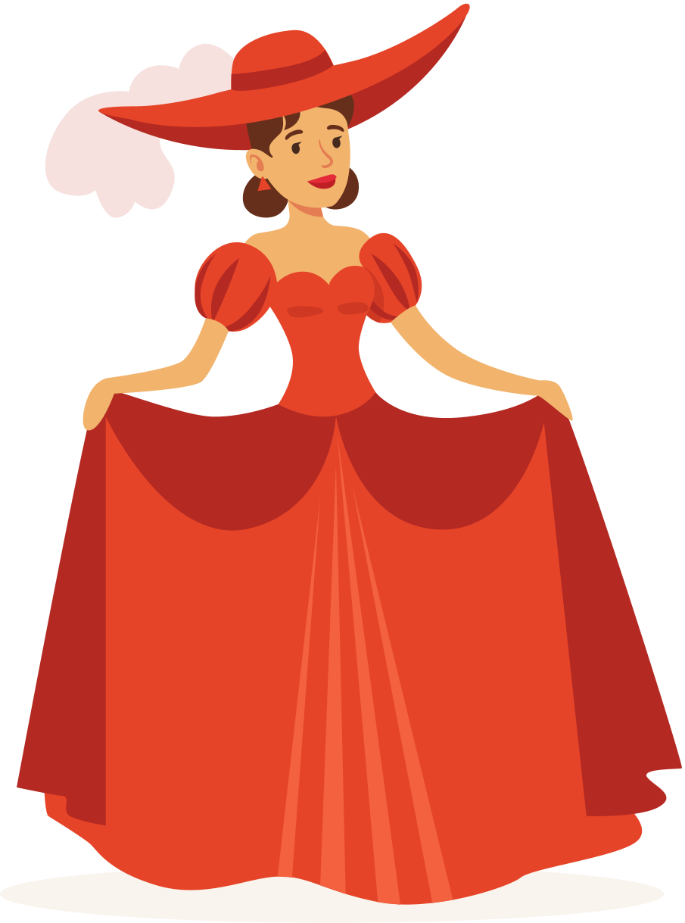
actor
(n)
01
/ˈæktə/
02
diễn viên nam
03
actress
(n)
04
/ˈæktrɪs/
05
diễn viên nữ
06

Slide 17
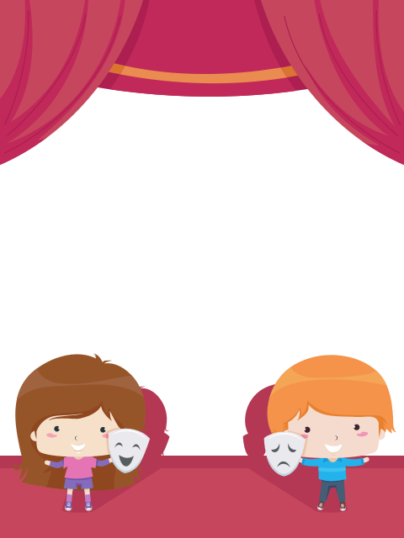

drama
(n)
01
/ˈdrɑːmə/
02
Kịch
03
drama club
(n)
04
/ˈdrɑːmə klʌb/
05
CLB kịch
06

Slide 18
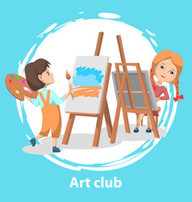
01
02
art club
(n)
03
/ɑːt klʌb/
04
CLB Mĩ thuật
05
06

Slide 19

01
Book club
02
(n)
/bʊk klʌb/
03
CLB đọc sách
04
05
06

Slide 20
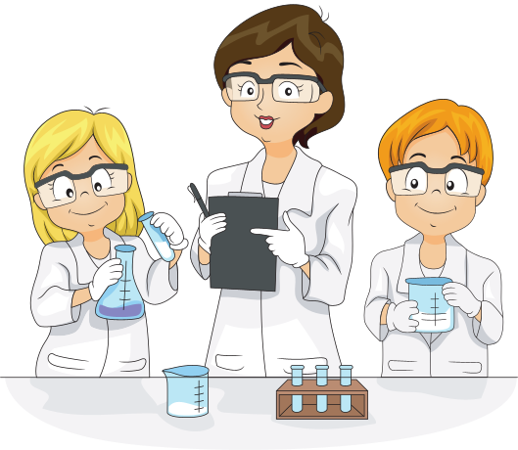
01
Science club
02
(n)
/ˈsaɪəns klʌb/
03
CLB Khoa học
04
05
06

Slide 21

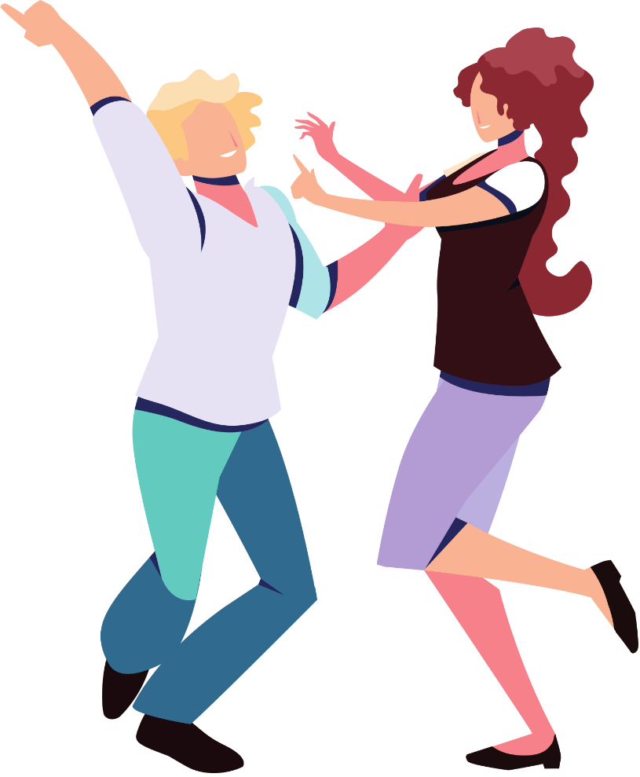
01
02
03
Dance club
(n)
04
/dɑːns klʌb/
05
CLB múa
06

Slide 22
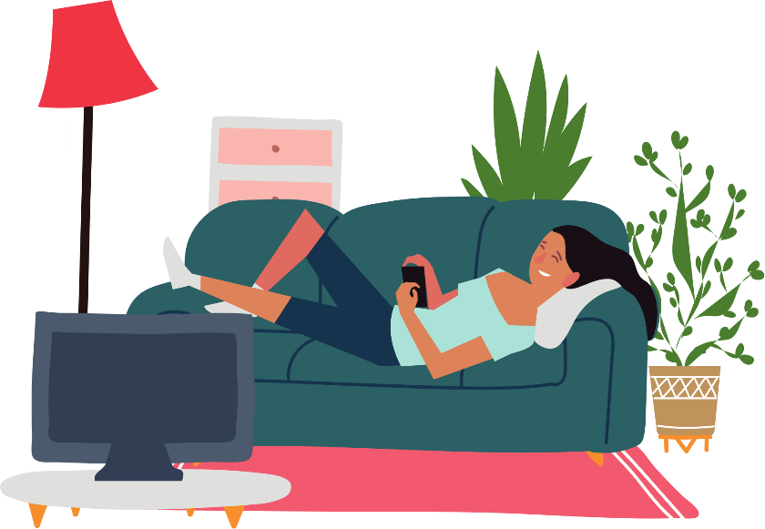
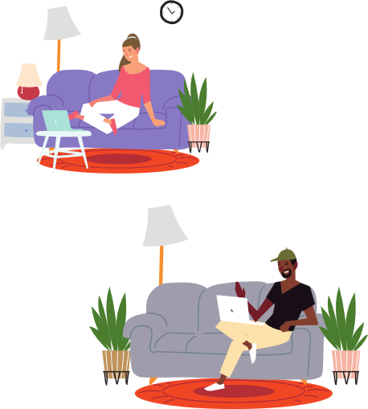
01
02
Indoor activity
03
(n)
/ˈɪndɔːr ækˈtɪvɪti/
04
Hoạt động trong nhà
05
06

Slide 23
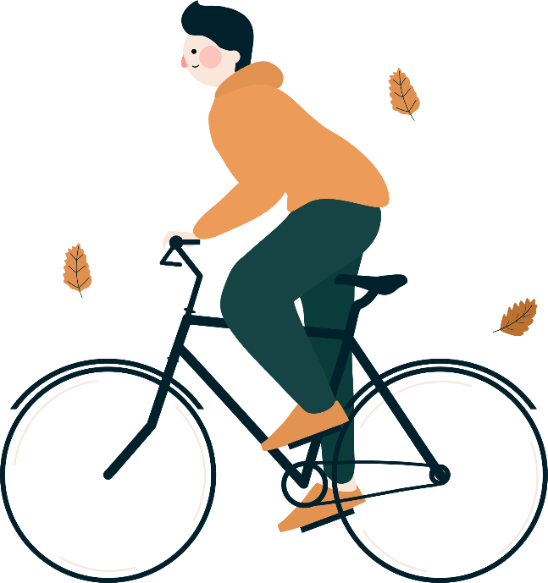
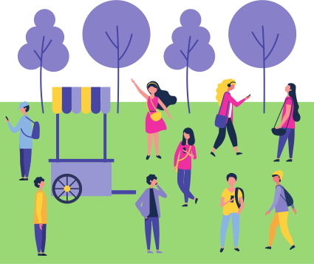
01
02
outdoor activities
03
(n)
/ˈˈaʊtdɔːr ækˈtɪvɪtiz/
04
Các HĐ ngoài trời
05
06

Slide 24

01
Sign up
(v)
02
/saɪn ʌp/
03
Đăng ký
04
05
06

Slide 25
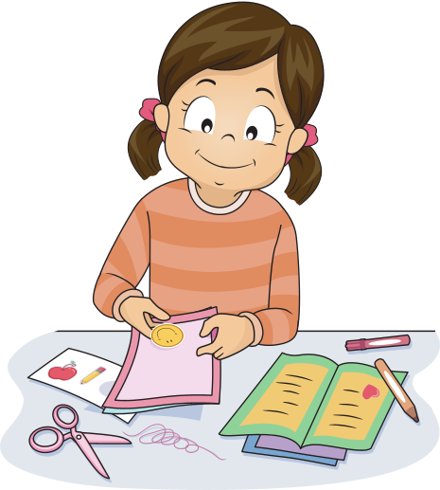
01
do arts and crafts
02
03
Làm thủ công
04
05
06

Slide 26

01
Notice board
(n)
02
/ˈnəʊtɪs bɔːd/
03
Bảng thông báo
04
05
06

Slide 27

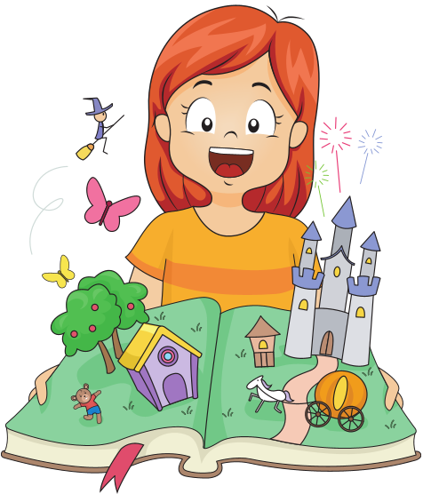
01
02
Fantasy
(n)
03
/ˈfæntəsi/
04
Kỳ ảo/ Ảo tưởng
05
06

Slide 28

01
Mystery
(n)
02
/ˈmɪstəri/
03
Bí ẩn
04
05
06

Slide 29
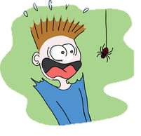
01
Scary
(adj)
02
/ˈskeəri/
03
Đáng sợ
04
05
06

Slide 30
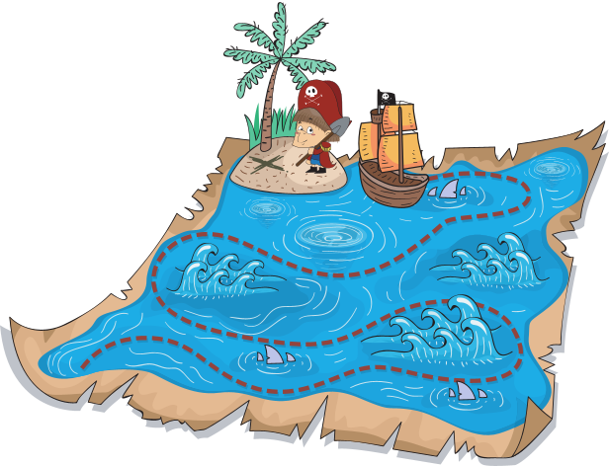
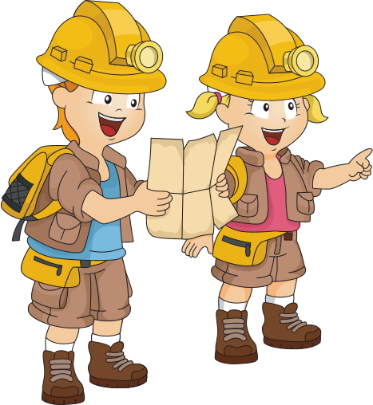
01
02
Adventure
(n)
03
/ədˈvɛnʧə/
04
Cuộc phiêu lưu
05
06

Slide 31
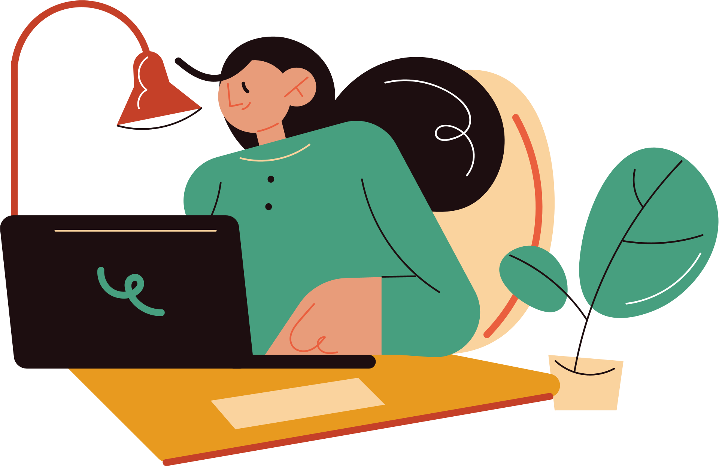
01
Author
(n)
02
/ˈɔːθə/
03
Nhà văn/ Tác giả
04
05
06

Slide 32

01
Novel
(n)
02
/ˈnɒvəl/
03
Tiểu thuyết
04
05
06

Slide 33

01
Mystery novel
(n)
02
/ˈmɪstəri ˈnɒvəl/
03
Truyện trinh thám
04
05
06

Slide 34

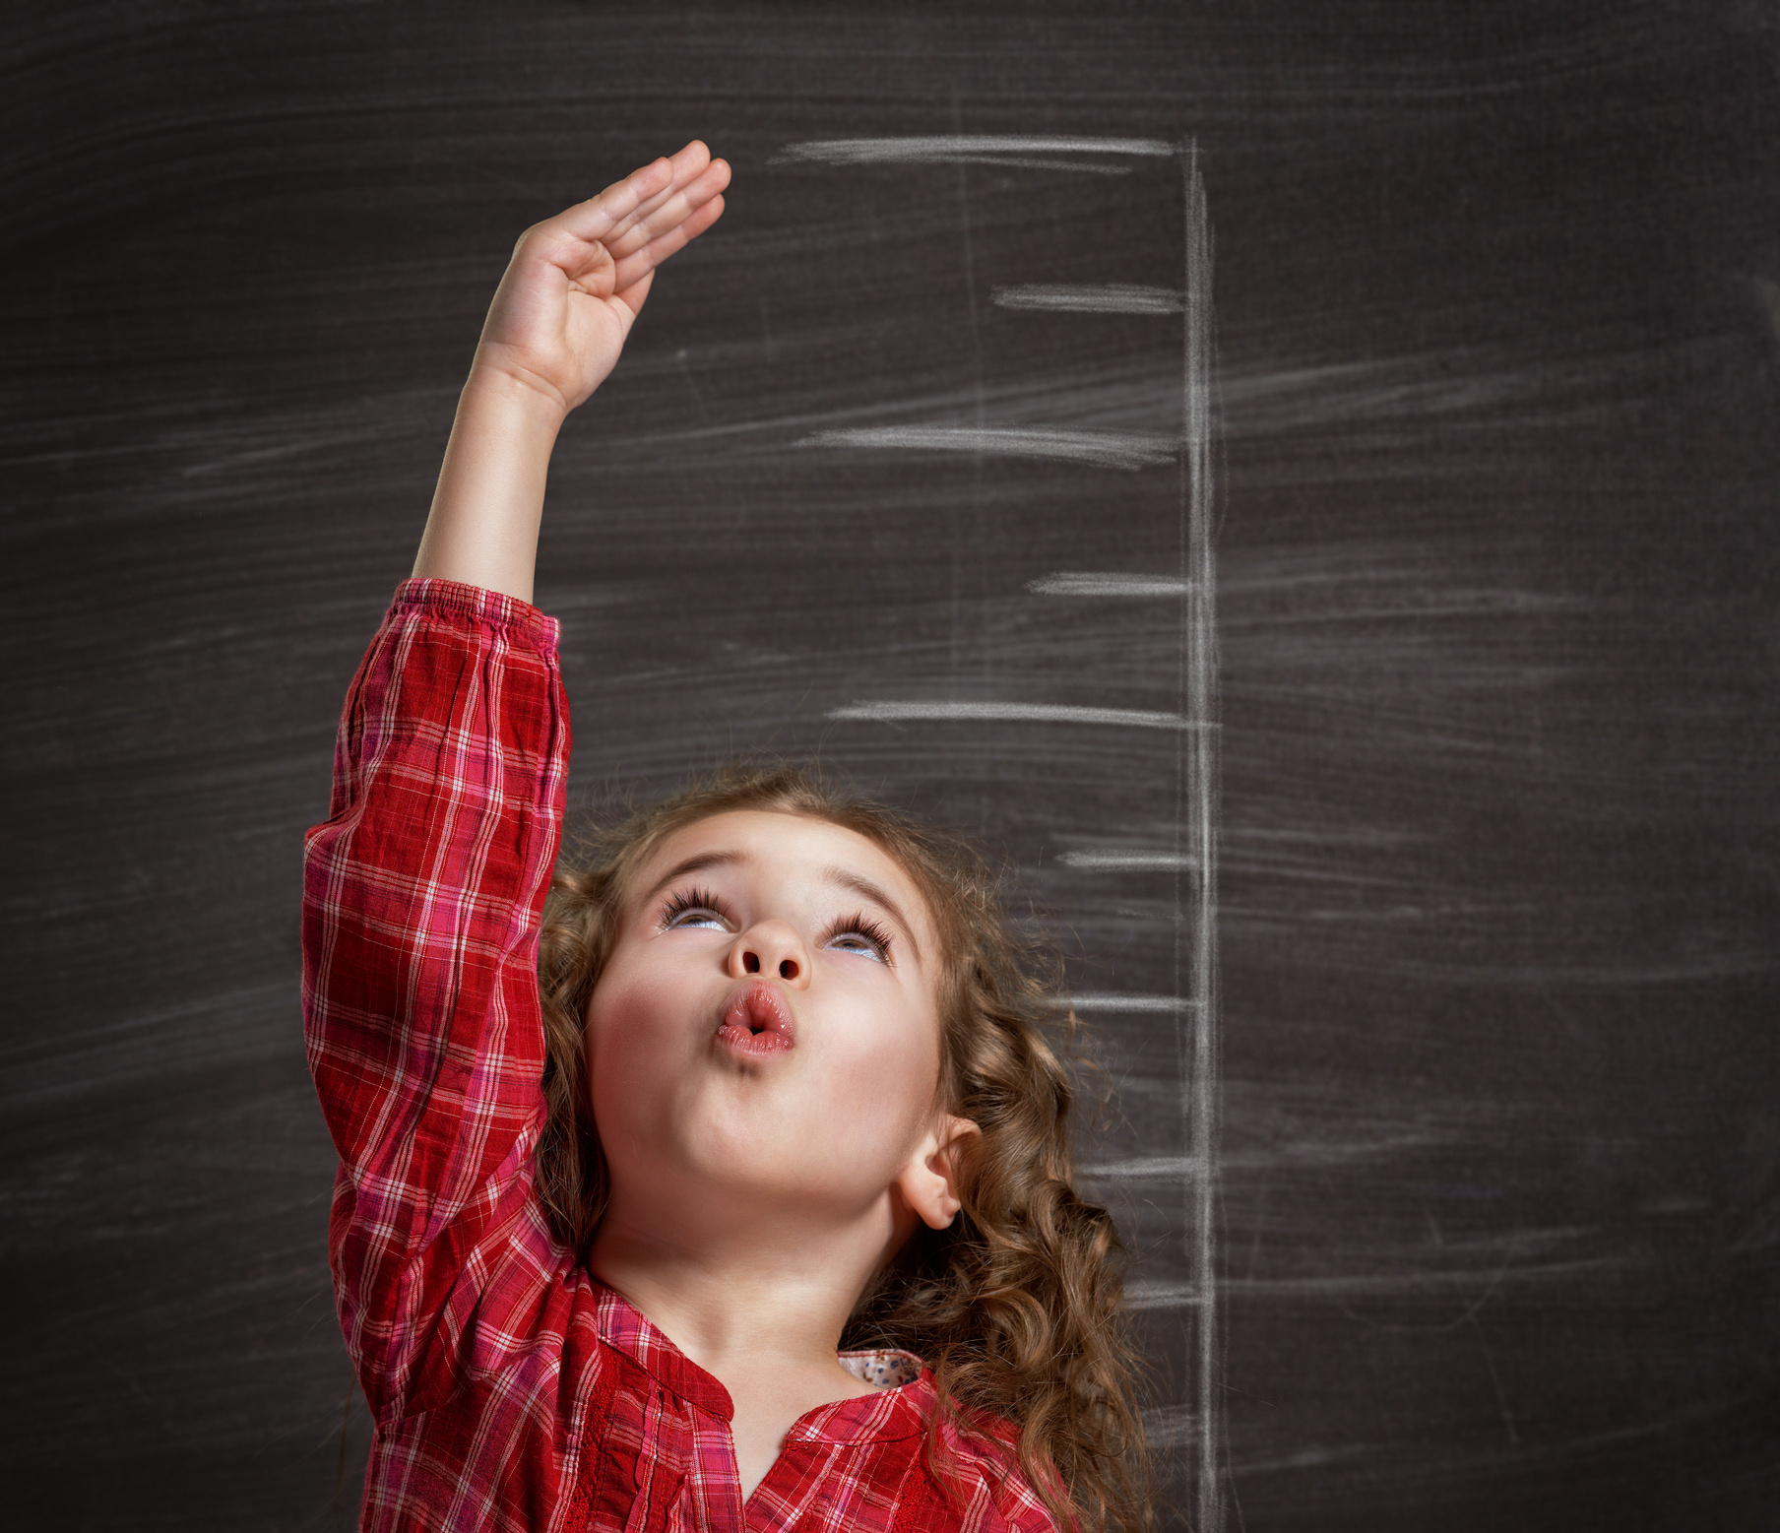
01
02
Grow up
(v)
03
/grəʊ ʌp/
04
Lớn lên
05
06

Slide 35

01
Find out
(v)
02
/faɪnd aʊt/
03
Tìm thấy
04
05
06

Slide 36
REVIEW
01
02
03
04
05
06

Slide 37
Review 1: Match
01
02
Music
03
Biology
04
Physics
05
Literature
06
Geography
History

Slide 38

01
02
Maths
03
Science
04
Physics
05
Physical Edu.
06
Geography
Information tech

Slide 39
REVIEW 2: WRITE THE WORDS
01
02
03
04
Physics
History
Literature
Maths
05
06
Physical Education
Geography
Biology
Science

Slide 40
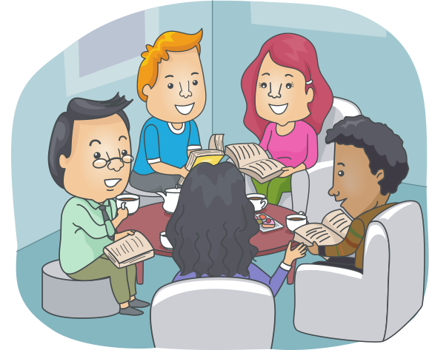

REVIEW 3: Match
01
02
03
04
05
06
Book club
Music club
Dance club
Art club
Soccer club
Drama club
English club
Science club

Slide 41

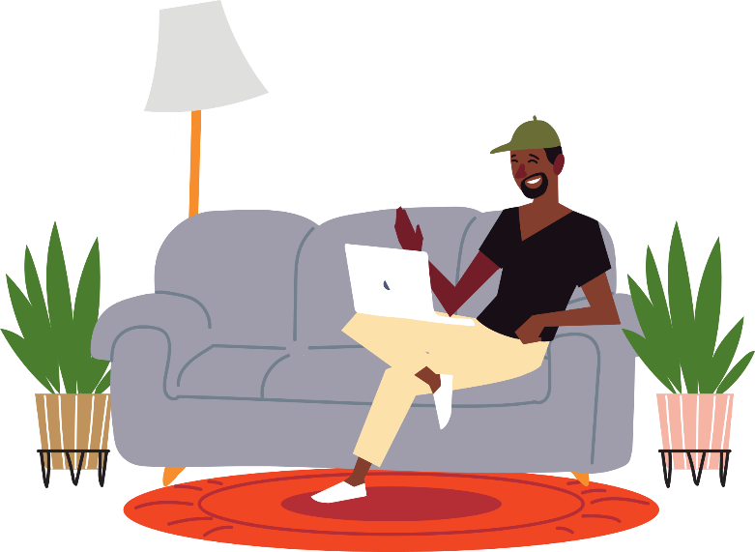
REVIEW 3 - Match
01
02
03
04
05
06
Indoor activities
Make arts and crafs
Mystery books
Author
Novel
Fantasy books
Noticeboard
Outdoor activities

Slide 42
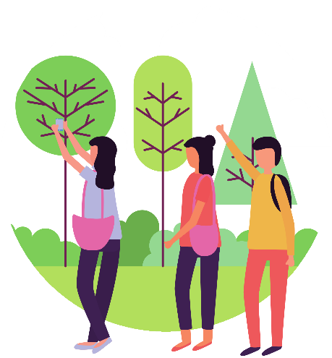
REVIEW 2
01
02
03
04
05
06
Indoor activities
Make arts and crafs
Mystery books
Author
Novel
Fantasy books
Noticeboard
Outdoor activities

Slide 43
REVIEW 3 - Match
01
02
03
04
05
06
Adventure
Make arts and crafs
Mystery books
Author
Novel
Grow up
Noticeboard
Scary

Slide 44
01
6. His new school has a big ………………..
noticeboard
02
Literature
7. Her favorite subject at school is …………………….
03
8. He likes computer games and that’s why he likes ……………………………….
04
Information Technology
05
9. Linh likes dancing. She wants to sign up for a ……………………….
Dance club.
06
Arts and Crafts.
10. The ………………..Club is for people who like making things

Slide 45

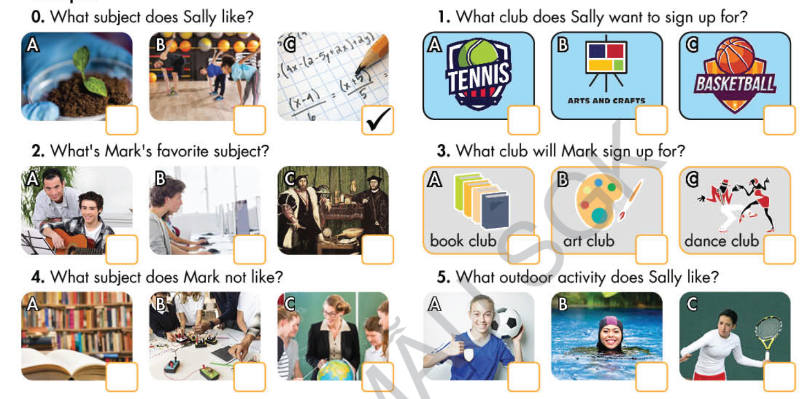

Listening
You will hear five short conversations. You will hear each conversation twice. There is one question for each conversation. For each question , choose the correct answer ( A,B or C)

Slide 46
Reading
Read the text. Choose the correct answer ( A, B, or C)
I really like art , English and literature. They’re really interesting and can be fun. I don’t like math, geopgraphy, or science. They’re boring. My favorite subject at school is literature. I like learning about stories of people from different places and times. My favourite book is Secret Garden. The author is Fances Hodgson Burnett. The girl in the novel, Mary Lennox, goes to live at ther uncle’s house and discovers a secret garden. She becomes friends with Dickon and her cousin Colin Craven. They often play together and take care of the garden. It’s a very interesting story and I really love their friendship.
Example: What subjects does Simon like?
A.Math, geography, and science
B. art, English, and literature.
C. He likes all of them

Slide 47
Reading
Read the text. Choose the correct answer ( A, B, or C)
I really like art , English and literature. They’re really interesting and can be fun. I don’t like math, geopgraphy, or science. They’re boring. My favorite subject at school is literature. I like learning about stories of people from different places and times. My favourite book is Secret Garden. The author is . The girl in the novel, Mary Lennox, goes to live at ther uncle’s house and discovers a secret garden. She becomes friends with Dickon and her cousin Colin Craven. They often play together and take care of the garden. It’s a very interesting story and I really love their friendship.
Why does Simon like these subjects?
They’re interesting
He is good at them
They’re exciting
2. What is Simon’s favorite subject?
A. English
B. literature
C. math

Slide 48
Reading
Read the text. Choose the correct answer ( A, B, or C)
I really like art , English and literature. They’re really interesting and can be fun. I don’t like math, geopgraphy, or science. They’re boring. My favorite subject at school is literature. I like learning about stories of people from different places and times. My favourite book is Secret Garden. The author is . The girl in the novel, Mary Lennox, goes to live at ther uncle’s house and discovers a secret garden. She becomes friends with Dickon and her cousin Colin Craven. They often play together and take care of the garden. It’s a very interesting story and I really love their friendship.
3. Who’s the author of Simon’s favorite book?
A. Mary Lennox
B. Fances Hodgson Burnett
C. Colin Craven.
4. Why does Simon like the novel?
A. He likes mystery novels
B. It has many fun adventures.
C. He likes the children’s friendship.

Slide 49
Vocabulary
Fill in the blanks with the words from the box.
1. My favorite subject is history . I like learning about people in the past.
fantasy
2. Harry Potter is a famous___________series. Many people love the magical world in the books
arts and crafts
3. There are many ________________projects before the holidays. You can learn how to make beautiful cards and decorations.
novel
4. Her first _____________ about her childhood in the south of India. Many people, especially girls and women, love it because they can see themselves in her story.

Slide 50
Vocabulary
Fill in the blanks with the words from the box.
sign up
5. Why don’t you ________for an outdoor activity? Being ourdoors is great for your health.
literature
6. Matt doesn’t like ___________. He thinks all the books he has to read in the class are boring.
geography
7. We learn different countries in ______________class.
drama club
8. The ______________ is looking for actors for their new play..

Slide 51
Grammar
Circle the correct words.
I like art, English, and /or music.
What’s your favourite subject? Mine/Yours is biology
Do you like play/playing sports?
The book’s by /on Harper Lee
I think the book is/are every exciting.
I like dancing/ danceing. I want to sign up for a dance class.
Do you know where my bag is? Hmm, is that mine/yours?
8. I don’t like draw/drawing.

Slide 52
PRONUNCIATION
Circle the word that differs from the other three in the position of primary stress in each of the following questions.
1. A. dramma B. baseball C. suggest D. subject
2. A. literature B. biology C. activity D. geography
3. A. music B. soccer C. physics D. indoor
4. A. fantasy B. history C. favorite D.adventure
5. A. novel B. decide C. author D. science

Slide 53
HOMEWORK
Review Unit 1, 2
Prepare for Test

Slide 54
Thank you !
01
02
03
04
05
06

