Slide 1
UNIT 2
SCHOOL

Slide 2
LESSON 8

Slide 3

WARM UP

Slide 4
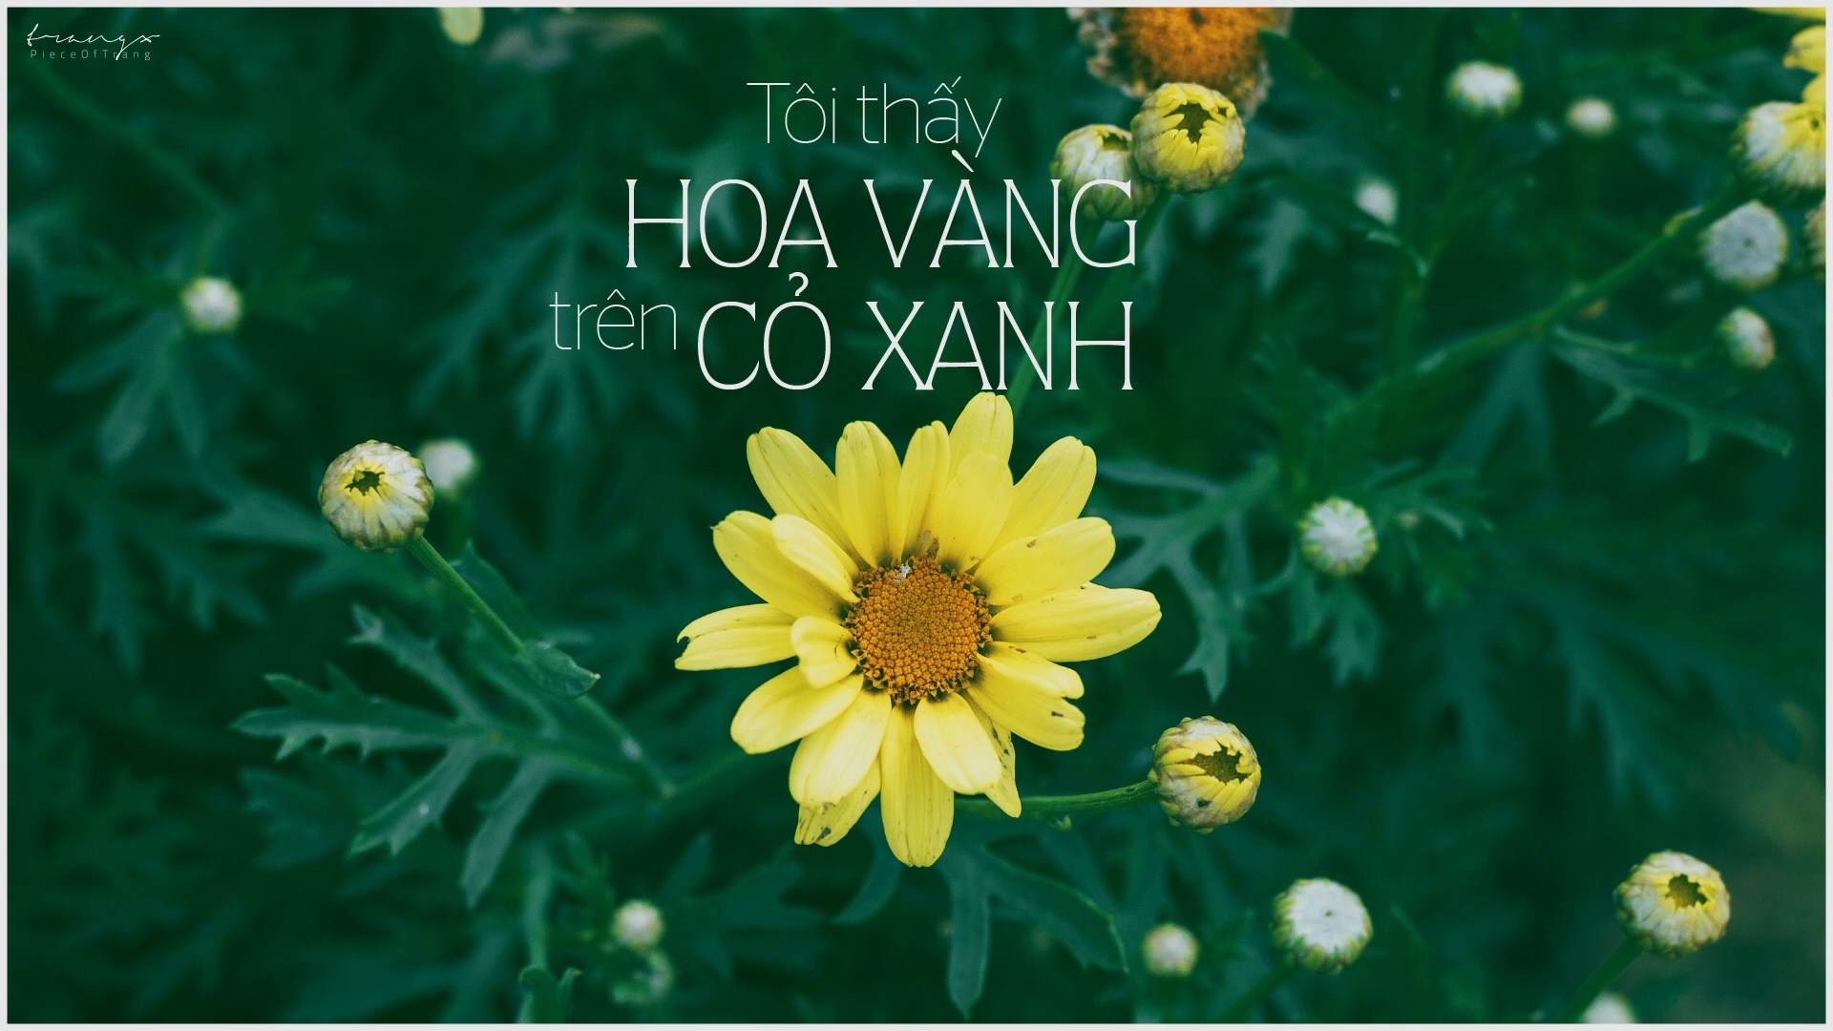
Let’s enjoy the song and guess which film does the song belong to?
Film: “ Tôi thấy hoa vàng trên cỏ xanh”
Author /writer : Nguyễn Nhật Ánh

Slide 5
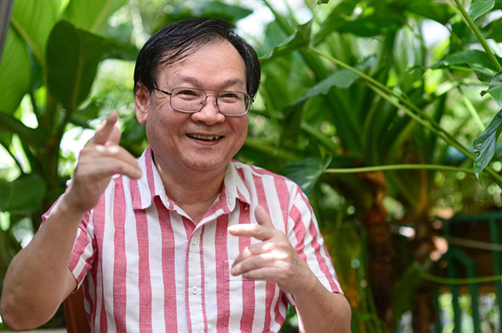
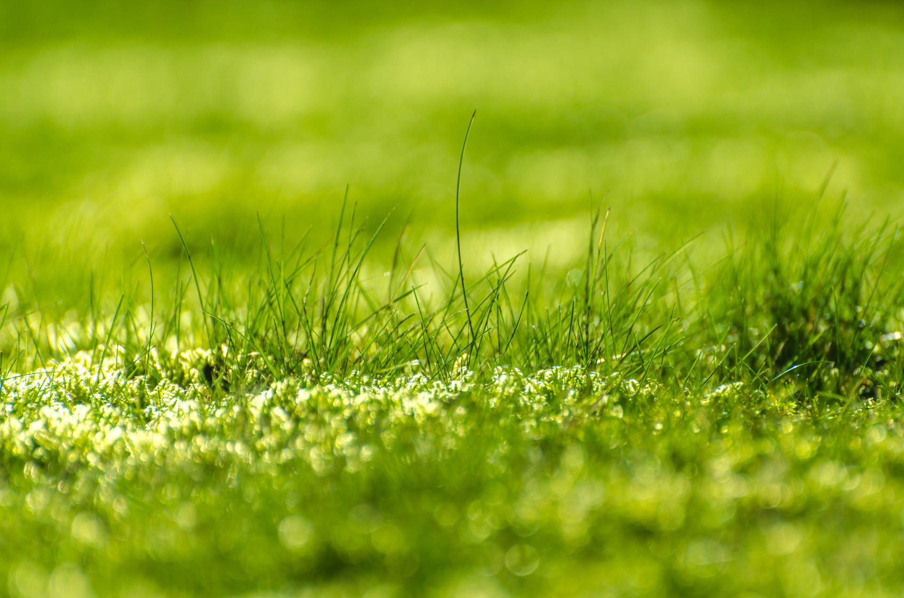
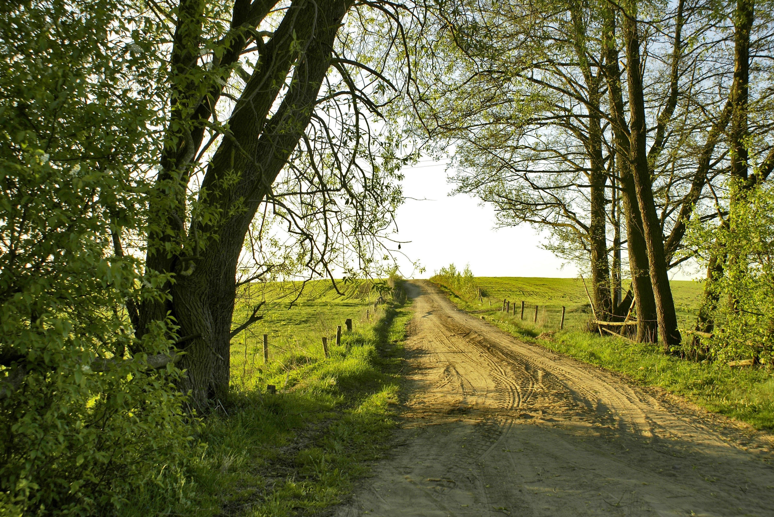
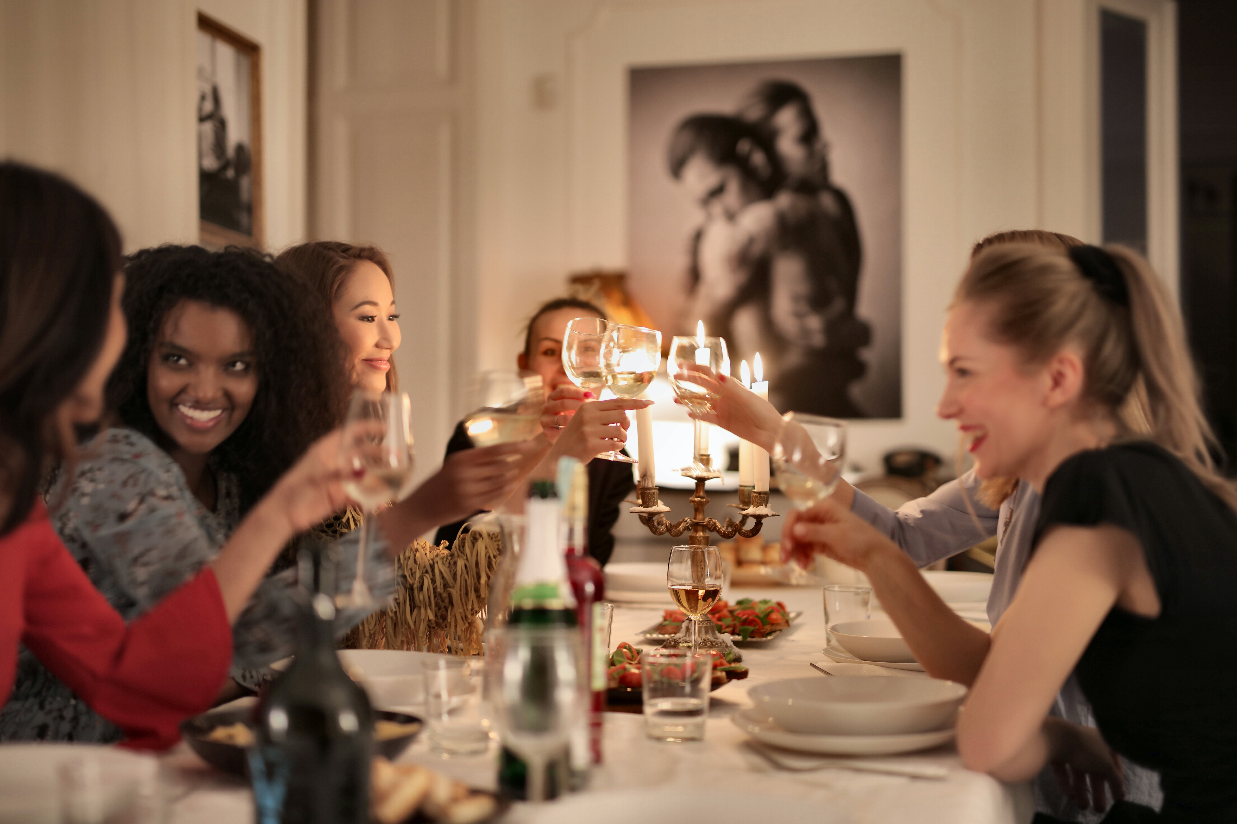
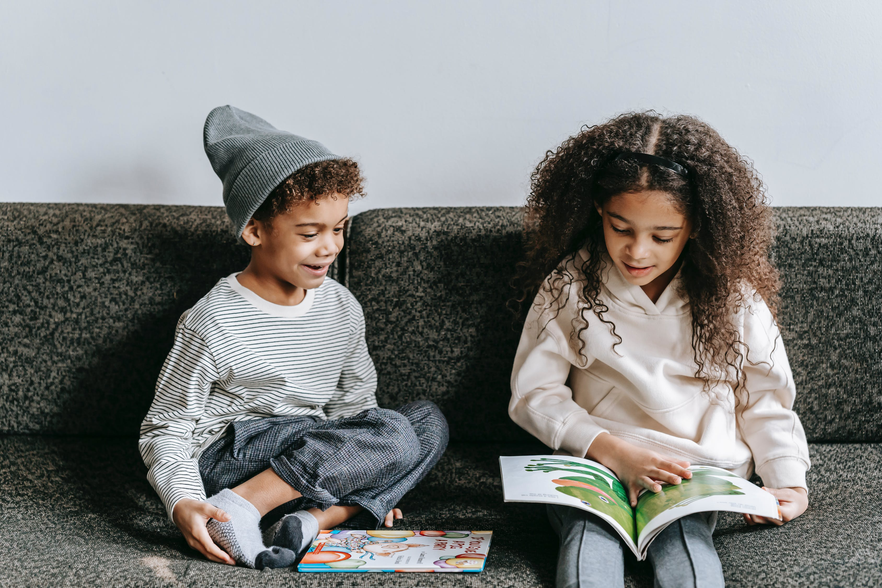
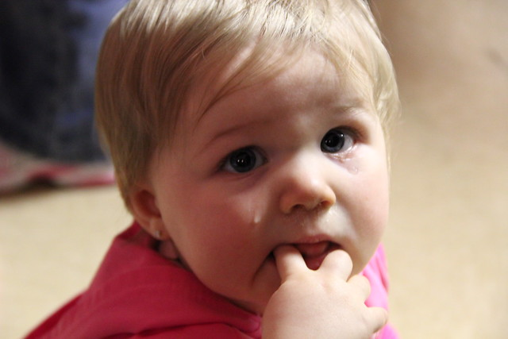
author
green grass
Peaceful village
around
interesting
cry

Slide 6

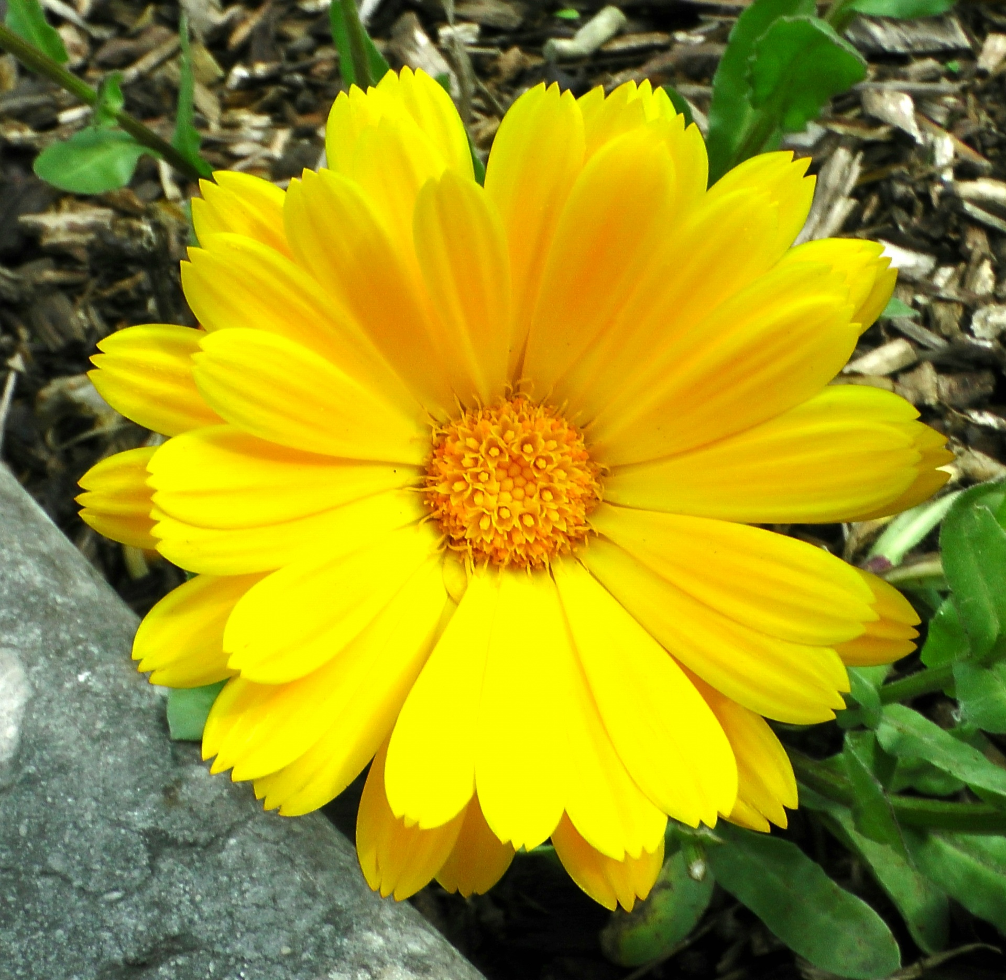
READING
My favorite novel
Thành Nguyễn, November 18
My favorite book is Yellow Flowers on the Green Grass ( Tôi Thấy Hoa Vàng Trên Cỏ Xanh). It’s an interesting novel. The author of the book is Nguyễn Nhật Ánh. The book is about Thiều and the people around him. I like the book because it shows us many beautiful things in Thiều’s village. It’s a peaceful village with green grass, trees, wind, and yellow flowers. Some parts of the story are very sad. I cried a lot when I thought Thiều’s brother , Tường, cannot walk again. I really like this book. I think you should read it.
1. Yellow Flowers on the Green Grass is by Nguyễn Nhật Ánh.
True/false
2. The writer thinks the book is boring.
True/false
True/false
3. The story is about three girls as they grow up.
True/false
4. In the story, Tường lives in a big city
5. Some parts of the story are sad.
True/false
6. The writer likes this story.
True/false

Slide 7
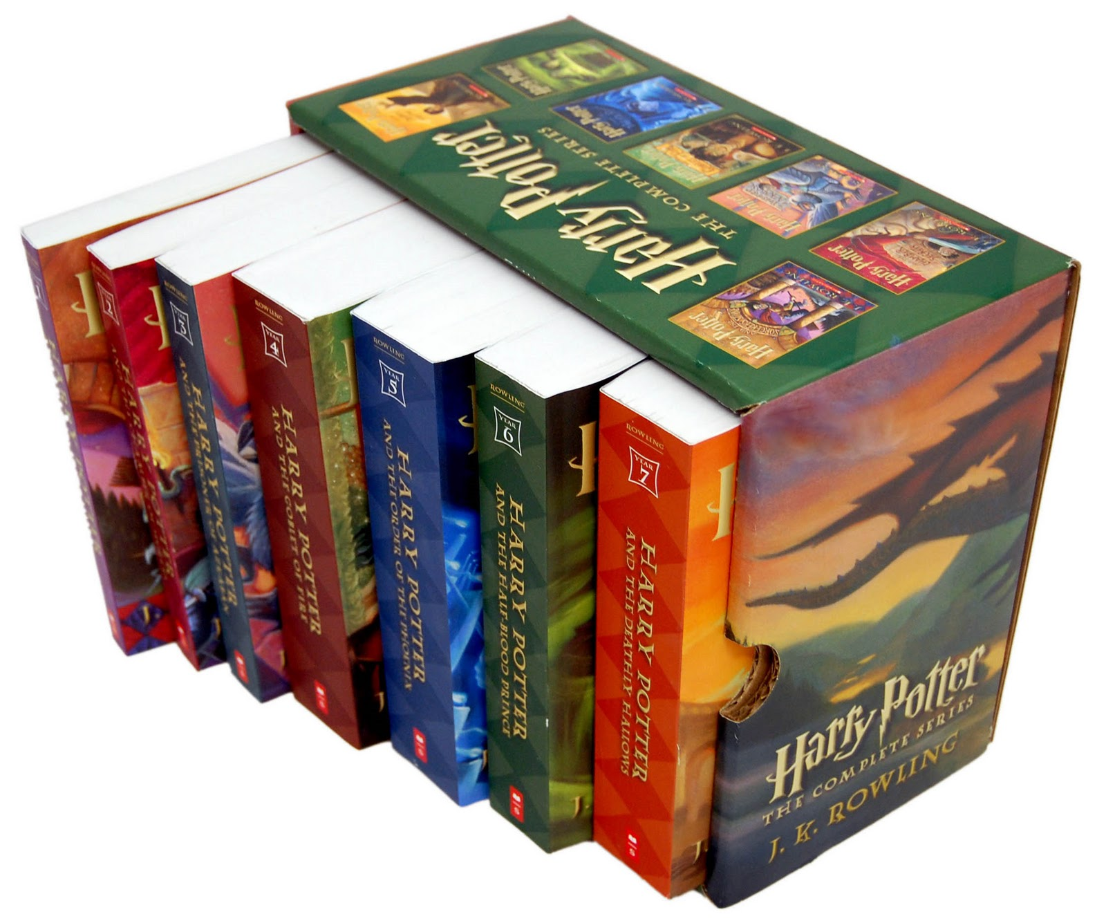
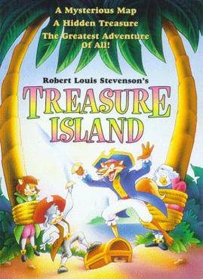
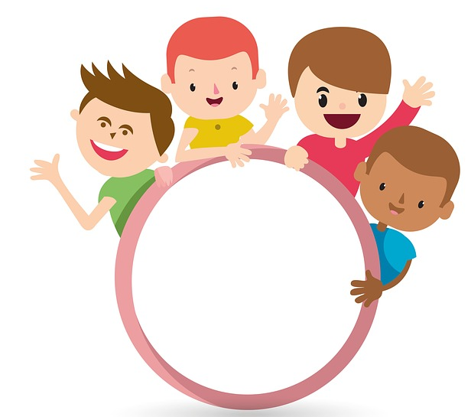
SPEAKING
01
02
Harry Potter and the Sorcerer’s Stone
- Type : Fantasy
- Author : J.K Rowling
- Interesting
Treasure Island.
- Type : Adventure.
- Author : Robert Louis Stevenson
- exciting
03
04
Look at the two stories above, read the clues and practice with your partner.
05
A. What’s your favorite book? B. I like …………………………………………
A. What kind of book is it? B. It’s a ……………………………………
A. Who’s the author? B. It’s by………………………………………
A. Why do you like it? B. I think it’s ………………………………
06
This Photo by Unknown Author is licensed under CC BY-NC-ND

Slide 8

Writing
Write a paragraph about your favorite book using the suggestions below.
What’s your favorite book? I like …………………………
What kind of book is it? It’s a ………………………..
Who’s the author? It’s by………………………..
Why do you like it? I think it’s ………………….
Do you think your best friends Yes/No: …………………
should read it?
PUNCTUATION : VIẾT HOA
- Đầu câu
- Tên người, nơi chốn, tên sách
- “ Đại từ I
- Ngày và tháng
This Photo by Unknown Author is licensed under CC BY-SA

Slide 9
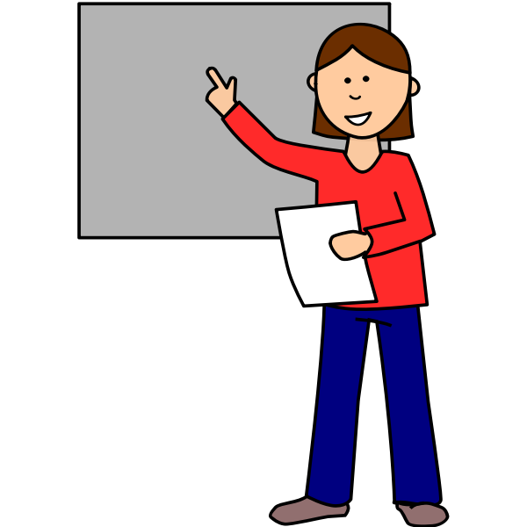
Make a presentation about your favorite story
Hello everyone!
My name is…………………
I ………….years old. I am a student at ………..secondary school. Today I’m going to talk about my favorite book.
The name of the book is ____________. It’s _____________book. It’s written by ______________. I really enjoy reading the book because ____________________. I think you should read it if you have free time.

Slide 10
HOMEWORK
Learn new words
Practice writing new words on writing sheet.
Do workbook page ( …………………)
- Make a presentation to talk about your favorite book

