Slide 1
UNIT 2
SCHOOL

Slide 2
WARM-UP

Slide 3
You are going to listen five people to talk about what they like doing. List two things they like doing on the table below.
NAME | Like
Nigel
Camila
john
Alex
Caroline

Slide 4
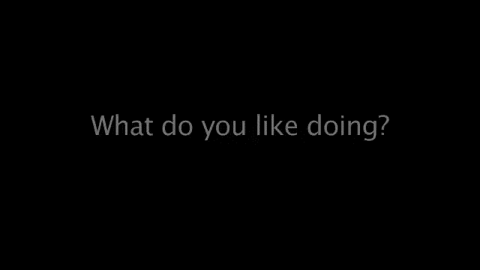

Slide 5
ANSWERS
 | Like
Nigel
Camila
john
Alex
Caroline
riding a bike , driving, cooking
travelling, taking photos,
running, football, going out with friends
listen to music,going to the cinema
cooking, reading, gardening, going to the cinema

Slide 6

PRONUNCIATION

Slide 7



PRONUNCIATION
Listen and guess the intonation of the answer.
Câu trả lời “Yes” : Ngữ điệu lên
Câu trả lời “ No” : Ngữ điệu xuống
Yes, I do
No, I don’t
Do you like basketball?
Yes, I do / No, I don’t
Practice

Slide 8

Intonation
b. Listen and focus on how the intonation does up or down?
Do you like playing basketball?
Yes, I do
No, I don’t
Intonation for positive answers goes up. Intonation for negative answer goes down.
Yes, I do No, I don’t
c. Listen and cross out the one with the wrong intonation.
Do you like reading?
Yes, I do
No, I don’t
d. Read the sentences with the correct intonation to a partner.

Slide 9

Work in pair, listen and mark correct intonation.
1. What subject does she like?
2. Do you like Geography?
3. No, I don’t.
4. Have you ever read the Harry Potter novels?
5. When do you sign up the Drama Club?
6. Would you like to go to the Book Club this afternoon?
7. I don’t like math and physics.
8. Yes, she does.
9. She loves literature.
10. Does he like IT?

Slide 10
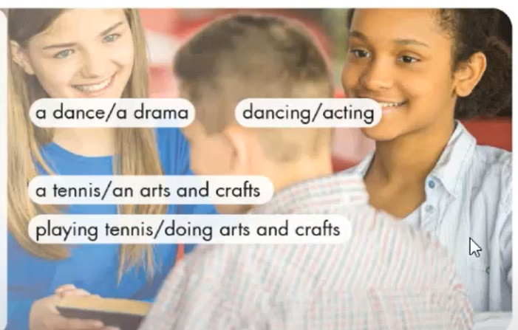
practice
Practice the conversation with your partner. Swap roles and repeat. Remember to speak with right intonation.
Emma: Which club do you want to sign up for?
Toby: Hmm. I don’t know.
Emma: There’s a book club. Do you like reading?
Toby: No, I don’t
Emma: How about an I.T club?
Toby: Yes, I really like using computers.
Emma: Why don’t you sign up for it?
Toby: Yes, good idea.

Slide 11
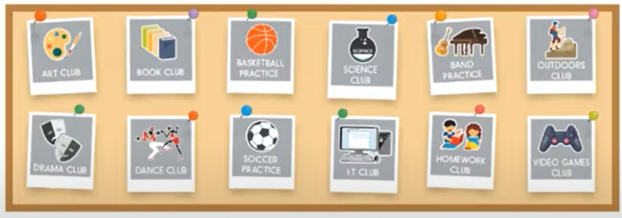
speaking
Let’s Join a Club!
Do you want to sign up for some clubs for next year. Find you what activities your partner likes doing and then decide on one club to join together.
Join another pair. Which club do most people want to join?

Slide 12
SAMPLE CONVERSATION
A: Which club do you want to sign up for?
B: Hmm. I don’t know.
A : There’s a book club. Do you like reading?
B: No, I don’t
A: How about an I.T club?
B : Yes, I really like using computers.
A : Why don’t you sign up for it?
B: Yes, good idea.

Slide 13








Work in group of four and order the conversation and practice with your partner.
Mrs Green : Which activities do you want to sign up for
Lucy: Yes, I like playing soccer.
Mrs Green : Why don’t you sign up for outdoor sport club or drama club?
Lucy : Yes, good idea
Mrs Green : How about soccer?
Mrs Green : Yes, it’s fun to act in plays, too.
Lucy : Oh, you like outdoor activities. And do you like acting?
Lucy : Hmm, I don’t know. I don’t like indoor activities.

Slide 14
WRAP-UP
Intonation: Intonation for positive answers goes up, for negative answers goes down.
* Asking and answering about school clubs you like to sign up for: Which club do you want to sign up for?

Slide 15
HOMEWORK
Practice using intonation for positive and negative answers
- Review school names and their activities.
- Make 2 sentences for each structure of giving suggestions
- Prepare: Lesson 3 – New Words and Listening (page 20 – SB)

Slide 16

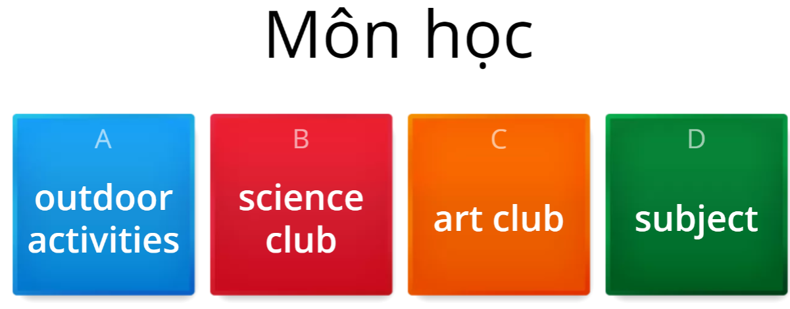
EXTRA ONLINE-PRACTICE

