Slide 1
UNIT 2
SCHOOL

Slide 2
LESSON 5

Slide 3
WARM - UP
Bạn học sinh đầu tiên nói I run, tiếp tục gọi bạn tiếp theo trả lời tiếp và phát triển câu càng dài càng tốt.
Sentence chain game
A. I run,
B. I run and dance
C. I run and dance and sing

Slide 4
GRAMMAR

Slide 5

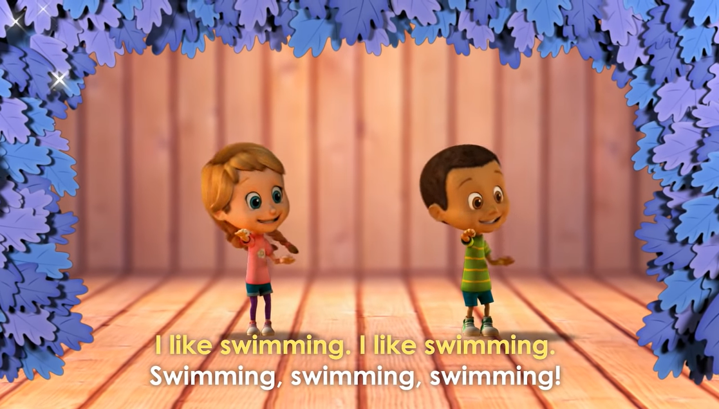
https://www.youtube.com/watch?v=vWHICfzKXHE
Let’s sing the song

Slide 6

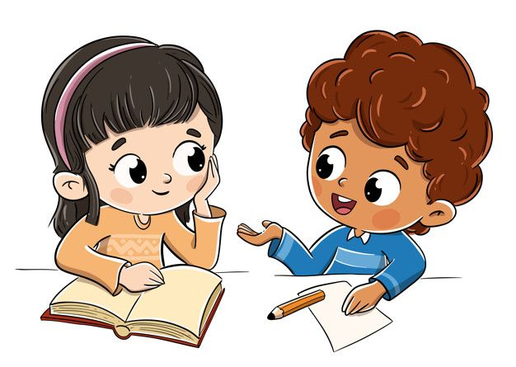
LISTEN TO THE SONG AGAIN AND PAY ATTENTION TO :
Yes, I do
Do you like reading books?
I LIKE RUNNING
I LIKE BOATING
I LIKE FISHING
Structure:
Like + V-ing
Khi muốn diễn tả ai đó thích làm gì

Slide 7
HOW TO ADD “ ING” AFTER A VERB
RULES ( Quy tắc) | EXAMPLE ( Ví dụ)
Động từ kết thúc là “ e” : bỏ e thêm ‘ing”
Động từ 1 âm tiết ở giữa là 1 nguyên âm ( u,e,o,a,i) – gấp đôi phụ âm cuối.
Nhưng không cần gấp đôi với các từ tận cùng là “ y, x,w)
Động từ kết thúc bằng “ ie” chuyển thành y+ing
Make – making take - taking
Run – running sit - sitting
Play – playing say - saying
Lie – lying die - dying

Slide 8

RUN TO THE BOARD GAME
Team A, Team B takes turn run to the board to add “ ing” before the verbs.
Team A
Team B
Sing
Draw
Cut
lie
Dance
Get
Act
Live
Sit
Run
eat
play
get
run
act
draw
do
swim
Lie
sit

Slide 9
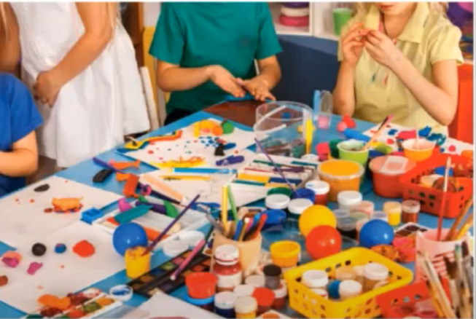
REWRITE THE VERBS USING -ING
Sing
Draw
Cut
Read
Dance
Get
Act
singing
________________
________________
drawing
________________
cutting
________________
reading
________________
dancing
________________
getting
________________
acting

Slide 10
Fill in the blanks and practice with your partners
Mia : There’s an art club. Do you like (1) ____________ ? ( paint)
Penny: No, don’t
Mia : Do you like (2) _______________________. ( do/outdoor activities)
Penny: Yes, I do. I like sports.
Mia: Do you like(3) ________________( play/tennis)
Penny : No, not really.
Mia : Do you like (4) ____________( swim)?
Penny: Yes, I do.
Mia : Great. We can sign up for the swimming club.
painting
doing outdoor activities
playing tennis
swimming

Slide 11
WRAP-UP

Slide 12

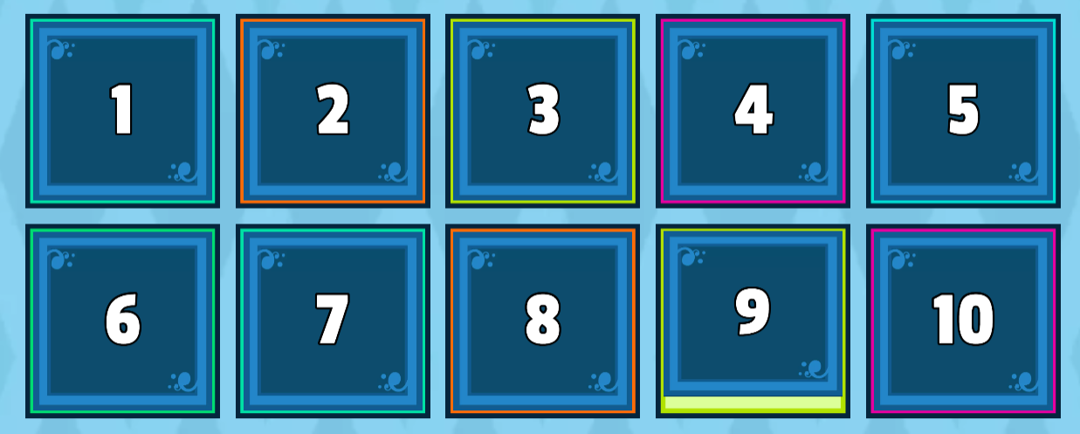
https://wordwall.net/resource/20562215/unit-2-grammar-like-ving
PLAY GAME: OPEN THE BOX.

Slide 13
HOMEWORK
Write some sentences about your family member’s hobby using LIKE+VING
My mother likes _____________________________
My father likes ______________________________
My sister/my brother likes______________________
I like_______________________________________
I don’t like___________________________________

