Slide 1
UNIT 2
SCHOOL

Slide 2
LESSON 4

Slide 3

WARM UP

Slide 4
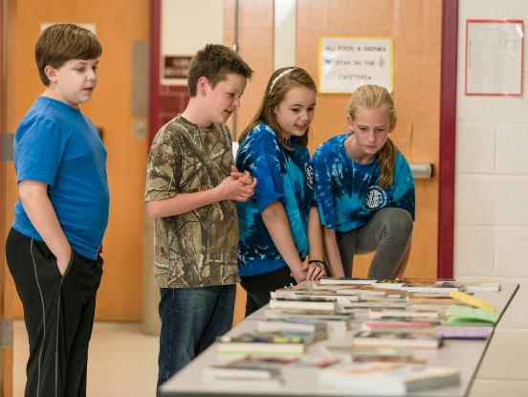
Look at the pictures and guess where are they?

Slide 5
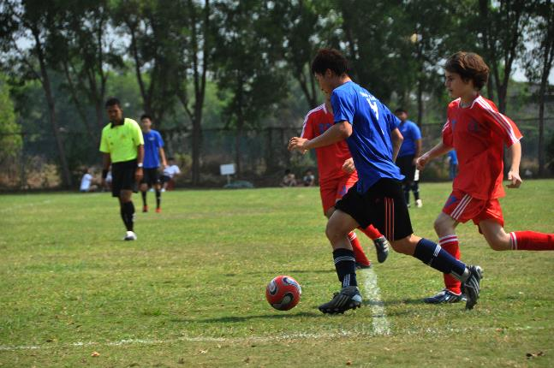
Look at the pictures and guess where are they?

Slide 6
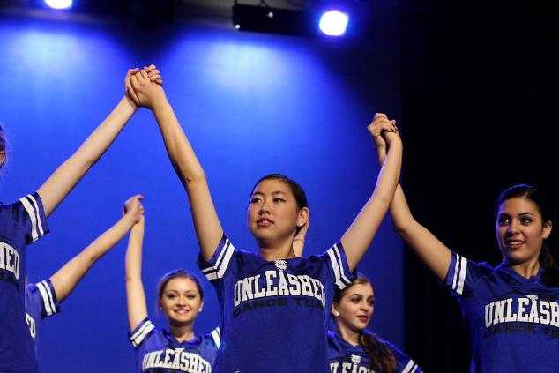
Look at the pictures and guess where are they?

Slide 7
NEW WORDS

Slide 8

01
act
02
(v)
03
/ækt/
diễn xuất
04
05
06
She acts a part in a play at her school.
Cô ấy đóng một vai trong vở kịch ở trường cô ấy.

Slide 9
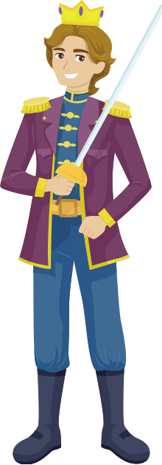

actor
(n)
01
/ˈæktə/
02
diễn viên nam
03
actress
(n)
04
/ˈæktrɪs/
05
diễn viên nữ
06
He is a famous actor and she is a well-known actress too.
Anh ấy là 1 nam diễn viên nổi tiếng và cô ấy cũng là một nữ diễn viên nổi tiếng.

Slide 10


drama
(n)
01
/ˈdrɑːmə/
02
Kịch
03
drama club
(n)
04
/ˈdrɑːmə klʌb/
05
CLB kịch
06
There is a drama club in my school.
Ở trường mình có một Câu lạc bộ Kịch.

Slide 11

01
art club
02
(n)
03
/ɑːt klʌb/
04
CLB Mĩ thuật
05
06
She likes drawing so she joins the Art club at school.
Cô ấy thích vẽ vì thế cô ấy tham gia CLB Mĩ thuật ở trường.

Slide 12

01
Book club
02
(n)
/bʊk klʌb/
03
CLB đọc sách
04
05
06
Do you want to join our school’s book club?
Bạn có muốn tham gia CLB đọc sách trường mình không?

Slide 13

01
Science club
02
(n)
/ˈsaɪəns klʌb/
03
CLB Khoa học
04
05
06
There is a Science club. Do you want to join?
Có một CLB Khoa học. Bạn có muốn tham gia không?

Slide 14


01
02
03
Dance club
(n)
04
/dɑːns klʌb/
05
CLB múa
06
She wants to join the dance club.
Cô ấy muốn tham gia CLB múa.

Slide 15


01
02
outdoor activities
03
(n)
/ˈˈaʊtdɔːr ækˈtɪvɪtiz/
04
Các HĐ ngoài trời
05
06
Cycling is an interesting outdoor activity.
Đạp xe là một hoạt động ngoài trời thú vị

Slide 16

01
Notice board
(n)
02
/ˈnəʊtɪs bɔːd/
03
Bảng thông báo
04
05
06
There is a big notice board in my school.
Có một bảng thông báo lớn ở trường học của mình.

Slide 17
REVIEW
01
02
03
04
05
06

Slide 18





REVIEW
Pass the ball activity
This Photo by Unknown Author is licensed under CC BY-SA

Slide 19
WORD | CLASS | MEANING
act
(v)
diễn xuất
drama club
(n)
câu lạc bộ kịch
book club
(n)
CLB đọc sách
science club
(n)
CLB khoa học
(v)
đăng ký
sign up
notice board
(n)
Bảng thông báo
do arts and crafts
(v)
Làm thủ công
ourdoor activity
(n)
hoạt động ngoài trời
indoor activity
(n)
hoạt động trong nhà

Slide 20
READING

Slide 21

Work in pair, fill in blanks , then listen and check.
1. I don’t like playing outside when it’s cold and raining. I like doing __________________________like playing video games.
Indoor activities
2. We watch people ______________ in the movies, theatre plays , and TV shows.
act
3. To join a club, ________________ the noticeboard. And your class and phone number, too.
sign up
dramma club
4. To be in the school play, Romeo and Juliet, you need to join the ____________.
5. In the summer, I love doing ______________ like football and cycling.
outdoor activities
6. I enjoy doing _________________. I make presents for my family , like T-shirts and necklaces.
arts and crafts

Slide 22
Let’s play game. The class is divided into two teams. Each member of the team runs to the board and writes as many words as possible.
INDOOR ACTIVITIES
OUTDOOR ACTIVITIES

Slide 23

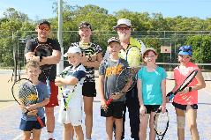
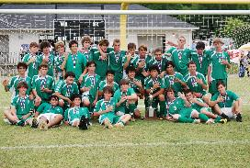
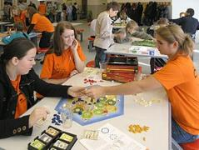

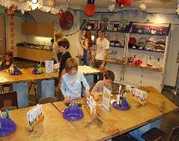
Work in pair and guess which clubs are they in?
READING
1
3
5
Tennis club
Soccer club
2
4
Board games club
Book club
Giáo viên có thể in tranh rồi chia làm các đội lên ghép tranh với từ.
Art and Craft club
This Photo by Unknown Author is licensed under CC BY-SA

Slide 24
READING
SCHOOL CLUBS
We have lots of fun at our school. If we like outdoor activities, the Scoccer Club meets at 4 p.m every Tuesday, with the Tennis Club at the same time on Thursdays. For indoor activities, the Board Games Club starts next week. It’s popular so please sign up on the noticeboard. The Book Club welcomes anyone who likes reading. You don’t need to sign up on the noticeboard but please bring your own copy of The Secret Garden with you to the library at 4 p.m on Wednesday. Our Art and Crafts is for people who like making things. The cost is $20 per term for materials.
The Soccer club
1. Which club is on Tuesday?
2. Which club wants you to sign up on the noticeboard?
The Board Games Club
The Book Club
3. Which club wants you to take something with you?
4. Which club needs money?
The Art and craft club

Slide 25


LISTENING
Listen and fill in the blank
We have lots of at our school. If we like outdoor (1)_______, the Scoccer Club meets at 4 p.m every Tuesday, with the Tennis Club at the same time on (2). For indoor activities, the Board Games Club starts next week. It’s popular so please (3)______ on the noticeboard. The Book Club welcomes anyone who likes reading. You don’t need to sign up on the noticeboard but please bring your own copy of The Secret Garden with you to the (4)_______at 4 p.m on Wednesday. Our Art and Crafts is for people who like making things. The cost is (5)___________ per term for materials.
activities
sign up
library
1: __________
Friday
4: __________
2: __________
3: __________
15
5: __________

Slide 26
WRAP-UP
In group of four discuss “ Which club do you want to sign up?” and Why?

Slide 27
HOMEWORK

