Slide 1
UNIT 2
SCHOOL

Slide 2
LESSON 2

Slide 3

WARM UP

Slide 4

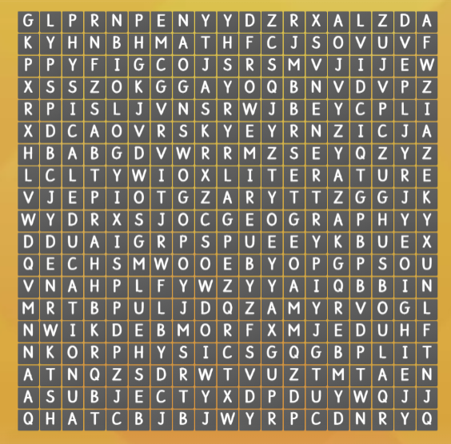
ONLINE
https://wordwall.net/resource/20592243
subject
biology
geography
DO THE WORDSEARCH
math
literature
physics

Slide 5
GRAMMAR
1
and , or
2
Possessive pronouns

Slide 6




1
and , or
Listen a boy taking to his favourite subjects and fill in the blanks.
I _________I.T _______ biology.
like
and
I _____________literature, physics _____P.E
don’t like
or
And, or hay được dùng để liệt kê, thêm ý trong câu. Tuy nhiên câu phủ định thường dùng “ or” hơn là “ and”

Slide 7



POSSESSIVES
( sở hữu)
Possessive adjective
( tính từ sở hữu)
Possessive pronouns
( Đại từ sở hữu)
1
2

Slide 8

1
POSSESSIVE ADJECTIVES
( TÍNH TỪ SỞ HỮ)

Slide 9
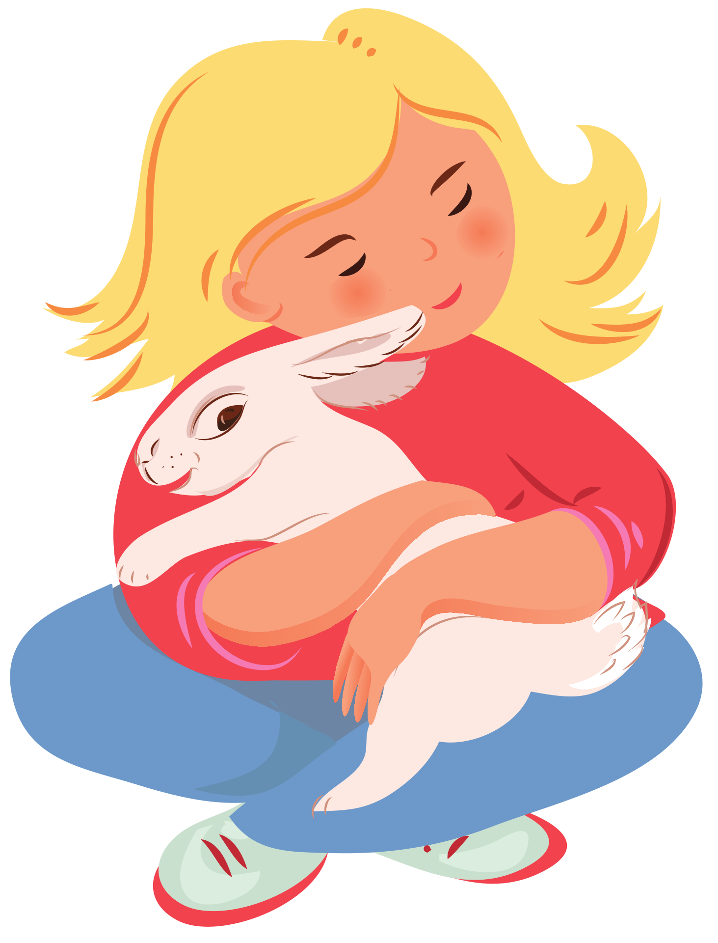

EXAMPLE
I have a rabbit
It's my rabbit.

Slide 10
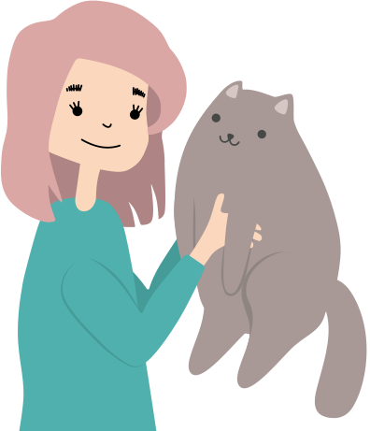
EXAMPLE
You have a cat.
It's your cat.

Slide 11
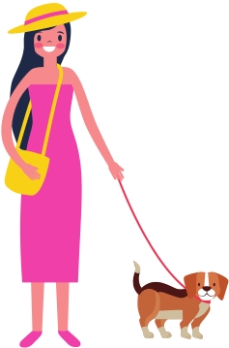
EXAMPLE
She has a dog.
It's her dog.

Slide 12

EXAMPLE
He has a car.
It's his car.

Slide 13

EXAMPLE
We have a house.
It's our house

Slide 14

EXAMPLE
They have a ball.
It's their ball

Slide 15

EXAMPLE
It has a bone
This is its bone

Slide 16

.
It's my rabbit.
.
It's your cat.
It's her dog.
It's its bone
It's their ball
It's our house.
It's his car

Slide 17
3. POSSESSIVE ADJECTIVE
I Tôi | my của tôi
You Bạn | your của bạn,các bạn
We Chúng tôi | our của chúng tôi
They Họ | their của họ
He Anh ấy | his của anh ấy
She Cô ấy | her của cô ấy
It Nó | its của nó
Personal Pronouns – Đại từ xưng hô
(Làm chủ ngữ đầu câu)
Possessive adjective ( ttsh)
( Đứng trước một danh từ)

Slide 18
PRACTICE 1

Slide 19


your
her
my
their
its
our
his

Slide 20



Your
You have a new dress. ______
dress is nice.
my
her
your

Slide 21

He lives in a small house.
______ house is so tidy.
His
her
his
my

Slide 22

My
I have got a hat. ______
hat is black.
my
its
his

Slide 23


Our
We have got dogs. ______
dogs are smart.
its
their
our

Slide 24


Its
This is a table. _______
colour is brown
his
its
our

Slide 25

Her
She is my sister. ______
name is Jane.
his
her
our

Slide 26

Its
I have got a cat. ______
name is Bugi
its
his
your

Slide 27
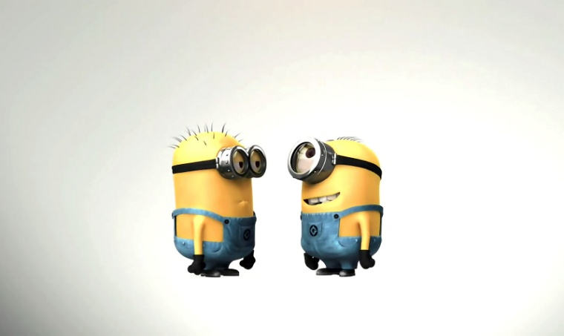

Our
We have English lessons. _____
lessons are interesting.
your
their
our

Slide 28

Her
Ann is a nice girl. ______
eyes are green.
its
her
his

Slide 29

Their
They go to school. _______
school is big.
your
our
their

Slide 30

Her
She has got a doll. ______
doll is beautiful.
its
her
his

Slide 31

Dan and Kate have got a parrot. _______ parrot can talk.
Their
your
our
their

Slide 32
2
POSSESSIVE PRONOUNS
(ĐẠI TỪ SỞ HỮU)

Slide 33
my This is my book. | mine This book is mine.
your It’s your umbrella. | yours Is it yours?
her That is her car. | hers That’s hers.
his He lent me his jacket. | his It’s his.
their Their house is nice. | theirs The house is theirs.
our Our party is coming. | ours the car is ours.
its Its tail is long. | ____( Không dùng đại từ sỡ hữu với “ it”)
Possessive adjectives
(Cần danh từ theo sau )
Possessive pronouns
( không cần danh từ theo sau)

Slide 34
PRACTICE 2

Slide 35
Fill in the suitable
possessive pronouns
1. I have a new book.
It’s_______
mine

Slide 36
Fill in the suitable
possessive pronouns
2. She has a new cat.
It’s ___________
Hers

Slide 37
Fill in the suitable
possessive pronouns
Are those books the children’s?
No, they’re not _____
theirs

Slide 38
Fill in the suitable possessive pronouns
Is that car the policeman’s?
Yes, it’s ___________
his

Slide 39
Fill in the suitable
possessive pronouns
Is that Kate’s racket?
Yes, it’s ___________
hers

Slide 40
Fill in the suitable
possessive pronouns
Is that David and Linda’s baby?
No, it isn’t ________
theirs

Slide 41
Fill in the suitable
possessive pronouns
Is that coat Sophie’s?
No, it’s not ___________
hers

Slide 42
Fill in the suitable
possessive pronouns
That’s our new house.
It’s ________
ours

Slide 43
Fill in the suitable
possessive pronouns
Is that John’s watch?
No, it isn’t ________
his

Slide 44
SUMMARY
ĐẠI TỪ XƯNG HÔ | TÍNH TỪ SỞ HỮU | ĐẠI TỪ SỞ HỮU
 |  | ______________________________________________
Làm chủ ngữ ở đầu câu
Cần một danh từ theo sau
Không cần danh từ theo sau
I
my
mine
You
your
yours
We
our
ours
They
their
theirs
He
his
his
She
Her
Hers
Không có
It
its

Slide 45


Practice this conversation with your partner.
What subjects do you like?
I like literature , music and P.E. What’s yours?
Mine’s English.

Slide 46

PRACTICE : Circle the correct words
1. My favourite sport is tennis. What’s mine/yours?
2. I found a bag. Is it mine/yours?
3. This book isn’t my book. Mine/yours is blue. Is it yours?
4. I saw a red hat on the table. Isn’t yours/mine red?
5. What’s your favourite ice cream? Mine/Yours is chocolate.
6. Do you have a ruler? Mine/Yours is at home.

Slide 47


PRACTICE : write the sentences using the prompts
history/I.T/physics
art/music
literature/biology
P.E/geography/physics
music/literature/art
____________________________
I like I.T and physics
____________________________
I don’t like music or art
____________________________
I don’t like geography or physics
____________________________
I like music, literature and art

Slide 48



Writing
Write two sentences about yourself
What subjects do you like or don’t like?
Using “ like” , “ and” , “ or”
Questions | Example
1. What subjects do you like? | I like math, biology, and P.E
2. What subjects don’t you like? | I don’t like I.T, physics , or art.
Speaking: Interview 2 classmates about their favourite subjects using the questions above.
This Photo by Unknown Author is licensed under CC BY-SA

Slide 49
WRAP-UP

Slide 50
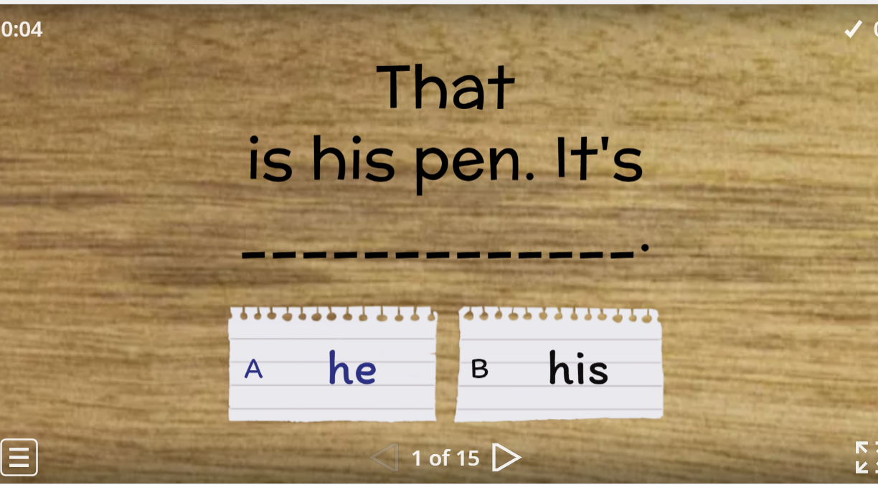
PLAY GAMES ONLINE
https://wordwall.net/resource/20400275

Slide 51
Fill in the suitable possessive pronouns
HOMEWORK

Slide 52



BÀI GIẢNG THUỘC QUYỀN SỞ HỮU TRÍ TUỆ CỦA E-TEACHERS. NGHIÊM CẤM MỌI HÀNH VI SAO CHÉP, PHÁT TÁN CHIA SẺ , MUA ĐI BÁN LẠI KHI CHƯA ĐƯỢC SỰ ĐỒNG Ý CỦA E-TEACHERS
PHONE /ZALO: 0966765064
https://www.facebook.com/maiphuongdo.dhnn/
SỬ DỤNG TÀI LIỆU CHÍNH CHỦ BẠN SẼ NHẬN ĐƯỢC SỰ TẬN TÂM VÀ CHÚNG TÔI SẼ PHỤC VỤ CÁC BẠN TẬN TÌNH.
TÀI LIỆU ĐƯỢC UPDATE VÀO MAIL CÁ NHÂN NGAY KHI UPDATE VÀ ĐƯỢC GIẢI ĐÁP MỌI THẮC MẮC VỀ KỸ THUẬT HOẶC CHUYÊN MÔN MỘT CÁCH KỊP THỜI NHẤT
TK: 3614689 ĐỖ MAI PHƯƠNG
NGÂN HÀNG VPBAK VIÊT NAM THỊNH VƯỢNG CHI NHÁNH HÀ NỘI.

